Slide 1
Solar magnetic fields 2
Philip Judge, High Altitude Observatory, NCAR
Magnetised plasmas
How we measure solar (plasmas and) magnetic fields

Slide 2
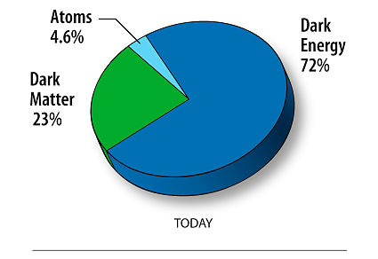
What is a plasma?
m=E/c²
Universe =
dark energy +
dark matter +
plasma +
gas +
solid +
liquid
Plasma:
free ions and e⁻ (hot and/or energized), yet quasi-neutral
many interacting particles (Coulomb force, plasma no >> 1)
collective effects
complex nonlinear behavior, especially when magnetized

Slide 3
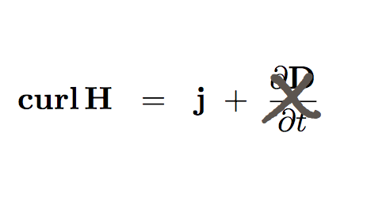
“This is supposed to be about magnetic fields:
Why do we have to talk about plasmas...?”
Maxwell
Newtonian momentum equations and O(u/c) relativistic transformations

σ huge
0
➔
⬆
⬇
Nonlinear coupling
Bulk fluid momentum equation
…Where do ρ, u, j, σ, T, π… come from?
Notes:
stop and discuss electron and proton equations of motion.. and sigma.. and current j

Slide 4
Simple plasma, Boltzmann transport: Braginskii 1965

Slide 5
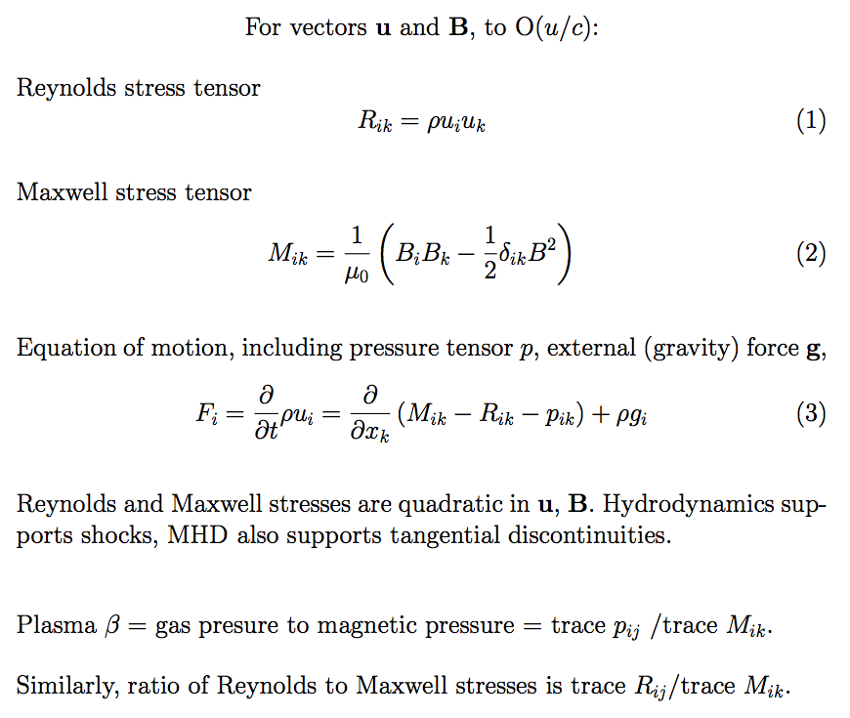
Bulk equation of motion (e+p)
Plasma β,
equipartition

Slide 6
Currents (n_{p}v_{p}e-n_{e}v e): Ohm’s law in collisional plasmas
problem

Slide 7
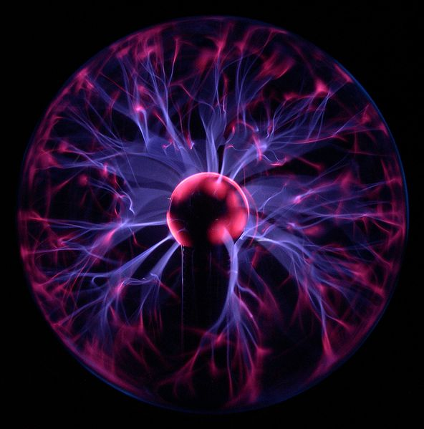
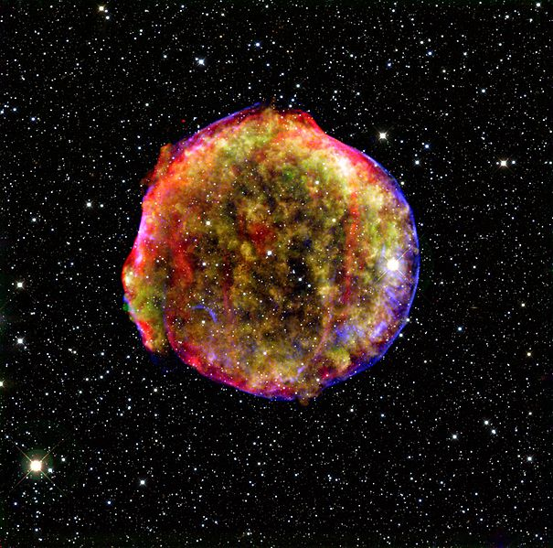
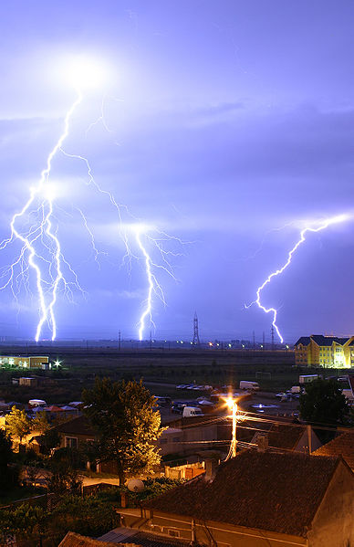
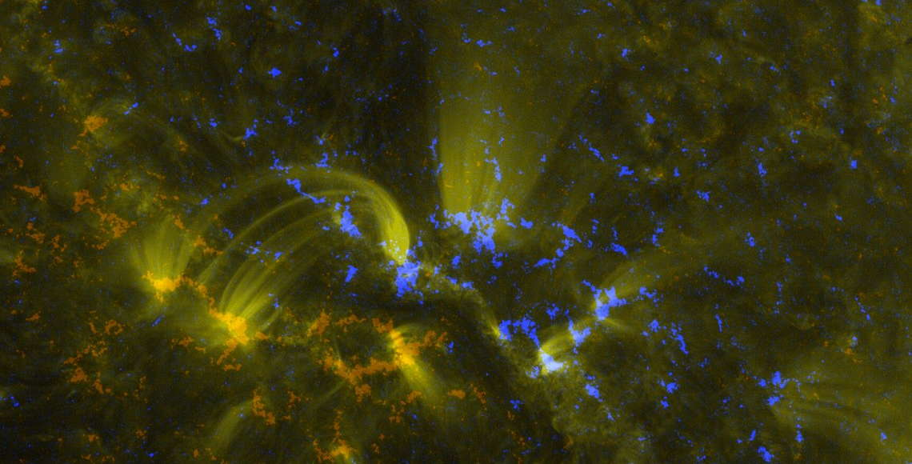
some plasmas

Slide 8
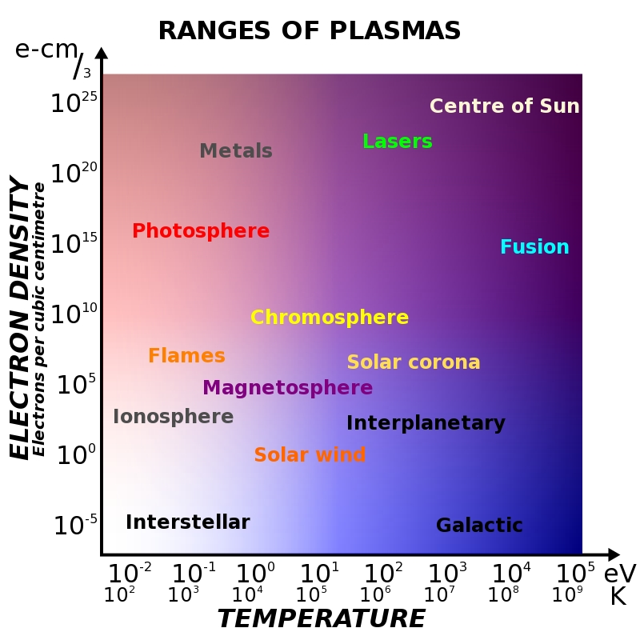
why is plasma so prevelant? Range of plasma characteristics
…wow

Slide 9
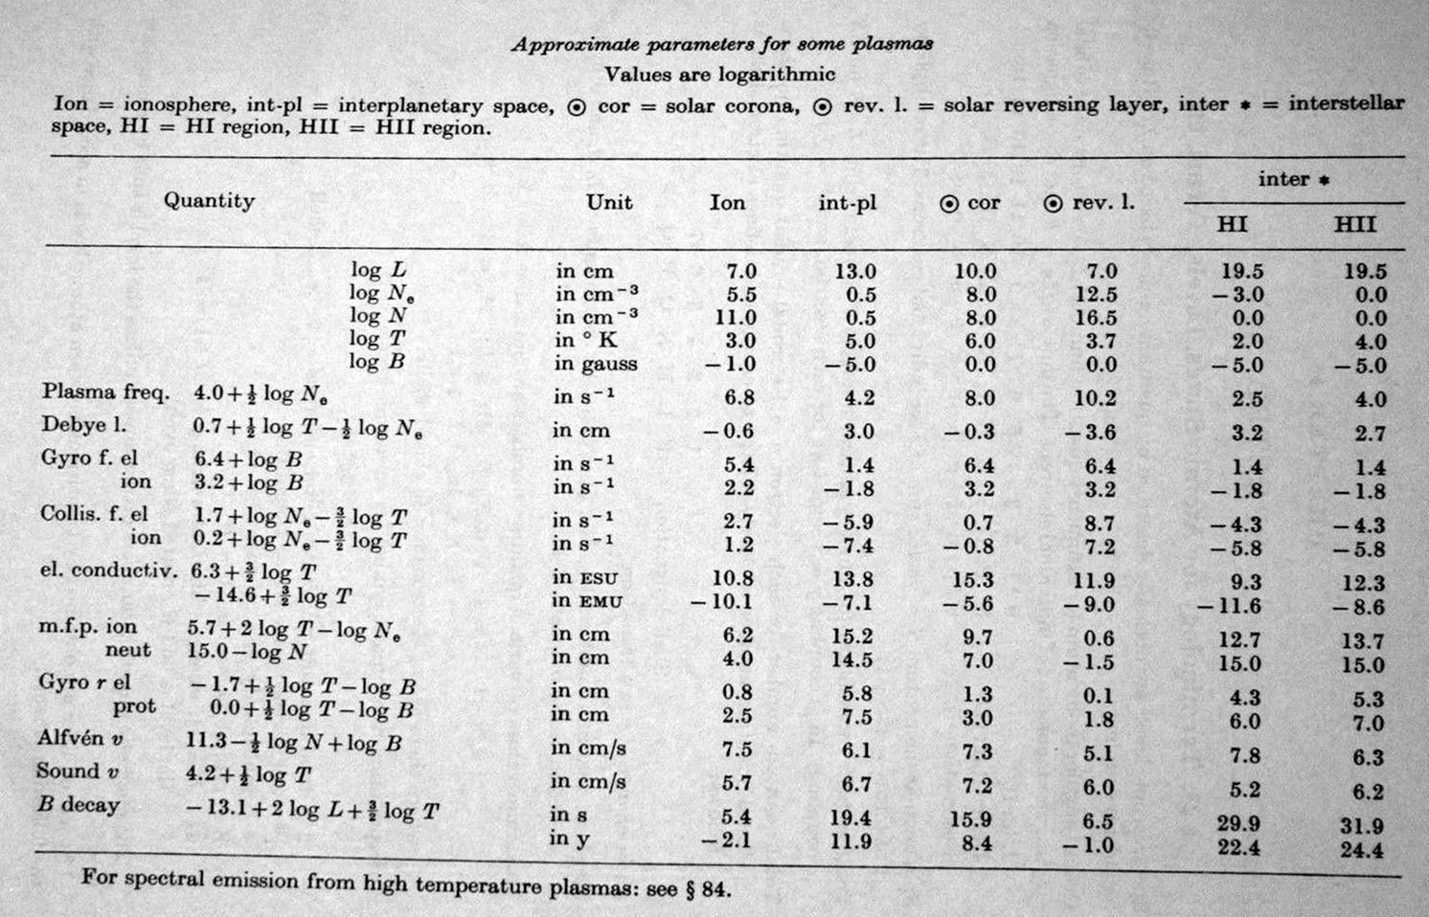
Allen 1973 compilation

Slide 10
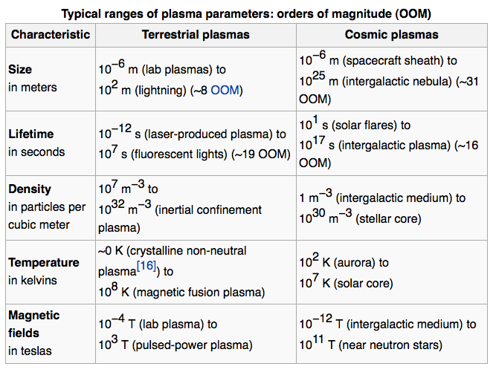
plasma characteristics
…wow

Slide 11
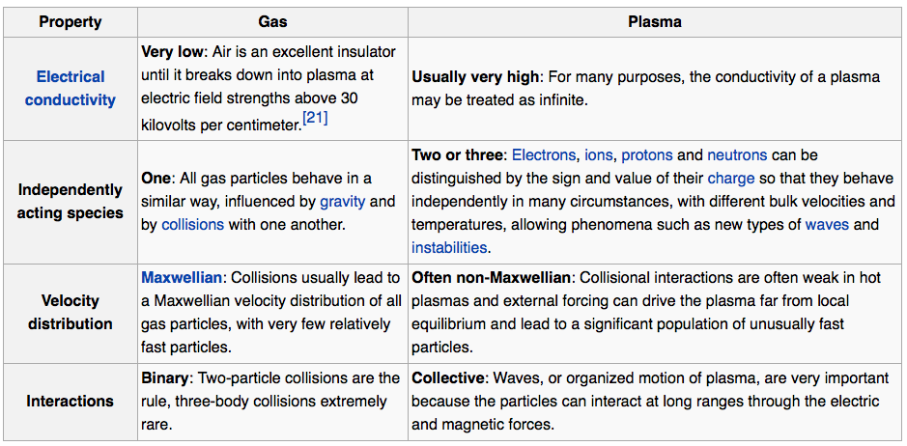
plasmas vs gases

Slide 12
The Sun as a laboratory for plasma physics in space and astrophysical regimes where R_{m} >>1, β >>1, β <<1, β=ratio plasma/magnetic pressure
Large R_{m} regimes exist outside
of laboratory plasmas,
-> MHD regime (frozen fields)

Slide 13
Induction equation and Large magnetic Reynolds number R_{M}
Induction diffusion
(non-linear)
timescale L/u L²/η
R_{M} = diffusion/induction times = Lu/η
η ➔ 0, Frozen flux condition (Alfven theorem)

Slide 14
R_{M} = ∞ dynamics: Lagrangian model (no diffusion) C. de Forest L. Rachmeler

Slide 15
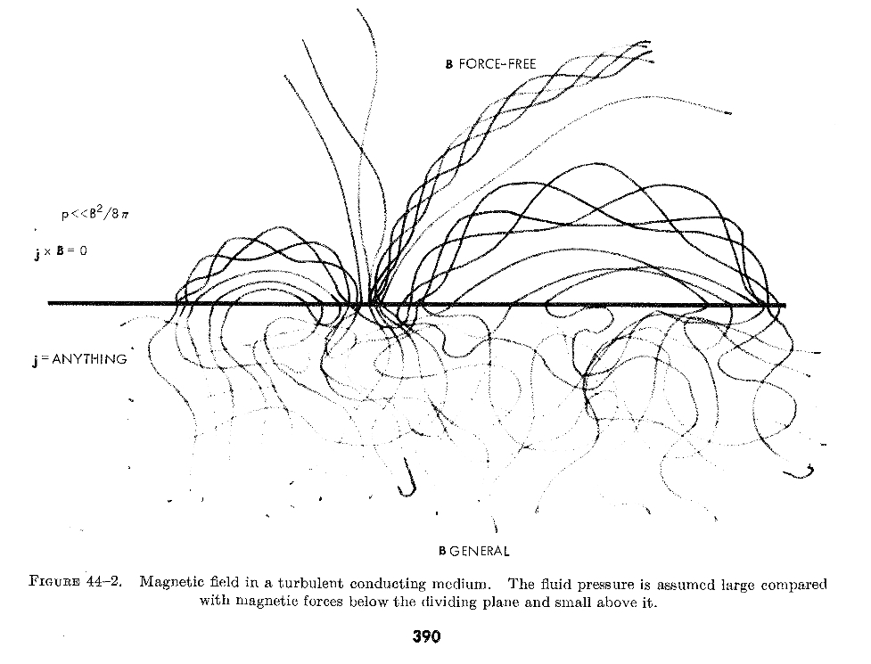
Gold (1964)

Slide 16
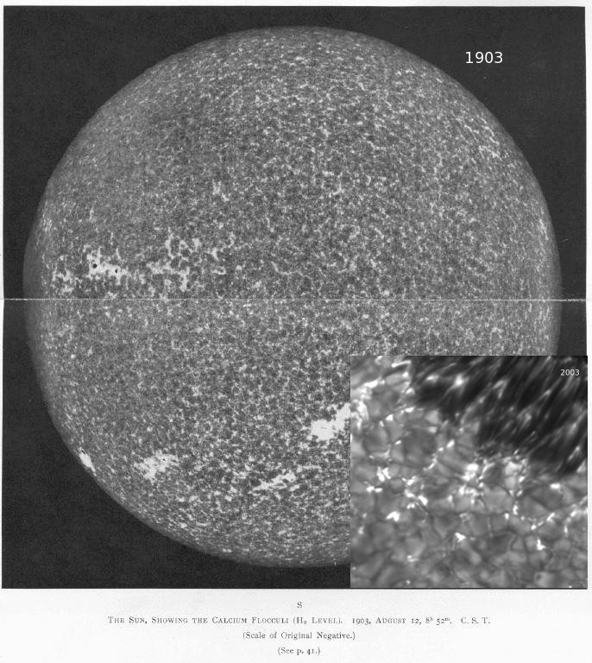
High and low β in the photosphere, quiet β >1, sunspot β <1, β = plasma/magnetic pressure
Solar magnetic fields
seen at the “surface”
are intermittent-
Spots on large scales
tubes, sheets, ribbons
on convective scales

Slide 17
High and low β regimes, photosphere β >1, corona β <<1, β = plasma/magnetic pressure
dense, turbulent solar plasma patches (β >1) with
tenuous field-aligned coronal plasma loops (β <<1)

Slide 18
signatures of solar magnetism Slides from R. Casini

Slide 19
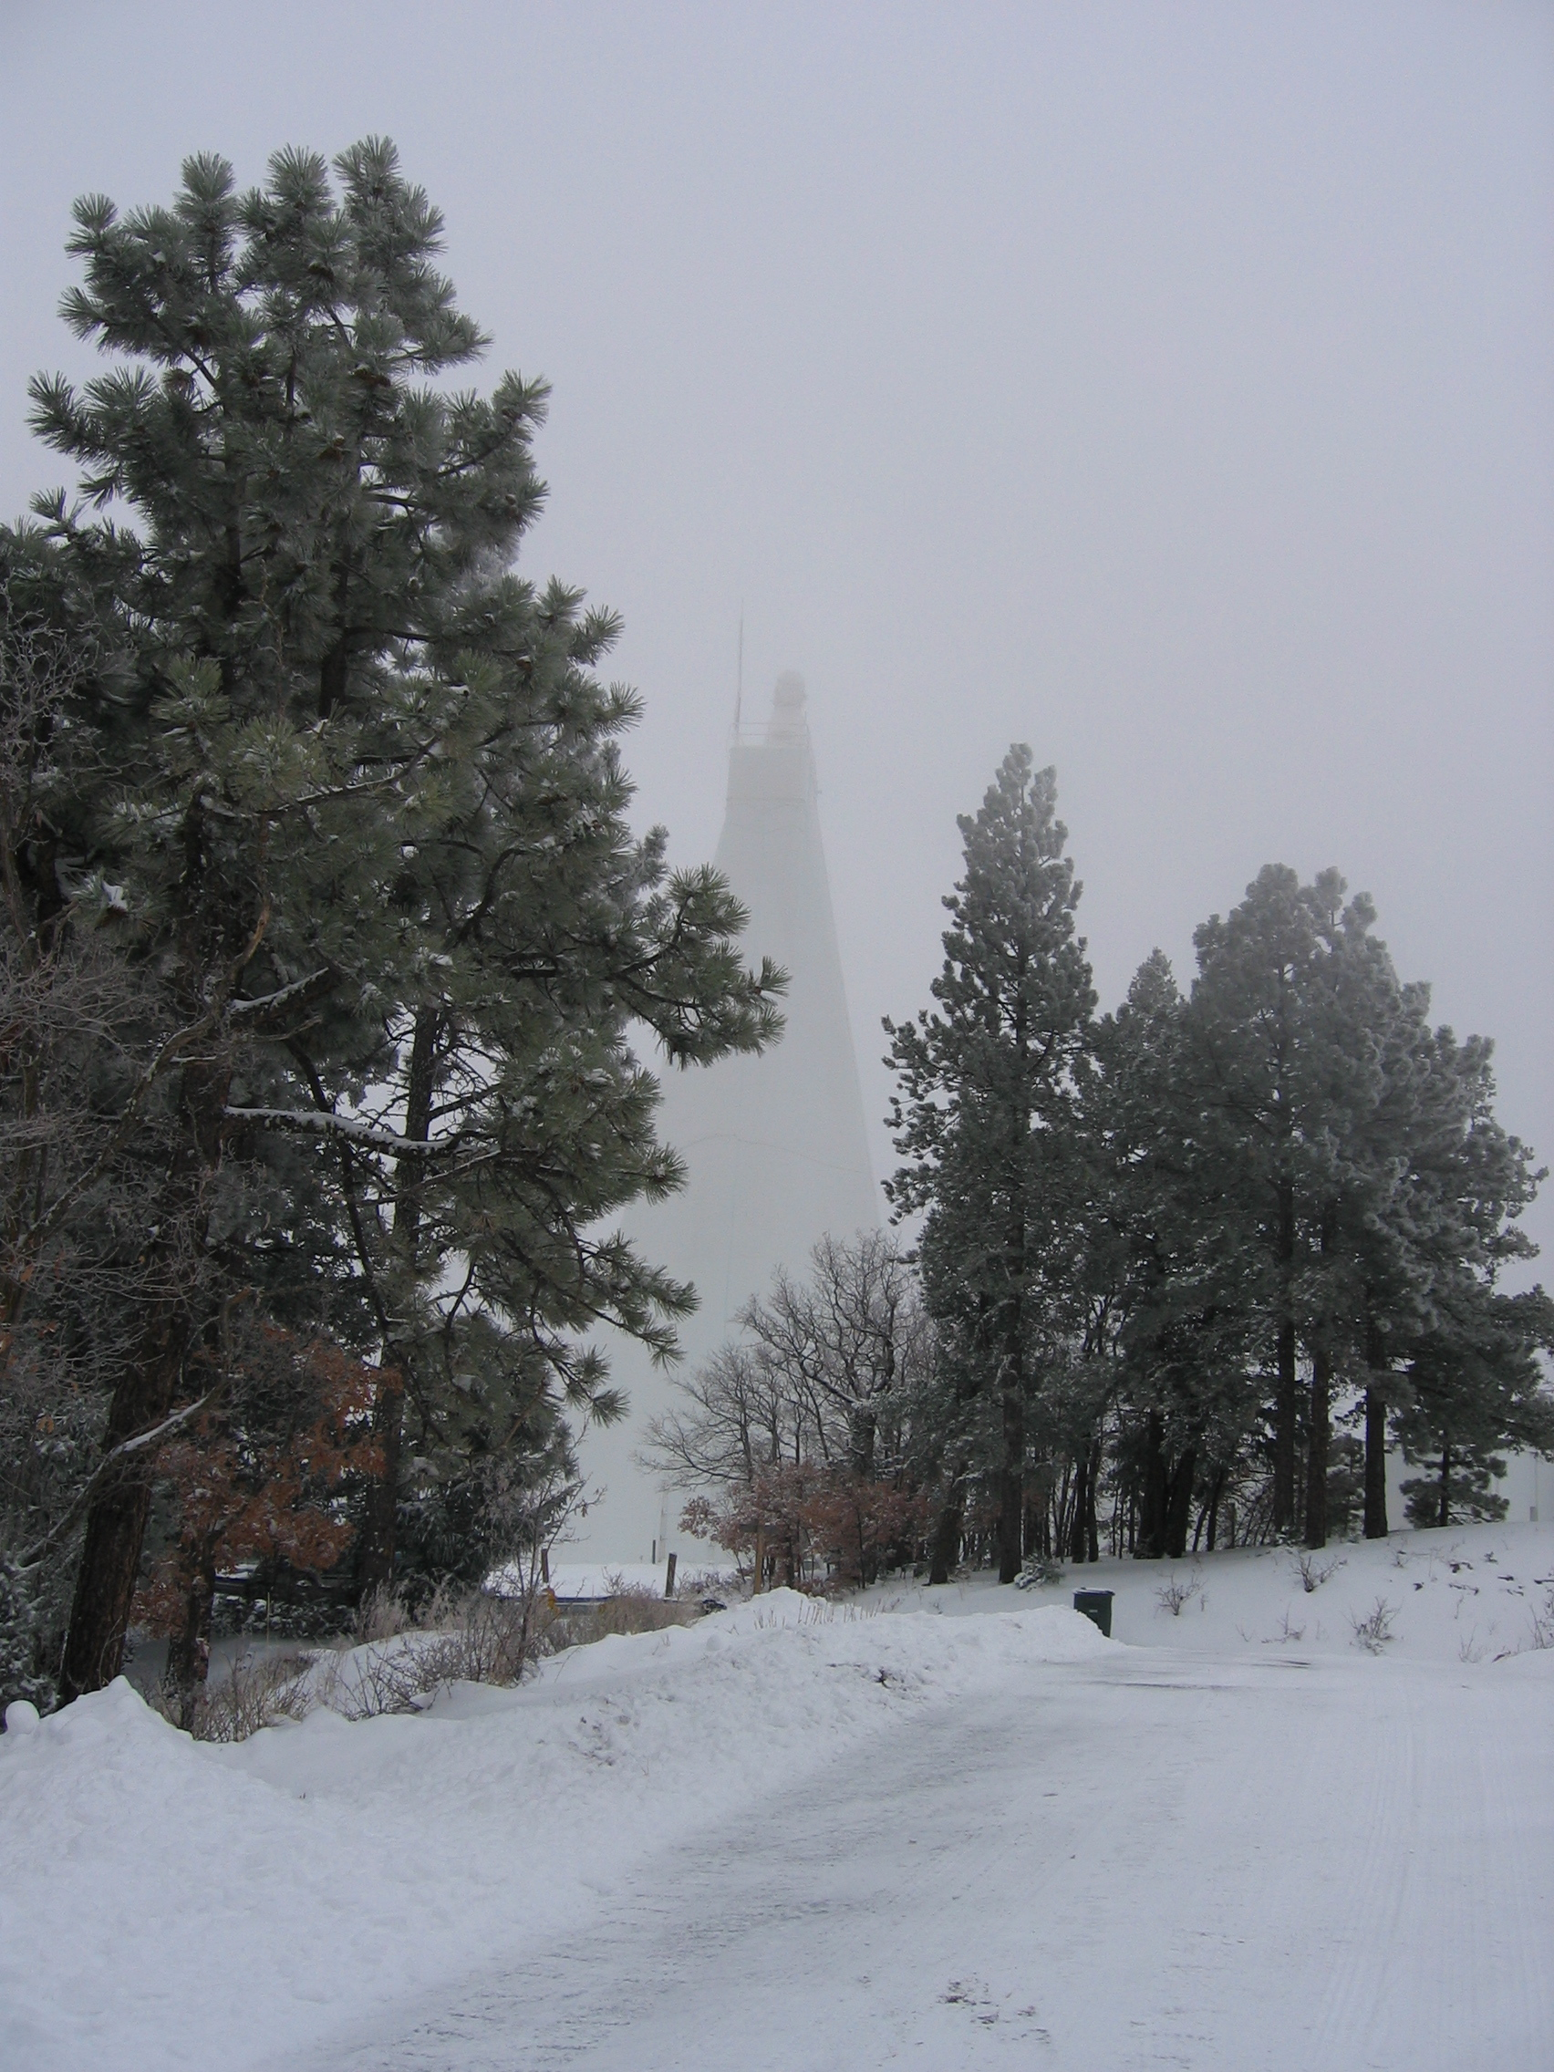
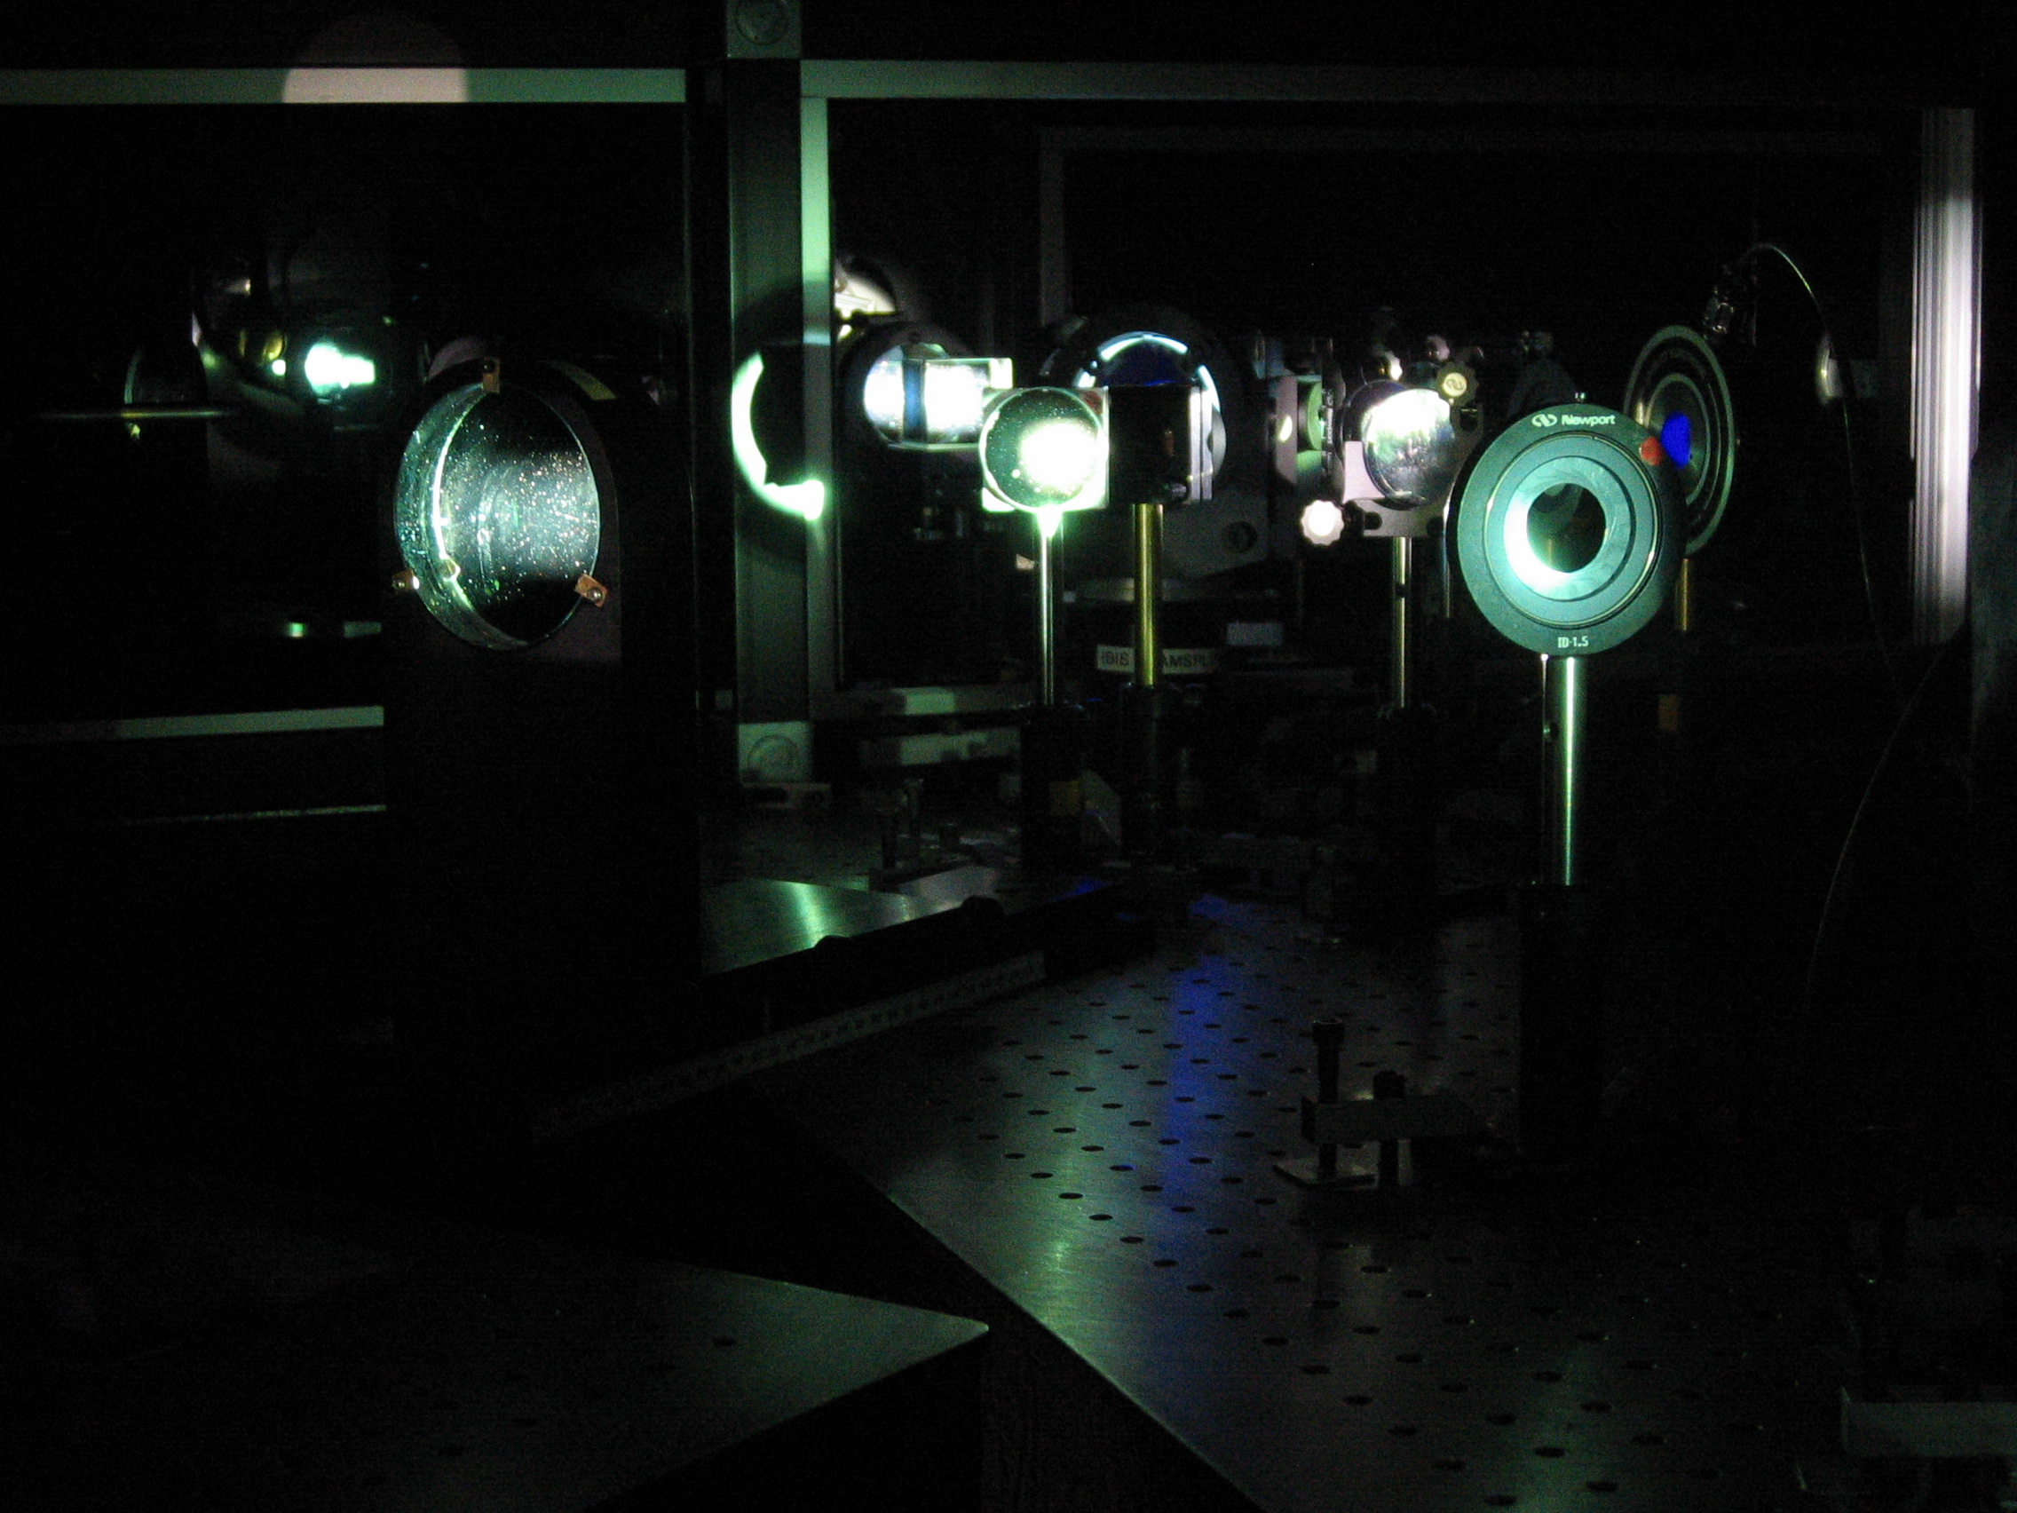
SPINOR- a real spectropolarimeter

Slide 20
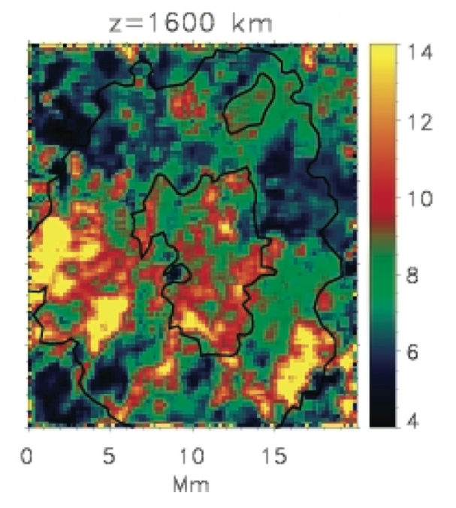
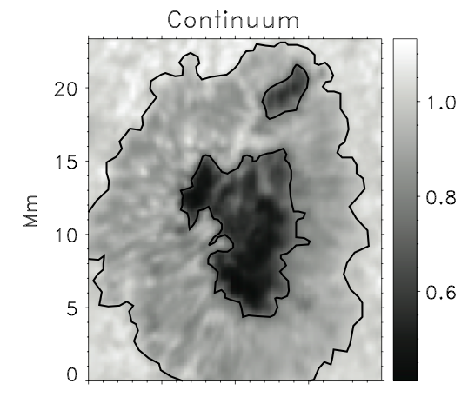
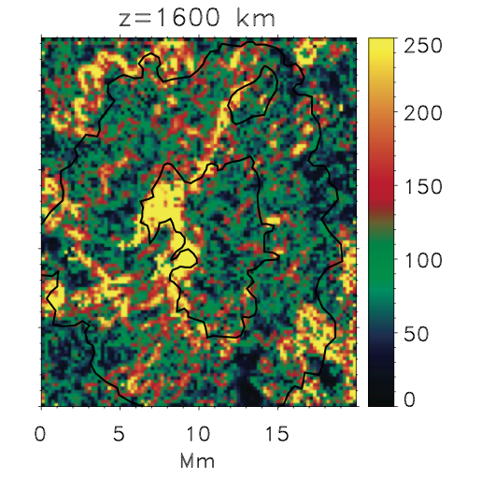
The “right stuff”: Navarro 2005a,b
Inversions of Fe I and Ca II lines in a sunspot, hydrostatic,
DST 76cm, SPINOR, sensitivity 1.5x10⁻⁴
Current density
“bandwidth
limited”
Temperature
Notes:
08/12/12
20

Slide 21
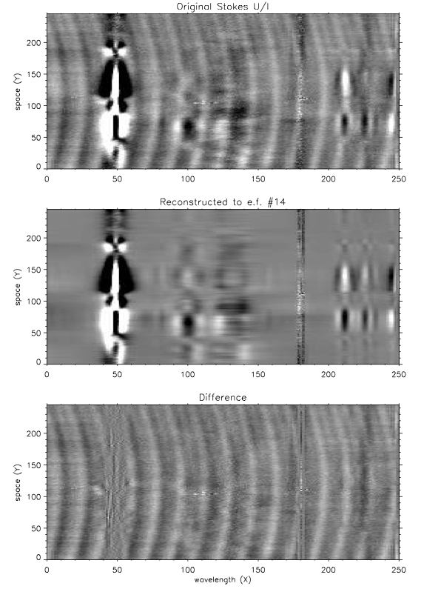
Measuring magnetic fields in solar low beta plasma is hard
Casini, Judge, Schad
2012 in press ApJ
Si I/ He I 1083 nm region
FIRS/DST, noise ~ 3x10⁻⁴
Instrument fringe removal using 2D PCA
Notes:
08/12/12
21
21

Slide 22
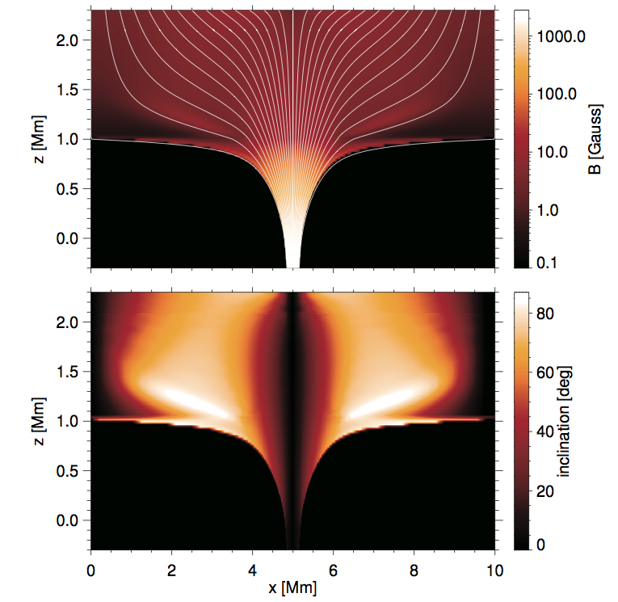
Measuring magnetic fields in solar low beta plasma is hard
200-2000G
Uitenbroek 2011
Ca II 854 nm
200-2000G
22
Notes:
08/12/12
22
22

