Slide 1
Solar magnetic fields 3
Philip Judge, High Altitude Observatory, NCAR
What is it we really want to know? [Different from stellar case]
How do we measure what we want to know? …solar spectropolarimetry

Slide 2
Examples of what we really need/want to know?
Which processes control:
surface field evolution and
the magnetic solar cycle
B at the surface, constraints on magnetic flux and helicity ∫A.BdV over a solar cycle
…requires measurements of B(r,t) on longer length and time scales

Slide 3
Examples of what we really need/want to know?
what processes control
surface field evolution and
chromospheric/coronal heating
“ dynamics
flaring
We should attempt to measure surface
B, magnetic free energy (total - potential)
Lorentz force j×B, including current sheets
requires measurements of B(r,t) on small length and time scales (flares) up to and
including the base of the corona

Slide 4
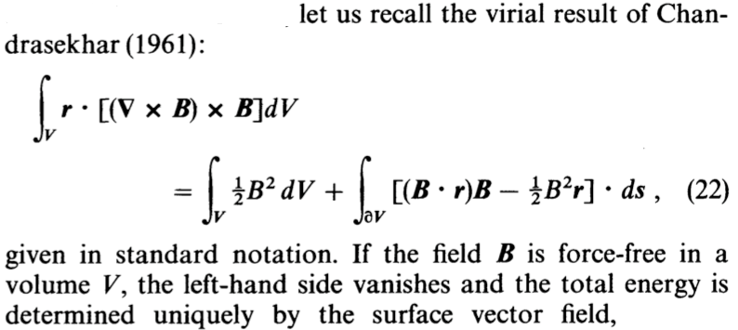
coronal magnetic free energy can be derived from measurements of magnetic fields at the base in force-free plasma

Slide 5
Conclusion: We must measure vector B
Magnetograph measurements
give B_{LOS} only
yield potential fields (no free energy) in overlying corona
no curl (currents) or uncurl (vector potential) or helicity

Slide 6
An example: Flare physics (Shibata et al 2007)
We can measure
plasma now
Notice- reconnection
site
It’s time to try to
measure the
evolving
magnetic field

Slide 7
For vector B we must use spectropolarimetry (most lines are not fully split, field is intermittent)

Slide 14
Polarization modulation in time
This is consequential…. unlike in stars, because of
solar evolution (t ~ v / l), l ~ 100 km, v ~ 0.3 c_{s}
atmospheric seeing
let’s look at a rotating waveplate

Slide 16
Spatial as well as temporal modulation removal of I-> QUV crosstalk with 2 beams
In absence of seeing/jitter, a single beam suffices (Solar B SP)

Slide 17
beam splitter
D(t) = Σ M₃ M₂(t) (M_{C}) X_{T} S
= M S
S = M⁻¹ D ideal solution for Stokes vector
Non-Mueller 4xn matrices, n≥4
Diagonality matters
In reality we have noise and crosstalk
S = (M+Δ)⁻¹ (D+δ), only statistical properties
of Δ,δ are knowable

Slide 18
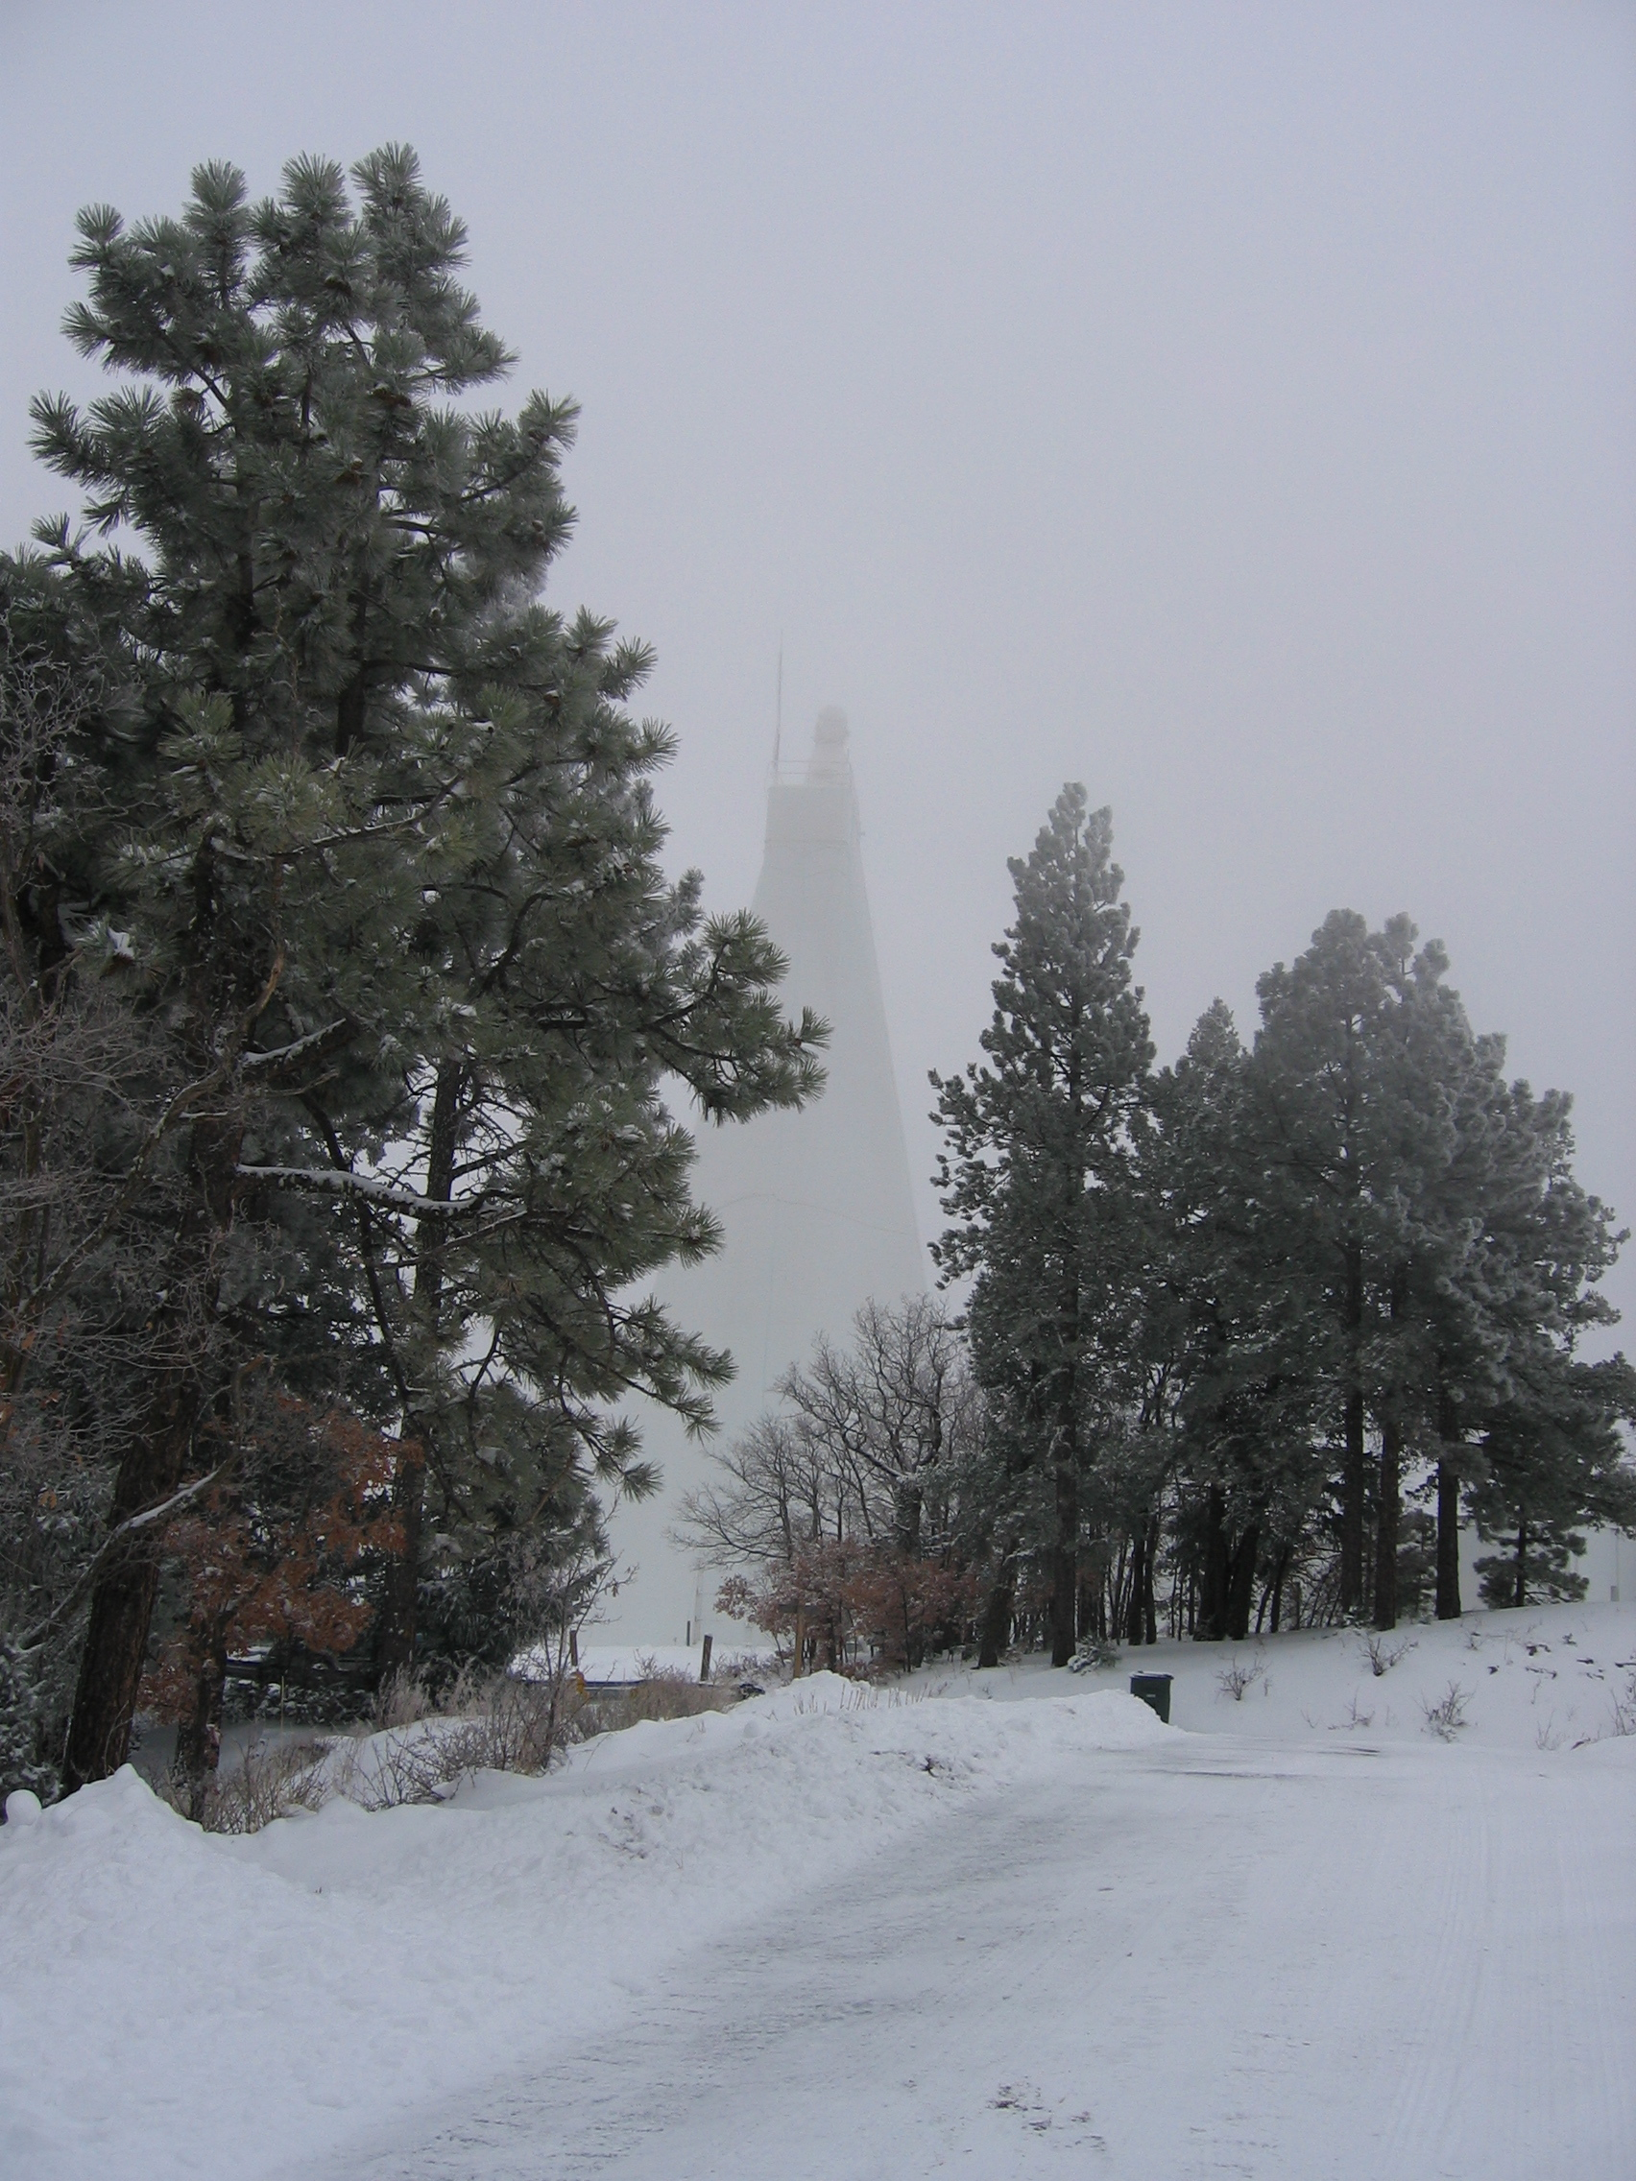
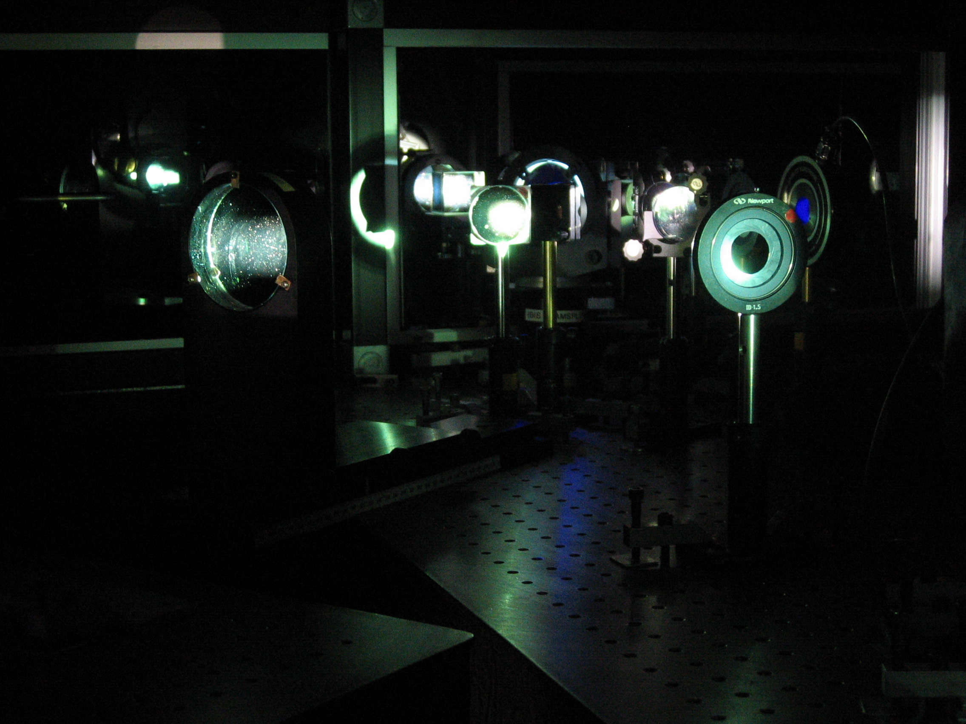
SPINOR spectropolarimeter

Slide 19
SOLIS VSM

Slide 20
Effects of seeing-
bad seeing
bad seeing good good+destretched
good seeing
good seeing, destretched

Slide 21
precise spectropolarimetry is
starved of photons!
21
Notes:
08/12/12
21
21

Slide 22
Landi Degl'Innocenti (2012 EWASS meeting):
λ = 5000 Å, Δλ = 10 mÅ, T= 5800 K, Δx in arcsec, Δt in seconds, telescope aperture D in meters, T system efficiency:
N_{phot} = 1.2 x 10⁹ D² Δx² Δt T
Critically sampling R = 1.22 λ/D gives for any aperture D:
N_{phot} = 5 x 10⁶ Δt T photons/ px
Realistically, Δt <10s, T <0.1 so
N_{phot} < 5 x 10⁶ photons/ px
Polarization sensitivity exceeds N_{phot} ^{-1/2} ~ 5 x 10⁻⁴
Target sensitivity for low β (force-free) plasmas: 10⁻⁴
Notes:
08/12/12
22
22

Slide 23
Optimal spectropolarimetry
Δx²/R must be 10x larger, e.g.
R=λ/Δλ= 120,000 (24mA @ 500nm, v=c/R = 2.4km/s)
Δx= twice diffraction limit (4x flux)
to give N_{phot}^{-1/2} ~ 5 x 10⁻⁵
Notes:
08/12/12
23
23

Slide 24
… different from stellar case
We must modulate at frequencies >> 1 kHz to remove seeing
e.g. ZIMPOL instrument (charge-caching detector 100 kHz)
otherwise limited to sensitivity P/I > 0.01 %

Slide 25
1st
2nd order in δω/ω₀=ω_{Β}/ω₀

Slide 26
Zeeman line splitting
Lites 2000

Slide 27
Zeeman-induced polarization
Zeeman parameter ζ:
ζ = ω_{L} / ω_{D},
ħω_{L} = μB,
ω_{D}= ω_{line} V/c.
If ζ << 1:
QU ~ ζ² φ” transverse B
180 deg ambiguity
V ~ ζ φ’ longitudinal B

Slide 28
Hanle-modified polarization

Slide 29
diagnosing surface MHD processes

Slide 30
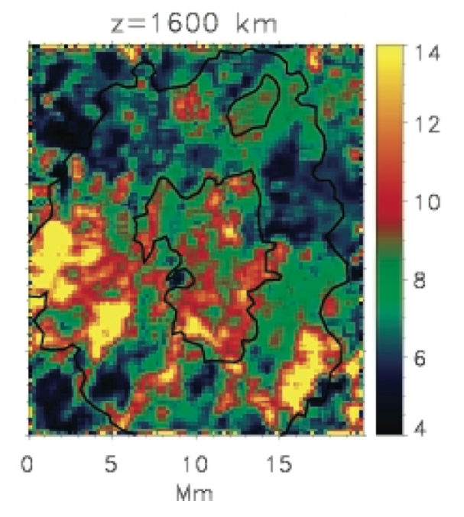
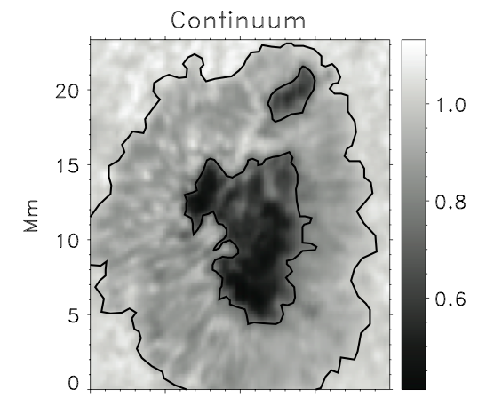
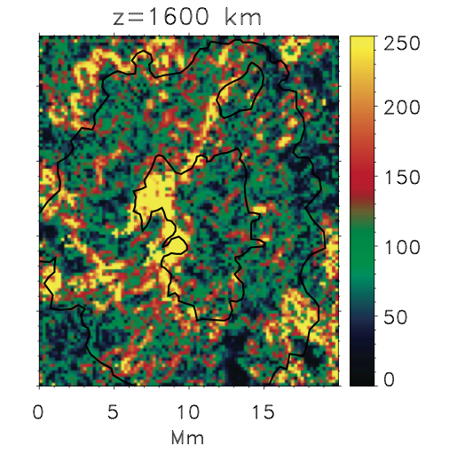
The “right stuff”: Navarro 2005a,b
Inversions of Fe I and Ca II lines in a sunspot, hydrostatic,
DST 76cm, SPINOR, sensitivity 1.5x10⁻⁴
Current density
“bandwidth
limited”
Temperature
Notes:
08/12/12
30

Slide 31
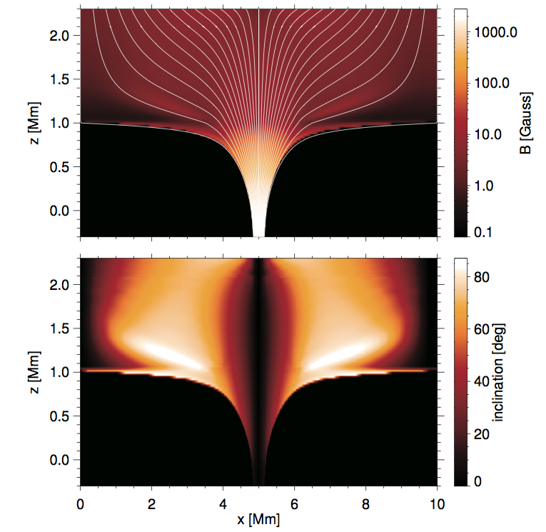
Measuring magnetic fields in solar chromiospheric/coronal (low beta) plasma is hard
200-2000G
Uitenbroek 2011
Ca II 854 nm
200-2000G
31
Notes:
08/12/12
31
31

Slide 32
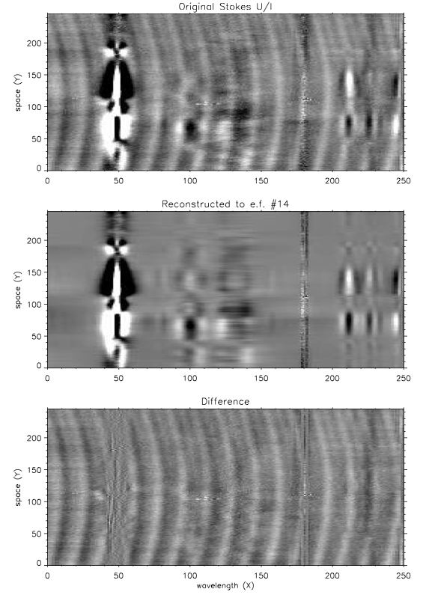
Measuring magnetic fields in solar low beta plasma is hard
Casini, Judge, Schad
2012 ApJ
Si I/ He I 1083 nm region
FIRS/DST, noise ~ 3x10⁻⁴
Instrument fringe removal using 2D PCA
Notes:
08/12/12
32
32

