Slide 1
Solar magnetic fields a physical perspective
Philip Judge, High Altitude Observatory, NCAR
"Double, double, toil and trouble; Fire burn, and cauldron bubble!" -- Three Witches, MacBeth

Slide 2
resources
http://people.hao.ucar.edu/judge/homepage/collaborators/WS2013/
SOLAR DATA SUMMARY:
one.pptx Lecture 1 of these classes.
ESSENTIAL IDEAS:
casini+landi.pdf: Casini, R. and Landi degl'Innocenti, E.,
"Astrophysical Plasmas". Spectropolarimetry.
rempel.pdf : Rempel, M. "Creation and destruction of magnetic fields".
Dynamo theory
CRITICISMS:
spruit2010.pdf: Spruit, H., "Theories of the solar cycle: a critical review"
parker2009.pdf: Parker, E.N., "Solar Magnetism: The State of Our
Knowledge and Ignorance", Space Sci Rev 144: 15

Slide 3
Autobiography of a middle-aged star: the Sun
~ 5 bn BCE I was born from debris of overweight, exploded parents, quickly clumping into a fast spinning spheroid with umbilical disk. The disk later shrivelled into 8-9 small children.
I started eating myself from the inside, can’t stop myself. I’m half way done.
After initial giddiness I slowed the spinning to a stately one turn/month.
I can’t abide electric fields because of what “Doctors” call “free charges”. But I was born with magnetic fields that keep giving me periodic, irritating spots.
This acne has quietened down a bit for a century or two (Louis XIV).
The children worry about my acne, the third is especially concerned. 154 years ago I gave this one a real fright when a spot burst all over it.
The “Doctors” say I will have spots as long as the pesky magnetic fields don’t start at monopoles, and providing I keep on spinning.
But what do Doctors know?

Slide 4
Why does humanity care?

Slide 5
after all, sunspots are benign, right?

Slide 6
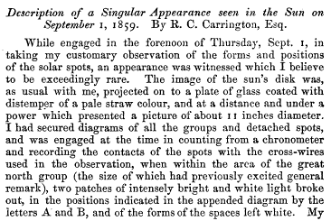
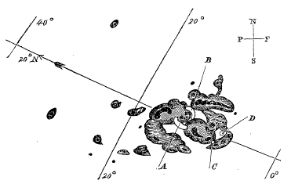
1859- some “space weather” on the ground

Slide 7
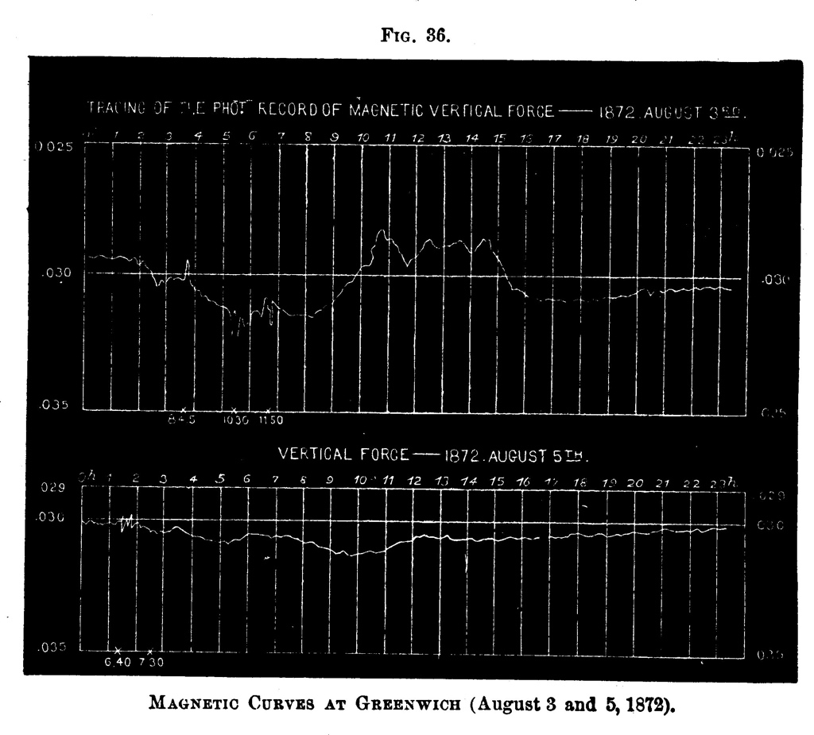
C. A. Young, “The Sun”, 1892

Slide 8
Modern (SOHO, TRACE, RHESSI) Flare Observations: April 22, 2002

Slide 9
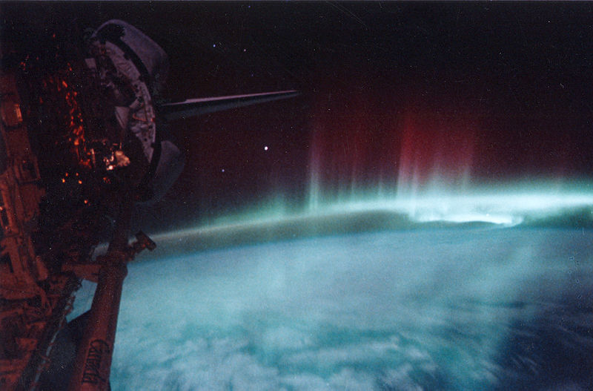
How’s the (space) weather today?
"So foul and fair a day I have not seen" --- MacBeth

Slide 10
Super-Carrington flares (food for budding Apocalyptic Movie Directors)
X ray, EUV solar data
1 Carrington
Stellar data from
KEPLER
mission
(boring optical
photometry)
100x Carrington
event occurs
once in 800 yr…

Slide 11
Why do physicists care?
?
… this is what these classes are about…

Slide 12
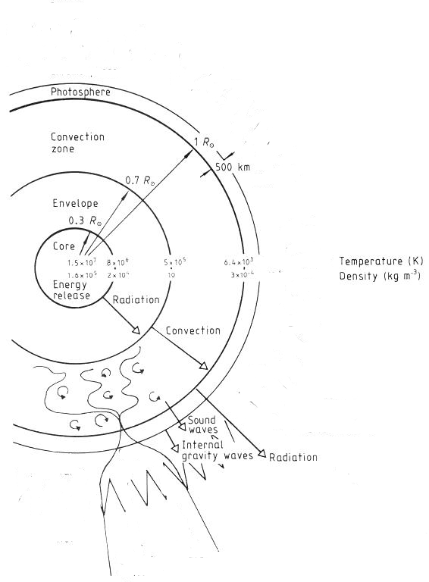
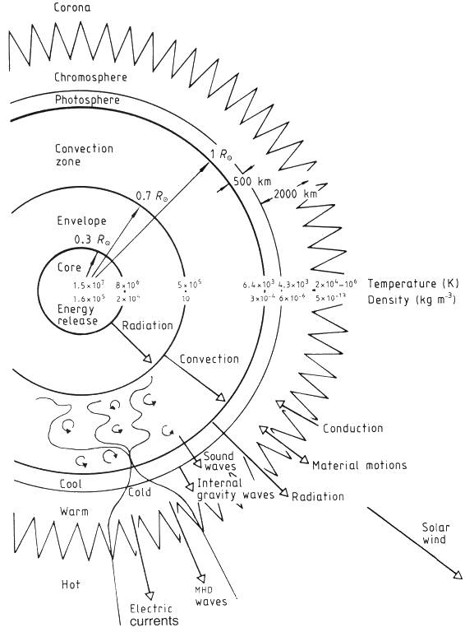
Global variations due to thermodynamics
Sound theory of thermodynamics, nuclear physics, (convection), radiative transport…
the above physics leads to global variations on Kelvin-Helmholtz timescales of 10⁵ yr, and longer
Remarkable success of helioseismology
(neutrino problem; interior rotation
beginning with Brown & Morrow 1987)
But..magnetic fields

Slide 13
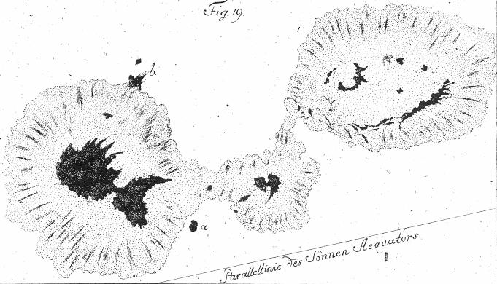
Why is the Sun obliged to…
1. regenerate its global magnetic field every 22 years given:
10⁵ yr Kelvin-Helmholtz timescale?
10⁹ yr magnetic diffusion (R²/η) timescale?
form such a thing as a 2. sunspot or a 3. corona?
4. produce flares
Sunspot drawing by Johann Hieronymus Schroeter (1745-1816)

Slide 14
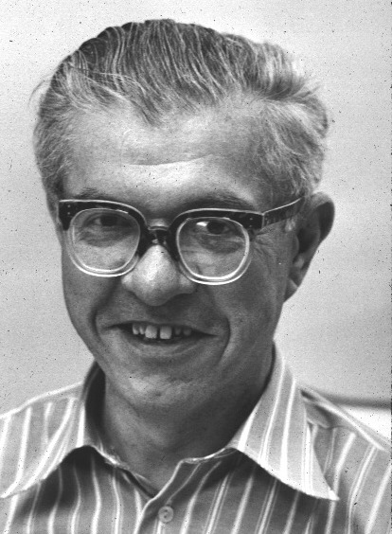
Corona: SDO AIA surface (5000 K) to corona (2 MK) Edlen 1943: Obvious violation of 2nd law of thermodynamics “Grand challenge” e.g. Hoyle 1955, “Frontiers in astronomy”)

Slide 15
Flares: how do solar magnetic fields change so fast?
Kinematic dynamos?
source sink
recommended: The Physics of Solar Flares (proc. of AAS-NASA Symposium),
Wilmot N. Hess, ed., NASA SP-50 1964!
Notes:
WHERE DO I GET l^2 and du/rdtheta ? Is it thickness of tach^2/ (du/r dtheta) with all params from helioseismology

Slide 16
Solar magnetism in history

Slide 17
19th century hints…
Young 1883, observations
taken in 1870.
“Reversals” seen clearly in
spectra of sunspot umbrae.
Earlier work had shown reversals
in chromospheric lines- origin
was interpreted as thermodynamic,
not magnetic.

Slide 18
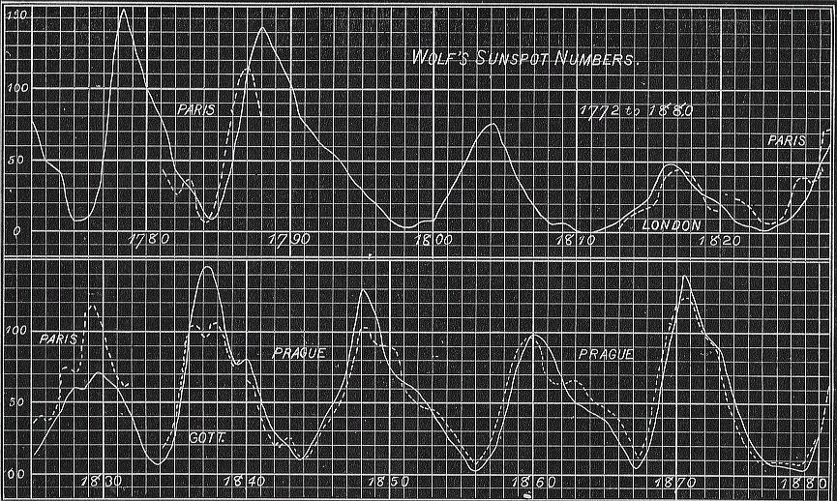
..more 19th century hints…
In 1843, after 17 years of observations, Schwabe discovered the cyclic increase and decrease of sunspot numbers. Schwabe originally estimated to be 10 years.
1852, Edward Sabine (1788-1883) announced that the sunspot cycle period was "absolutely identical" to that of geomagnetic activity,
Figure from Young’s “The Sun”.

Slide 19
..more 19th century hints…
1878 eclipse: Some resemblance of the corona to magnetic lines of force was noted.
HAO
eclipse
archive

Slide 20
del toro iniesta
..the 20th century
Young 1883, observations
taken in 1870
Offical history:
Zeeman 1897- laboratory
Hale 1908 – sunspots, also polarimetry

Slide 21
Essential observations of solar magnetism

Slide 22
why spots?

Slide 23
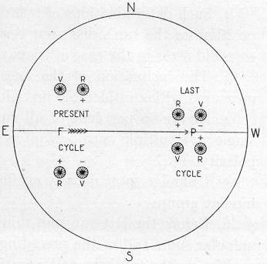
Hale’s polarity law
Hale, Ellerman, Nicholson, Joy, 1919, ApJ 49,153-178.
Left-right circularly polarized light
Evidence for a well-organized large-scale magnetic field in the solar interior, which cyclically changes polarity every 11 years.

Slide 24
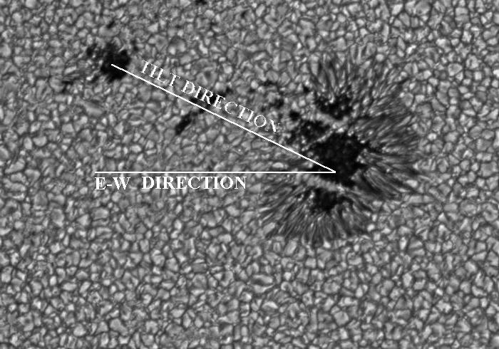
Joy’s law
..Spots tend to be "tilted” with leading spot closer to the equator than the follower
…Tilt increases with heliographic latitude
Turbulence

Slide 25
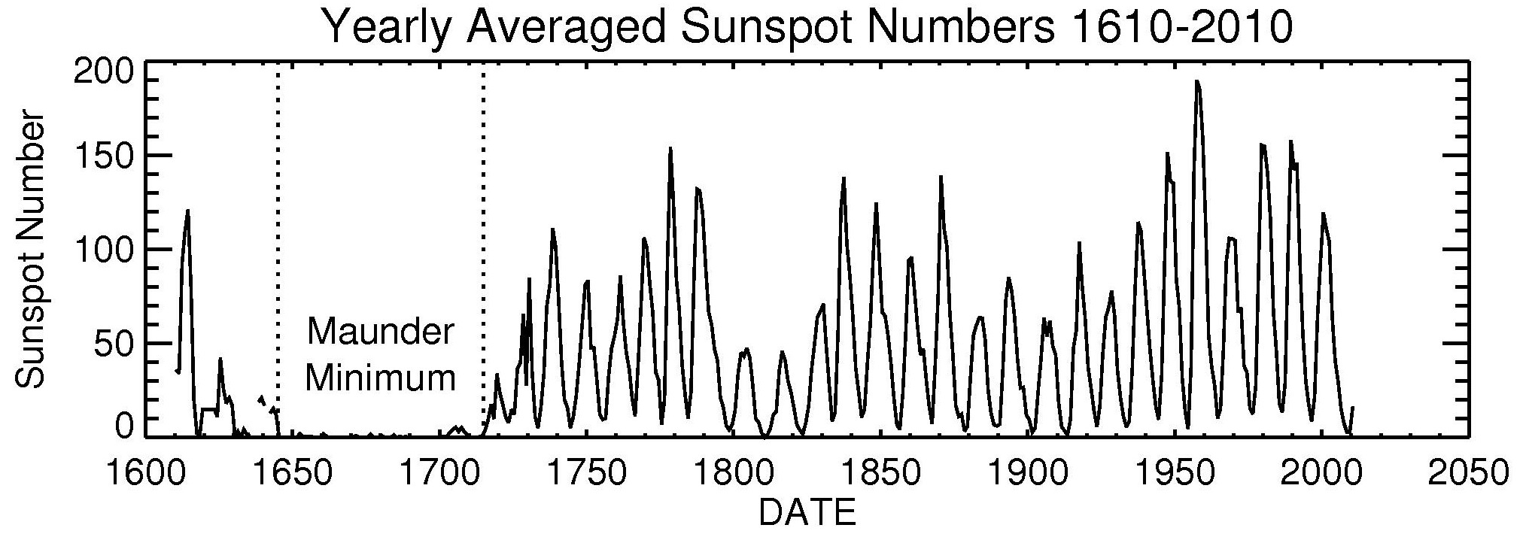
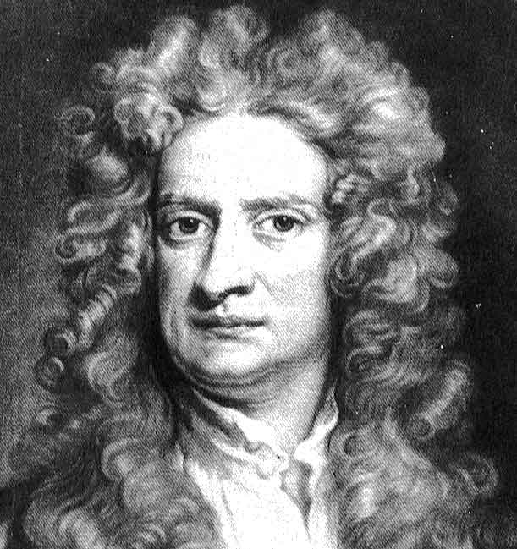
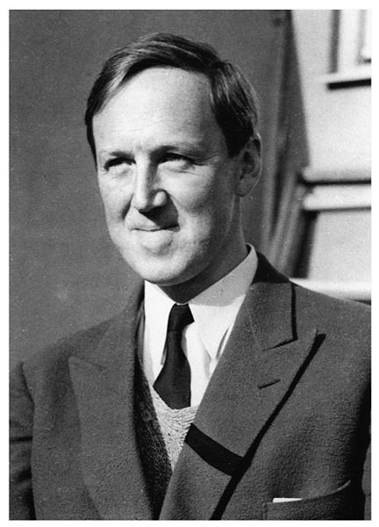
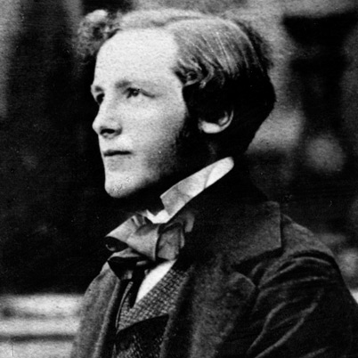
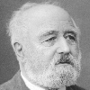
*
photograph width = life span

Slide 26
Using neutrons to get prehistoric sunspots

Slide 27
Prehistoric data
Solar modulation

Slide 28
Prehistoric data

Slide 29
Prehistoric data

Slide 30
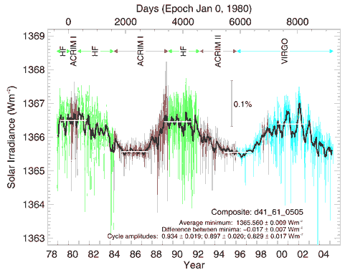
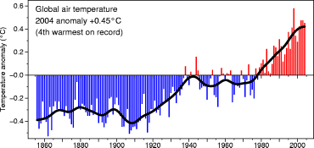
Total or Spectral Solar Irradiance Variation:
0.068%
0.066%
0.061%
Figure from http://www.cru.uea.ac.uk
Figure from http://www.pmodwrc.ch
Sunspot crossing the solar disk
Faculae crossing the solar disk
PSPT 26 September 2001 CaIIK line center (393.5nm)
Lockwood 2005, The Sun, Solar Analogs and the Climate, p.109
and blue continuum (409.4nm)

Slide 31
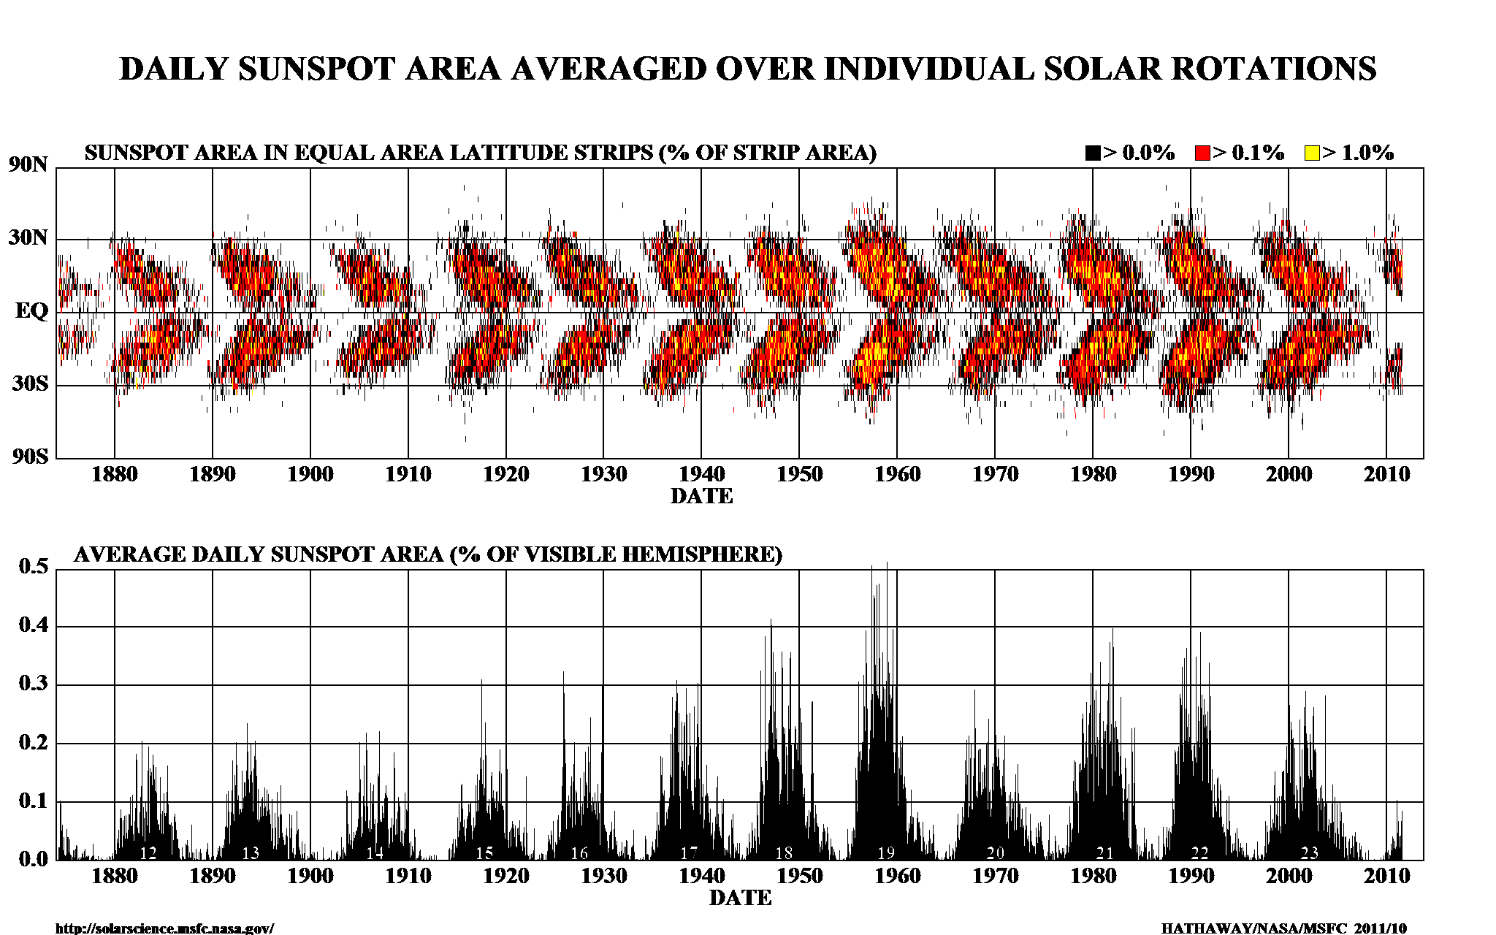
More basic observational facts
“order from chaos”

Slide 32
Sunspots vs Line-of-Sight magnetograms
Hale, Ellerman, Joy (1919) sunspot
reversal using circular polarization,
to give LOS polarity
1952: Babcock & Babcock, stable
instrument to measure circular
polarization, “Mapping the
Magnetic Fields of the Sun”,
“The Solar Magnetograph” 1953.
LOS magnetogram= Flux / area
solar “general magnetic field” of a
few Mx cm⁻²

Slide 33
sunspots: emerging magnetic fields LOS magnetogram, Hinode
Kinematic dynamos?
Tsuneta:active region 10926, the “trilobite”
“order from chaos”

Slide 34
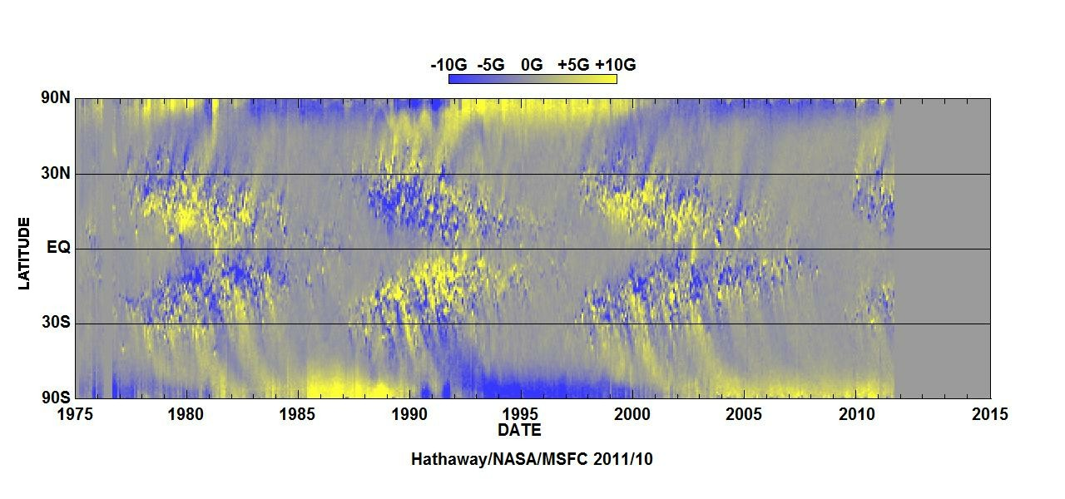
Sunspots in relation to large scale magnetic fields
“order from chaos”

Slide 35
Hathaway movie
Rotation somehow yields “order from chaos”

Slide 36
Active regions
Active regions – spot
groups - evolve
at the surface on times
of order weeks.
They re-appear at
specific longitudes.
(Dikpati & Gilman 2005,
showing synoptic maps over
15 rotations ~ 1 yr)

Slide 37
Hanle effect: average quiet Sun variations
Kleint et al 2010
no relation to
sunspots

Slide 38
The “chaos”

Slide 39
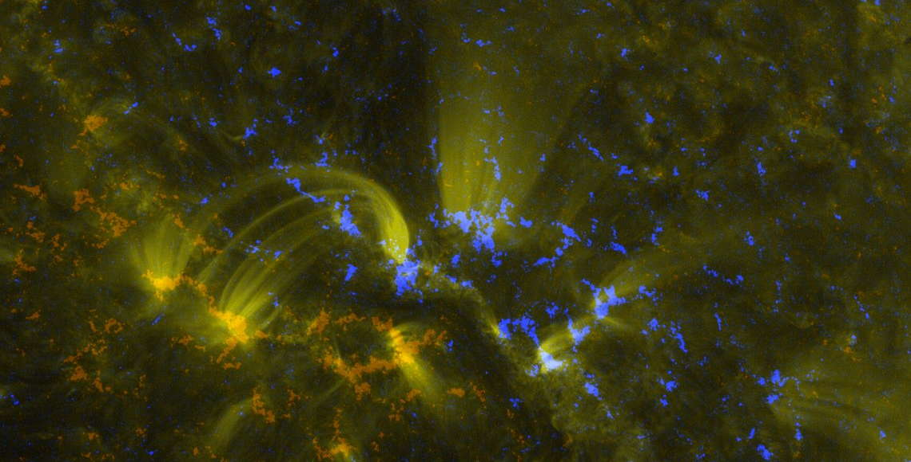
from untidy photospheric magnetism (β > 1) to tidy coronal plasma loops (β < 1)

Slide 40
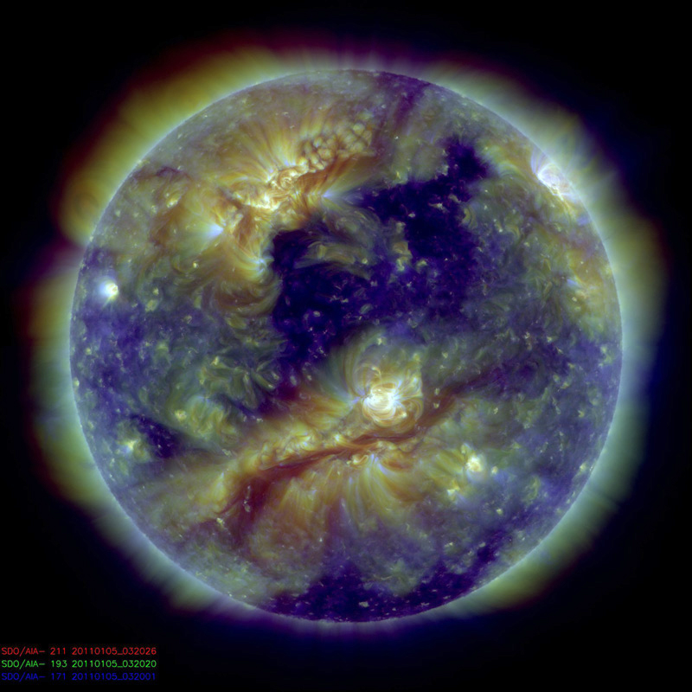
Surprise: large scale order in coronal plasma: ?
Blue= 1MK, Green=1.5 MK, Red= 3MK
Order out of chaos

Slide 41
The Sun is not alone: chromospheric activity vs rotation and convection (Noyes et al 1984)
Sun fits
stellar trends
statistical “order
from chaos”

Slide 42
The Sun is not alone: indirect evidence for “fast” magnetic variations in stars
Baliunas et al 1995: The Sun is a typical middle aged star: Almost as many such stars don’t “cycle” as do.
1966 1993
Flat
Irregular, “chaos”?
Cycling: order from chaos
Varies with sunspot number

Slide 43
Observational facts
Somehow, the solar plasma/magnetic field interactions
induce global solar variability to time scales of 11 yr and (much) less, from 10⁵ years, and
introduce highly variable high energy tails to the distributions of photons and particles
produce order out of chaos
Let’s now look more closely at
theoretical considerations (Newton, Maxwell)

Slide 44
Magneto-hydro-dynamics
*
photograph width = life span

Slide 45
Magneto-hydro-dynamics “MHD”
Einstein changed Newton’s formulation to fit Maxwell’s equations.
He got a Nobel Prize, but not for this.
MHD can be thought of as the reverse applied to a conducting fluid-
change Maxwell’s equations, with field and plasma transformations
including O(v/c) to fit Newton’s laws of motion.
Originally formulated by H. Alfvén.
He got a Nobel Prize for this and related work.
It is the simplest model of a magnetized plasma

Slide 46
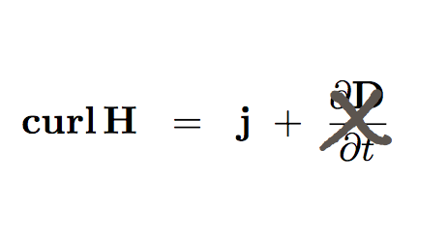
MHD
Maxwell
Newtonian momentum equations and O(u/c) relativistic transformations
➔

σ huge
⬆
⬇
Nonlinear coupling = MHD
Bulk fluid momentum equation

Slide 47
Summary 1
We are accustomed to observing the Sun,
its features and their variations
In these classes we will examine:
these remarkable, unanticipated magnetic variations, from the point of view of Newton and Maxwell (MHD)
their consequences,
keeping in mind
the sun among the stars (repeating
the solar experiment)
first we look at how to measure magnetic fields

