Slide 1
Surprises in Solar Physics some critical problems
Philip Judge
High Altitude Observatory
National Center for Atmospheric Research

Slide 2
This discussion
A global solar dynamo
reconnection
Parker and turbulent diffusivity
Spruit and the solar cycle
Parker and spontaneous generation of current sheets

Slide 3
resources
http://people.hao.ucar.edu/judge/homepage/collaborators/WS2013/
*.pptx Lectures for these classes
MATERIALS THIS CLASS:
spruit2010.pdf: Spruit, H., "Theories of the solar cycle: a critical review"
parker2009.pdf: Parker, E.N., "Solar Magnetism: The State of Our
Knowledge and Ignorance", Space Sci Rev 144: 15
Parker, E. N., "Conversations on Electric and Magnetic Fields in the Cosmos". (Not
provided as a pdf file), ch. 8.

Slide 4
Surprises: why is the Sun obliged to…
regenerate its global magnetic field every 22 years
(of all time scales), given:
10⁵ year Kelvin-Helmholtz timescale?
10⁹ year magnetic diffusion (R²/η)timescale?
form such a thing as a sunspot, as the primary
manifestation of this regeneration?

Slide 5
why would the Sun/stars choose to…
produce such order out of chaos?
[broad answer from MHD: symmetry breaking via net kinetic helicity]
regenerate B so rapidly (“dynamo”)
change B almost instantaneously, producing
flares? [energy conversion]
CMEs? [topological changes]
Produce ubiquitous coronae?

Slide 6
This discussion
A global solar dynamo
reconnection
Parker and turbulent diffusivity
Spruit and the solar cycle
Parker and spontaneous generation of current sheets

Slide 7
A large scale α−Ω dynamo
Fausto discussed dynamo problems of α² type

Slide 10
Ω effect

Slide 11
α effect

Slide 13
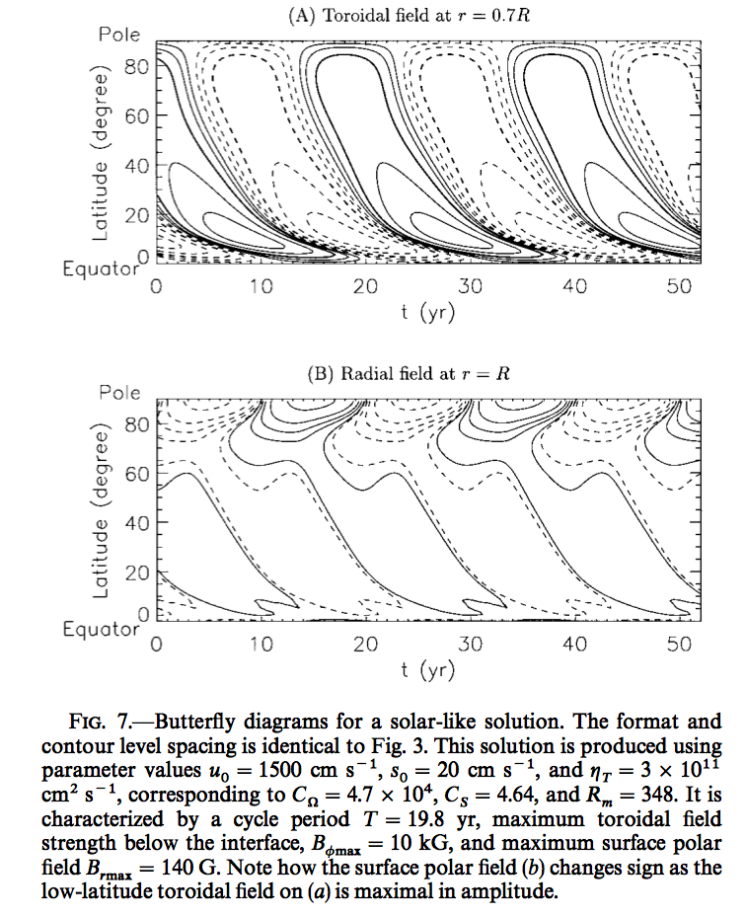
“success” of dynamo models
Note:
turbulent, not kinetic
diffusivity is required:
η_{T} ∼ 10¹¹⁻¹² cm²/s

Slide 14
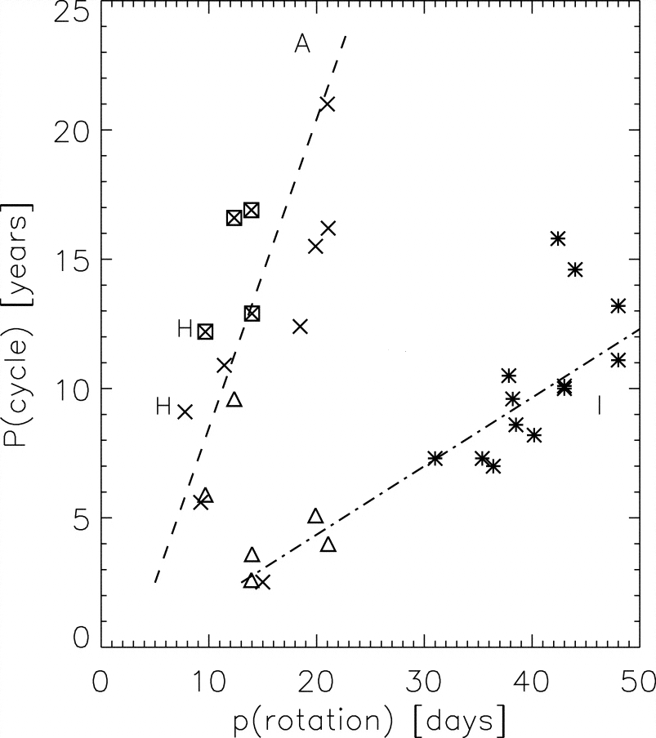
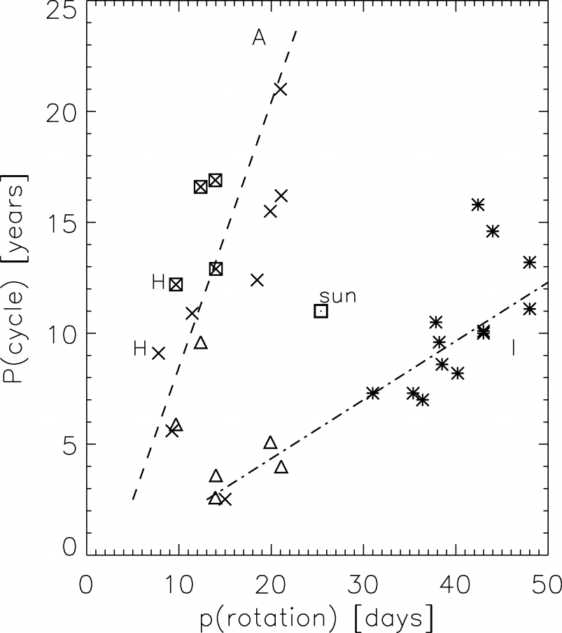
A warning to the Sun from the Stars…
Kinematic dynamos?
Ca II S index stellar data from
Saar & Brandenburg (1999), includes
determinations of P_{rot} from Ca II:
Two branches “Active”, “Inactive” suggested to be associated with shear layers above and below CZ following Durney et al (1981)
Surprise ! What then is the Sun doing?

Slide 15
Role of shear layers- solar data
What about
me?
We talked about this interior shear
Kinematic dynamos?

Slide 16
This discussion
A global solar dynamo
reconnection
Parker and turbulent diffusivity
Spruit and the solar cycle
Parker and spontaneous generation of current sheets

Slide 17
Reconnection, turbulence
Notice the sudden “snapping” of field lines that are needed to complete the αΩ effects in the movies….
this is due to “η_{T}”…
after all, without this, we have…

Slide 18
R_{M} = ∞ dynamics: Lagrangian model (no diffusion) C. de Forest L. Rachmeler

Slide 19
Reconnection, turbulence and dynamos a topological picture

Slide 21
Reconnection, turbulence
Syrovatskii - susceptibility of Y and
X points to reconnection
Sweet-Parker: slow (entire L_{x} is needed) v_{in} ~ V_{A} /R_{m}^{1/2}
Petschek uses shocks to
reduce L_{x},v_{in} ~ V_{A} /(ln R_{m}), fast
Turbulence invoked by Vishniac,
Lazarian (1999), reduces L_{x}, fast.
Implies magnetic “field line wandering”
and effective diffusion
NOTE:
Both dynamos and flares require fast reconnection (independent of R_{m}, see 1964 NASA conf. proceedings…)
(Much recent work also with plasmas, not MHD
supports fast reconnection, e.g., Battacharjee)

Slide 22
This discussion
A global solar dynamo
reconnection
Parker and turbulent diffusivity
Spruit and the solar cycle
Parker and spontaneous generation of current sheets

Slide 24
Sources and sinks
Kinematic dynamos?
source sink
latitudinal shear
radial shear
latitudinal shear
Notes:
WHERE DO I GET l^2 and du/rdtheta ? Is it thickness of tach^2/ (du/r dtheta) with all params from helioseismology

Slide 25
First considerations
Kinematic dynamos?
source sink
Consider solar differential rotation, from seismology:
Time scales t_{STRETCH} ~ (du/rdθ)⁻¹ ~ 5 days; t_{DIFF} ~ (l²/η)
Parker 2007: “A magnetic Reynolds number of 10²-10³ is `about right’..” to produce a large scale dynamo
So t_{DIFF} ~ t_{STRETCH} / R_{M} implies, with l~0.2R
η ~ 10³ l² du/rdθ ~ 4 10¹¹ cm²/s,
Yet η(kinetic) ~ v_{thermal} λ_{mfp} ~ 10³⁻⁴ cm²/s,
=> η ~ v_{eddy} λ_{eddy} “turbulent” not kinetic.
Notes:
WHERE DO I GET l^2 and du/rdtheta ? Is it thickness of tach^2/ (du/r dtheta) with all params from helioseismology

Slide 26
Order from chaos via mean field theory (“inverse cascade”)
With eq. motion: dynamic coupling across enormous scales
Ordered energy in u can generate B – this is a “dynamo”
But much dynamo work is kinematic- fix u=u₀, compute dB/dt
Mean field theory, inspired by Parker 1955
obtain d<B>/dt, set B= B₀+B₁…, B₁= fluctuations, can be big
<P+Q> = <P>+<Q>…< P<Q> > = <P> <Q>, <c>=c.
So <B>=B₀, and
∼ −1/3 < u₁. curl u₁> t_{c}; β∼1/3 <u₁²> t_{c}, t_{c} = turbulent correlation time
- effect” “turbulent diffusivity”
A prescription to get “Order from chaos”

Slide 27
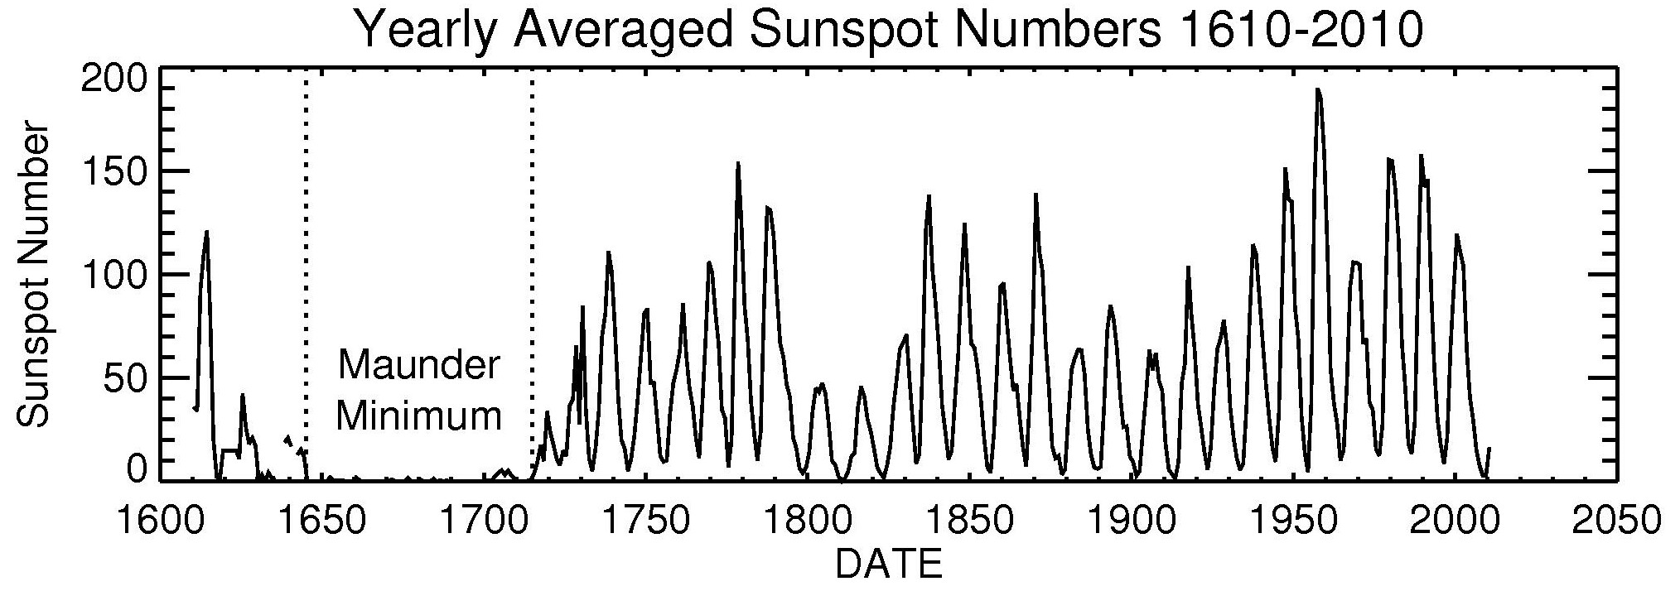
η in the solar interior
kinetic @ base of convection zone
10³ cm²/s
“Goldilocks” values to make a cycling, global dynamo
R_{m} = uL/ η ~ 10²⁻³ (“seems about right”, Parker)
10¹¹⁻¹² cm²/s

Slide 28
Parker 2008: η and the Lorentz force
Examine kinematic assumption on small scales
Follows earlier work (e.g. Cattaneo & Vainshtein 1991)
Unlike scalar field, magnetic flux is conserved (ideal MHD)
as field is stretched out along a turbulent eddy trajectory length L (λ=eddy size) at speed u:
B ~ B(0) exp( u t / λ )
thickness h ~ λ exp( - u t / λ ) (Bh constant, flux sheet)
when h²/4η ~ λ/u, dissipation occurs, i.e. when B ~ B(0) R_{M}^{1/2}
BUT in the same time stresses increase by B² ~ R_{M},
=> magnetic stresses dominate before diffusion sets in!
Parker concludes:
“There is no way to account for the value η ≈ 10¹² cm²/sec, suggesting that it is necessary to rethink the [..] dynamo for the Sun.”

Slide 29
η, β and the plasma material
Transport via eddies: β ~ u²t_{c} = ul/3
by analogy with kinetic theory η ∼ u_{thermal} λ/3
OK for passive scalars, fluids
BUT j μ₀ η = Ε, j = n e (u_{p} – u_{e})
in eddies, protons are advected with electrons (E’=0)
resistive dissipation cannot work in eddies
Something quite DIFFERENT is going on in β wrt η

Slide 30
This discussion
A global solar dynamo
reconnection
Parker and turbulent diffusivity
Spruit and the solar cycle
Parker and spontaneous generation of current sheets

Slide 31
Kinematic dynamos?

Slide 32
Spruit 2010
Based upon cyclonic turbulence, wave-like statistics of the sunspot cycle (Parker 1955), and tractability, mean field dynamos have been treated using
cascades in wavenumber space
correlation functions to represent non-linear interactions between u & B
separation of length scales between mean fields and fluctuations
Instead, Spruit claims:
It is *sufficient* that a star rotate differentially
α effect (toroidal ➔ poloidal) is inevitable due to
dynamo depends on the finite amplitude of the field, which determines the time
scale of the buoyant magnetic instability leading to the α effect. (Leighton 1969)
“compatible with critical data”

Slide 33
Spruit 2010
Kinematic dynamos?
+ buoyancy

Slide 34
Spruit 2010: What essential surface observations tell us about the dynamo: emerging magnetic fields
Kinematic dynamos?
Tsuneta’s movie of active region 10926, the “trilobite”: flux ropes vs diffusion

Slide 35
Spruit 2010
“computing resources needed for a simulation would become
available 100 years from now (Schuessler 2008)
…The MHD equations are completely symmetric with respect to the sign of the magnetic field… There are no flows (no matter how complex) that can separate fields of different signs out of a mixture.
This striking behavior is the opposite of diffusion. To force it into a
diffusion picture, one would have to reverse the arrow of time…
This rules out a priori all models attempting to explain the formation
of sunspots and active regions by turbulent diffusion….
The orientation and location of the polarities seen in an active region
must already have been present in the initial conditions: in the layers
below the surface from which the magnetic field traveled…”
Kinematic dynamos?

Slide 36
Spruit 2010 problems
Kinematic dynamos?
“The most challenging problem may well be finding a satisfactory description for the process by which the mass of buoyant vertical flux tubes resulting from a cycle’s worth of eruptions gets ‘annealed’ back into a simpler configuration”.
Leighton’s non-linear picture (1969) needed a magnetic diffusivity η~ 10¹² cm²s⁻¹ throughout
Are we back to “square one”?

Slide 37
More surprises- “η” at the surface
Global solar surface magnetic evolution w/ observed flows
few x10¹² cm²/s (Wang, Nash, Sheeley; Schrijver, Zwaan)
Coronal hole boundary evolution (Fisk & Schwadron 2001)
called “interchange reconnection”
effectively 3 x 10¹³ cm²/s (inside “unipolar” CH)
(BUT 10¹⁵ cm²/s low latitudes)
photosphere eddy vλ/3 = r²/3τ values
granules 5x10¹² cm²/s
supergranules 2x10¹² cm²/s
MHD simulations of granular surface flux dispersal (Cameron et al 2011)
2x10¹² cm²/s (v and r both effectively smaller)
Flares
Store 10³² erg of free energy in a volume ~ 3x10²⁷ cm³ in ~3 days
release it in a few minutes (0.01 L, for dMe stars, ~ L★)
L²/η > 10x 3 days, gives η < 4x10¹³ cm²/s (conservatively)

Slide 38
“η” at the surface
This can in principle be “observed”, currently ~ 0.15” = 100 km resolution
tiny structures (100 km) with lifetimes of > 100s (chromospheric
fibrils) are approaching interesting numbers already:
η < L² / t ~ 10¹⁴ /100 ~ 10¹² cm²/s
ATST (4m telescope, 2019 onwards) etc.
New telescopes get at an essential ingredient in high R_{M} MHD (“Parker report” led to ATST)

Slide 39
“η” at the surface
Hinode spacecraft
observations of
chromospheric
plasma

Slide 40
This discussion
A global solar dynamo
reconnection
Parker and turbulent diffusivity
Spruit and the solar cycle
Parker and spontaneous generation of current sheets

Slide 41
Surprising consequences of small η relaxation of dB/dt, atmspheric heating, dynamics..

Slide 42
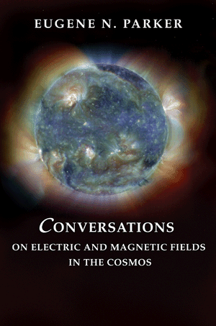
Fair is foul, and foul is fair.
-Witches, Act I, scene I, MacBeth
The irony and poetic consequences of ideal MHD, lim η ➔0

Slide 43
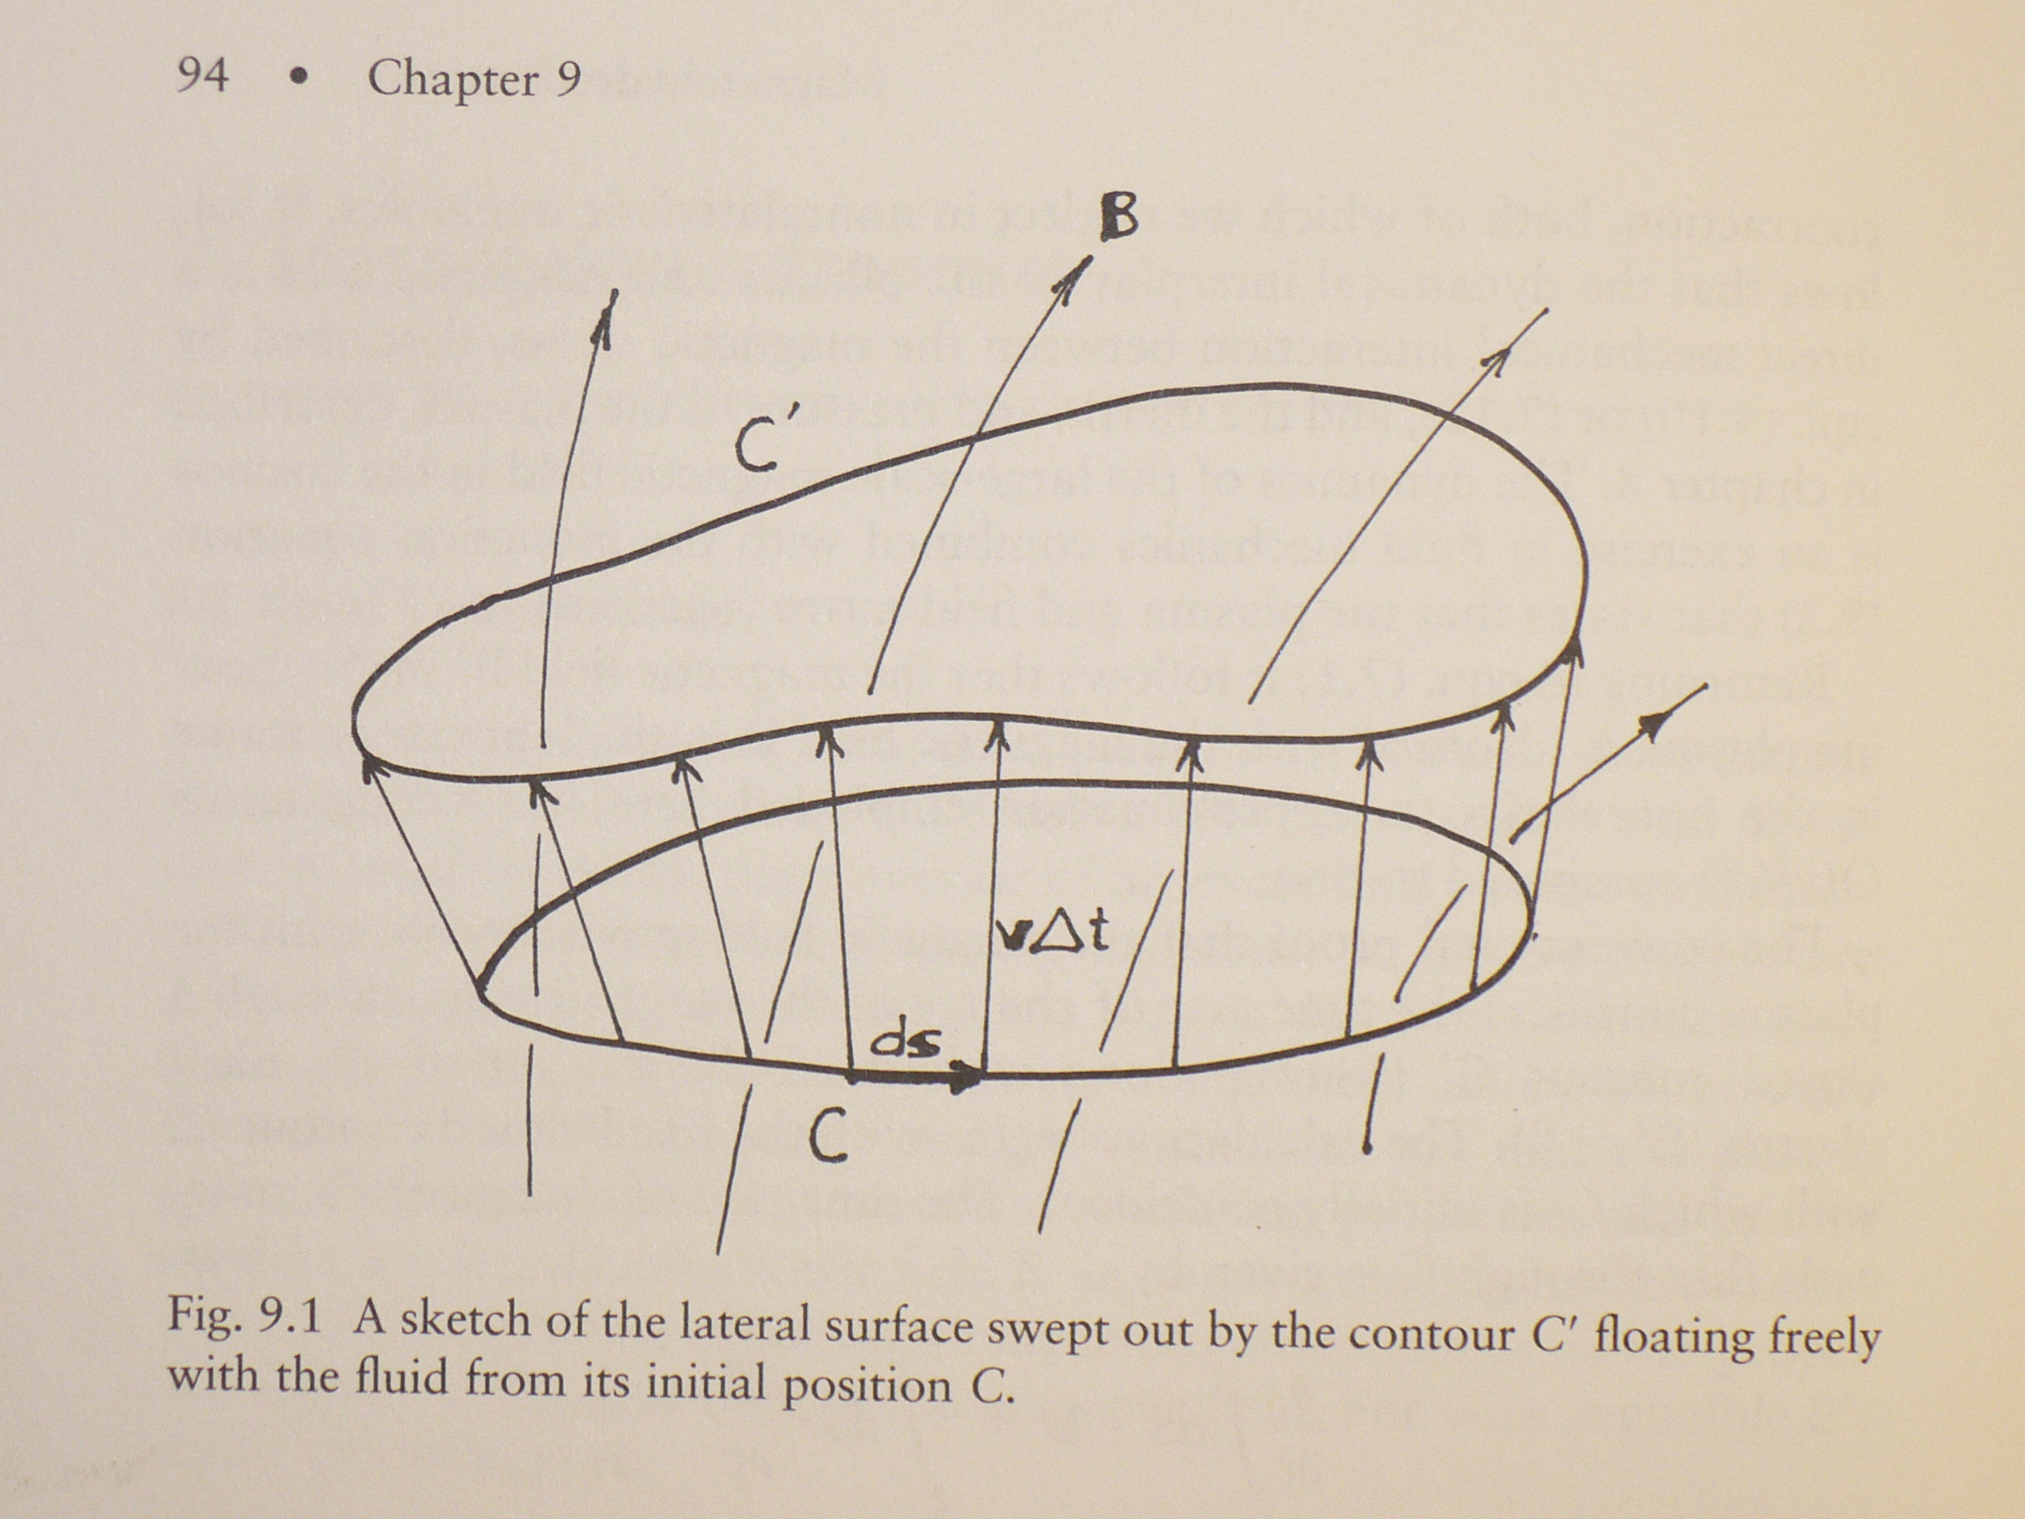
Ideal MHD, η −> 0
Ideal case
frozen fields
fixed field-line topology
, and E’= 0

Slide 44
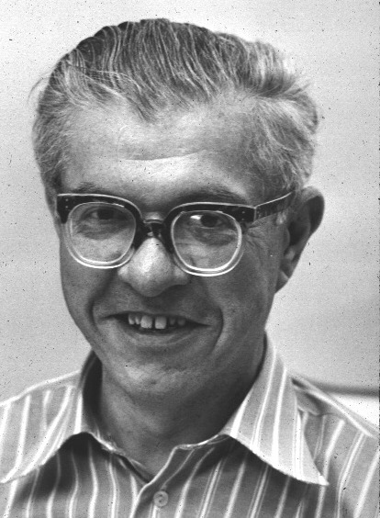
SDO AIA surface (5000K) to corona (1 million K). Obvious violation of 2nd law of thermodynamics “Grand challenge” e.g. Hoyle 1955, “Frontiers in astronomy”)

Slide 45
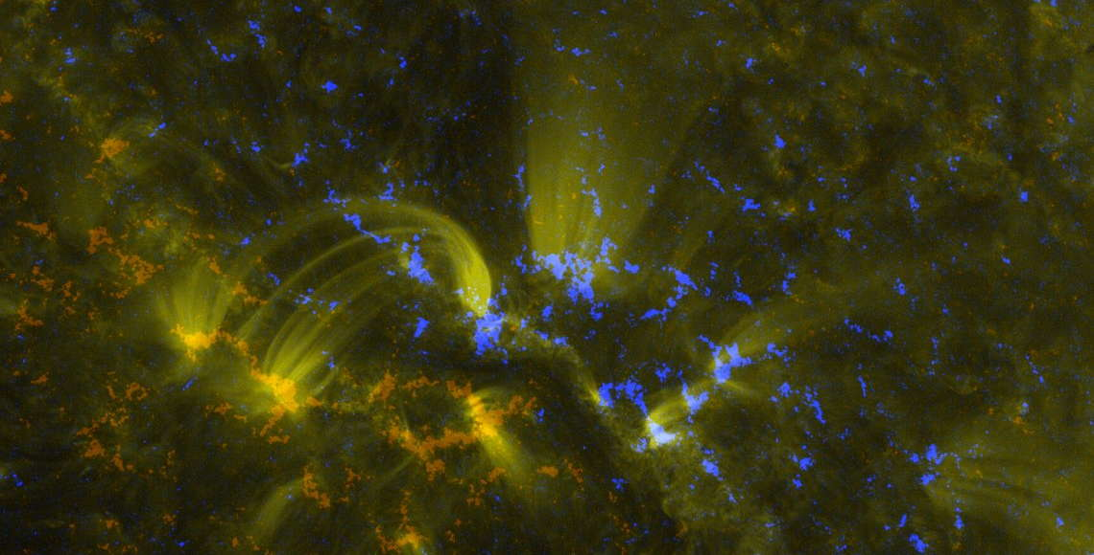
from untidy photospheric magnetism to coronal plasma loops

Slide 46
Corona: low beta plasma
Limit of zero plasma beta
j x B = 0
(no forces can balance the overwhelming Lorentz force)
Parker considers this condition together with

Slide 47
Parker 1972, 2007
Under ideal conditions
“… the fact is that the Maxwell stress tensor
of a magnetic field with an untidy field line topology has the
curious property of creating internal surfaces of tangential
discontinuity (TD), i.e. current sheets, as the magnetic field
relaxes to an equilibrium… while the dynamical swirling.. defines
a large scale mixing length, the magnetic stresses acting alone
cause the magnetic field gradients to steepen without limit when
the field is allowed to relax to its lowest energy state”
”

Slide 50
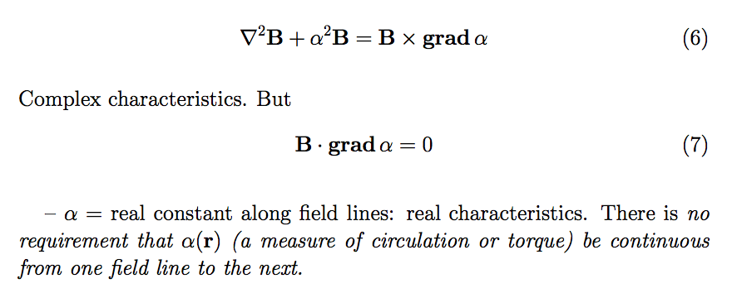
Another view (Parker 2007)

Slide 51
Another view
The equations of force balance and ideal induction are over-constrained

Slide 52
Parker
“…the basic nature of the mathematics of the equilibrium field [is that] the topology of
the real characteristics of the final [force-free] equilibrium solution is identical with
the topology of the [initial or imposed] magnetic field.”
“The importance of the spontaneous formation of Tangential Discontinuities lies
in the rapid reconnection of magnetic field across each TD.”
So, the tragedy of ideal MHD is as follows:
Ideal MHD dynamics + untidy fields => TDs
Genuine TDs (singular equilibrium states) cannot form
in the presence of a small, finite resistivity
So, in trying to become singular, on time scales L/C,
Maxwell stresses make steeper gradients until ideal MHD causes its own demise
BUT we gain a theory of dB/dt / dissipation / heating/
dynamics: fast reconnection…

Slide 53
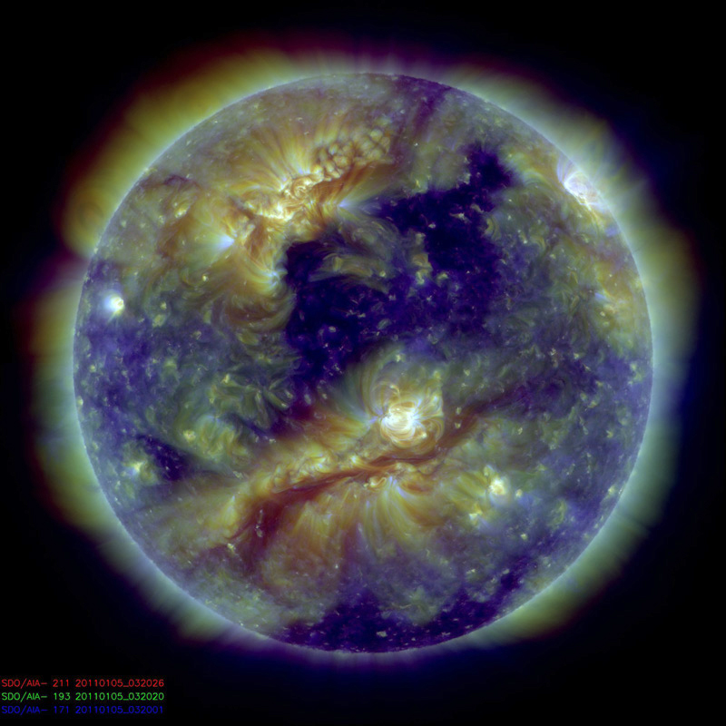
Questions: large scale order in coronal plasma: ?
Not just shades of grey:
Order out of chaos

Slide 54
Conclusions
We have become accustomed to seeing the Sun vary somewhat
Variations dB/dt_{SUN} have well known consequences:
atmospheric heating, a tragic consequence
of almost ideal MHD ?
flares, CMEs
variable UV and particles (ionosphere)
space weather
all the above = “solar- or helio- physics”
BUT, we must not forget
that the Sun and stars exhibit remarkable, unanticipated magnetic variations
when viewed from the point of view of Newton and Maxwell
that many fundamental questions remain as challenges in solar physics
that there is no satisfactory explanation for dB/dt_{SUN}
to keep an open mind and try to acquire critical data, especially of stars

Slide 55
solar physics remains essentially attempts to answer the question
?
Thank you and good luck

