Slide 1
Miscellaneous topics
Don Kurtz
Jeremiah Horrocks Institute
University of Central Lancashire

Slide 2
The first exoplanet
The first exoplanet – PSR1829-10b
Using the timing method
M = 10 M_{earth}
P = 6 months; e =0
“It is not clear whether it formed in the aftermath of the supernova that created the neutron star, or was pre-exisiting and somehow survived through the late stages of stellar evolution …”
Bailes et al., 1991, Nature, 352, 311

Slide 3
The first exoplanet
The first exoplanet – PSR1829-10b
A “small correction” to the value of the Earth’s ellipticity
Imprecise position of the pulsar
Error in the calculation of BJD led to the discovery of a planet with P = 6 months
The planet’s name is Earth
Lyne & Bailes 1991, Nature, 355, 213

Slide 4
Time and time traps
What is time?
Measuring time
Calendar adjustments
Leap years
Leap seconds
Length of the Day is increasing by ~1.7 ms/century;
i.e. the Earth’s rotation is accelerating on a long time scale
At the moment it is decreasing

Slide 5
Universal Time (UT)
UT is based on the Earth’s rotation
UT1 is based on a mean solar day of 86400 mean solar seconds
In practice, UT1 is based on GMST
P_{s} ≈ 86164.0905 mean solar seconds
This is 0.0084 s shorter than the rotation period because of precession
The mean solar day is about 1 ms longer than 86400 s
Earth’s rotation period is currently 86164.0999 SI s
UT1 is measured with VLBI of quasars
(GPS is not good enough because of orbital variations)

Slide 6
Ephemeris Time (ET)
ET is based on the period of the Earth’s orbit about the Sun
It is based on Newcomb’s Tables of the Sun (1895)
The length of the tropical ET year in 1900 was 31,556,925.9747 s
The reciprocal of this defines the ET second
1976
Terrestrial dynamical time (TDT)
Barycentric dynamical time (TDB)
1991 IAU renames TDT ➔ Terrestrial Time (TT)

Slide 7
TT
TT = TAI + 32.184 s
TAI = International Atomic Time
The offset is the difference between ET and UT1 on 1 January 1958
1991 IAU
Basis of the time scale includes GR
Geocentric coordinate time (TCG)
Barycentric coordinate time (TCB)
These do not run at the same rate as TT!

Slide 8
TAI
This is defined by a hyperfine transition in the ground state of Ce¹³³
The atomic second is defined to be 9,192,631, 770 periods of the radiation of this transition
Two hundred clocks in 50 countries contribute to the maintenace of TAI

Slide 9
Does this matter?

Slide 10
Earth rotation
http://tycho.usno.navy.mil/systime.html

Slide 11
UTC
Coordinated UT was introduced in the 1950s
Adjustment to quartz clocks were coordinated between laboratories in the USA and UK
It is now international
Both rate and epoch are variable to stay in step with astronomical time

Slide 12
UTC
McCarthy, D., 2004, In Transits of Venus: New Views of the Solar System and Galaxy,
D.W. Kurtz, ed., IAU C196, Cambridge University Press

Slide 13
Julian Date
Joseph Justus Scaliger introduced Julian Date in 1583 at the time of the Gregorian Calendar reform
The zero point is 4713 BCE January 1 at 12:00 at the meridian of Alexandria
Solar cycle of 28 years
Metonic cycle of 19 years (235 lunar months = 18.9999 years)
Roman indiction (tax) cycle of 15 years!
15 x 28 x 19 = 7980 years
The epoch is the last time they were all in their first year

Slide 14
Julian Date
12:00 UT 2010 November 26 =
JD 245 5527.00000
Modified Julian Date
MJD = JD – 240 0000.5 (Watch out!)
JD 245 5527.00000 = MJD 55526.50000
Reduced Julian Date
RJD = JD – 240 0000.0
JD 245 5527.00000 = RJD 55527.00000
Truncated Julian Date
TJD = JD – 244 0000.5 (NASA definition)
TJD = (JD – 0.5) mod 10,000 (NIST)
TJD = JD – 244 0000.0 (common asteroseismic use)

Slide 15
HJD, BJD, BJED
HJD = Heliocentric Julian Date
Correct the time of observation to the centre of the Sun
BJD = Barycentric Julian Date
Correct the time of observation to the barycentre of the Solar System
Differs from HJD by up to ~ 2 s
Jupiter is the prime cause of this, but even the asteroids are measurable
BJED = Barycentric Julian Ephemeric date
BJD with the leap seconds removed
Note that the IAU recommends that JD be given in ET, but asteroseismology uses UTC

Slide 16
Kepler Time
The Kepler team originally gave times in MJD measured here at the Earth
The latest download files at KASOC give BJD corrected from the time of observation at the satellite (not Earth, so not so easy to do using standard tools)
Many Kepler papers use BJD – 240 0000.0, or BJD - 245 0000.0 and call these truncated BJD.
Be clear and be careful

Slide 17
Beware of time traps!
The potential for mistakes is high
Make sure you are sure of your time base(s), especially when concatenating data sets from different sources
If you do discover a planet, it is better that it is not the Earth

Slide 18
Computer truncation
BJD 2451234.123456
BJD 51234.123456 as in Kepler data
11 decimal precision; 10¹² ~ 2⁴⁰, so 40 bits
Exponent up to 999, so 10 bits
Sign (+ or -) on exponent and on mantissa gives 2 more bits
You need 52 bits to represent this time
32-bit precision is not enough; you need 64-bit precision for your computations

Slide 19
The timing method
Bailes & Lyne were wrong about the first pulsar planet
But the first exoplanets were discovered orbiting a pulsar using the timing method
PSR 1257+12; 6.2-ms pulsar
O-C = Observed – computed
V391b Pegasi sdBV EHB stars
M = 3.2 M_{jupiter}
a = 1.7 au; P = 1170 d
Wolszczan & Frail 1992, Nature, 355, 145
Silvotti et al. 2007, Nature, 449, 189

Slide 20
V391b Peg ν₁

Slide 21
V391b Peg ν₂

Slide 22
The timing method
Pulsating stars can be good clocks
A planet induces a Doppler shift to the star’s pulsation frequency
The pulsation frequency is then periodically variable with time
Be on the lookout for pulsational frequency multiplets split by the orbital frequency of the planet
The splitting depends on frequency, so you cannot sum over all pulsation frequencies

Slide 23
Discovering clocks in the telescope
When searching for periodic phenomena in astronomy, be careful not to discover the clocks in your telescope
The “pulsar” at the core of the SN1987a remnant
Pulsation harmonics in the roAp stars HD60435 and HR1217

Slide 24
SN1987a
SN1987a (February 1987) in the LMC was the first naked-eye supernove since Kepler’s supernova of 1604
A team searched hard for a pulsar remnant
Using the CTIO 4-m telescope they found one in January 1989
ν = 1968.629 Hz
P ~ 0.5 ms!
Theory argued for spin-up from material falling back onto the remnant
Uh-oh! Nobody could confirm the observation
Kristian et al. 1989, Nature, 338, 324
Woosley & Chevalier 1989, Nature, 338, 321
Kristian et al. 1991, Nature, 349, 747

Slide 25
Harmonics in roAp stars – HR3831
Artefact; P = 2 sidereal min
ν = 8.4 mHz
Real – 2v, 3v, 4ν
Kurtz et al. 1993, MNRAS, 260, 343

Slide 26
Harmonics in roAp stars – HD60435
Artefact; P = 4 sidereal min
ν = 4.2 mHz
Real
Matthews et al. 1986, ApJ, 300, 348

Slide 27
Harmonics in roAp stars – HR1217
White, T. et al. 2010,
in preparation

Slide 28
Aliases – a visual view
Aliases from gaps in the data
Nyquist aliases
How to create a spectral window
Be careful of asymetry near ν = 0

Slide 29
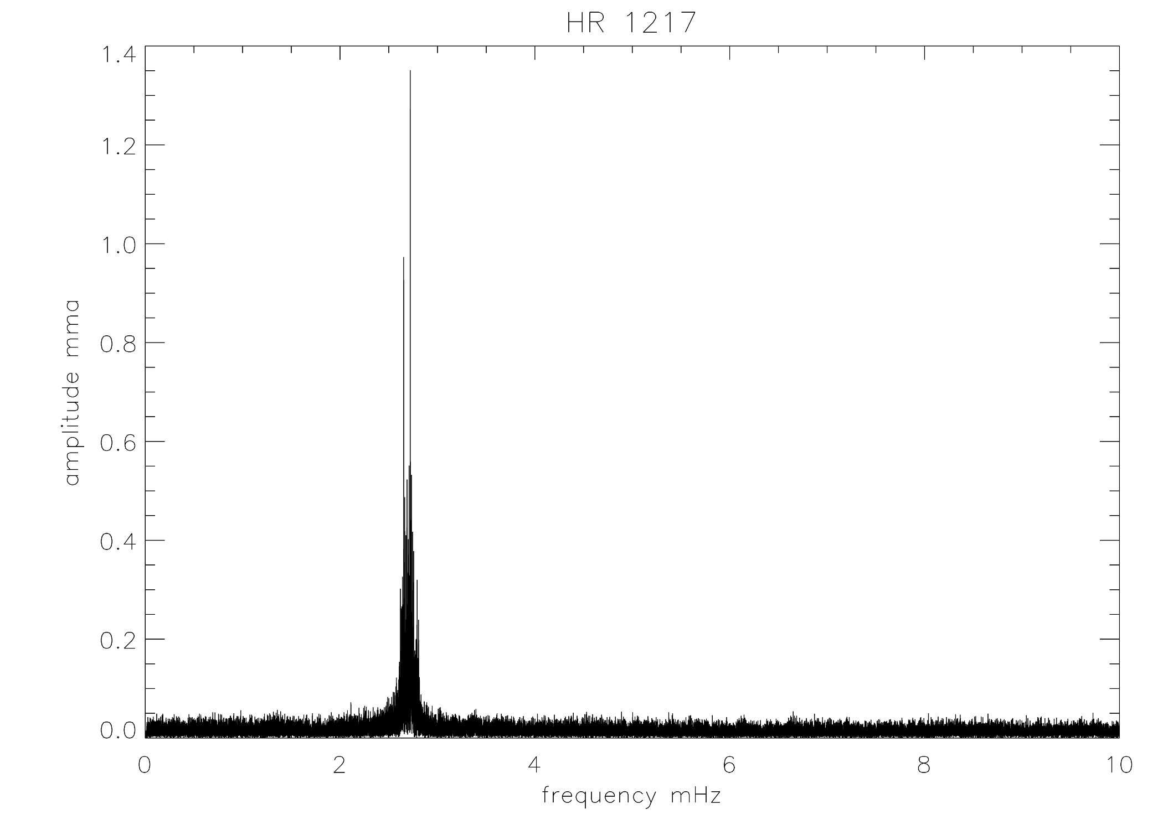
The amplitude spectrum of HR1217

Slide 30
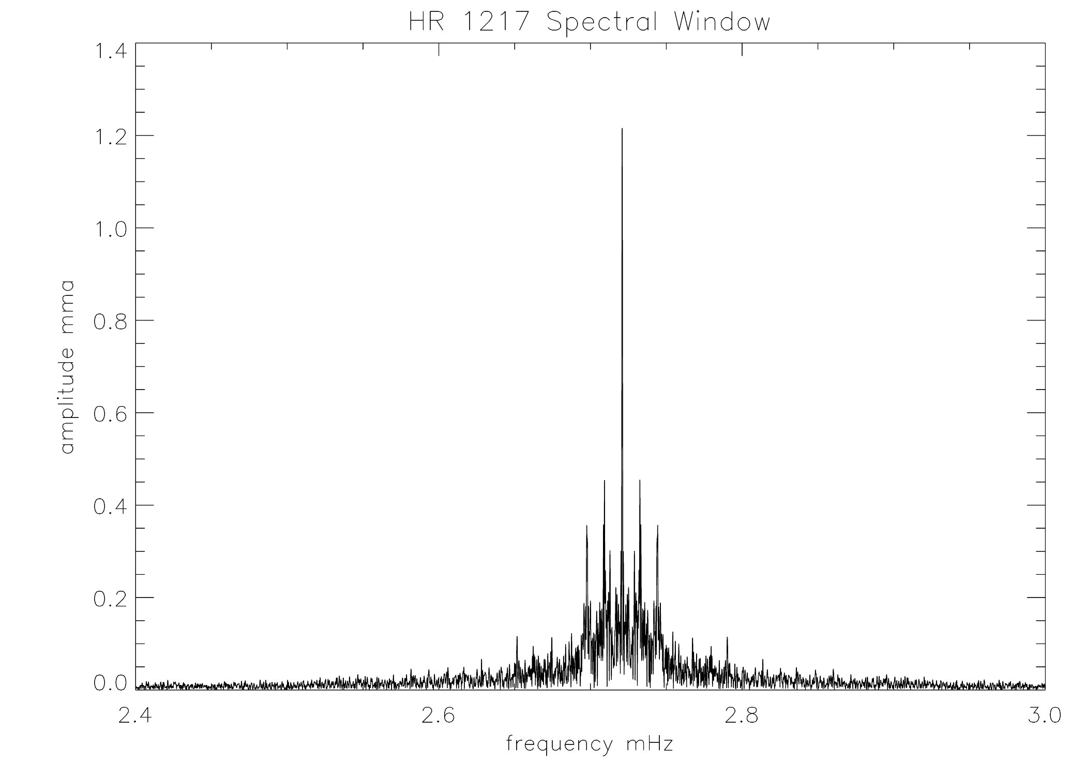
Amplitude spectrum – the Spectral Window

Slide 31
The Spectral Window near ν = 0

Slide 32
The Spectral Window near ν = 0

Slide 33
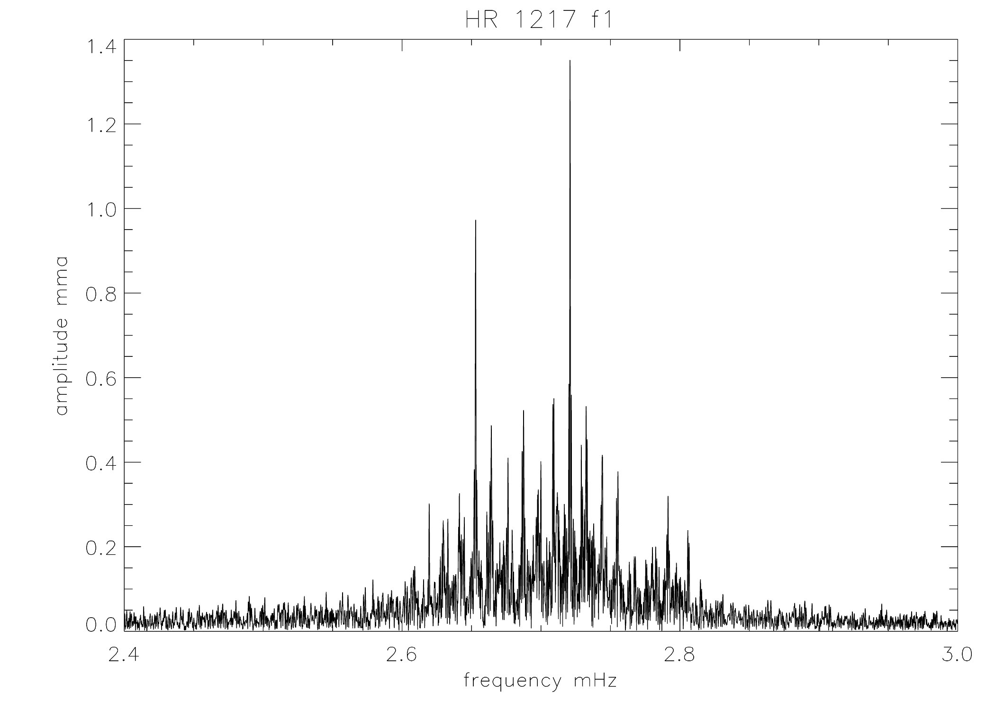
Amplitude spectrum – ν₁

Slide 34
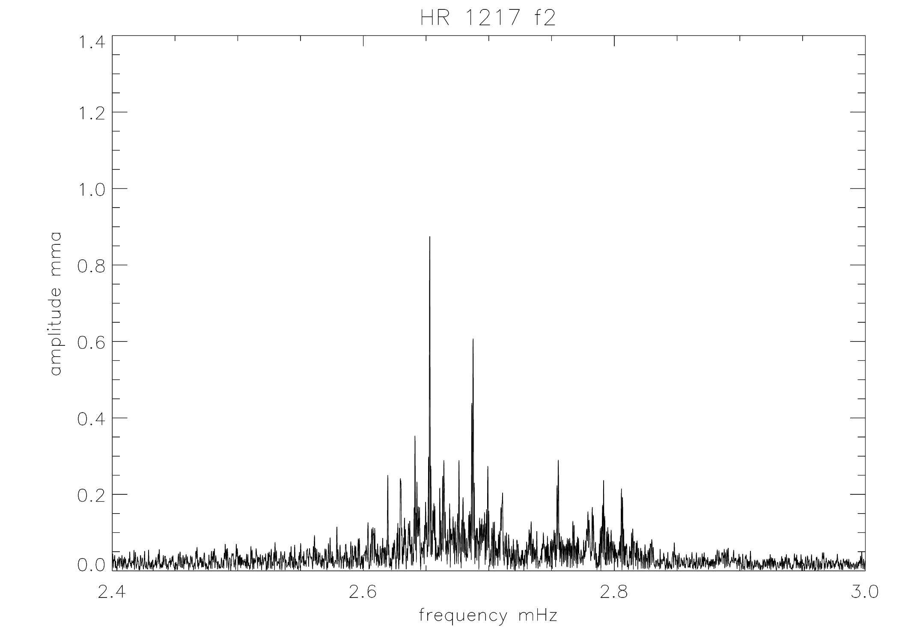
Amplitude spectrum – ν₂

Slide 35
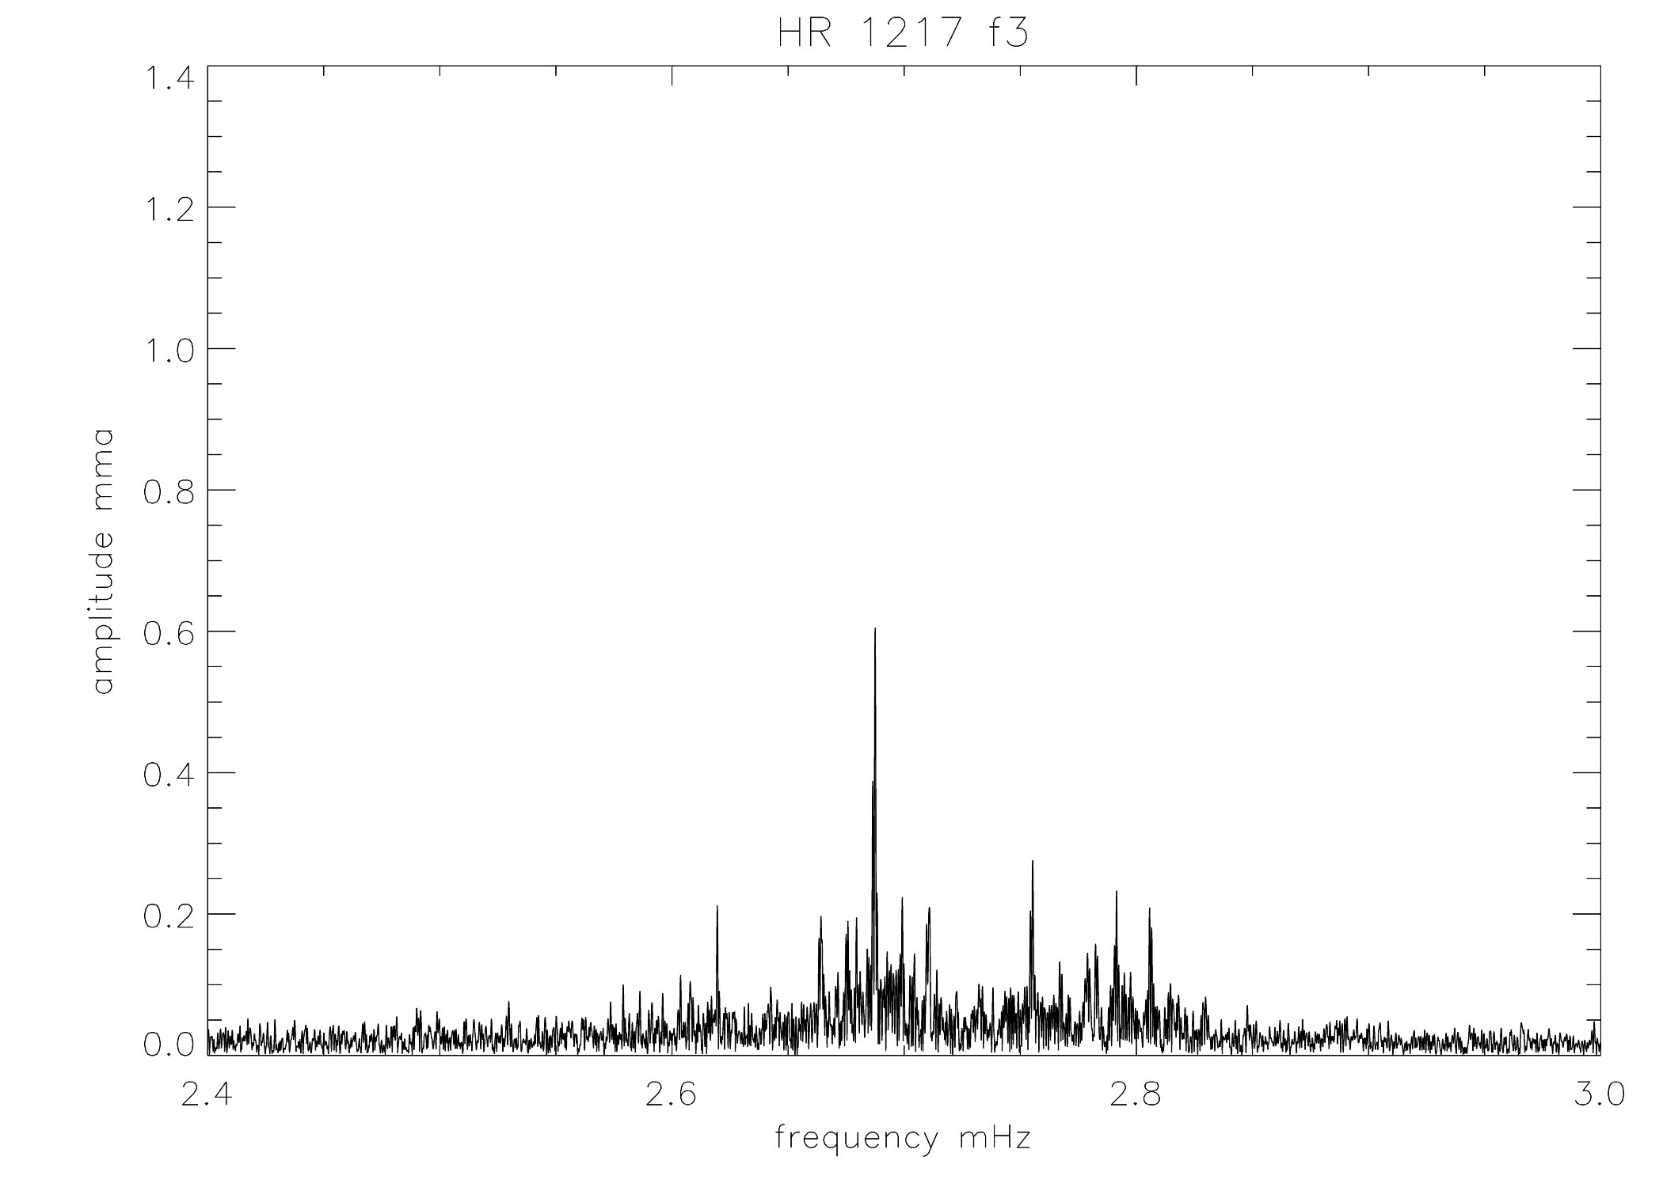
Amplitude spectrum – ν₃

Slide 36
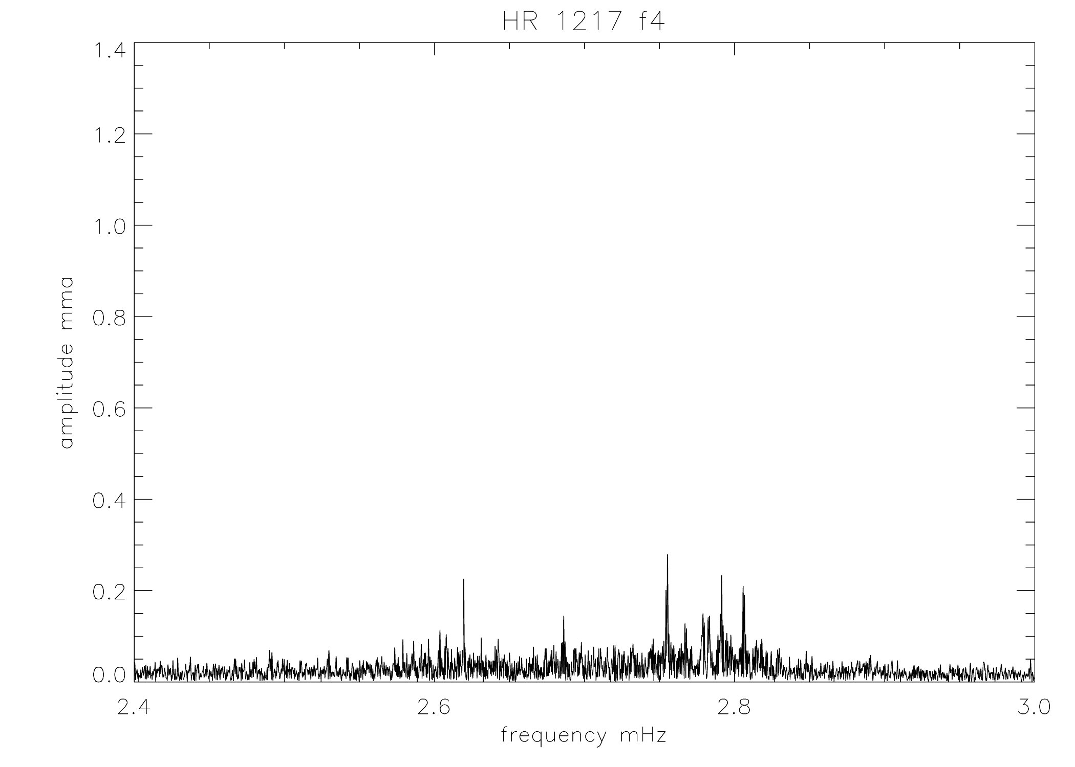
Amplitude spectrum – ν₄

Slide 37
Aliases – a visual view
Aliases from gaps in the data
So fine, but who cares?
Kepler data have almost no gaps, so there is no problem, right?
Maybe …

Slide 38
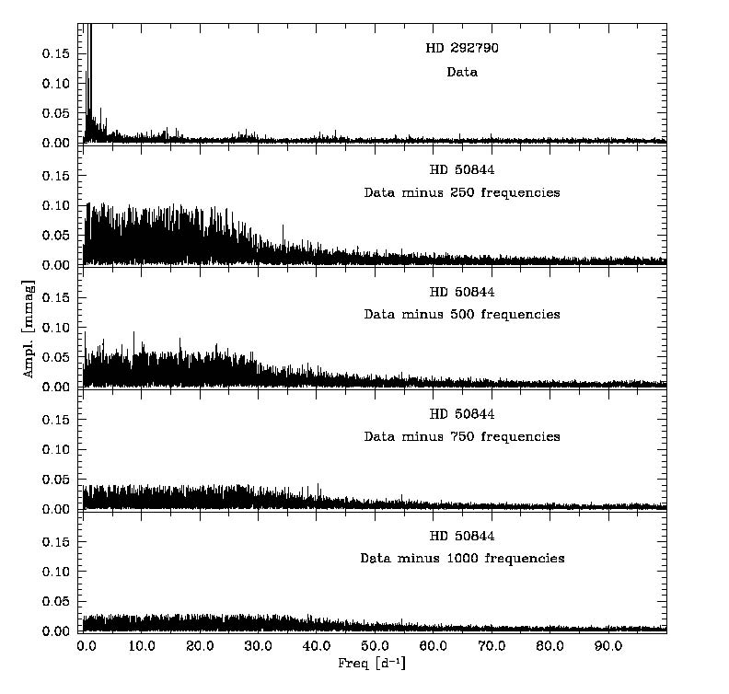
CoRoT - HD50844 - δ Sct star

Slide 39
How to grow your own grass
Pieter de Groote
PhD thesis

Slide 40
Nyquist Aliases – a visual view
Why is the Nyquist frequency half the sampling frequency?
Can you find frequencies above the Nyquist frequency?
cadence = 1 minute
Sampling frequency = 16.666 mHz = f_{s}
Nyquist frequency = 8.333333 mHz

Slide 41
Input frequency f_{i} = 0.1 mHz
Input frequency
f_{s} – f_{i}
f_{s} + f_{i}
2f_{s} – f_{i}
2f_{s} + f_{i}

Slide 42
Input frequency f_{i} = 1.0 mHz
Input frequency
f_{s} – f_{i}
f_{s} + f_{i}
2f_{s} – f_{i}
2f_{s} + f_{i}

Slide 43
Input frequency f_{i} = 5.0 mHz
Input frequency
2f_{s} + f_{i}
f_{s} – f_{i}
f_{s} + f_{i}
2f_{s} – f_{i}

Slide 44
Input frequency f_{i} = 11.66666 mHz
f_{s} – f_{i}
Input frequency

Slide 45
Nyquist Aliases – a visual view
You must have some external constraint to choose the correct Nyquist alias
This does not matter whether it is above or below the Nyquist frequency
You can detect frequencies above the Nyquist frequency
If you do, it is better to get higher cadence data (if you can)

Slide 46
Pulsation phases
Phases are sometimes useful
t₀ matters!
f and Φ are coupled
When frequency is fitted by nonlinear least squares t₀ should be set to the central time of the data set
Otherwise the phase errors are overestimate at best, and at worst there is no convergence

Slide 47
KIC blah blah blah

Slide 48
KIC blah blah blah

Slide 49
KIC blah blah blah

Slide 50
KIC8677585 – roAp star g mode or background binary star?
Balona et al. 2010, MNRAS, in press

Slide 51
Kepler data Forget computer games – go prospecting!

