Slide 1
The oblique pulsator model
Don Kurtz
Jeremiah Horrocks Institute
University of Central Lancashire

Slide 2
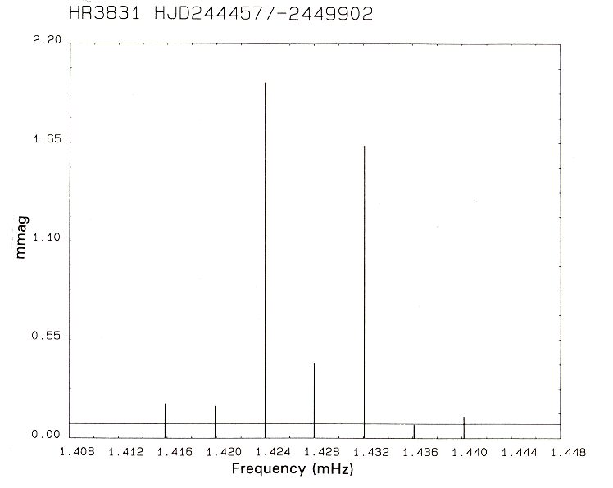
This is not a rotationally split multiplet – so what is it?

Slide 3
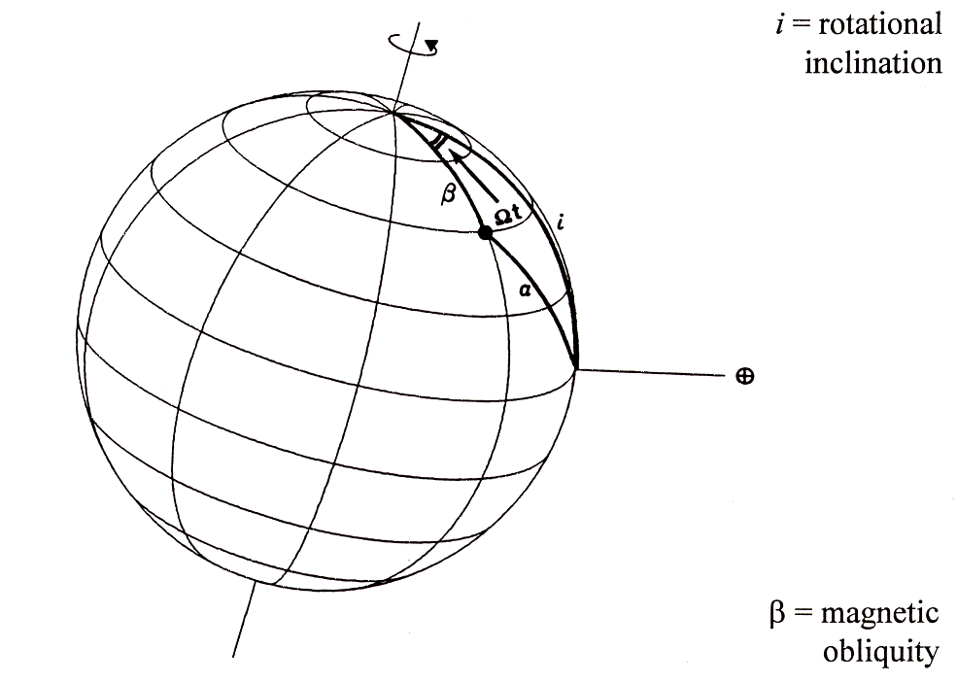
A simple idea
What if the pulsation axis is not the rotation axis?
Kurtz 1982, MNRAS, 200, 807 – 859
Shibahashi & Saio 1985, PASJ, 37, 601

Slide 4
A simple idea
For a nonradial mode the observed amplitude is:
where α is the angle between the line-of-sight and the pulsation axis; i.e. the co-latitude of the pulsation mode, since the angle is measured form the pole, not the equator.
If the line-of-sight is over a node for any mode, the observed amplitude will be zero (in the absence of limb-darkening)

Slide 5
A reminder
Aerts, Christensen-Dalsgaard, Kurtz, 2010, Asteroseismology, pp. 10-11

Slide 6
An example: a dipole mode
An axisymmetric l = 1, m = 0 dipole mode:
Pulsation pole-on: maximum observed amplitude
Pulsation equator-on: minimum observed amplitude
In this case the amplitude = zero, because the line-of-sight is over a node

Slide 7
An example: a dipole mode
An sectoral l = 1, m = 1 dipole mode:
Pulsation equator-on: maximum observed amplitude
Pulsation pole-on: minimum observed amplitude
In this case the amplitude = zero, because the line-of-sight is over a node

Slide 8
An example: a quadrupole mode
An axisymmetric l = 2, m = 0 quadrupole mode:
Pulsation pole-on: maximum observed amplitude
Pulsation equator-on: -1/2 the pole-on amplitude
- means 180º out of phase
minimum observed amplitude occurs when
In this case the amplitude = zero, because the line-of-sight is over a node

Slide 9
Mode visibility – don’t be confused
For modes viewed pole-on - best angle for highest amplitude –
in the absence of limb-darkening:

Slide 10
Mode visibility
Why does l = 1 have a higher observed amplitude than l = 0?

Slide 11
A simple idea
For a dipole mode the observed amplitude is:

Slide 12
Oblique pulsator model

Slide 13
Trig identity
Try this
Sum them:
We find:

Slide 14
Oblique pulsator model

Slide 15
Oblique pulsator model

Slide 16
Oblique pulsator model
The pulsation axis is not the rotation axis
This generates a (2l+1) multiplet
The frequencies are split by exactly the rotation frequency
At the time of pulsation maximum all members of the multiplet have the same pulsation phase
In the simplest model A_{+m} = A_{-m}
contains information about the geometry of the mode

Slide 17
HR 3831 – a distorted oblique dipole mode

Slide 18
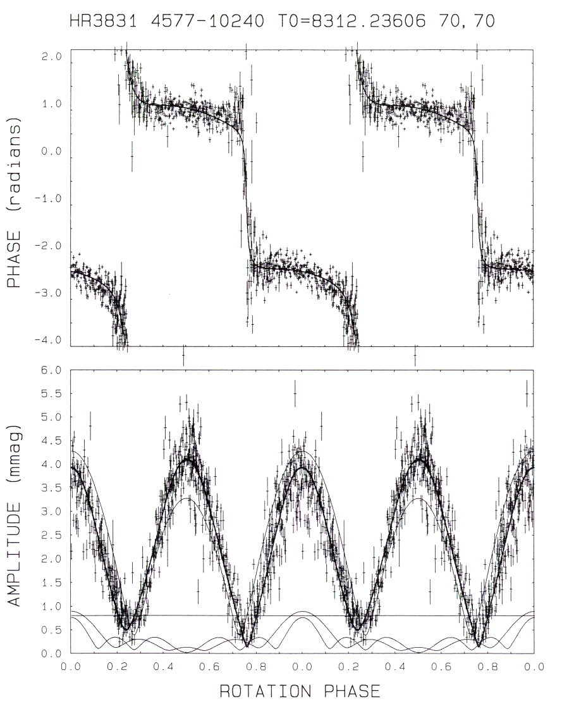
HR 3831

Slide 19
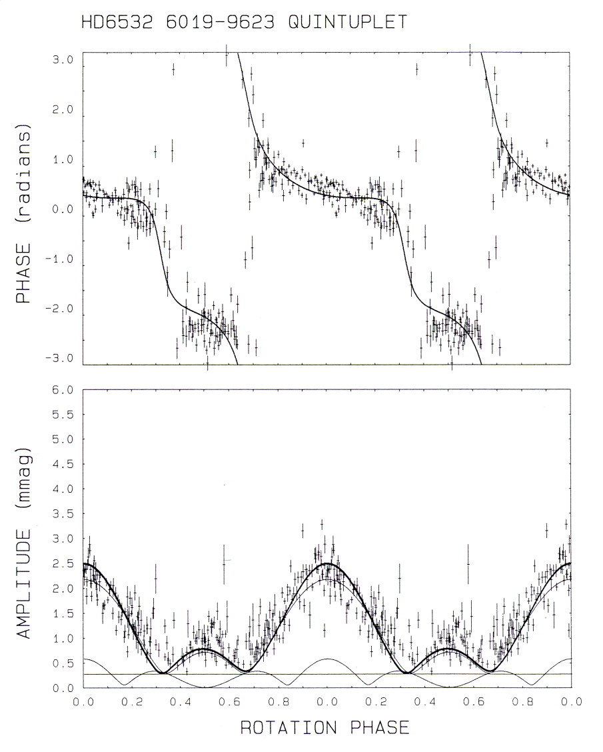
HD 6532

Slide 20
Oblique pulsation
The roAp stars are oblique pulsators
Some white dwarfs with MG magnetic fields may be oblique pulsators
Neutron stars may be oblique pulsators
Kurtz, 1990, ARA&A, 28, 607 - 655
Montgomery et al., 2010, ApJ, 716, 84 (DBV GD 358)
Rosen etal., 2010, Bull. AAS, 42, 465

Slide 21
Oblique pulsation
Oblique pulsation has been proposed as an explanation of the Blazhko effect in RR Lyrae stars
Could tidal distortion in close binary stars cause the pulsation axis to be the tidal axis?
Ask Kelly Hambleton
Shibahashi 2000, ASPC, 203, 299
Szabó et al., 2010, MNRAS, in press

Slide 22
What is interesting about roAp stars?
T_{eff}: 6600 – 8500 K
P_{pul}: 5.65 – 21.2 min
Asymptotic p modes
A_{phot}: < 10 mmag
A_{rv}: < 3000 m s⁻¹
B_{s}: < 30 kG
Atomic diffusion

Slide 23
XCOV20
HR1217
48 astronomers
8 observatories
3 weeks

Slide 24
HR 1217 WET Xcov20
= 14 mag
precision
Kurtz et al., 2005, MNRAS, 358, 651

Slide 25
HR 1217 WET Xcov20
Kurtz et al., 2005, MNRAS, 358, 651

Slide 26
HR 1217 WET Xcov20
Kurtz et al., 2005, MNRAS, 358, 651

Slide 27
Magnetic purturbation to the pulsation frequencies
Cunha, M. Gough, D., 2001, MNRAS, 319, 1020
Bigot et al. 2000, A&A, 356, 218
Saio, H., 2005, MNRAS, 360, 1022
Cunha, M., 2007, CoAst, 150, 148

Slide 30
HR1217: weighting the observations
White, T. et al., MNRAS, in preparation

Slide 31
HR1217: short time scale variations
1986 data
White, T. et al., MNRAS, in preparation

Slide 32
HR 1217 magnetic Doppler Imaging
Lueftinger et al. 2010, A&A, 509, 71

Slide 33
HR 1217 magnetic Doppler Imaging
Lueftinger et al. 2010, A&A, 509, 71

Slide 34
New upper atmospheric frequencies
Short time-scale variability not seen in photometry
log ₅₀₀₀
Pr, Nd
5
4
3
2
1
0
H
Fe

Slide 37
New upper atmospheric frequencies
Highest relative Amp for Pr III, Nd III
Lower relative Amp for Nd II, Hα
Low amplitude in photometry
log ₅₀₀₀
Strong level effect
Modes? some frequencies are stable
Energy gain and loss?
Pr, Nd
5
4
3
2
1
0
H
Fe

Slide 38
Why use an 8-m telescope to observe bright stars?

Slide 39
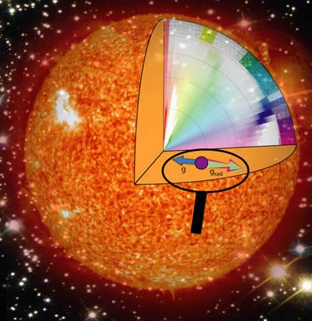
Atomic diffusion
log ₅₀₀₀
Pr, Nd
5
4
3
2
1
0
H
Fe

Slide 40
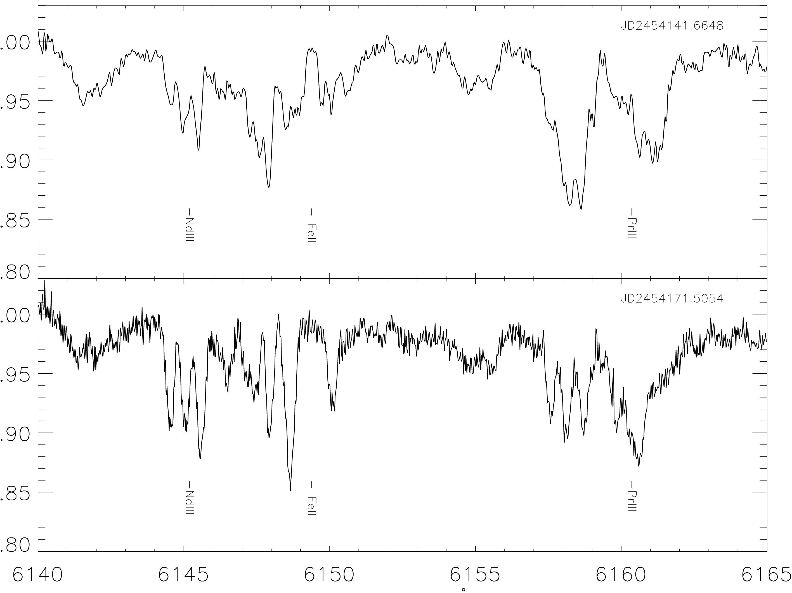
HD75049 30 kG
1
1
UCLan-005
12.5 kG
Freyhammer et al. 2008, MNRAS, 389, 441

Slide 41
Doppler imaging of HD 99563 NdIII spots VLT UVES + Subaru HDS
Freyhammer et al., 2009 MNRAS, 396, 325

Slide 42
Doppler imaging of HD 99563 EuII spots VLT UVES + Subaru HDS
Freyhammer et al., 2009 MNRAS, 396, 325

Slide 43
Line by line radial velocities

Slide 44
Line bisector radial velocities
⧫ = 0.1
⧫ = 0.7
Saio, H. 2005, MNRAS, 360, 1022

Slide 45
Viewing the 3rd dimension – nodes?

Slide 46
Viewing the 3rd dimension – nodes?

Slide 47
Viewing the 3rd dimension – nodes

Slide 48
Viewing the 3rd dimension – nodes

Slide 49
Viewing the 3rd dimension – running waves

Slide 50
Viewing the 3rd dimension – running waves

Slide 51
Viewing the 3rd dimension – running waves

Slide 52
⧫ ~ 10⁻²
~ 10⁻⁵
⧫ ~ 10⁻⁵
<<  ~ 10⁻⁵

Slide 53
Theoretical expectation
⧫ = 0.1
⧫ = 0.7
Saio, H. 2005, MNRAS, 360, 1022

Slide 54
LPV for m >> 0

Slide 55
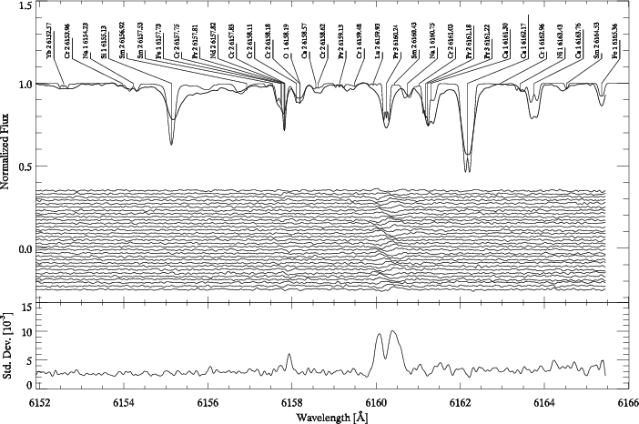
γ Equ
Pr III
6160
Kochukhov, O., Ryabchikova, T., 2001, A&A, 374, 615

Slide 56
Upper atmosphere shock waves
Shibahashi, H., Gough, G., Kurtz, D., Kambe, E., 2008, PASJ, 60, 63

Slide 57
HD99563 NdIII

Slide 58
Studies of roAp stars atmospheres test:
Atmospheric structure in 3D
Pulsation mode geometry in 3D
Interaction of pulsation with rotation and strong magnetic fields
Atomic diffusion

Slide 59
HD154708 – 24.5 kG
Hubrig et al. 2009, MNRAS, 396, 1018

Slide 60
HD154708
Kurtz et al. 2005, MNRAS, 372, 286

Slide 61
p modes and magnetic fields
Sunspots retard p modes
Sunspots deflect p modes and dissipate acoustic energy
roAp stars provide an observational look at p modes interacting with magnetic fields much stronger than in sunspots

