Slide 1
The chemically peculiar stars of the upper main sequence
Don Kurtz
Jeremiah Horrocks Institute
University of Central Lancashire

Slide 2
CP star taxonomy
T_{eff} (K) | Magnetic stars | Non-magnetic stars
7,000 - 10,000 | Ap SrCrEu A3 – F5 | Am, λ Boo A0 - F1
10,000 - 14,000 | Ap Si B8 - A2 | Ap HgMn B6 - B9
13,000 - 18,000 | He-weak, Si, SrTi B3 - B7 | He-weak PGa B4 - B5
18,000 - 22,000 | He-strong B1 - B2

Slide 3
CP1 CP2 CP3 CP4
T_{eff} (K) | Magnetic stars | Non-magnetic stars
7,000 - 10,000 | Ap SrCrEu A3 – F5 | Am, λ Boo A0 - F1
10,000 - 14,000 | Ap Si B8 - A2 | Ap HgMn B6 - B9
13,000 - 18,000 | He-weak, Si, SrTi B3 - B7 | He-weak PGa B4 - B5
18,000 - 22,000 | He-strong B1 - B2
CP2
CP1
CP3
CP4
Kurtz & Martinez, 2000, Baltic Ast., 9, 253-353

Slide 4
Am and related stars
Spectral line peculiarities: abundance peculiarities
Am spectral type = CaK/H/metals
e.g., A5kA9hF3m
Classical Am star
A difference of 5 or more subtypes between the K-line type and metal type
Marginal Am star - Am:
Fewer than 5 subtypes
Hot Am star
A0 – A3; Sirius is an example
δ Del or ρ Pup star: evolved Am stars

Slide 5
λ Boo stars
λ Boo stars:
A0 – F0 H line type
A0 Ca K line type
Weak metal lines – metal deficient particularly Mg II 4481 Å
Lighter elements normal

Slide 6
Observed properties of the Am and Ap stars
Slow rotation vsini < 100 km s⁻¹
Nearly 100% close binary (Am)
Magnetic braking (Ap) (very few close binaries)
Strong global magnetic fields in CP2 Ap stars
CP2 Ap stars show:
magnetic variability
spectrum variability
light variability (not pulsation)
all with the same period
α² CVn stars = upper main sequence spotted magnetic stars, hence rotational variables

Slide 7
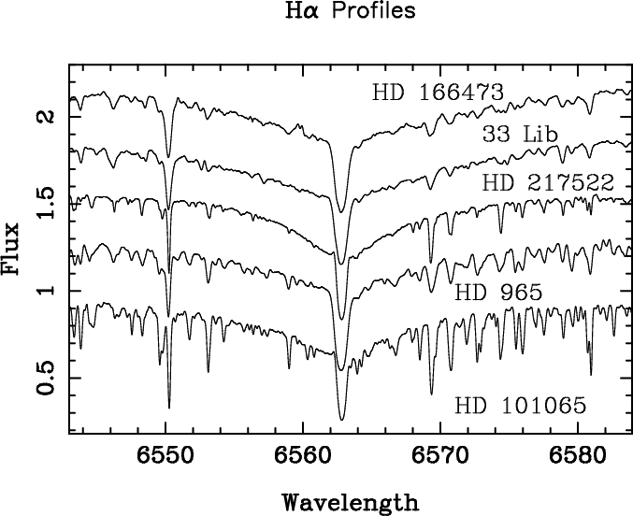
Anomalies in Ap SrCrEu (CP2) stars
Rare earth element anomaly:
1.5 dex between III and II ionisation states
H core-wing anomaly
Cores give, e.g., T_{eff} ~ 6500 K
Wings give, e.g., T_{eff} ~ 7500 K
Ryabchikova et al., 2004,
A&A, 423, 705
Cowley et al. 2001, A&A, 367

Slide 8
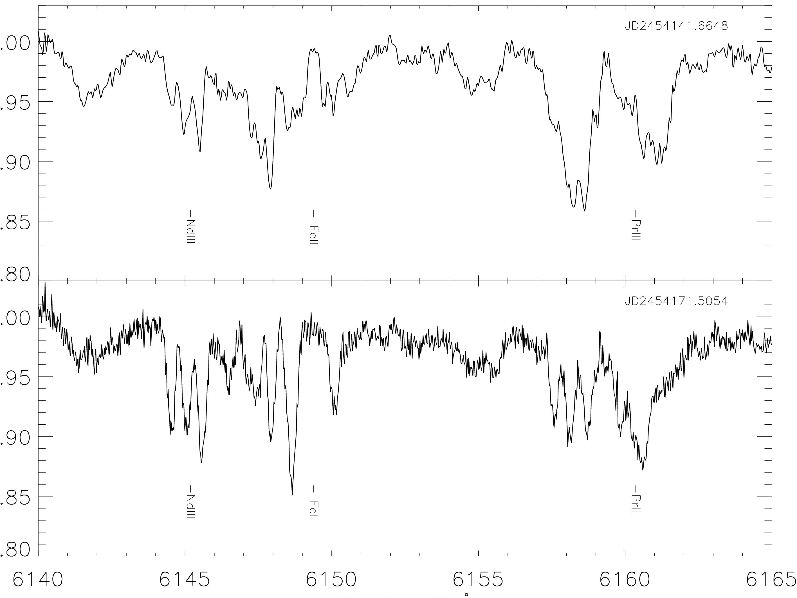
CP2 stars magnetic fields: HD75049 - 30 kG spectrum variability
1
1

Slide 9
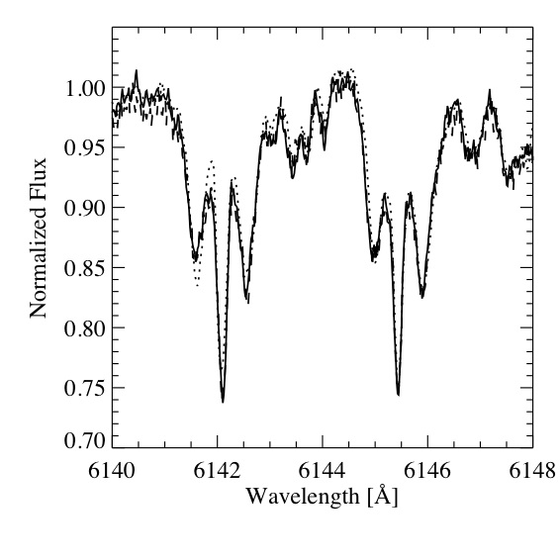
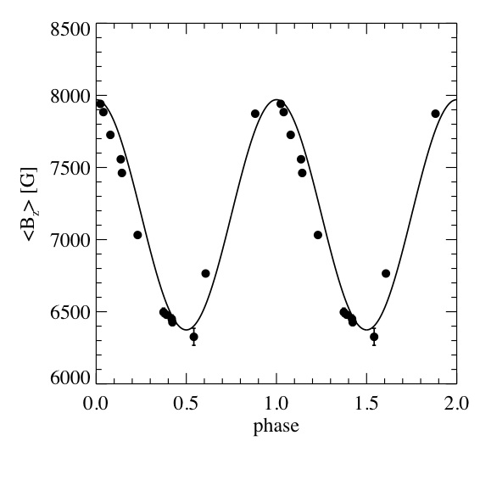
HD 154708 - 24.5 kG magnetic variability

Slide 10
KIC blah-blah-blah rotational variability - spots
P = 5.68459 d
Pulsation maximum
Kurtz et al., 2010, submitted

Slide 11
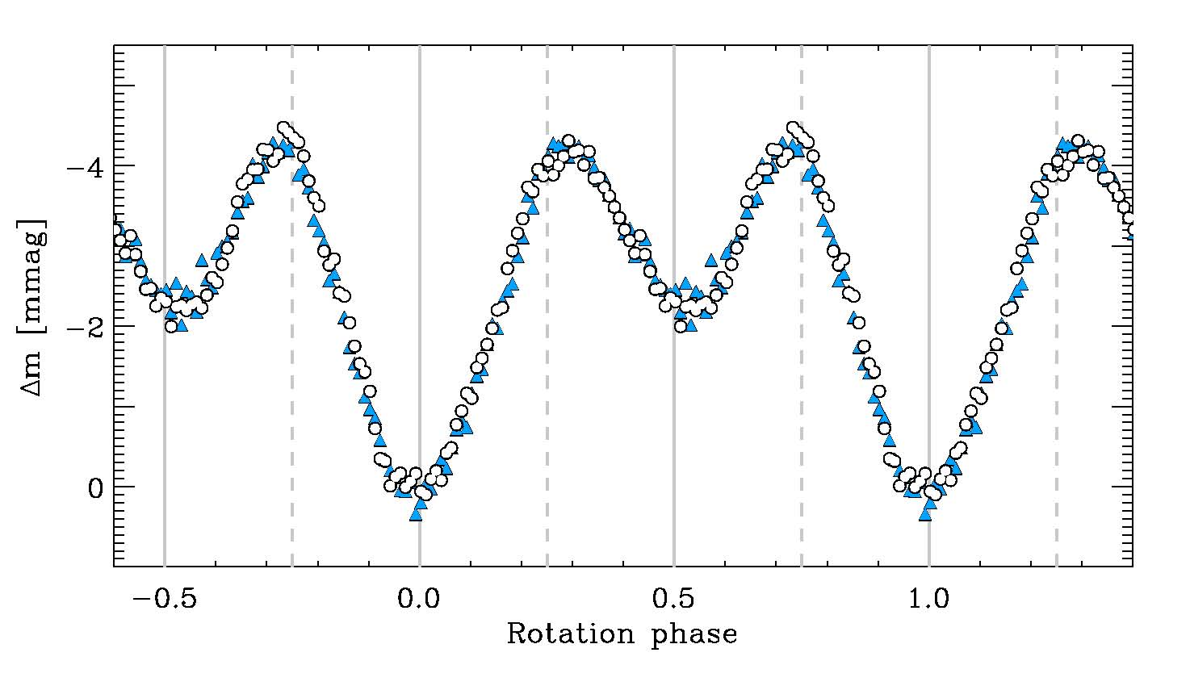
 Cir
Pulsation maximum
Bruntt et al., 2009, MNRAS, 396, 1189

Slide 12
 Cir - Photometric Doppler Map
pulsation pole
Igor Savanov; private communication

Slide 13
Oblique rotation
Magnetic axis
Rotation axis

Slide 14
Doppler imaging of HD 99563 NdIII spots VLT UVES + Subaru HDS
Freyhammer et al., 2009,
MNRAS , 396, 325
P = 2.91179 d

Slide 15
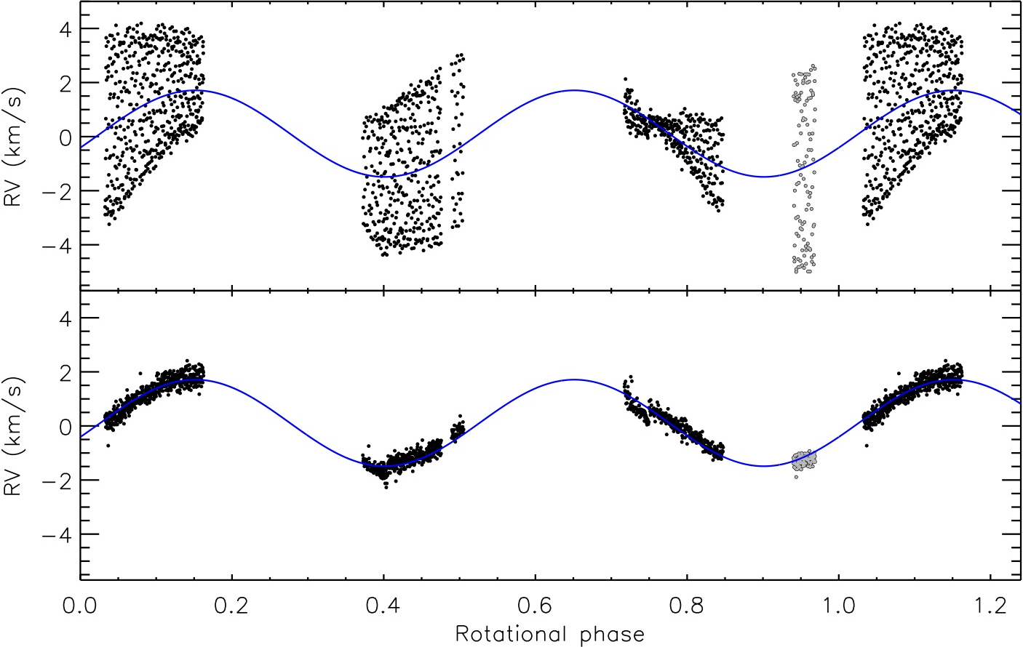
Hydrogen RV variability
P = 2.91179 d

Slide 16
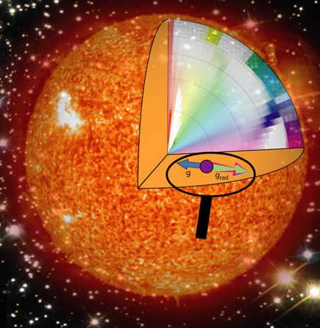
Atomic diffusion

Slide 17
Solar abundances
Grevesse et al., 2010, Ap & Sp. Sci., 328, 179

Slide 18
Problem 1
The solar abundance of U is:
log N_{H} = 12.00
log N_{He} = 10.93
log N_{U} = -0.54 (from meteorites)
If the Sun were completely stratified by gravitational settling, what would the radius of the central U sphere be?
Solar abundances:
Grevesse et al., 2010, Ap & Sp. Sci., 328, 179
IAC WS 2010 – Lecture 1
11/25/10

Slide 19
Problem 1
X = 0.75; i.e. 75% of the atoms in the Sun are H
M = 2 x 10³⁰ kg
N_{H} = 0.75 x 2 x 10³⁰ kg/1.67 x 10⁻²⁷ kg =9 x 10⁵⁶ atoms
N_{U} = N_{H} x 2.9 x 10⁻¹³ =2.6 x 10⁴⁴ atoms
m_{U238} = 238 m_{H} x 2.6 x 10⁴⁴ atoms = 1 x 10²⁰ kg
Density of the core of the Sun is 155 g/cm³
R = 54 km
IAC WS 2010 – Lecture 1
11/25/10

Slide 20
Problem 2
Jupiter has an infrared luminosity of L = 4 x 10¹⁷ W
This is powered by gravitational settling of He
If this were simply overall gravitational contraction of Jupiter, what would be dR/dt in mm/yr?
IAC WS 2010 – Lecture 1
11/25/10

Slide 21
Problem 2
IAC WS 2010 – Lecture 1
11/25/10

Slide 22
Problem 2
Gravitational settling, particularly of He:
Releases energy that must be included in models
Changes μ, the mean molecular weight
IAC WS 2010 – Lecture 1
11/25/10

Slide 23
Problem 2
What about the Sun if it were powered by gravitational potential energy?
IAC WS 2010 – Lecture 1
11/25/10

Slide 24
Sun and cluster ages
He settling is included in the Standard Solar Model
He settling reduces ages for clusters determined from isochrones
ε(3α) ~ T³⁰
Globular cluster ages come down by 1-2 Gyr
Chaboyer et al., 1996, Science, 271, 957-961
IAC WS 2010 – Lecture 1
11/25/10

Slide 25
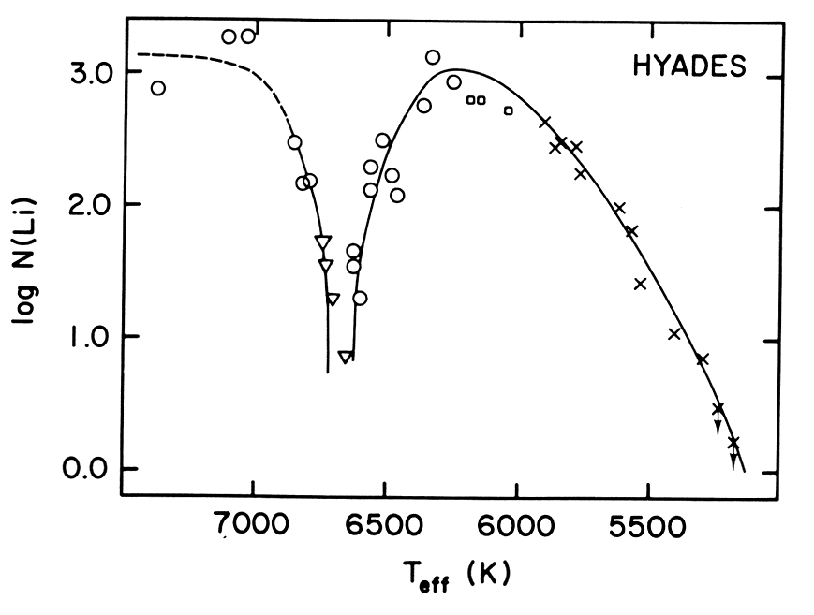
The Li gap
Li fuses at 2 – 2.4 MK
Convection drags Li down to layers where is is destroyed in cool stars
Gravitational was thought to explain the Li gap in F stars
Boesgaard et al., 1986, ApJ,
302, L49-L53.
Baumann et al., 2010, A&A, 519, 87:
Is there a connection between Li depletion and planets?
IAC WS 2010 – Lecture 1
11/25/10

Slide 26
White dwarfs
White dwarfs are stratified
Some of this is the result of core and then shell burning
In the strong gravitational field of white dwarfs settling and stratification are quick
Typically:
C-O core
He layer
H layer
Studies of g modes in white dwarfs measure the atmospheric layer masses
IAC WS 2010 – Lecture 1
PG1159: Costa et al., 2008, …
11/25/10

Slide 27
White dwarf taxonomy
McCook & Sion, 1999, ApJS, 121, 1- 130

Slide 28
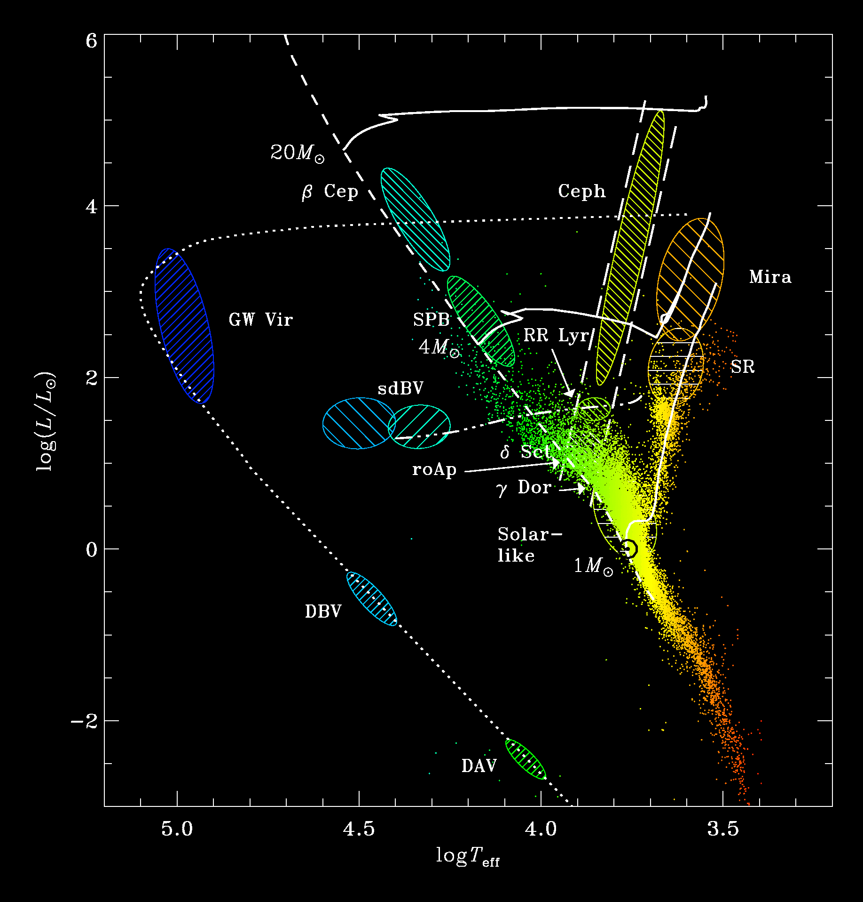
The DB gap
Thin H layer
Competition between convection and gravitational settling
see Kurtz et al., 2008, MNRAS, 389, 1771
IAC WS 2010 – Lecture 1
11/25/10

Slide 29
Ap stars: Stratification – radiative levitation
log ₅₀₀₀
Pr, Nd and other lanthanides
5
4
3
2
1
0
H
Fe

Slide 30
Stratification
The accumulation of Fe by radiative levitation provides increased opacity in layers of some stars
The explains the driving mechanism for
sdBV stars

Slide 31
He³/He⁴ in moon rocks
The He³/He⁴ ratio in moon rocks is higher than in the Sun
He³ is preferentially driven of the Sun the solar wind compared to He⁴
This is a consequence of abundance and opacity:
The typical He³ gets to see more photons than the more abundant isotope He⁴
This explain the abundance anomlaies and isotope ratios of the HgMn stars
CP3; nonmagnetic; late B stars

Slide 32
Atomic diffusion in the CP stars accounts for or is consistent with:
Overabundances of the Fe-peak and rare earth elements
Underabundances of Ca, Sc, C, He in Am stars
Noble gas electronic configuration
Ages of Cp stars
Anomalies disappear in red giants with Cp precursors
Slow rotation in Am and Ap stars
Binary fraction of Am stars
Magnetic braking in Ap stars
Spots in Ap stars

Slide 33
Atomic diffusion in the CP stars accounts for:
Stratification of Ap stars atmospheres
Pulsation – peculiarity relationship:
Ap stars may be roAp (high radial overtone), but not δ Sct (low radial overtone) pulsators
It was previously thought that an exclusion existed between Am and δ Sct stars
It is now known that Am stars do not pulsate with high amplitudes, but are low amplitude δ Sct stars in many cases
There may be a high incidence of δ Sct – γ Dor hybrids among Am stars
Grigacene et al. 2010,
ApJ, 713, 192

Slide 34
Przybylski’s star – a most peculiar star
HD 101065: B5 star in the HD catalogue
Przybylski (1961) discovered it not to be a B star
He found the strongest lines are of:
Ho II, Dy II, Sm II and Nd II
He thought:
continuum spectral type = K0
H line spectral type = F8 or G0
Wolff & Hagen discovered a – 2200 G global magnetic field
Przybylski A. 1961, Nature, 189,739
Wolff S.C., Hagen W. 1976, PASP, 88, 119

Slide 35
1978
Gary Wegner and I thought that HD101065 is an Ap star
Everone knew that the strong, global magnetic fields of Ap stars should stabalize them against δ Sct pulsation
I had a look with the SAAO 0.5-m telescope using differential photometry and found the star to be constant to less than 3 mmag rms

Slide 36
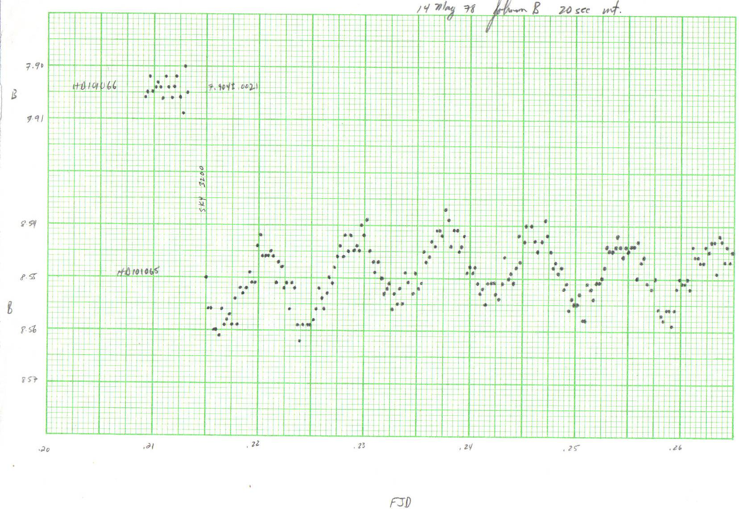
The discovery of the rapidly oscillating Ap stars
12 minutes

Slide 37
HR 3831
This is the third roAp star discovered
Let’s look at some multi-site data obtained over a time span of 17 days
Find the three highest amplitude frequencies in this data set and determine their pattern
Data set = 2448303-2448320bzl40
The bzl40 means:
b means Johnson B filter
z means zero in the mean
l means high pass filter (low frequencies removed)
40 means 40-s integrations

Slide 38
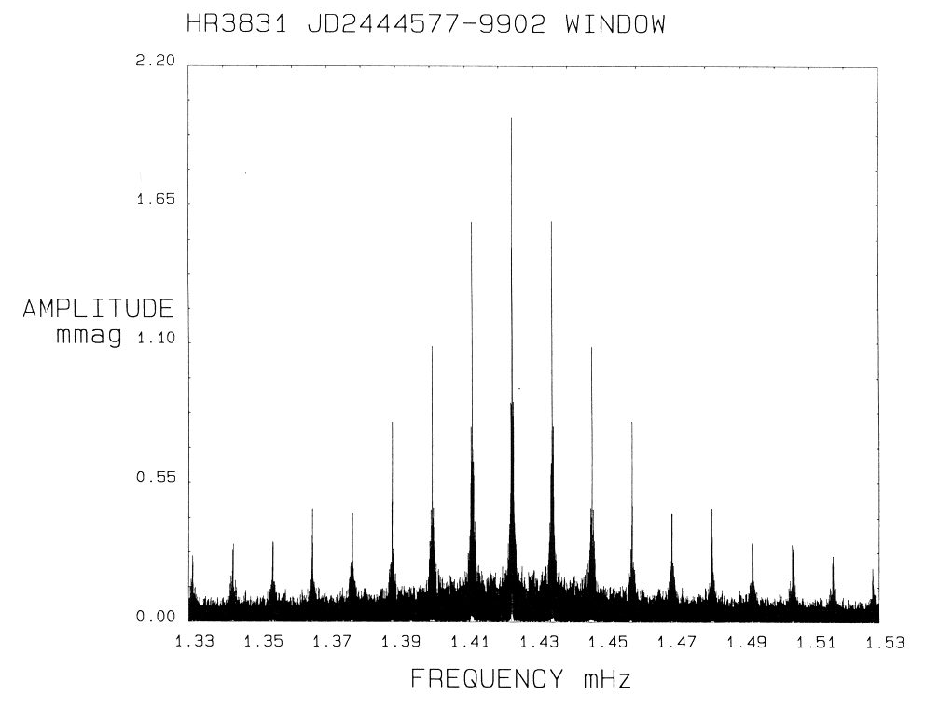
HR 3831

Slide 39
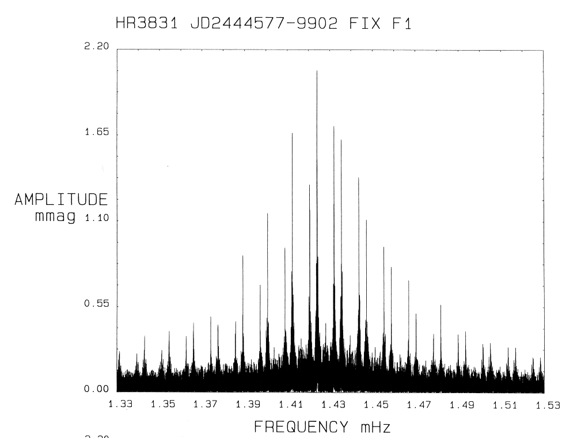
HR 3831

Slide 40
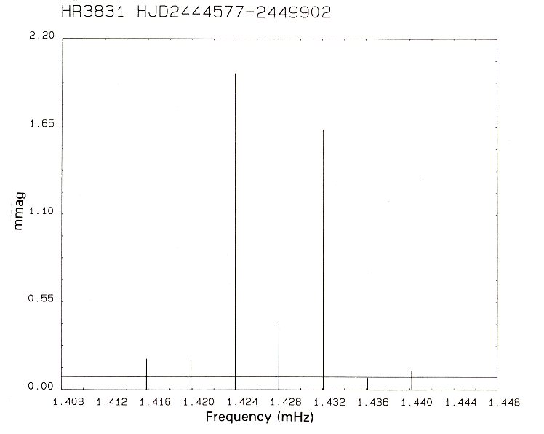
HR 3831

Slide 41
HR 3831
id frequency amplitude phase
μHz mmag radians
The fundamental septuplet
ν – 3ν_{rot} 1415.834274 0.194 ± 0.009 –0.009 ± 0.044
ν – 2ν_{rot} 1419.892539 0.180 ± 0.009 –1.436 ± 0.048
ν – ν_{rot} 1423.950803 1.985 ± 0.009 –0.370 ± 0.004
ν 1428.009068 0.420 ± 0.009 –2.317 ± 0.021
ν + ν_{rot} 1432.067332 1.635 ± 0.009 –0.370 ± 0.005
ν + 2ν_{rot} 1436.125597 0.075 ± 0.009 +2.443 ± 0.115
ν + 3ν_{rot} 1440.183861 0.121 ± 0.009 +0.387 ± 0.071
Kurtz et al., 1997, MNRAS, 287, 69

Slide 42
HR 3831
The seven frequencies of the low frequency septuplet are split by a frequency very close to the rotation frequency
Why not interpret them as rotational split m modes?
l = 3; m = -3, -2, -1, 0, +1, +2, +3

Slide 43
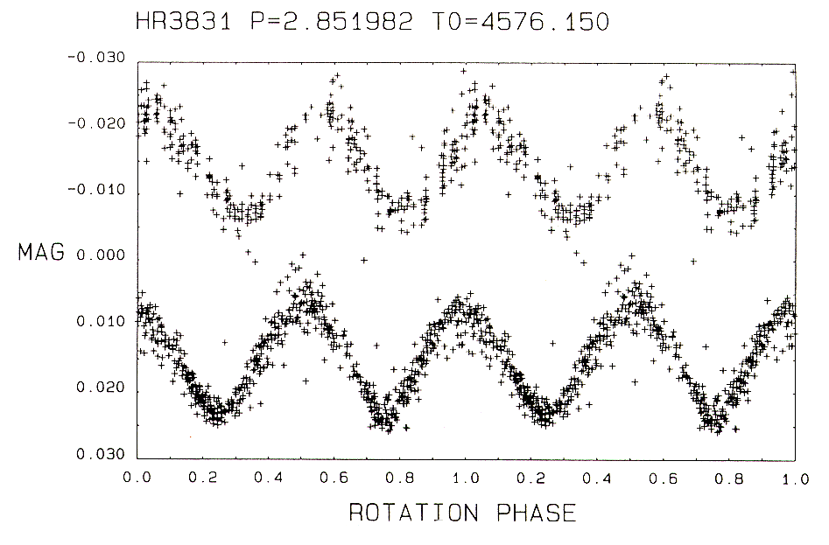
HR 3831

Slide 44
HR 3831
The rotational period of HR 3831 is known from the mean light variations
ν_{rot} = 4058.256 ± 0.007 nHz
Using the splitting from the frequency analysis and
C_{nl} < 6 x 10⁻⁶ at 3σ confidence
Thoeretically Cnl > 10⁻³
Pulsation maximum coincides with magnetic maximum

Slide 45
This is not a rotationally split multiplet

