Slide 1
Formation and evolution of coronal rain observed by SDO/AIA on February 22, 2012
Zurab Vashalomidze (1)
In collaboration with
T.V. Zaqarashvili (2,1,3), V.Kukhianidze(1), R. Oliver (4), B. Shergelashvili(3,1,5), G. Ramishvili(1), S. Poedts (5), P. De Causmaecker (5)
1. Abastumani Astrophysical Observatory at Ilia State University, Georgia
2. University of Graz, Austria
3. Space Research Institute, Austria
4. Univers tat de les Illes Baléares, Spain
5. KU Leuven, Belgium
Astronomy and Astrophysics, 577, A136, 2015

Slide 2
Formation and Dynamics of Coronal Rain
Observations off limb prominences and active regions often show dense blobs descending with an acceleration smaller than free fall (Schrijver, 2001, De Groof et al. 2004, 2005, Antolin et al. 2010).
Coronal rain is probably connected to coronal heating and plasma condensation, therefore it is important to answer two major questions:
1. How does the coronal rain form?
2. Why is its acceleration less than gravitational free fall?

Slide 3
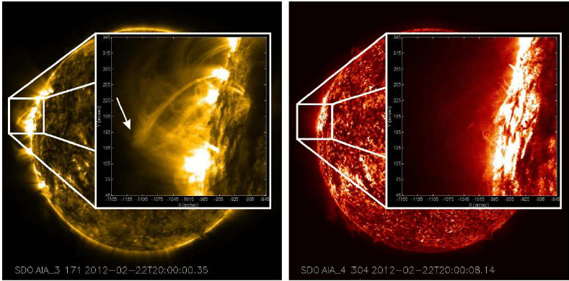
Coronal rain was observed in the 171 Å and 304 Å line above active region AR 11420 on 22nd February 2012. Event started at 19:16 UT and lasted until 24:00 UT .
(Vashalomidze at al. 2015)

Slide 4
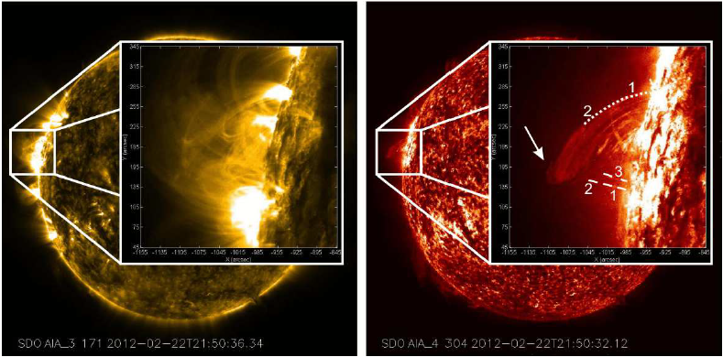
However, during the next 1-2 hours the loop has permanently disappeared in 171 Å and appeared in the 304 Å line.
It is evident that the loop has cooled down from ∼ 10^{5.8} to ∼ 10^{4.7} K.
(Vashalomidze at al. 2015)

Slide 5
Coronal Rain in 171 Å wavelength.
After 1 ∼ 2 hour Coronal Rain in 304 Å wavelength.
(Vashalomidze at al. 2015)

Slide 6
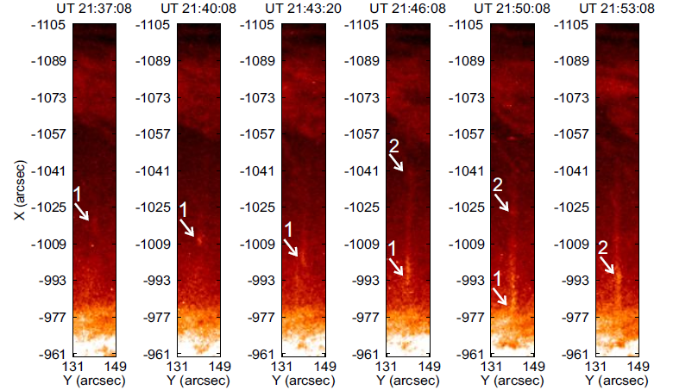
When the coronal loop cools down, bright blobs start to form below the loop visible in the 304 Å line. The first blob of the first sequence appears at UT 21:37 at a height of ∼ 4×10⁴ km.
(Vashalomidze at al. 2015)

Slide 7
First set of blobs
The First blob at its first appearance is ∼ 1400 km wide and ∼ 3600 km length, respectively. It reached the surface in ∼ 13 min with a mean speed of ∼ 50 km s⁻¹.
The second blob appeared at UT 21:50 at a height of ∼ 6×10⁴ km. It follows the same path as the first blob and reached the surface in ∼ 16 min with a mean speed of ∼ 60 km s⁻¹
The third blob reached the surface in ∼ 12 min with a mean speed of ∼ 40 km s⁻¹ but moves along a different path.
Second set of blobs
The first blob appeared at UT 21:41 at aheight of ∼ 9.5×10⁴ km. It reached the surface in ∼ 15 min with a mean speed of ∼ 100 km s⁻¹.
The blob follows the same trajectory as the first blob and reached the surface in ∼ 15 min with a mean speed of ∼ 90 km s⁻¹.

Slide 8
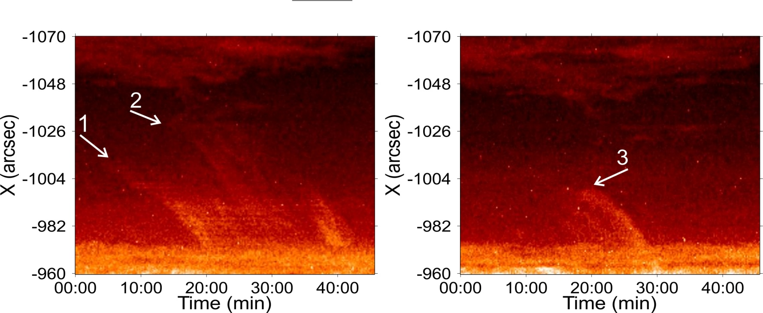
We made the x-t cuts (to calculate variation of height in time) during the time interval UT 21:30-22:15 in the 304 Å line. The width of each cut is 1 pixel equivalent to 0.6 arc sec (and situated at a given point of the limb).
Then we made plots of height vs time for the first and third blobs and we estimated velocity and acceleration.
(Vashalomidze at al. 2015)

Slide 9
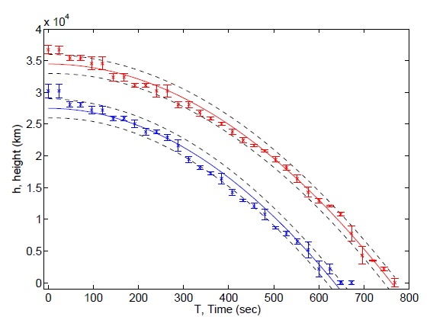
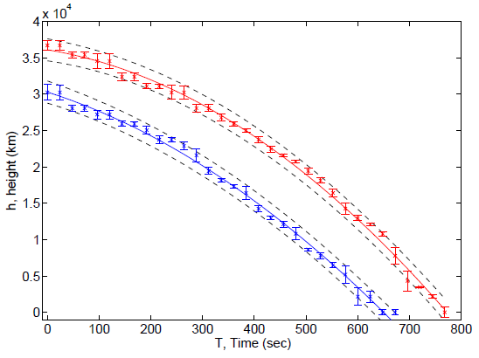
The results of these fittings show two cases: one with finite initial velocity and without it.
The estimated acceleration without initial velocity (V0 = 0) is 120 m s⁻² for the first blob and 136 m s⁻² for the second blob. On the other hand V0=12 km s⁻¹ and a=92 m s⁻² for the first blob and V0=22 km s⁻¹ and a=74 m s⁻² for the third blob.
(Vashalomidze at al. 2015)

Slide 10
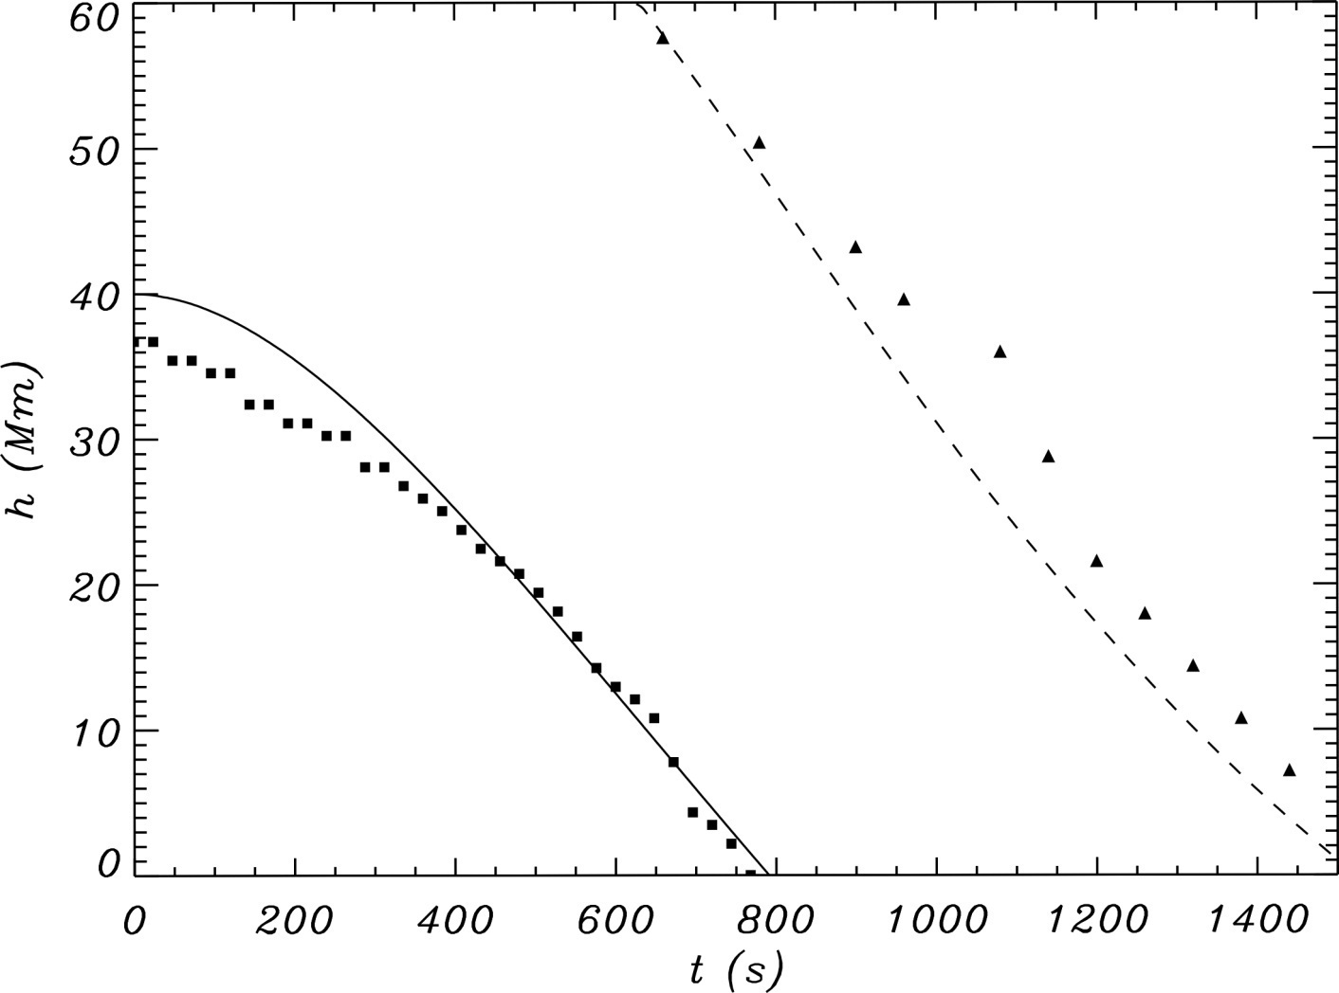
However, the acceleration of the second blob in the first set is almost zero. For understanding the different behavior of the two blobs falling along the same magnetic flux tube, we have done a few numerical simulations based on the work of Oliver et al. (2014).

Slide 11
It is clear that in this numerical simulation the second blob very rapidly achieves a roughly constant speed, as observed. This phenomenon can be explained as follows: the first drop in magnetic tube leads to the appearance of the pressure gradient, which is in opposite of gravity force, so the second drop moves with less acceleration.
We detected the rapid cooling of a coronal cloud from 1 MK to 0.05 MK on February 22, 2012. So we estimated the energy balance during the cooling.

Slide 12
For a typical loop electron number density of 10⁹ cm⁻³ and a radiative loss function corresponding to 1 MK (Rosner et al. 1978), the radiative loss rate is (Aschwanden 2004).
The conductive flux for the loop half-length of 110 Mm is
Estimated heating function for this loop is (Rosner et al. 1978)
Thus, the energy balance is violated as the radiative losses overcome the heat input. Consequently this may lead to a ”catastrophic cooling” process.

Slide 13
Conclusion
Time-series of the 171 Å and 304 Å spectral lines obtained by AIA/SDO show the rapid cooling of a coronal loop from 1 MK to 0.05 MK over one hour.
The cooling was accompanied by the appearance of coronal rain in the 304 Å line.
An energy estimation showed that catastrophic cooling is responsible for the formation of the coronal rain.

Slide 14
Thank you for your attention

