Slide 1
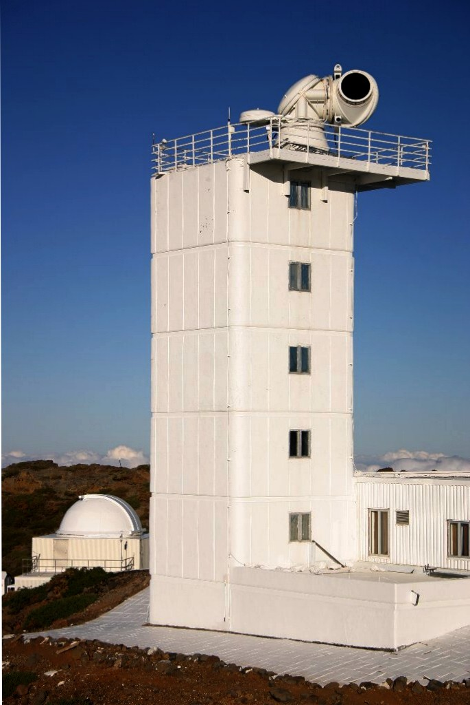
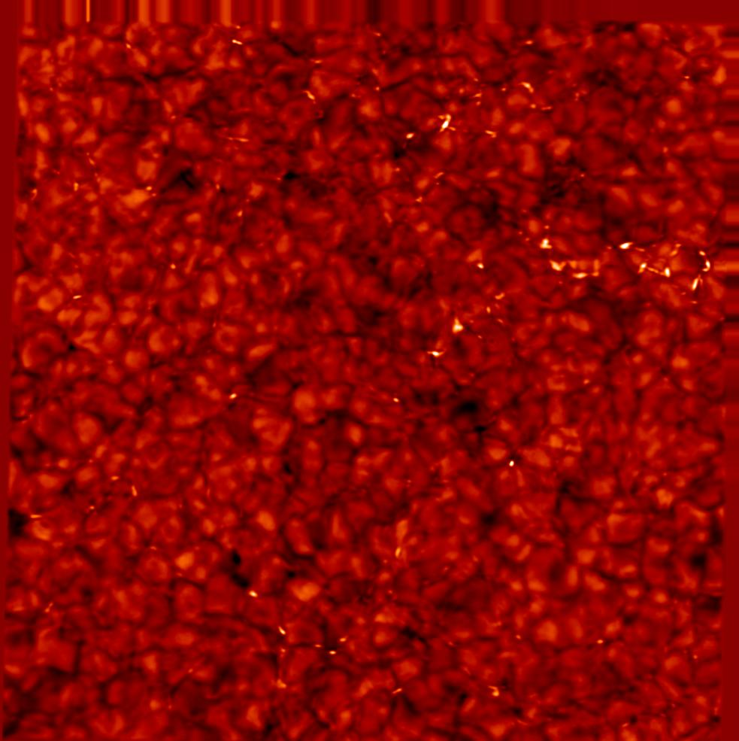
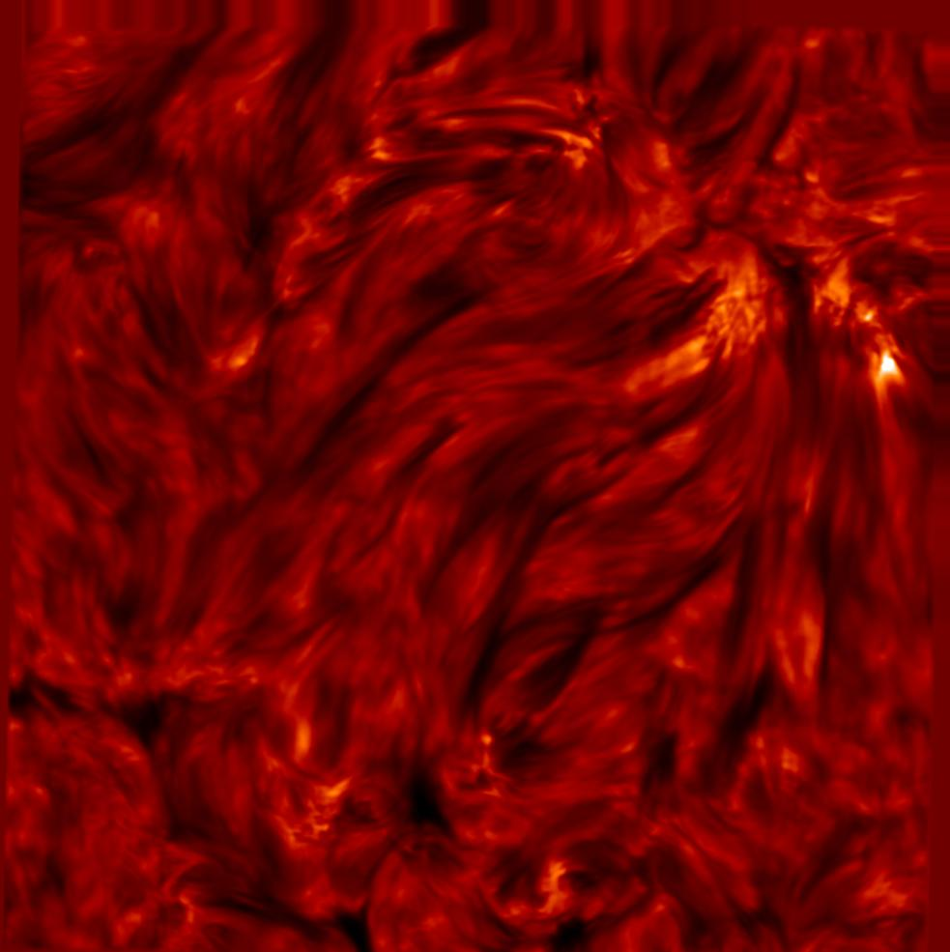
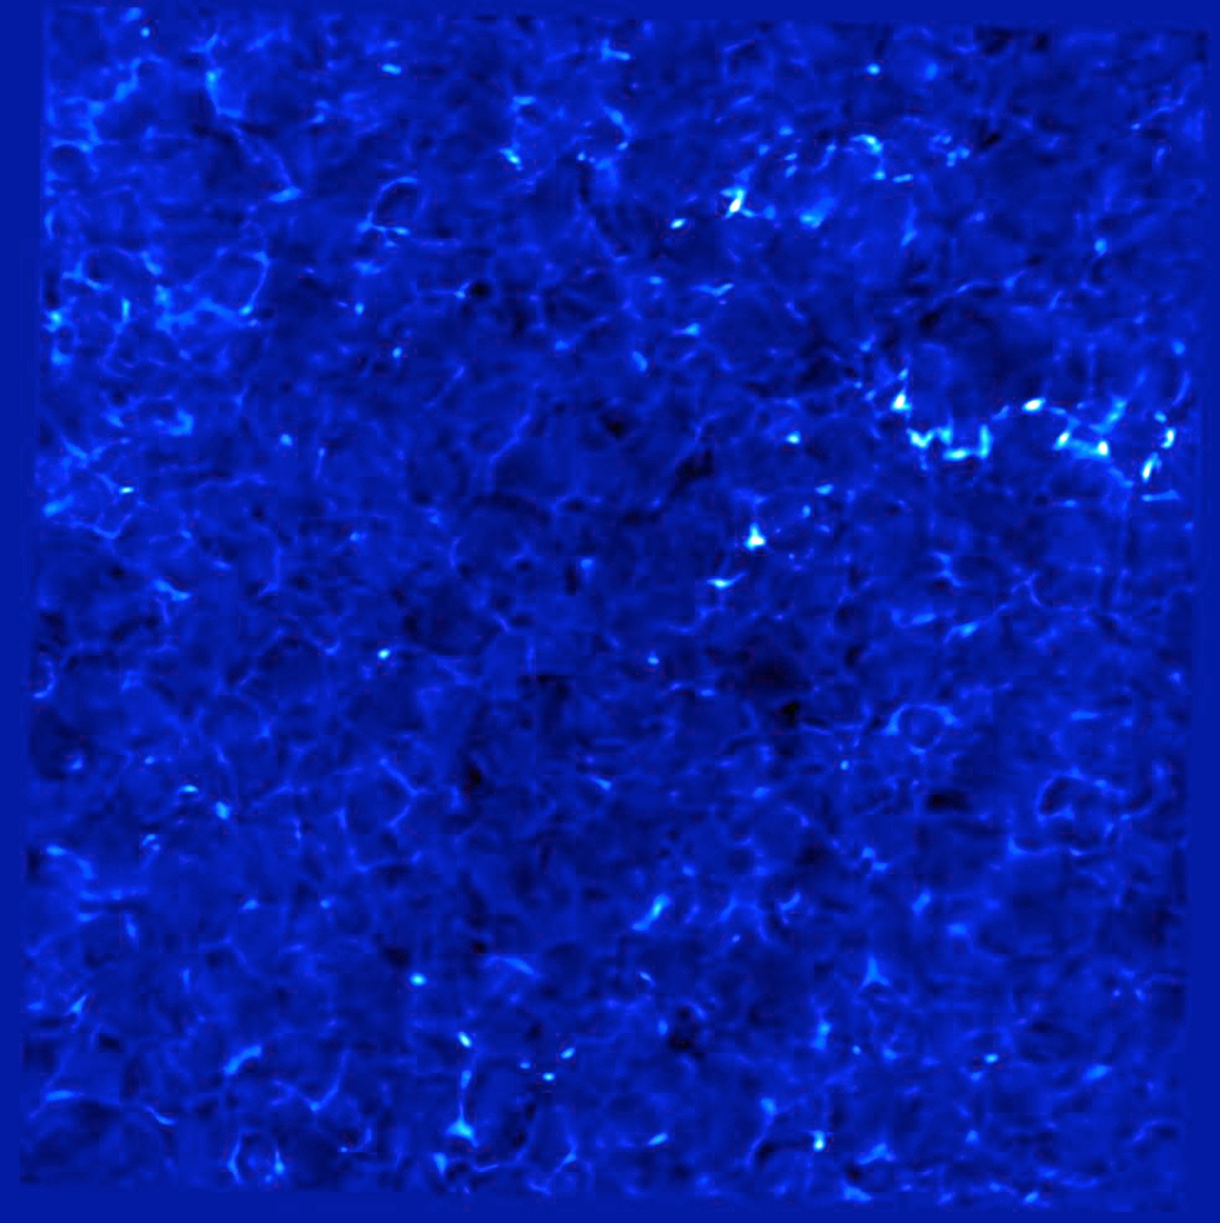
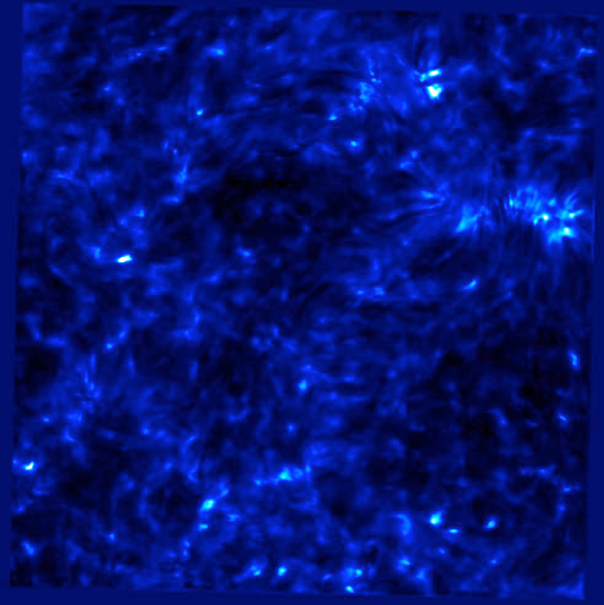
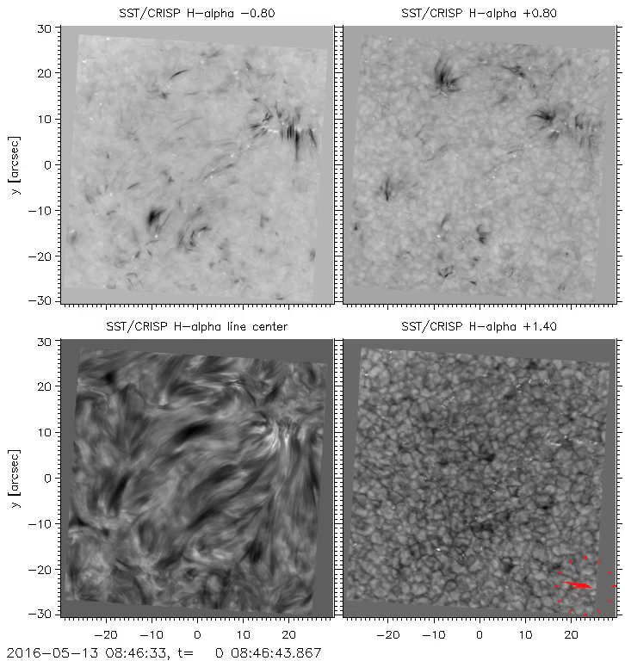
Dynamics of the lower solar chromosphere using CRISP-SST data Arnold Hanslmeier(1), Teimuraz Zaqarashvili (1), Julius Koza (2), Jan Rybak (2) (1) Institut für Physik, Univ.-Platz 5 8010 Graz Austria (2) Astronomical Institute Slovak Academy of SciencesP. O. Box 18059 60 Tatranská Lomnica
Motivation:
study dynamics of the higher photosphere to lower chromosphere;
propagation of oscillations,
turbulence, waves
First analysis: calculation of correlation of parameteres.
Convective energy transport: mainly determined by the correlation <Intensity, velocity>
Turbulence: as a proxy full width at half maximum
Instrument:
Swedish SST at La Palma
1-m refractor
Imaging mode: dichroic beamspliter: red and blue
beam
In the red beam there is a tunable filter called CRSIP
Imaging spectro polarimeter. (510 to 860 nm).
CRISP Instrument
Ca II: Continuum Line center
H-Alpha: Continuum line center
Observations:
May 13, 2016
Time series,
Timestep between images: 12.39 s
Resolution: 0.057 arcsec/px
Total field: 56 x 56 arcsec
Observed wavelengths:
H-Alpha 656.3 nm
IR Ca II 854.2 nm
In total: a time series consisting of 150 mages was analyzed.
This corresponds to a duration of 31 min
Parameters analyzed:
vc Doppleshift of the centroid of the line core
ir residual intensity, line profile minimum intensity
ic proxy of continuum intensity (wing intensity)
fw line width defined as the wavelength separation of the two line flanks at half intensity
Maximum of contribution function:
H-Alpha: 1.6 Mm
Ca II: 1.4 Mm
Results:
Correlation oscillates
Correlation highest for vc
Correlation about 0.5 for fw
Correlation about 0.3 for ir
Small correlation for ic, strong oscillation.
Corr between vc and Ic higher for H-Alpha
Acknowledgement: The observations were taken within
The SolarNET transnational access and
Service program. A.H. and T.Z. thank the Austrian FWF for supporting.
Correlation analysis
(a) Correlation between H-Alpha and Ca Images as
function of time.
Corr between reisdual intensities, continuuum intensities, line center
velocities and full width at half maximum values.
(b) Corr between residual intensity and line center velocity for
H -Alpha
Ca line
Literature:
"SST CRISP images". SST website. Institute for Solar Physics. Retrieved 28 May 2011
Scharmer, G. B. (March 2006). "Comments on the optimization of high resolution Fabry-Pérot filtergraphs".
Astronomy and Astrophysics. 447 (3): 1111–1120.
Scharmer, G. B.; Narayan, G.; Hillberg, T.; de la Cruz Rodriguez, J.; Löfdahl, M. G.; Kiselman, D.;
Sütterlin, P.; van Noort, M.; Lagg, A. (December 2008). "CRISP Spectropolarimetric Imaging of Penumbral
Fine Structure". The Astrophysical Journal. 689 (1): L69–L72.

