Slide 1
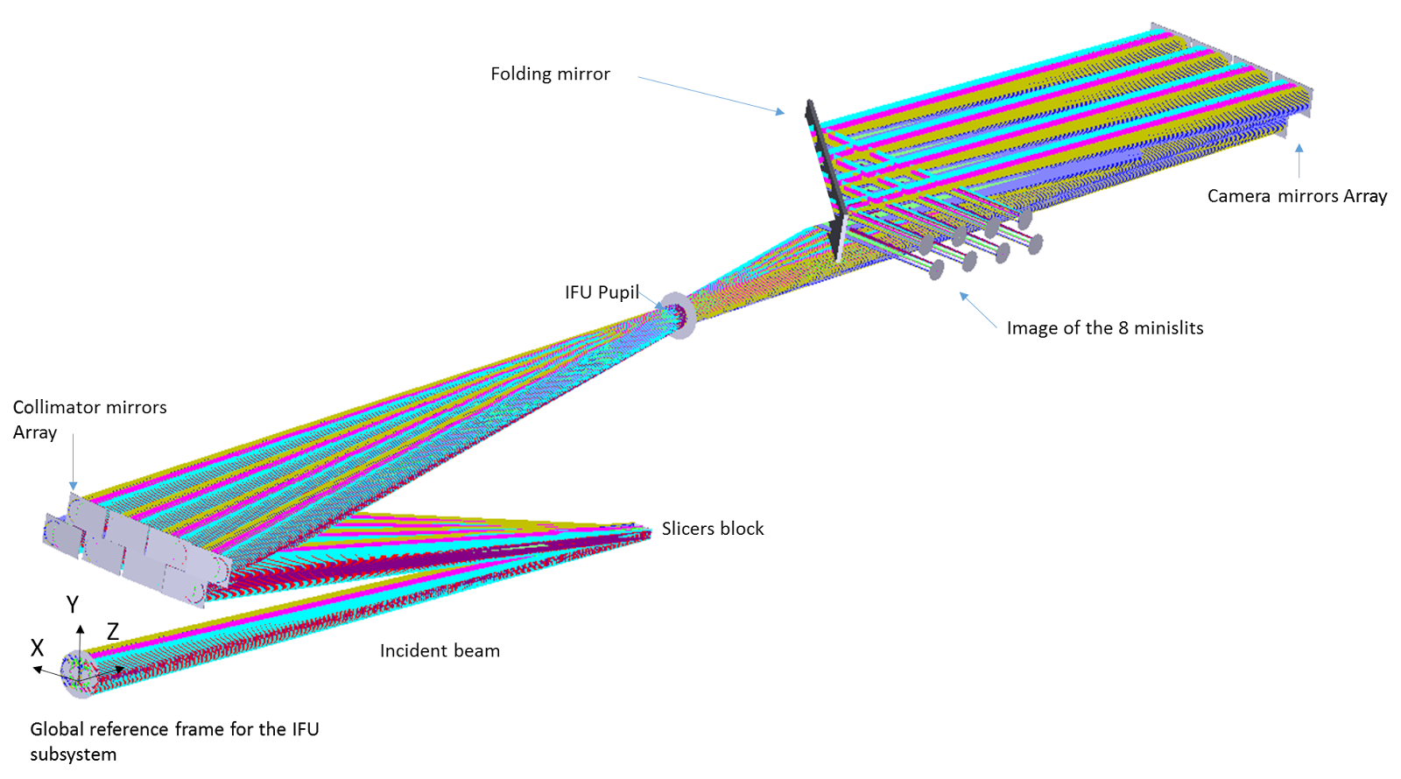
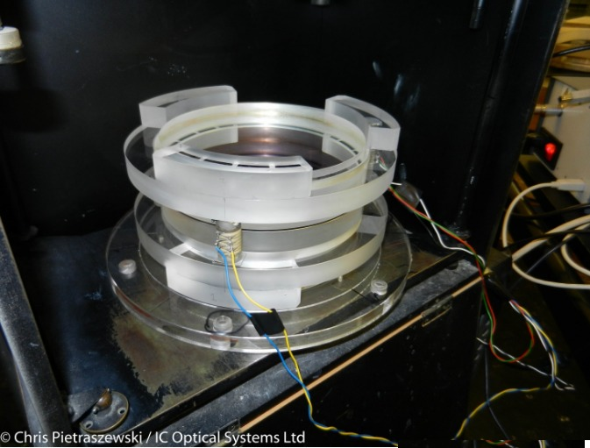
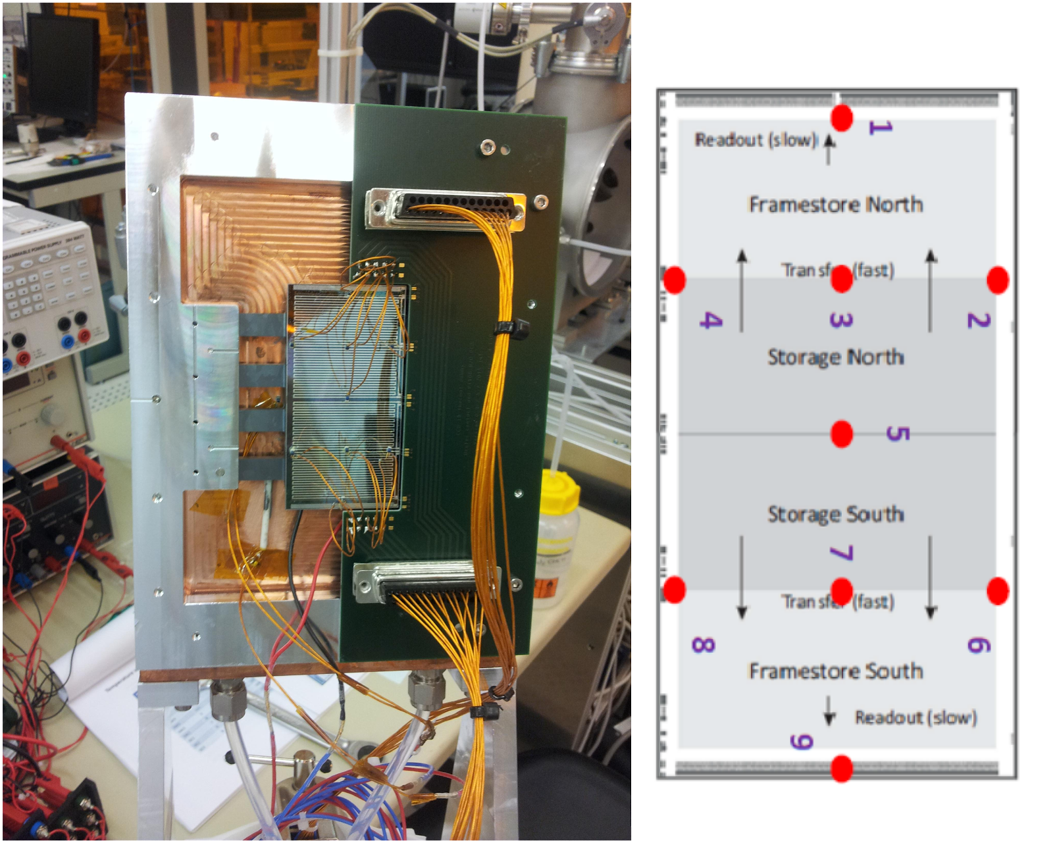
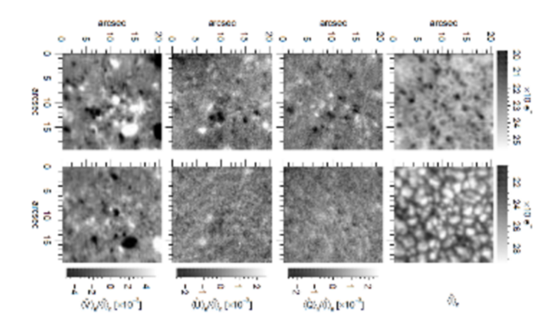
WP 60: Advanced Instrumentation Development
Lead Institution: IAC
Partiticipants: AIP, CNR-INO, INAF, IRSOL, KIS, MPG, PNS, UToV
60.1 Large Diameter Etalon Development
60.2 Image Slicer for 2D Spectroscopy
This sub-WP aims at building a large-format Fabry-Perot Interferometer (FPI) with minimal cavity defects. Capacity-controlled tunable FPIs are currently produced in the range of diameters of 50 to 150mm by IC Optical Systems Ltd (ICOS). Identifying and characterizing cavity defects is a critical step for this development. The large 150-mm etalon was commissioned at ICOS in March 2016. It is extremelly difficulty to put the two wedges into optical contact, having a diameter of over 150 mm. Indeed, the presence of even one small speck of dust or a single small air bubble invalidates the entire optical contact. The process was repeated several times, and each time the forced separation of the two surfaces produced damages requiring re-grinding and lapping process. It was necessary to work twice the surfaces constituting the optical cavity, for which a better flatness was required. In fact, after the optical contact of the two wedges, a hard AR coating at 633 nm was deposited on the outer surfaces of the cavity. However, the process of deposition of the hard coating has altered the flatness of the surfaces constituting the cavity to such an extent as to require a new lapping process of both. The following figure shows the status of the 150mm prototype at the time of writing this.
This sWP consists in the development of a prototype of Image Slicer optimized for the infrared spectrograph of GREGOR telescope. The image slicer would cover a 2D field-of-view of ~25 arcsec2 to produce a single slit 68 arcsec long by 0.37 arcsec wide. IAC and WINLIGHT will work together to define the best optical and mechanical design to produce narrow slices (of the order of 100 μm) and small collimator and camera mirrors (with a diameter of a few mm). The alignment of all these elements is crucial to produce a straight output long slit without aberrations. This sWP includes the following tasks:
• Optical and mechanical design of the Image Slicer Prototype according to the GREGOR telescope infrared spectrograph requirements and the manufacturing capabilities.
• Manufacturing and assembly of the Image Slicer Prototype.
• Tests at laboratory.
• Integration in the telescope spectrograph and
telescope tests.
The etalon seems to work properly. However, the electronics controller fails to control plate parallelism properly. This component needs to be upgraded. A new controller has been developed for the GREST project and will be tested with the 150mm etalon.
The slicer has been manufactured and integrated with the FoV scanner on an optical bench for the GRIS spectrograph. The system has been tested during an observing campaign at GREGOR. The tests were successful, although some manufacturing defects were detected in the slicer. This component will be sent back to the manufacturer (Winlight Optics) to correct them.
60.3 Microlens-fed Spectrograph
60.4 Fast Imaging Polarimeter
The microlens spectrograph is a 2D spectrograph, that detects the light of a small spectral region at a high spectral resolution in each spatial image element in an extended field of view. To avoid overlap, each image element is reduced in size, thus creating space in which to disperse.
The FSP project has been split into 2 development phases:
(1) FSP I evaluation model based on a single-beam modulator configuration and a small (264 x 264 pixels) pnCCD camera
(2) Science-ready FSP II instrument, based on a dual-beam modulator configuration and a larger (1024 x 1024 pixels) pnCCD camera.
FSP I: In May 2015, we have carried out an additional observing campaign with FSP I at the TESOS filtergraph of the German Vacuum Tower Telescope on Tenerife, Spain. In contrast to the earlier VTT test observations reported previously, which were focused on the camera performance, we have assessed, in this particular campaign, the performance of the FSP polarization modulator. The main goal was to carefully isolate potential artefacts introduced by the modulator from other spurious signals originating in different parts of the optical path including the telescope and the TESOS instrument. The insights from these tests have been crucial in preparation for the later FSP II dual-beam modulator configuration. An extensive description of FSP I incl. the modulator, and a presentation of the main results of these observing campaigns, have been published in Iglesias et al. 2016a and 2016b (see Figure below)
The very high alignment requirement of the microlens array motivated the decision to produce both microlenses on a single substrate, to ensure this alignment is maintained at all times. To manufacture the microlens array, we have worked on the specifications together with two leading research groups in the field of optical microstructures. The technologies most appropriate for the production of the optical surfaces were defined and some modifications to the design to accommodate those technologies were made. Both manufacturers were able to produce relatively equivalent offers, one of which, the Fraunhofer Institute for Applied Optics in Jena, was selected based on their experimental research oriented background. Three samples within specs were delivered in September 2015, one of which was fully finished, including the application of an anti-reflective coating. The two uncoated samples will be finished when their suitability for other wavelengths can be established, and a suitable coating has been identified.
To detect the image produced by the prototype, an image sensor is needed that combines a very large number of pixels (>16Mpixel), with a high frame rate of 100Hz, to satisfy the seeing freezing condition of the atmosphere. Unfortunately, this combination could not be found, but one high-quality sensor could be found that satisfies them at least approximately. The CMOSIS CMV20000 is a CMOS sensor with 20Mpixels, and a maximum frame rate of 30fps. A number of issues make this detector a non-optimal solution but it will allow to test the instrument.
The prototype has been built and tested and the laboratory. Telescope tests will be presented soon.
FSP II: The FSP II camera is developed in a collaborative effort involving the Max Planck Institute for Solar System Research (MPS) and the MPG semiconductor lab (german “Halbleiterlabor”, HLL). The FSP II camera manufacturing has proceeded without major technical problems. However, the delivery date has been pushed back to January 2017.
IV SOLARNET Meeting
Lanzarote, January 16-20, 2017
Notes:
<number>

