Slide 1


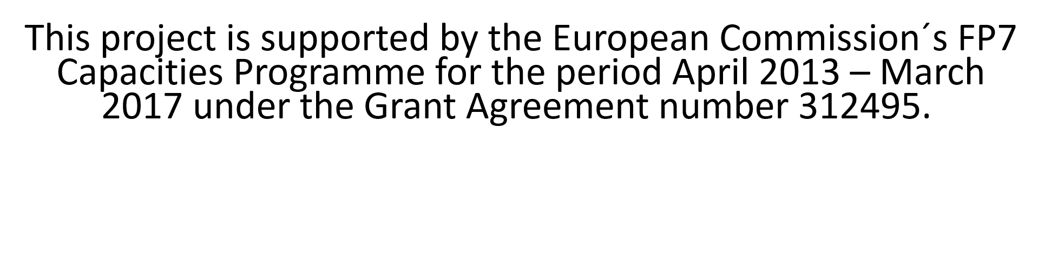





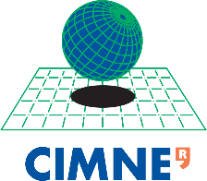





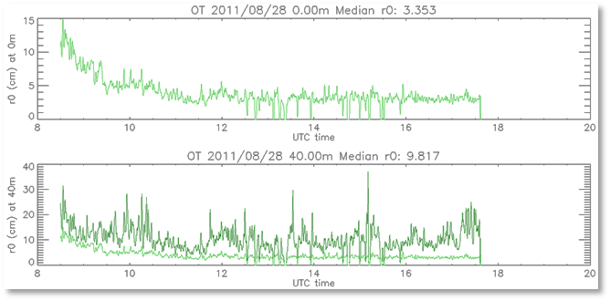
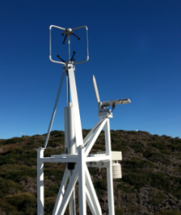
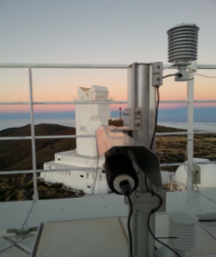
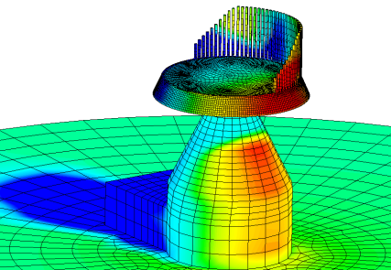
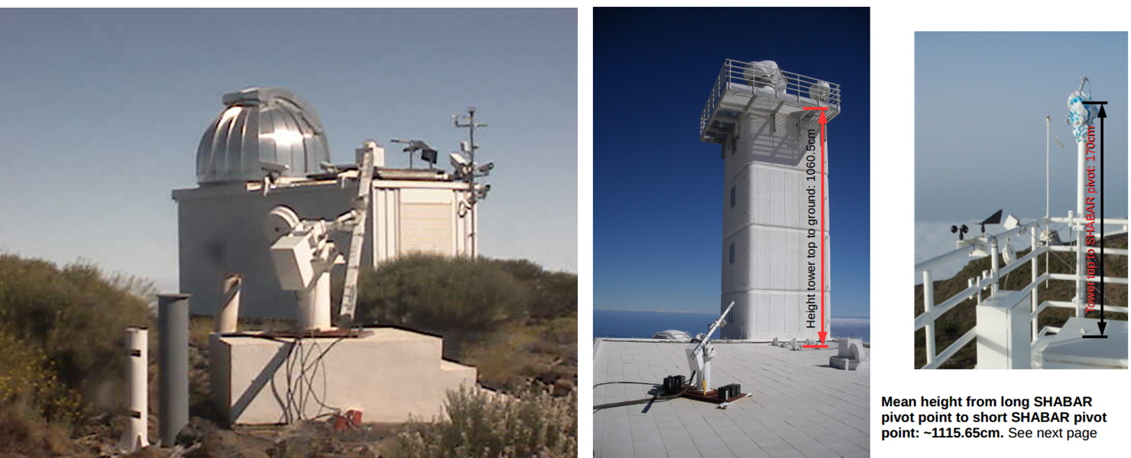
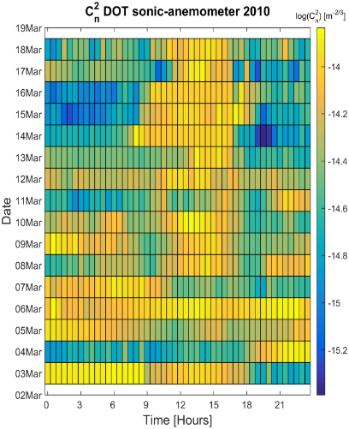
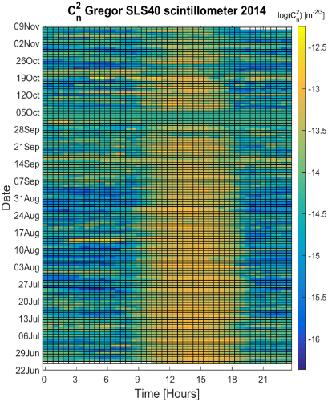
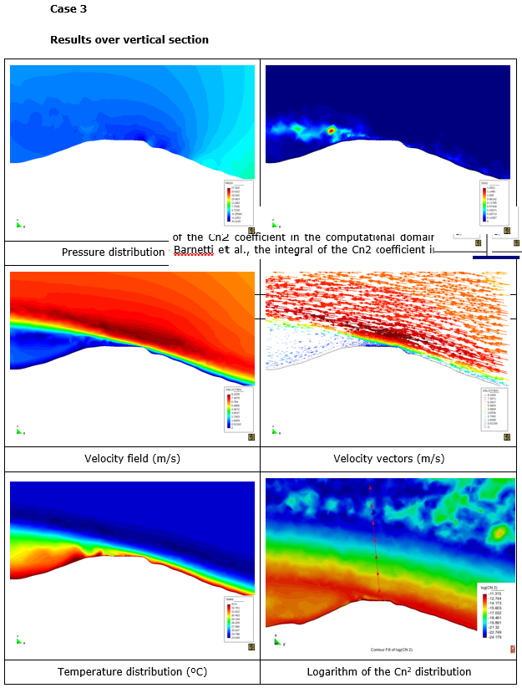
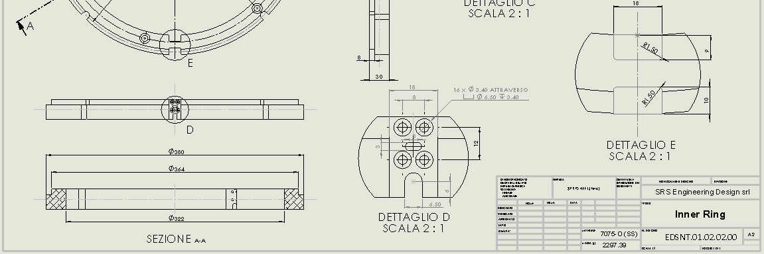
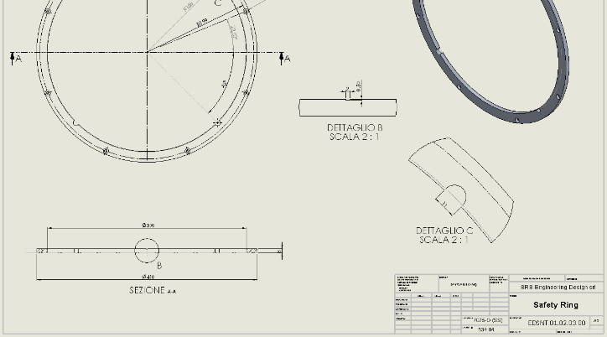
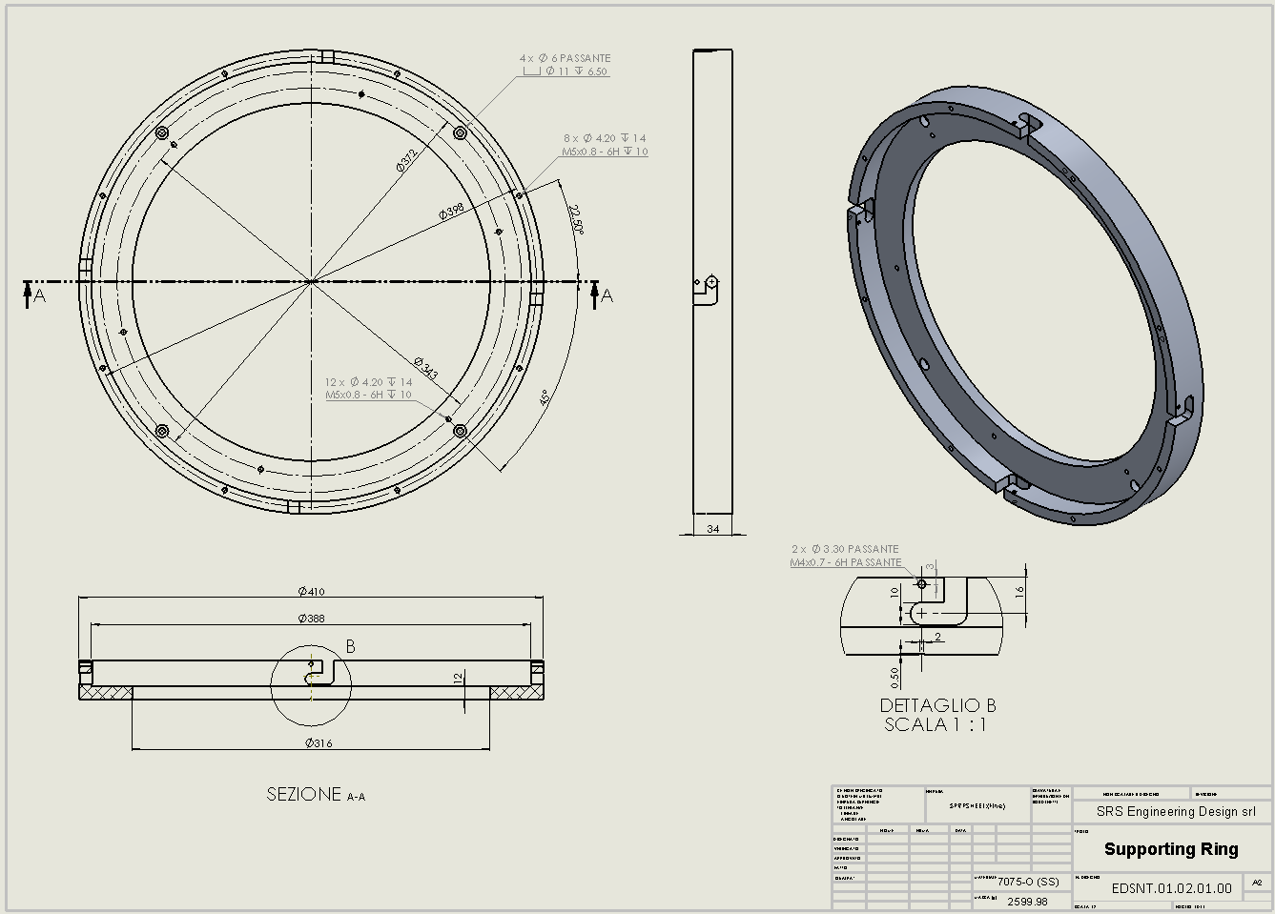
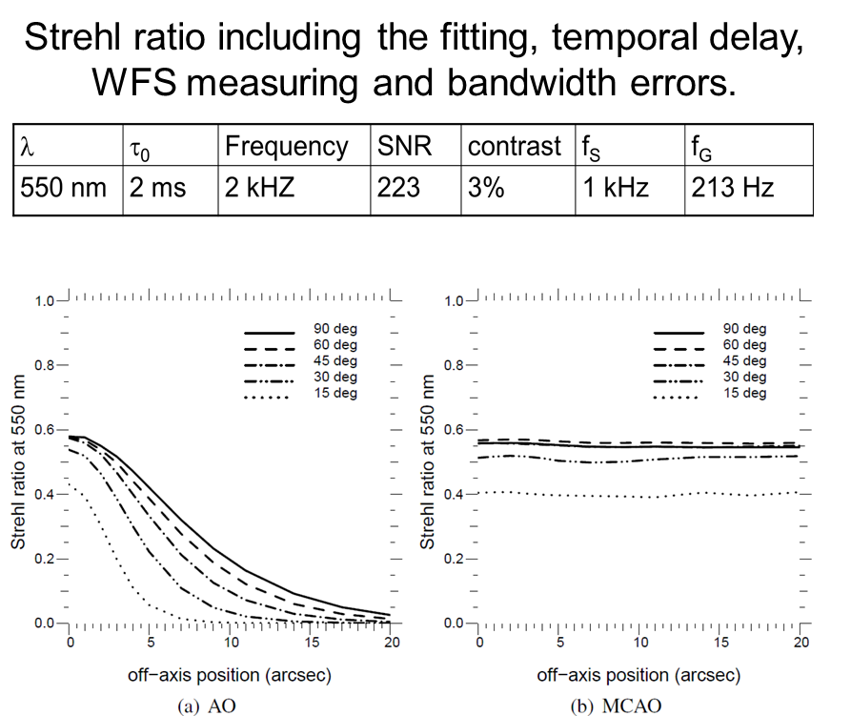
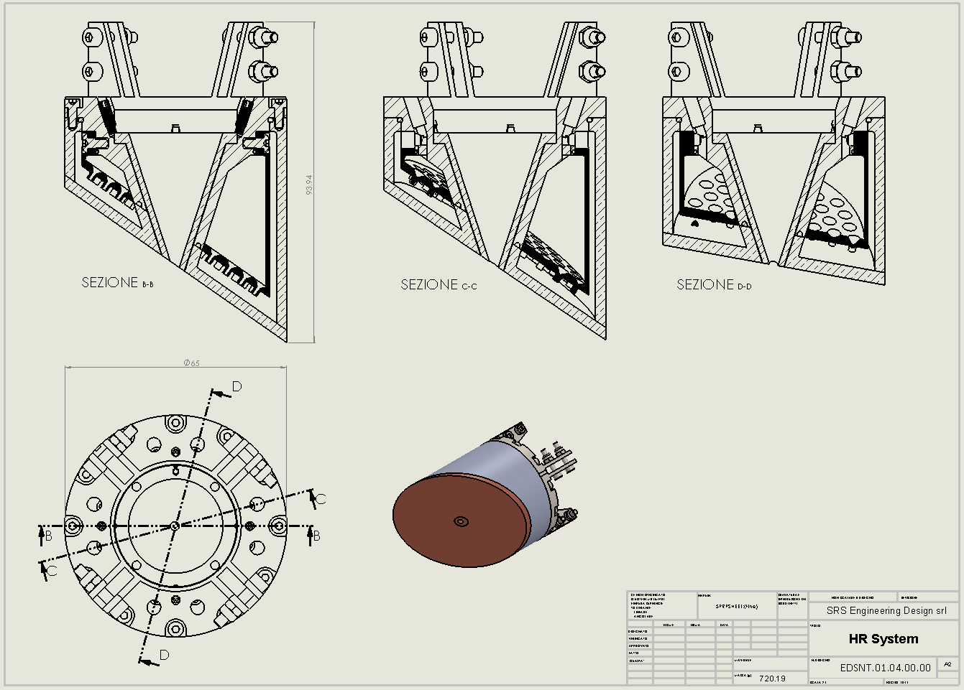
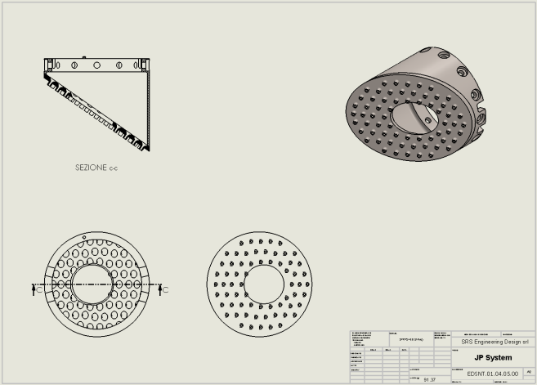
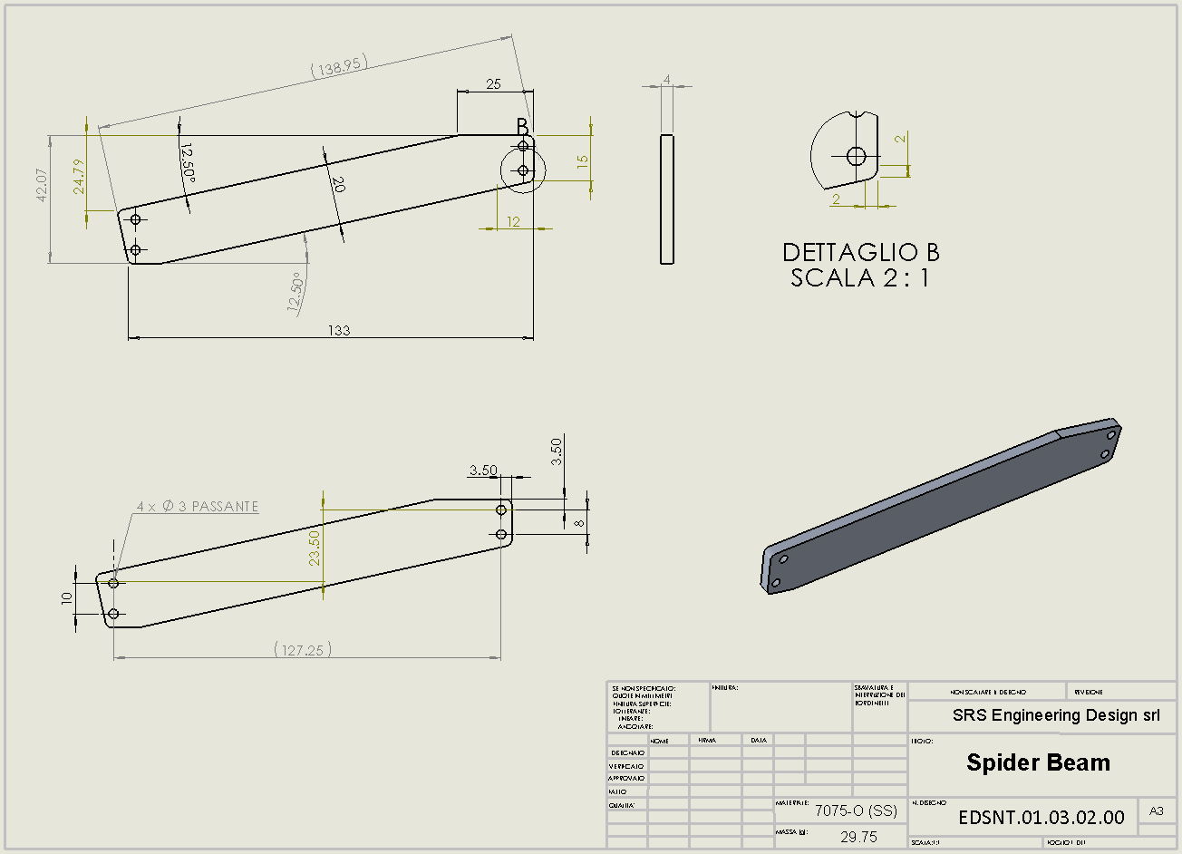
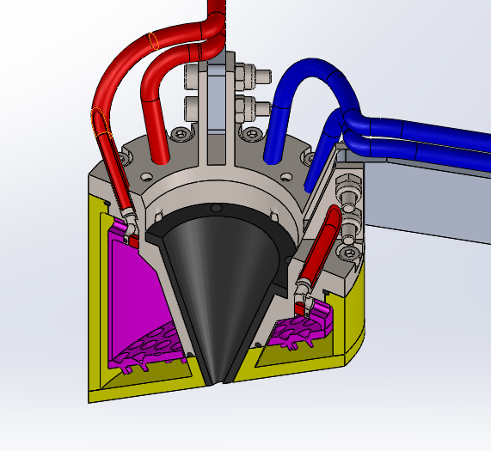
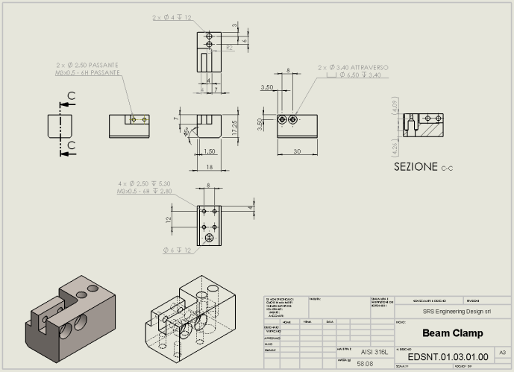
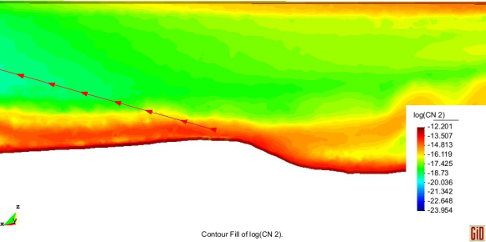
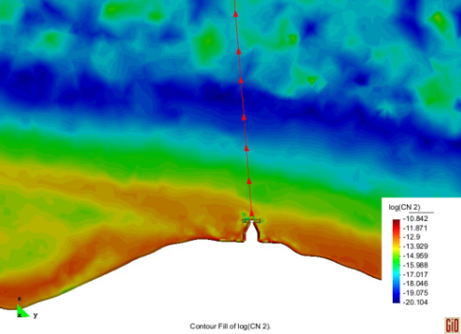
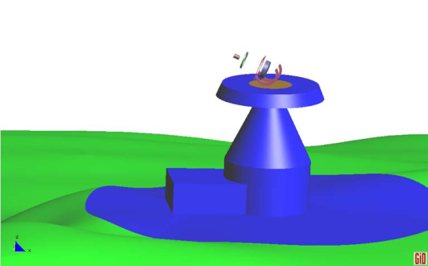
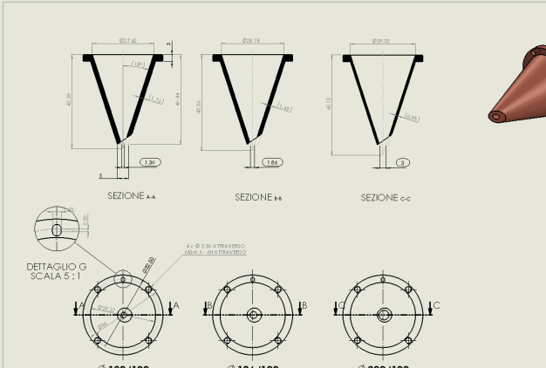
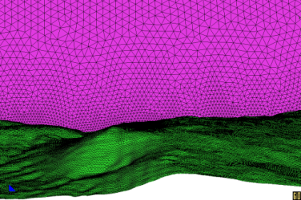
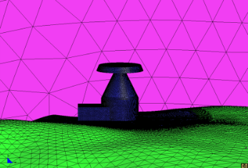
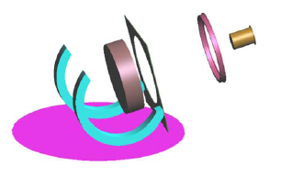
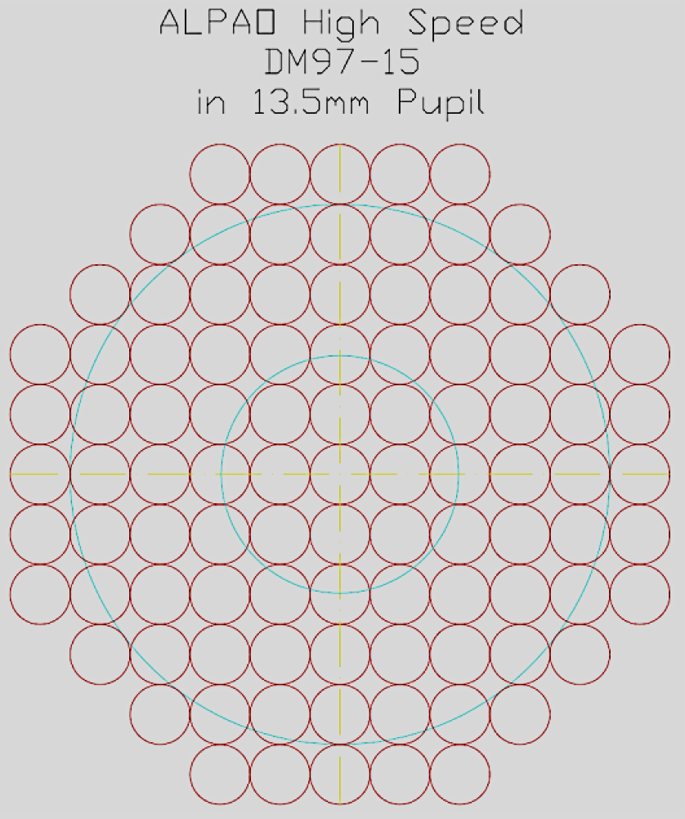
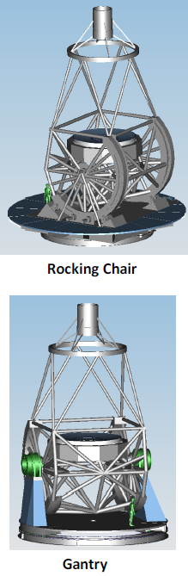
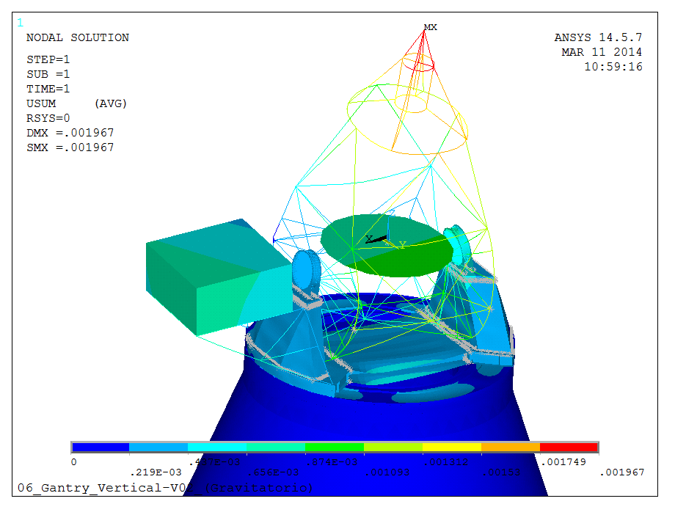
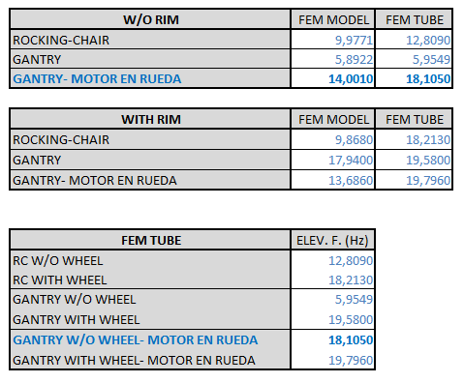
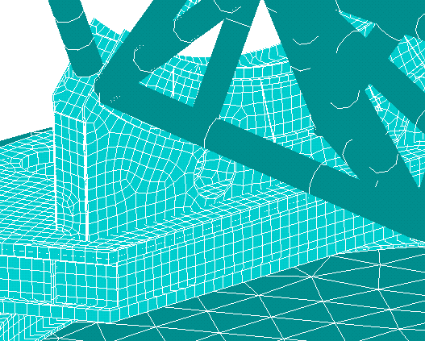
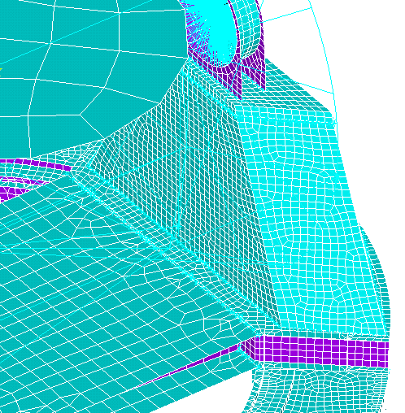
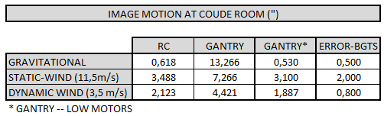

WP 70:Turbulence characterisation and correction
Lead Institution: IAC
Partiticipants: KIS, CNRS, UToV, SU, Wageningen Univ., HANKOM, CIMNE, SRS, FGG-INAF
SOLARNET WP70 investigates the effects of air turbulence on wavefront distortion and analyses techniques to reduce and correct the optical degradation in order to improve the performance of existing solar telescopes and to optimise the design of EST.
The objectives of this WP are divided in these areas:
Characterisation of the daytime atmospheric turbulence at the Canarian observatories
Characterisation of the air turbulence produced at the telescopes environment
Implement an optimized heat rejecter prototype at the GREGOR telescope
Development of numerical simulations to optimize the performance of MCAO systems
Implement an adaptive optics system prototype at THEMIS telescope
Optimization of EST telescope structure
ATMOSPHERIC SEEING CHARACTERISATION
1
DOT
GREGOR
DOT: Developed method to obtain local C_{n}² at telescope level from a 3D sonic anemometer
Gregor: Line-of-sight scintillometer data that yields path averaged C_{n}² at telescope level (Fraunhofer Institute)
EST THERMAL ANALYSIS
1
2
1
40 m: EST HEIGHT
SHABAR INSTRUMENTS: OT AND ORM
CFD ANALYSES
2
  HEAT REJECTER PROTOTYPE FOR GREGOR
4
AO/MCAO PERFORMANCE
3
Surface finite element mesh employed for the flow over the EST enclosure (6.0 million elements)
FoV SR as function of r0,numer of DMs
and zenithal distance
Tenerife without facilities.
(South view)
Tenerife without telescope structure (South view)
with facilities (Building West)
Tenerife with facilities (Building West) and telescope structure.
6
EST: DYNAMIC BEHAVIOUR OF TELESCOPE
5
AO PROTOTYPE FOR THEMIS
ELEVATION EIGENFREQUENCY
IV SOLARNET Meeting
Lanzarote, January 16-20, 2017

