Slide 1
An alternative cellular avalanche model based on maximum release of energy during solar flares
Nastaran Farhang
Hossein Safari & Michael S. Weatland
University of Zanjan
January 2017

Slide 2
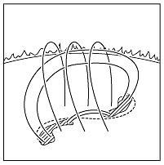
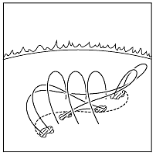
Solar Flares
Solar Flares
Cellular Automaton Avalanche Models
The Optimized Model
What is next ?

Slide 3
Solar Flares
Cellular Automaton Avalanche Models
The Optimized Model
What is next ?
Explain The Observed Power-law Behaviour of Solar Flare Energies
GOAL

Slide 4
Cellular Automaton Avalanche Models
Solar Flares
Cellular Automaton Avalanche Models
The Optimized Model
What is next ?
Studying the quasi-static evolution of coronal magnetic field and their complex behavior by dividing avalanches into discrete elements.
Sand-pile Model

Slide 5
CA MODELS Development
Solar Flares
Cellular Automaton Avalanche Models
The Optimized Model
What is next ?
Lu & Hamilton
1991
Georgoulis & Vlahos
1996
Norman et al
2001
Strugarek & Charbonneau
The Optimized Model
2014
2017
1. Strugarek, A. & Charbonneau, P. 2014, SoPh, 289, 4137
2. Strugarek, A., Charbonneau, P., Joseph, R. & Pirot, D., 2014, SoPh, 289, 2993

Slide 6
Solar Flares
Cellular Automaton Avalanche Models
The Optimized Model
What is next ?
Lu & Hamilton Model (1991)
1. Lu, E. T. & Hamilton, R. J. 1991, ApJ, 380, L89
2. Lu, E. T., Hamilton, R. J., McTiernan, J. M., & Bromund, K. R. 1993, ApJ, 412, 841

Slide 7
Solar Flares
Cellular Automaton Avalanche Models
The Optimized Model
What is next ?
Lu & Hamilton Model (1991)
$$≥$$
1. Lu, E. T. & Hamilton, R. J. 1991, ApJ, 380, L89
2. Lu, E. T., Hamilton, R. J., McTiernan, J. M., & Bromund, K. R. 1993, ApJ, 412, 841

Slide 8
Solar Flares
Cellular Automaton Avalanche Models
The Optimized Model
What is next ?
The Deterministically Driven Model
1. Strugarek, A. & Charbonneau, P. 2014, SoPh, 289, 4137
2. Strugarek, A., Charbonneau, P., Joseph, R. & Pirot, D., 2014, SoPh, 289, 2993

Slide 9
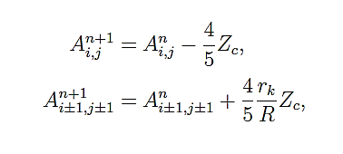
Solar Flares
Cellular Automaton Avalanche Models
The Optimized Model
What is next ?
The Deterministically Driven Model
1. Strugarek, A. & Charbonneau, P. 2014, SoPh, 289, 4137
2. Strugarek, A., Charbonneau, P., Joseph, R. & Pirot, D., 2014, SoPh, 289, 2993

Slide 10
Solar Flares
Cellular Automaton Avalanche Models
The Optimized Model
What is next ?
?

Slide 11
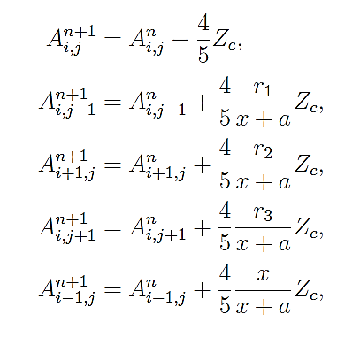
Solar Flares
Cellular Automaton Avalanche Models
The Optimized Model
What is next ?
The Optimized Model

Slide 12
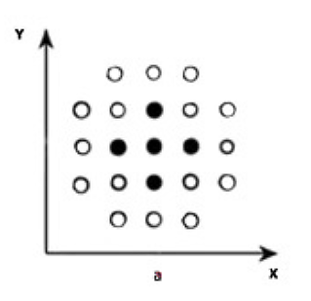
Solar Flares
Cellular Automaton Avalanche Models
The Optimized Model
What is next ?
The Optimized Model
1. Lu, E. T. & Hamilton, R. J. 1991, ApJ, 380, L89
2. Strugarek, A., Charbonneau, P., Joseph, R. & Pirot, D., 2014, SoPh, 289, 2993

Slide 13
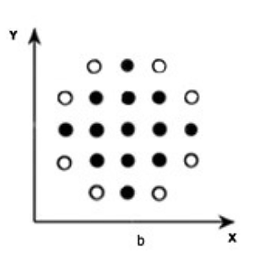
Solar Flares
Cellular Automaton Avalanche Models
The Optimized Model
What is next ?
The Optimized Model

Slide 14
Solar Flares
Cellular Automaton Avalanche Models
The Optimized Model
What is next ?
The Optimized Model

Slide 15
Solar Flares
Cellular Automaton Avalanche Models
The Optimized Model
What is next ?
What is the next step?
?

Slide 16
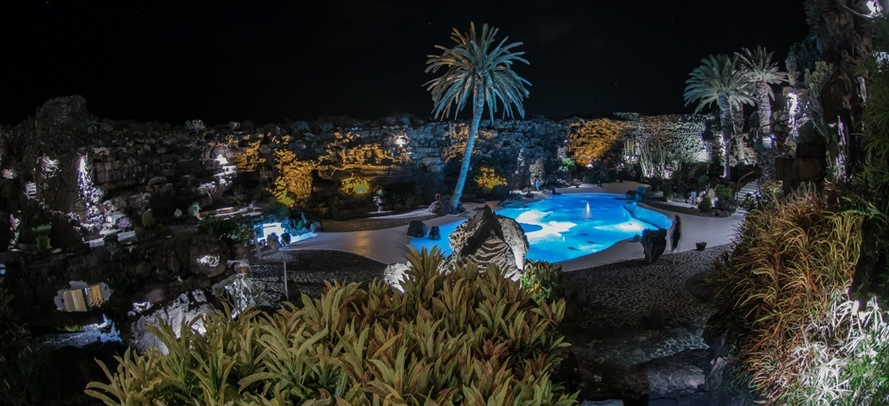
Thanks ☺

