Slide 1
SOLARNET IV MEETING
THE PHYSICS OF THE SUN FROM THE INTEIOR TO THE OUTER ATMOSPHERE (Lanzarote, Spain, 17 Jan 2017)
Numerical simulation of cool ascending flows in chromosphere
Tatsuki Nakamura, Kazunari Shibata
Kyoto University, Japan

Slide 2
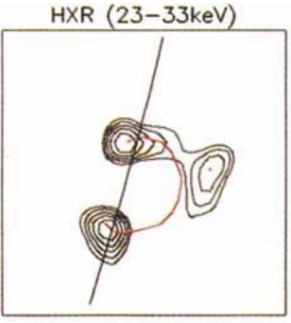
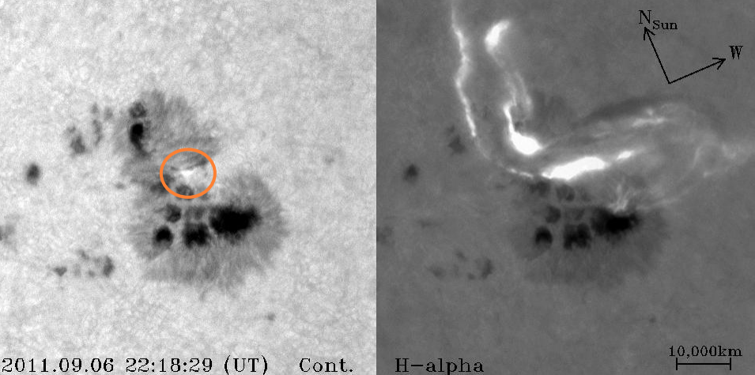
Introduction: Solar flare = explosion by magnetic energy release in corona
Solar flares are observed in various wavelength and height.
Especially, continuum brightening(white light flare) occurs in photosphere (or chromosphere).
in HXR
(corona,chromosphere)
in Hα
(chromosphere)
in continuum
(photosphere)

Slide 3
So energy is transported from corona to lower atmosphere (e.g. chromosphere)
There is some candidates for energy carriers.
thermal conduction
t~${10}^{−3}$ s on surface of chromosphere, T=${10}^{7}$K
but takes some time to reach(t~10s)
non-thermal electron beam
t~${10}^{−2}$ s inside of chromosphere,
in a M class flare
very fast: v~c
radiation
t~10s, T=${10}^{7}$K
model of energy transport
magnetic field line
input
>
>
corona
>
>
>
>
chromosphere
transition region

Slide 4
Thermal conduction -> cool descending flow($\sim {10}^{4}$K)
Conduction heats chromosphere from its surface.
>Pressure on upper chromosphere increases.
>makes cool(${10}^{4}$K) descending flow
and hot(${10}^{7}$K) ascending flow
(Nagai+80 checked numerically)
corona
chromosphere
pressure up
>
>
>
>
>
>
model of heating by thermal conduction

Slide 5
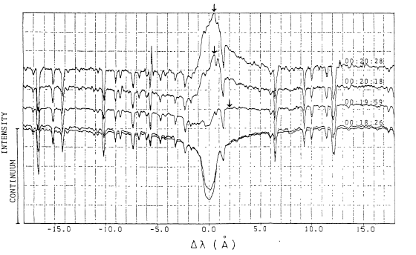
Observation of cool descending flow(${10}^{4}$K)
Doppler effect shifts chromospheric lines to red side. (e.g. Hα)
> This flow can be observed as red asymmetry of chromospheric lines.
time
Red shift of Hα during flare
Ichimoto
& Kurokawa(1984)
blue
red

Slide 6
high energy electron beam -> also cool descending flow($\sim {10}^{4}$K)
Electron beam can penetrate chromospheric surface.
heats inside of chromosphere.
100km~500km inside
(Nagai and Emslie+84)
e:input
corona
In any cases, cool descending flow(${10}^{4}$K) is generated
and red shift will be found.
chromosphere
pressure up
>
>
>
>
>
>
model of heating by electron beam

Slide 7
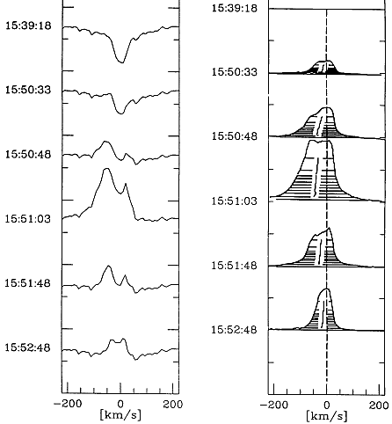
Motivation: Existence of blue shift
However, blue shift of chromospheric line (Hα) was found in onset phase of some flares.
(Svestka+62, Canfield+90)
> Cool ascending flows
can explain this.
temperature:~${10}^{4}$K
duration:~60s
velocity:~40km/s
Intensity around Hα
I(t)
I(t)-I(0)
Canfield+(1990)
blue
red
blue
red
time

Slide 8
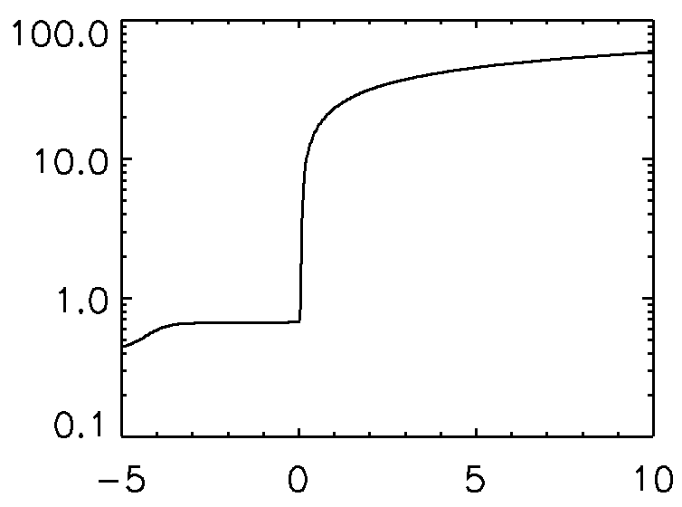
Method: Conditions of numerical calculation
Regard actual flux tube to 1D
Vertical motions are prevented
by hard magnetic flux tube
Initial condition:
hydrostatic equilibrium
temperature is taken from
Avrett+08
Boundary condition:
corona：symmetric
chromosphere：free
1D tube
>
>
>
>
>
>
model of atmosphere
initial temperature
[${10}^{4}$K]
chromosphere
corona
height(x=0:transition region)[300km]

Slide 9
Use hydrodynamic equations.
Dealing 1D motion in static flux tube, equations are reduced to 1D hydrodynamic ones. (B is not solved)
mass : $\frac{∂}{∂t}ρ+\frac{∂}{∂x}ρv=0$
momentum : $\frac{∂}{∂t}ρv+\frac{∂}{∂x}\left(p+ρv2\right)=ρg$
energy : $\frac{∂e}{∂t}+\frac{∂}{∂x}\left((e+p)v\right)=ρgv+Q_{f}−Q_{c}+Q_{c0}+Q_{cond}$
$Q_{f}$:heating by high energy electron
$Q_{c}$:cooling by radiation
$Q_{c0}=Q_{c}(t=0)$
$Q_{cond}$:thermal conduction

Slide 10
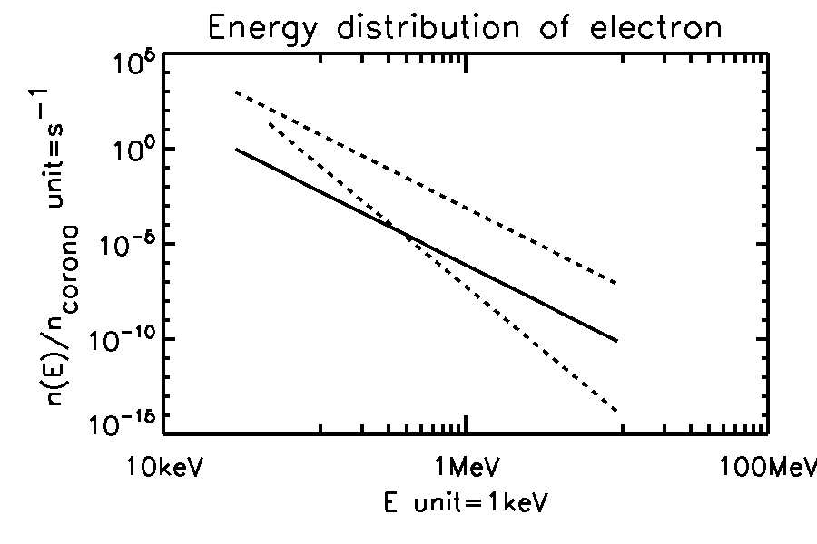
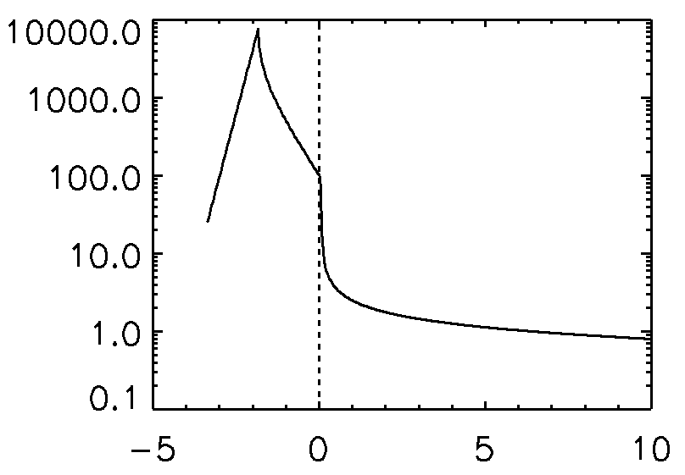
Heating rate by high energy electron: $$Q_{f}=ρf(N)$$
$N=\int_{x}^{top}{n\left(x^{′}\right)dx^{′}}$
Use Nagai and Emslie(1984)’s thick target heating model
f depends on electron spectrum parameters.
power law index(F∝$E^{−δ}$)
total energy input: $F_{tot}$
lower energy cut-off: $E_{c}$
energy spectrum of electron
number density of electron
energy of electron
heating rate
heating rate
transition region
chromosphere
height
corona
Notes:
＊図の変更
沢山のスペクトルの図（冪を変える）＋一本だけの加熱率
予備スライドとして、他の二つを変えたものも用意

Slide 11
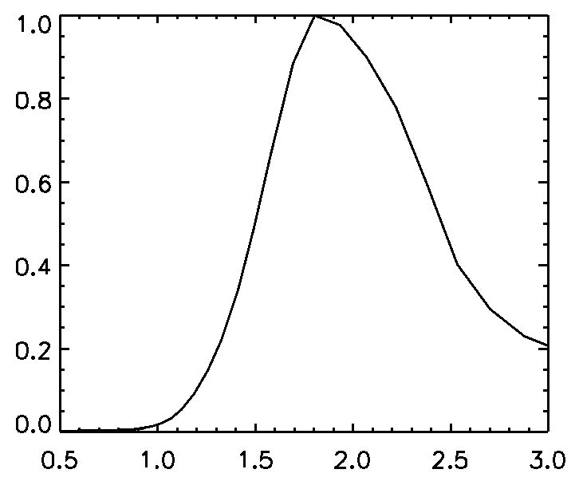
Cooling rate by radiation: $$Q_{c}=n^{2}Λ\left(T\right)X\left(T\right)E(N)$$
We adopted radiative cooling, followed by Carlsson+2012.
$N:$column number density
$N=\int_{x}^{top}{n\left(x^{′}\right)dx^{′}}$
Only in case of Hydrogen,
$N=\int_{x}^{top}{n\left(x^{′}\right)X_{H}(T\left(x^{′}\right))dx^{′}}$
X(T):neutral fraction
Λ(T):optically thin radiation
E(N):escaping probability
temperature dependence of cooling function (Hydrogen)
ΛX(T)
Mg
Ca
H
T
$$T^{∗}$$
temperature [${10}^{4}$K]

Slide 12
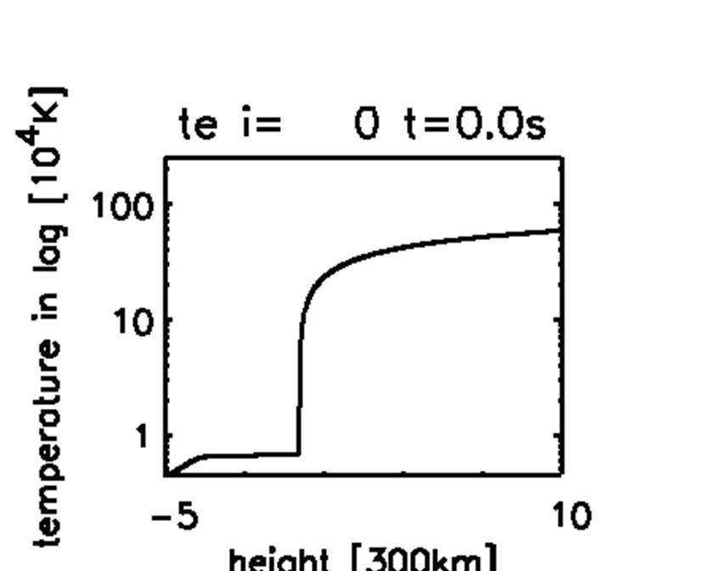
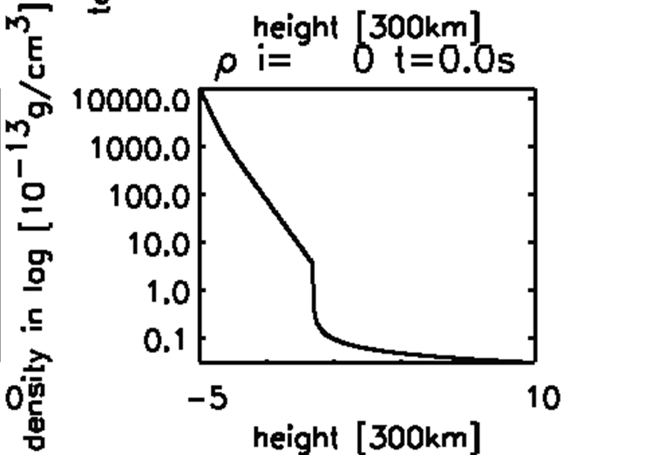
Result: $δ=7, Ec=30keV, E_{tot}={10}^{9}\text{erg}\text{/}\text{s}\text{/}\text{c}m^{2}$
0
Cool ascending flow was generated!
T~${10}^{4}$K
v~70km/s

Slide 13
Existence depends on parameters.
calm input
small energy input
compared to cooling
Material cannot be accelerated.
energetic input
Great energy input heat upper chromosphere in a short time.

Slide 14
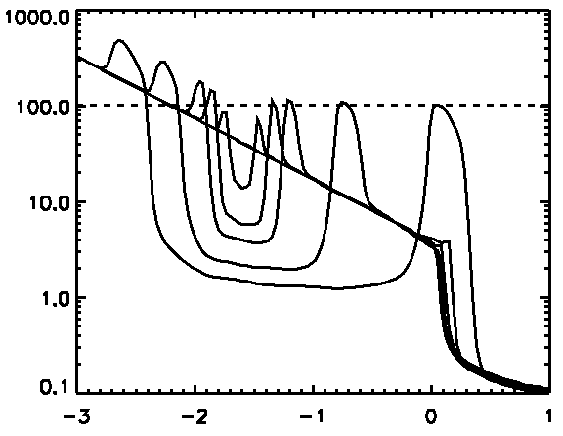
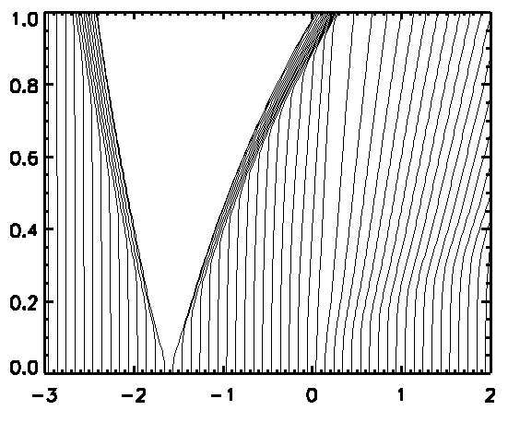
Only initial density profile may decide the existence of cool ascending flow.
Density variation ~ factor 2
No particles pass through.
time variation of density
Lagrange particle trace
density[${10}^{−13}$g/c$m^{3}$]
time [25s]
In time variation, local and column number density in cool ascending flow does not change.
no entering particles
distance from transition region [300km/s]
distance from transition region [300km/s]
distance from transition region [300km/s]

Slide 15
Cooling function has maximum value to temperature variation.
Radiative cooling: $Q_{c}=n^{2}Λ\left(T\right)X\left(T\right)E(N)$
a criteria is $T^{∗}$=$18000K$(in case of Hydrogen)
More temperature rather
decreases cooling rate
and heats plasma more.
temperature dependence of cooling function (Hydrogen)
ΛX(T)
$$T^{∗}$$
temperature [${10}^{4}$K]

Slide 16
So, we got criteria for cool ascending flows
 | $Q_{f}>max{(Q}_{c}(T))$ ?
Upper chromosphere | Yes | No | No
Point where heating rate becomes maximum | Yes | Yes | No
Cool ascending flow | Not exists | Exists | Not exists
There’s no cases like (Yes, No).

Slide 17
Compare with numerical simulation: occurrence of cool ascending flows at time=50s
Red : cool ascending flows are expected
Yellow : ambiguous
$F_{tot}$/$10^{8}$ Ec | 3 | 10 | 30 | 70 | 100
10 | 5 | none | none | none | none
15 | none | 7 | none | none | none
20 | none | 4 | none | none | none
25 | none | 5 | 12 | 17 | none
30 | none | 3 | 10 | none | none
$E_{tot}$/$10^{8}$ Ec | 3 | 10 | 30 | 70 | 100
10 | 5 | none | none | none | none
15 | none | 7 | none | none | none
20 | none | 4 | none | none | none
25 | none | 5 | 12 | 17 | none
30 | none | 3 | 10 | none | none
[10km/s]
none：v<20km/s or T>$2×{10}^{4}$K

Slide 18
Summary
Blue shift of chromospheric lines has been found.
We researched this with 1D numerical calculation and parameter survey.
As a result, we found:
①Electron beam can generate cool ascending flow.
②The balance between radiative cooling and beam
heating is very important.

