Slide 1
Estimation of Coronal Rotation using 171Å Extreme UV image observations from SOHO
Shivam Raval
Indian Institute of Technology, India
SOLARNET IV Meeting, Lanzarote

Slide 2
Outline
Introduction
Methods of Analysis
Flux Modulation Approach
Image Analysis
Results
Conclusions

Slide 3
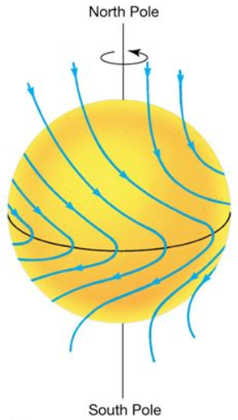
Introduction
Observation of solar rotation is being recorded since the 17th century
Differential Solar Rotation was first measuring the equatorial rotation rate at various latitudes, and it was found that the rotation is slower at higher latitudes.
However, North-South Asymmetry in Solar Rotation was first reported in 1915.

Slide 4
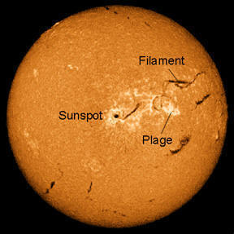
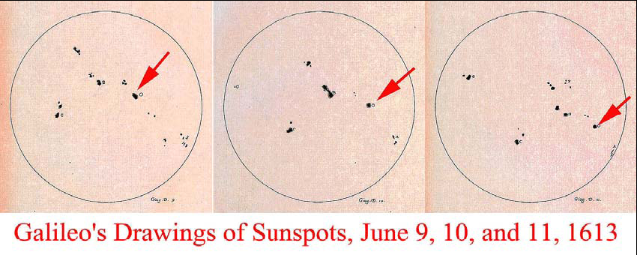
Methods for Estimating Solar Rotation
Tracer method: Track and observe certain features on the Sun, like CBPs, which can be optical (Wöhl et al. 2010; Brajša et al. 2014), X-ray (Kariyappa 2008) or magnetic (Parker 1987) coronal features. The is a limitation in the latitudes for which it can be used as the features themselves move longitudinally along the surface.
Observations of Sunspots (Chen et al. 2015; Chandra & Vats 2011) have produced rotation values close to those derived from other methods (Chandra et al. 2009).

Slide 5
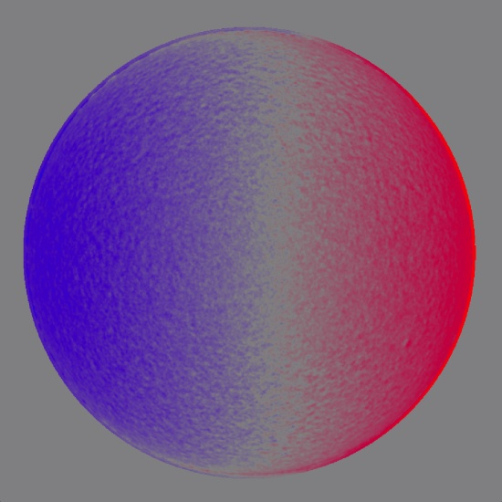
Spectroscopy
Spectroscopic Methods can be used to study a wider range of latitudes.
One such approach is to measure the Doppler shift in selected spectral lines near the solar limb (Scherrer & Wilcox 1980).
But these measurements quite susceptible to scattered light due to the instrument and the constant variation in the atmosphere and are sometimes less accurate due to the presence of macroscopic motions within the coronal features.

Slide 6
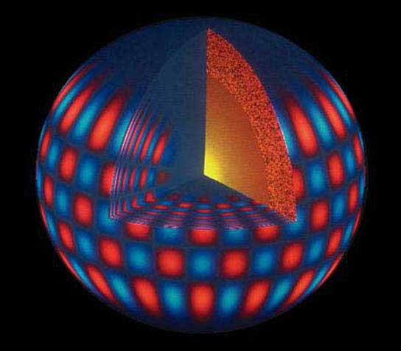
Helioseismology
Studying the oscillations of acoustic modes of the Sun resulting from the perturbations generated deep inside it can provide significant information about the Sun, from its interior to the surface
Inferences of the subsurface rotations can be made using the time-distance helioseismology by measuring the travel times for acoustic waves on the solar surface and using them to infer the variations of structure and flow velocities.
Helioseismology also suggests that the some features in the different layers in the Sun are coupled via features like convection flows, which would mean that those features cannot be used to analyse the rotation.

Slide 7
Flux Modulation Method
A recent approach to observing the differential rotation is to analyze the fluctuations in the flux emitted by the Sun.
Analysis of such variations in the solar emissions from a particular region along the heliocentric latitude can be used to precisely determine the solar rotation at that latitude of the layer of the solar atmosphere from where the flux is emitted.
Vats et al. (1998) first showed that the time series analysis of 10.7 cm (corresponding to 2.8GHz frequency) solar flux can give valuable information about the coronal rotation, and also inferred that solar corona rotates slightly faster than photospheric features and that the rotation period decreases as we go further in the corona (Vats et al. 2001).

Slide 8
Here, Solar Full Disk (SFD) images are used for analysis, as the value of pixel corresponds to the intensity of solar flux from that region.
SFD images of NoRH at 17 GHz and showed that the differential rotation in corona is lesser than the photosphere and chromosphere (Chandra et al. 2009).
In the present work, we have used the time series analysis on SOHO/EIT SFD data of 171 nm corresponding to ionized Fe(XI)/(X) emission of the Corona and show that the time series and autocorrelation analysis gives an accurate description of the coronal differential rotation as well as the north-south asymmetry in rotation.

Slide 9
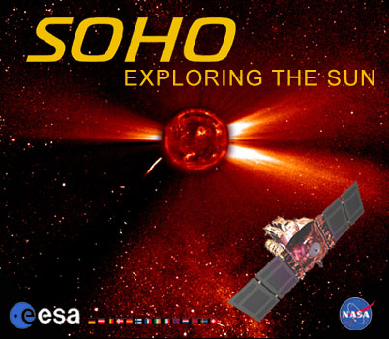
EIT Image selection and Reduction
The Extreme ultraviolet Imaging Telescope (EIT) is an instrument on the SOHO spacecraft used to obtain high-resolution images of the solar corona in the ultraviolet range. The EIT instrument is sensitive to light of four different wavelengths: 171, 195, 284, and 304 Å, corresponding to light produced by highly ionized Iron (XI)/(X), (XII), (XV), and helium (II).
We use the image data corresponding to Fe(XI)/(X) emission at 171 Å. A time slot is chosen per day and image in that time range is taken. Though there are a few extended periods of time where the SFD data was unavailable, the gap was compensated for by using interpolation.

Slide 10
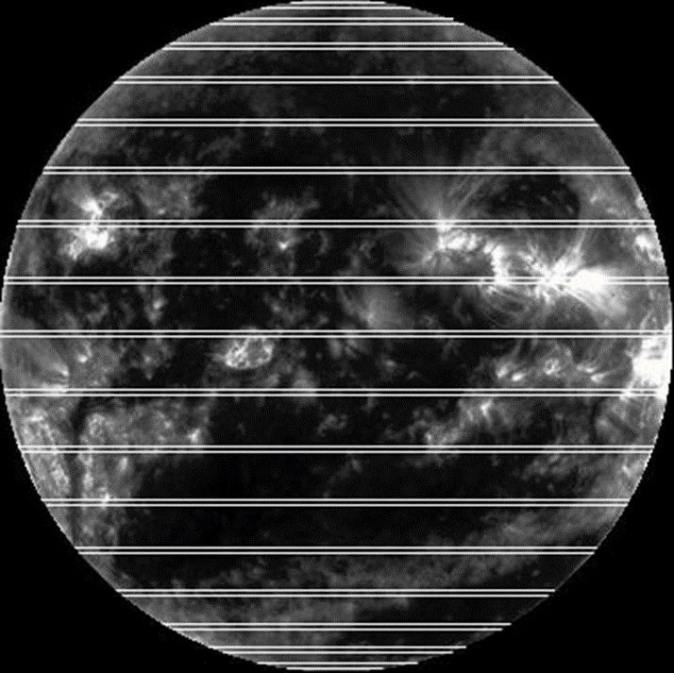
Image processing
The outer coronal region in the peripheral view is removed to eliminate the extended coronal features like flares, coronal loops and other large scale structure from circumferential region of the image.
It is then processed to obtain an image characterised by the single valued pixel intensity.
17 rectangular latitude bins from 80ºS to 80ºN are selected at 10º interval, with 2 pixel width.
We require a single pixel intensity value corresponding to each image. This is done by averaging it for all the pixels in a particular latitude bin.
80ºN
70ºN
60ºN
50ºN
40ºN
30ºN
20ºN
10ºN
00º
10ºS
20ºS
30ºS
40ºS
50ºS
60ºS
70ºS
80ºS

Slide 11
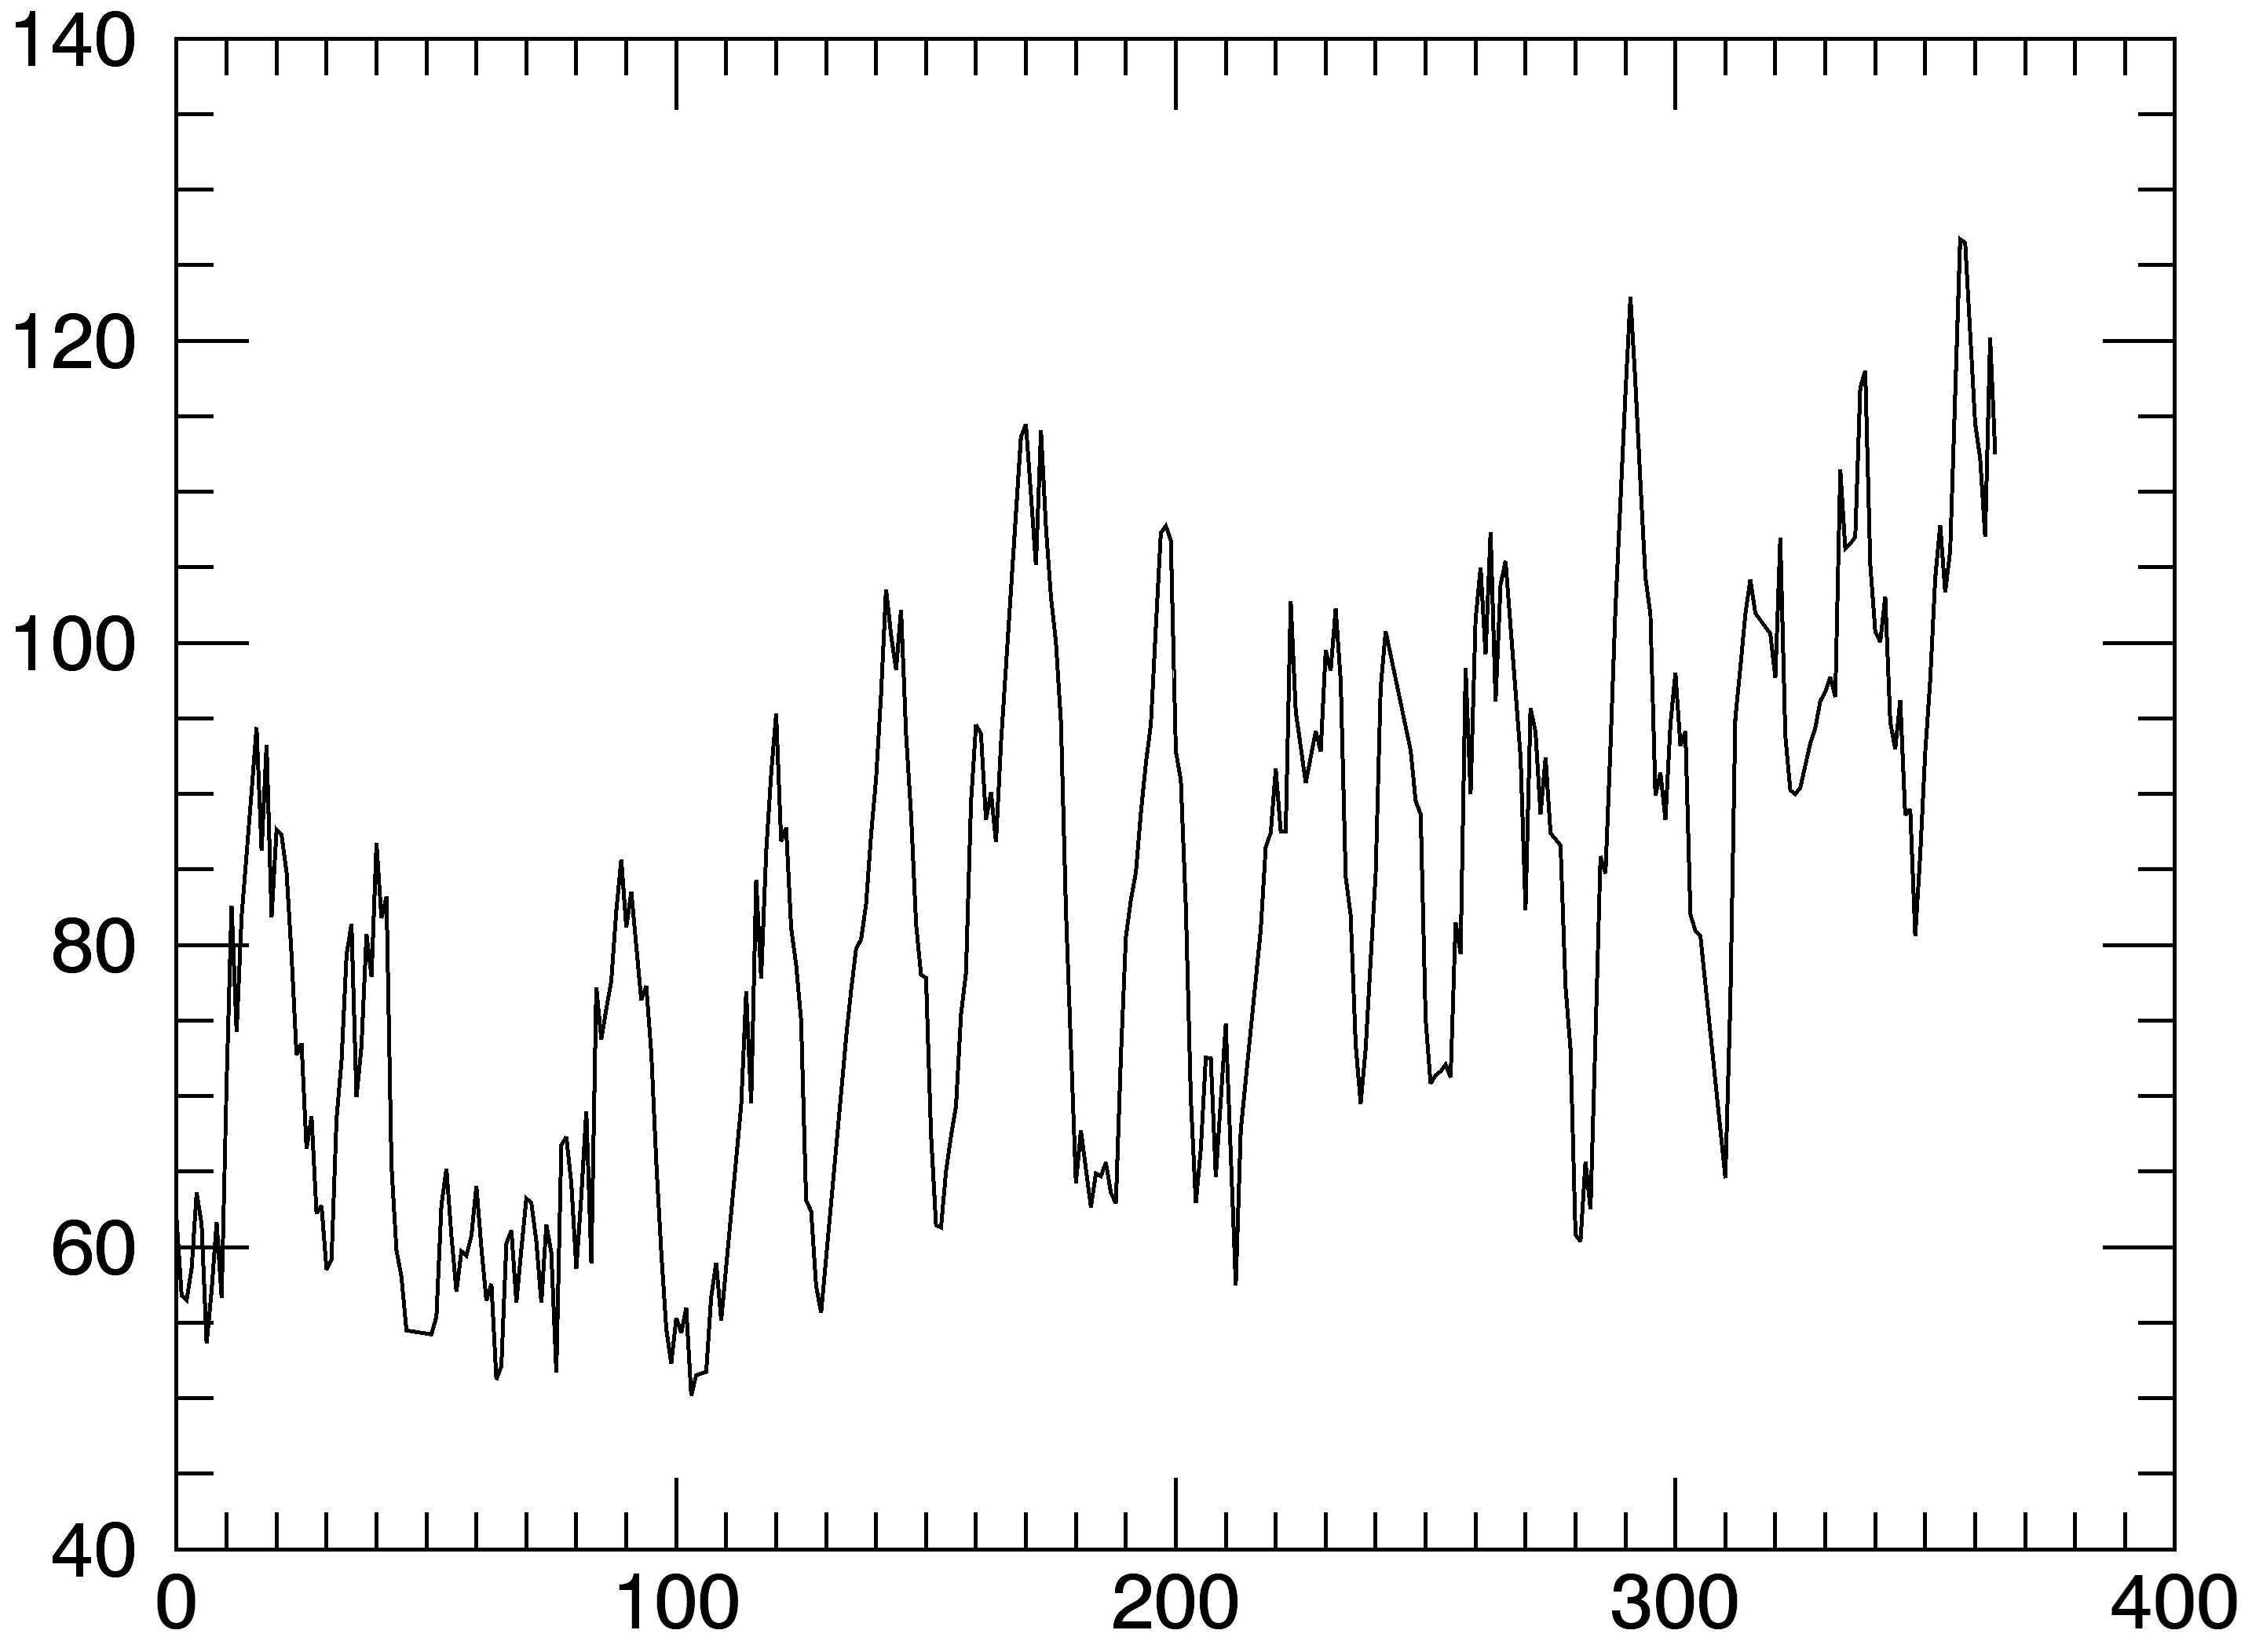
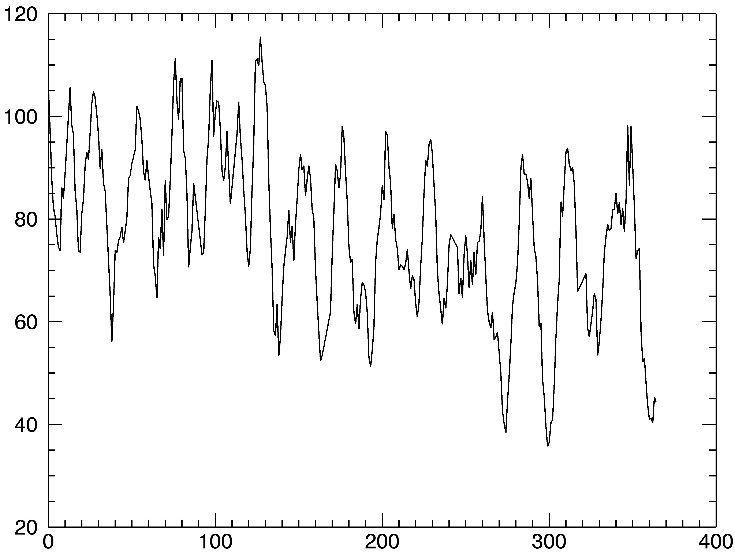
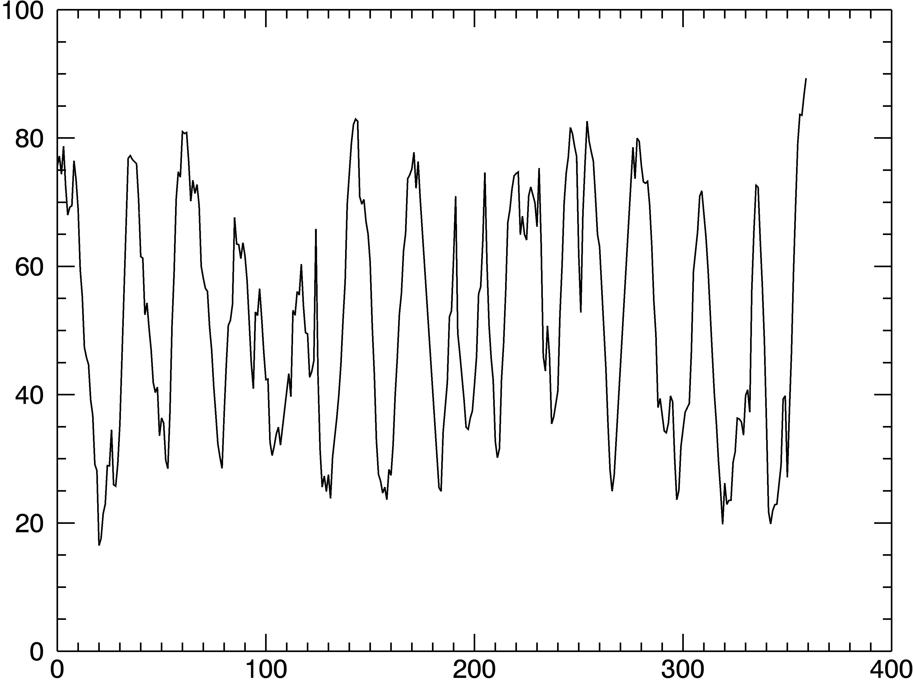
2001
2002
Intensity
plots
10ºN
10ºS
Pixel Intensity
Pixel Intensity
Days
Days
2003
70ºN
2003
70ºS
Pixel Intensity
Pixel Intensity
Pixel Intensity
Days
Days

Slide 12
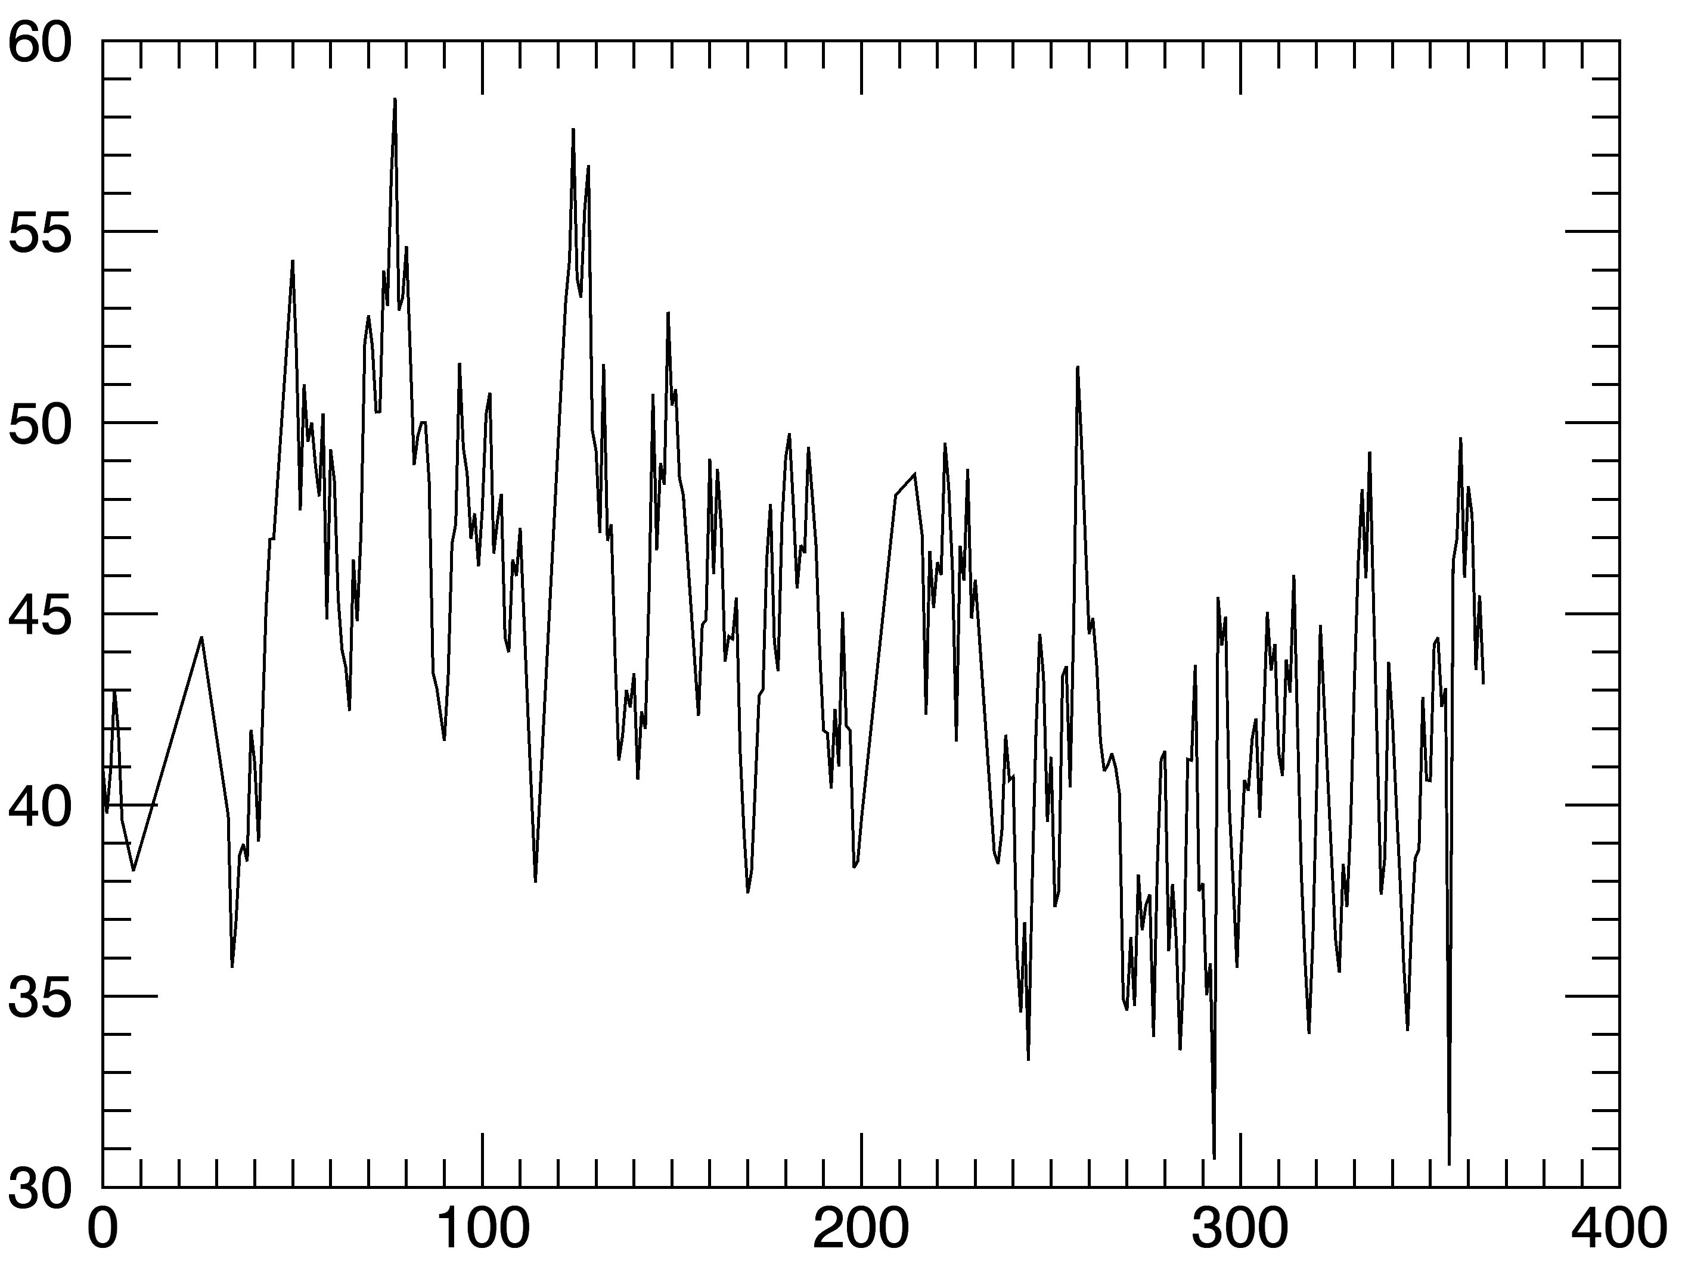
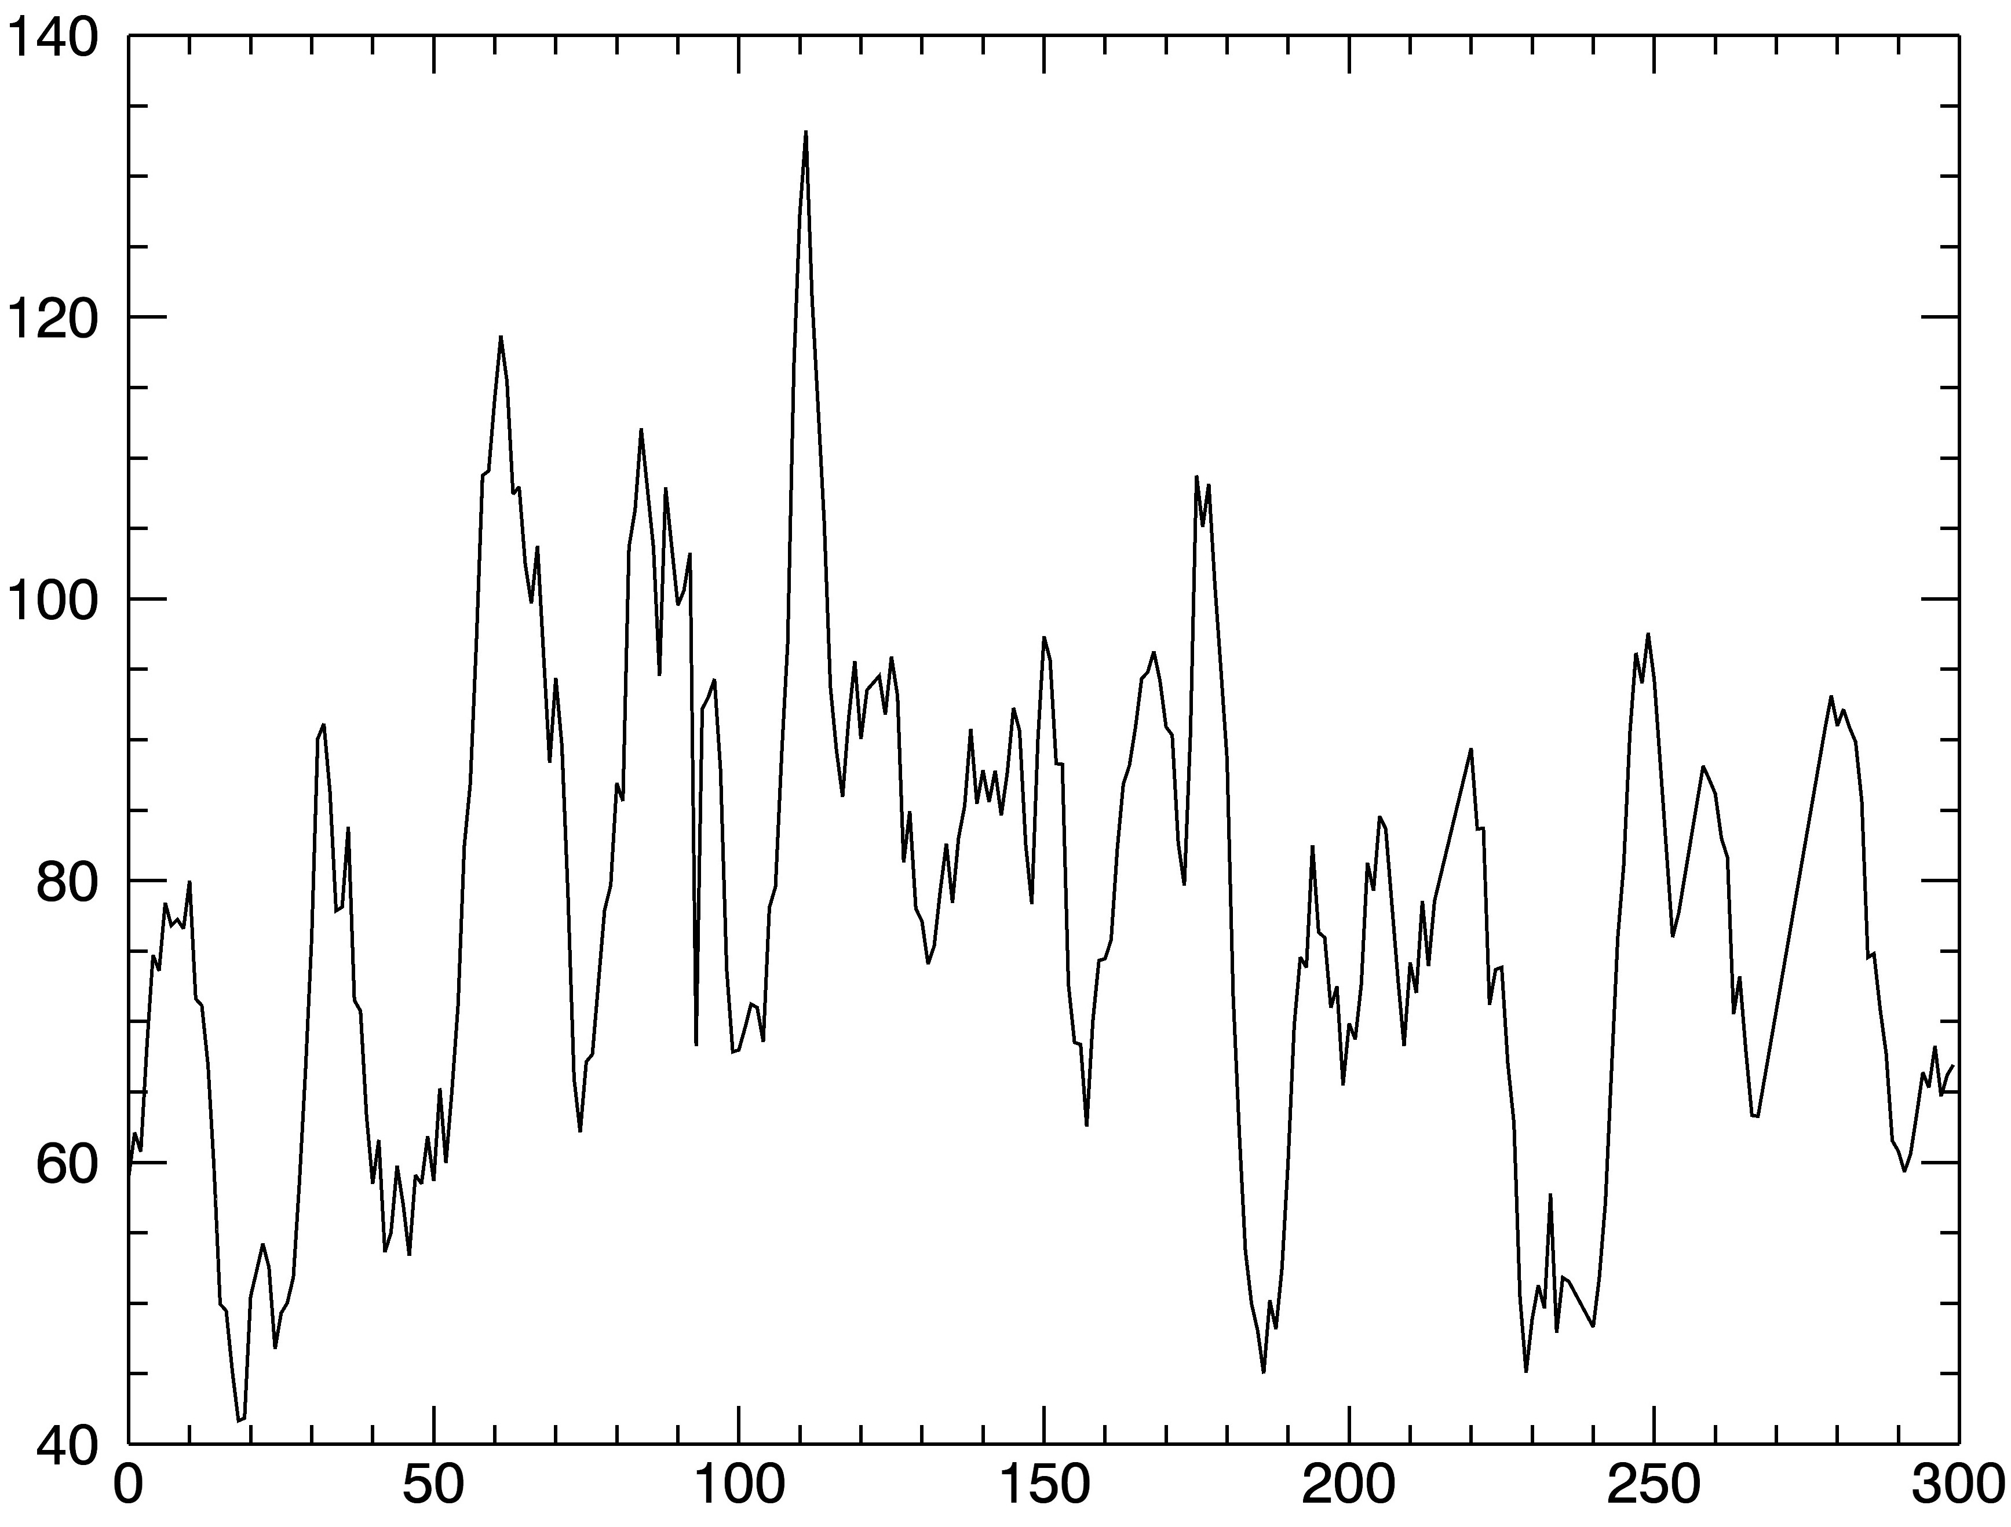
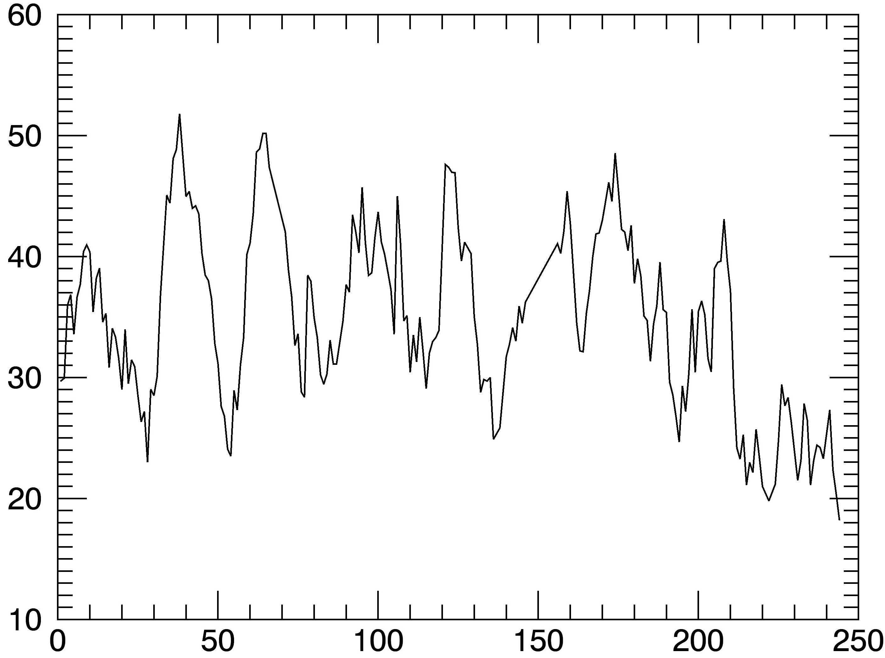
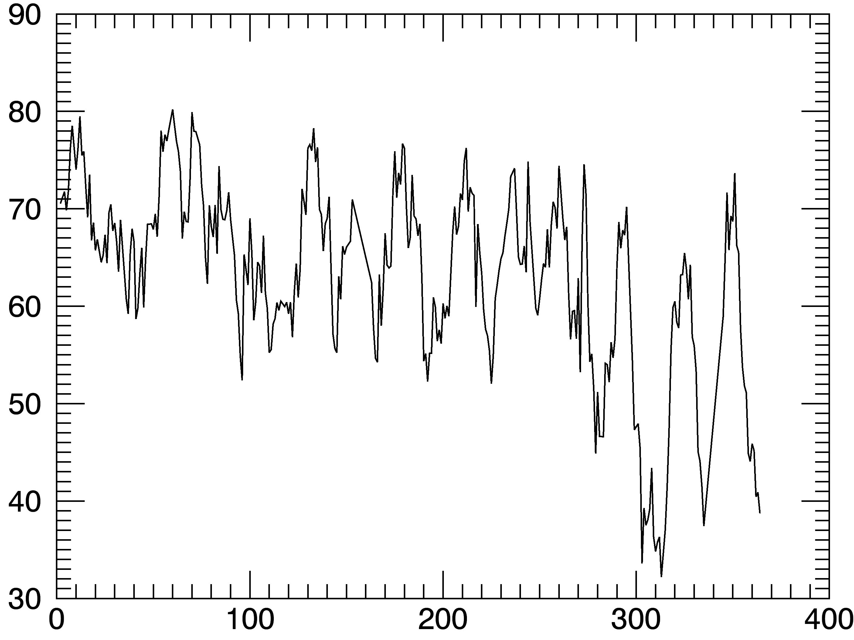
2010
1999
20ºN
00º
Pixel Intensity
Pixel Intensity
Days
Days
2015
2016
60ºN
80ºN
Pixel Intensity
Pixel Intensity
Days
Days

Slide 13
Autocorrelation Analysis
The intensity variation can be made more apparent by using autocorrelation analysis.
The pixel intensity corresponding to a particular year can be represented in the form of a time-series of n terms (x₀, x₁, x₂, ... x_{n-1}). We can create (n-l) pairs of observations from this series, where n is the number of days in that year and l is called the lag. They are (x₀, x_{l}), (x₁, x_{1+l}), (x₂, x_{2+l}), .(x_{n-l-1}, x_{n-1}).
By considering the first observation of each pair as one variable and the second observation as another variable, the autocorrelation coefficient as a function of the lag can be found by:
$$Px(l)=\sum_{i=1}^{n−l−1}{\frac{(xi−\overline{x})(xi+l−\overline{x})}{\sum_{i=1}^{n−l}{\left(xi−\overline{x}\right)2}}}$$

Slide 14
Autocorrelation of a set of data which consists of periodic function along with a random component reveals the exact periodic nature of the function by removing the random part.
The process of autocorrelation allows us to remove the information regarding the short-lived features and obtain the rotation period from those which are persistent and relatively stable at a particular latitude for longer times.

Slide 15
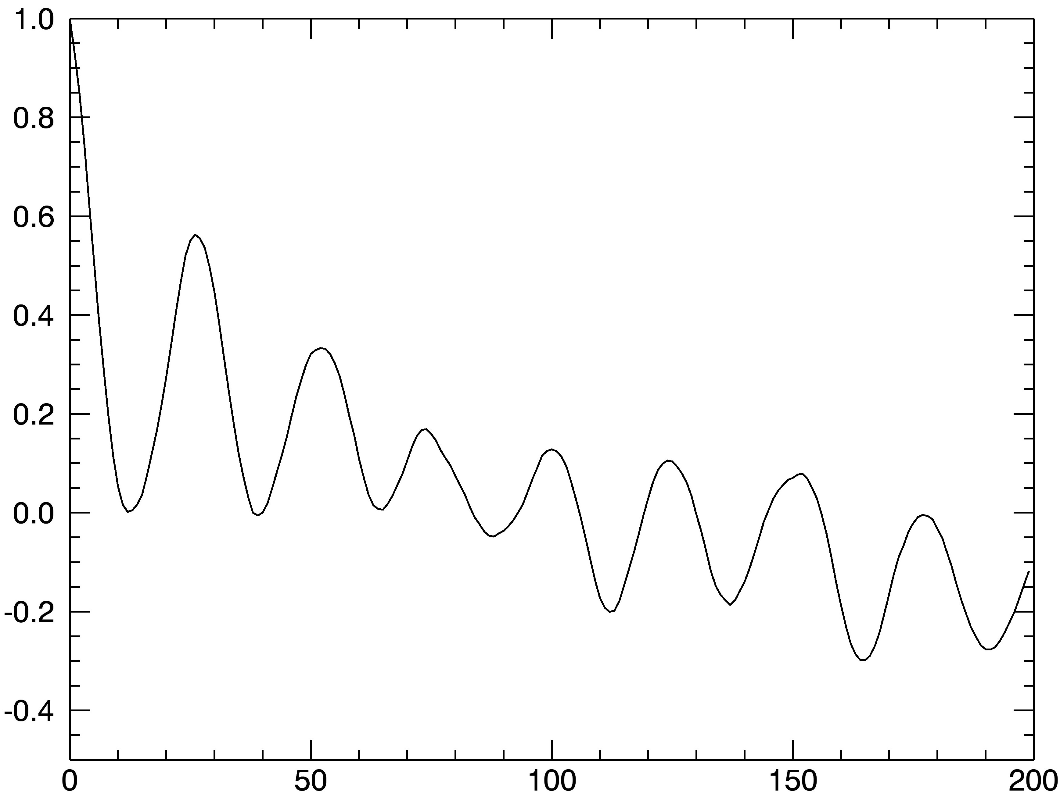
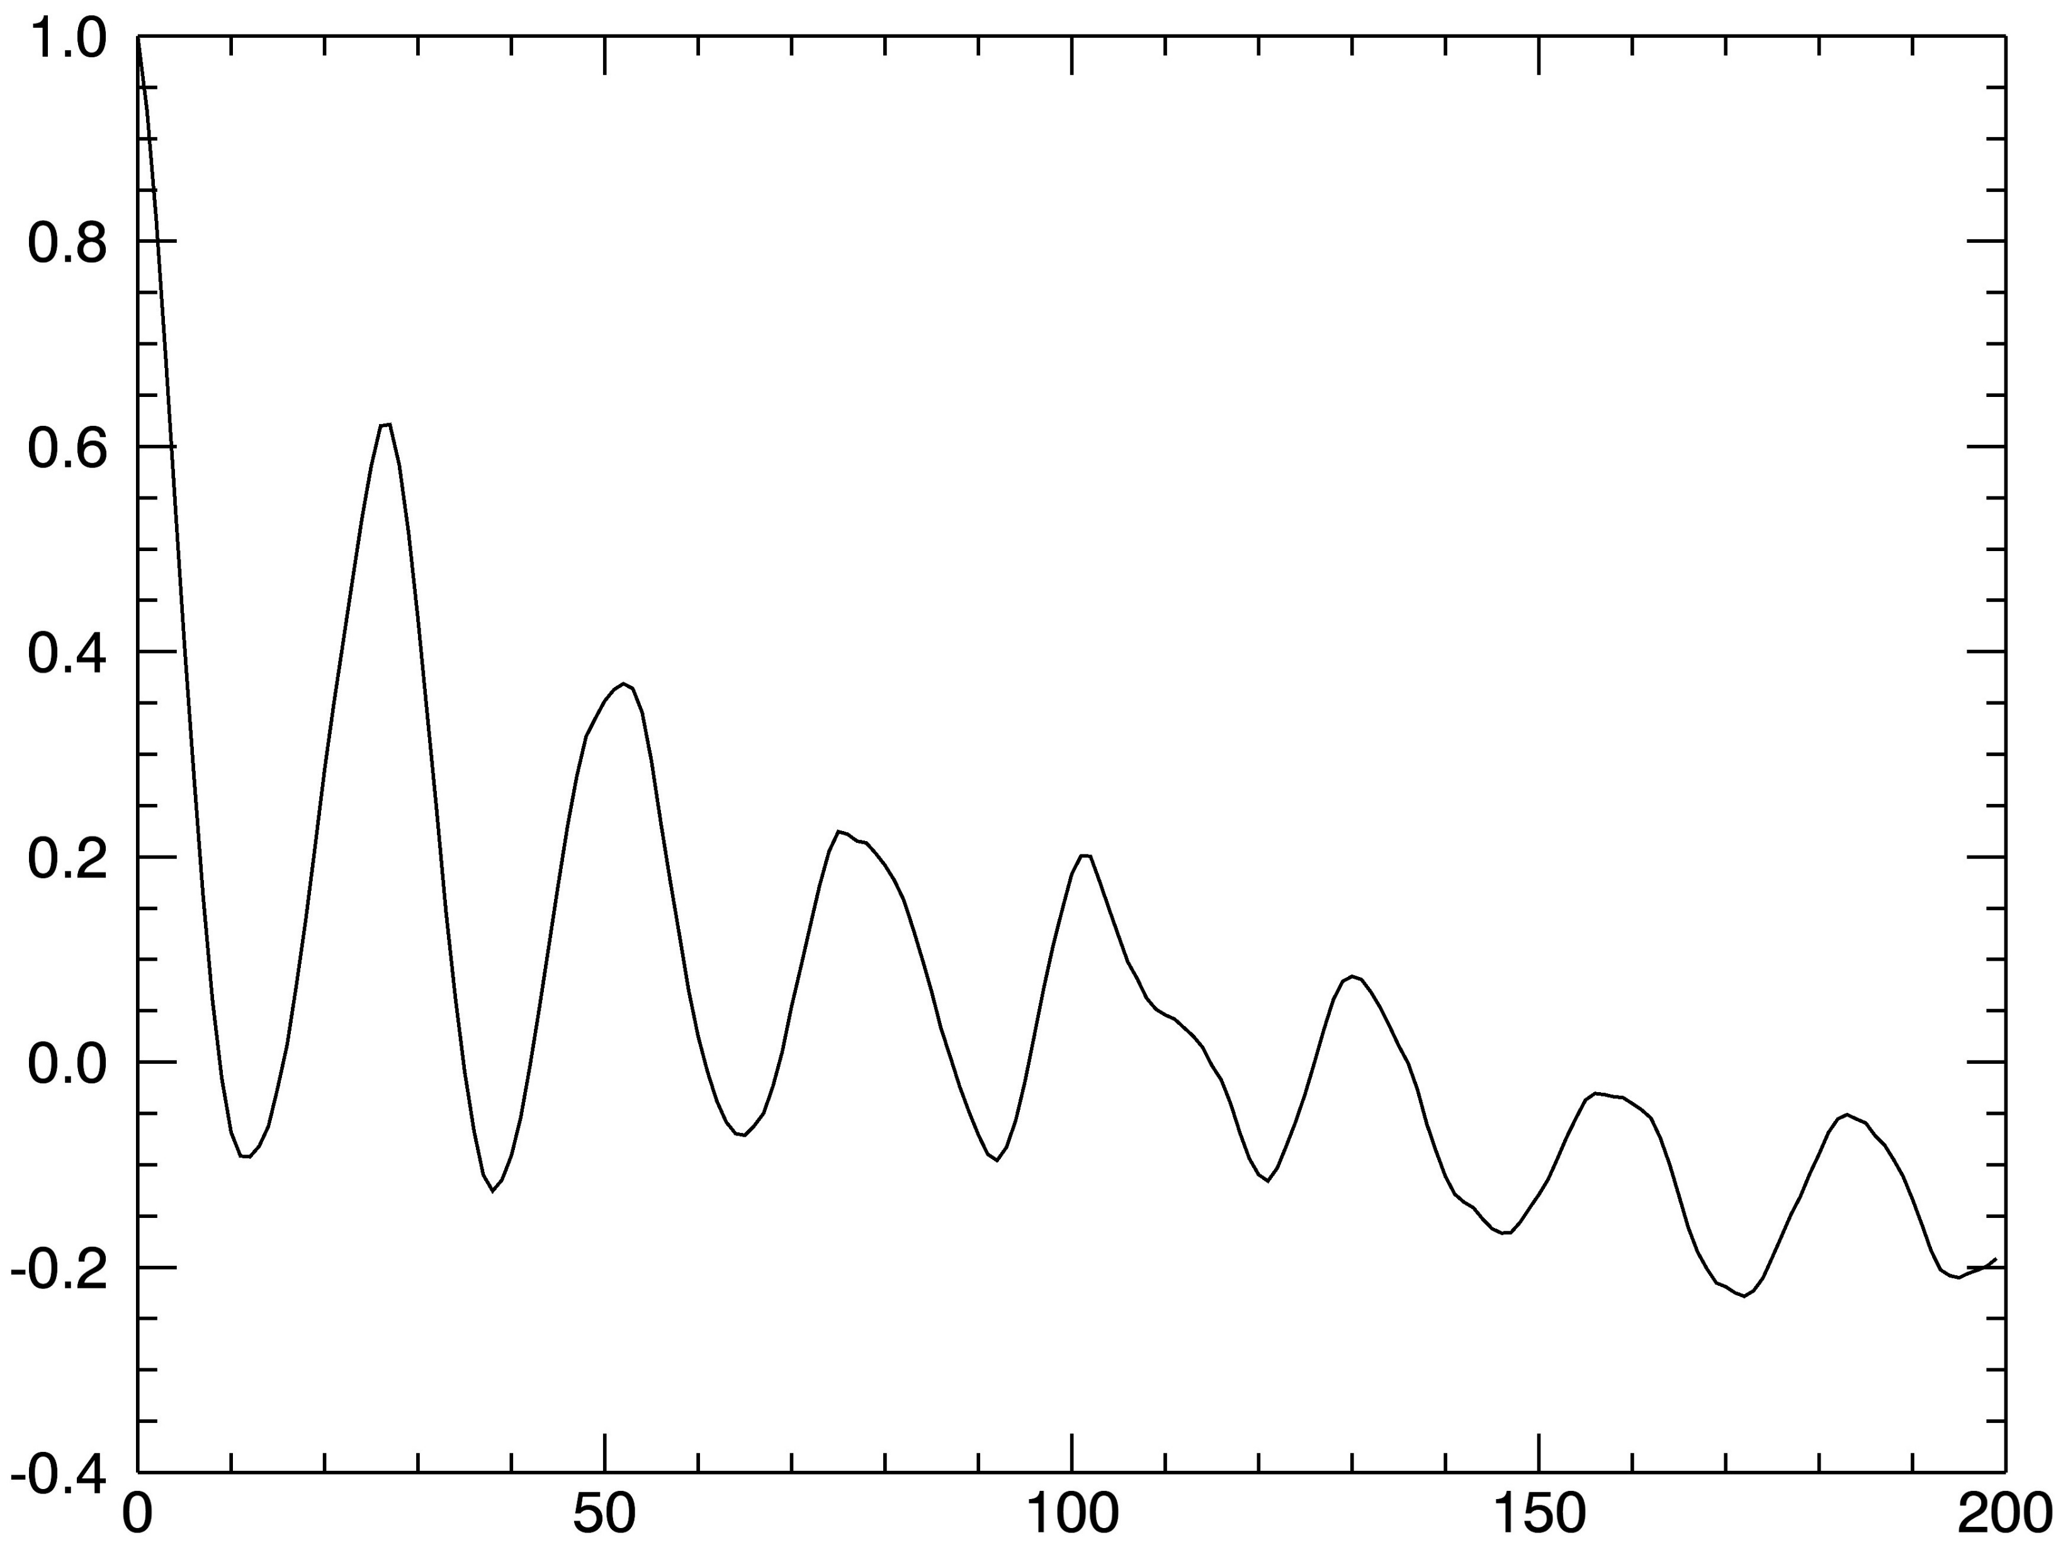
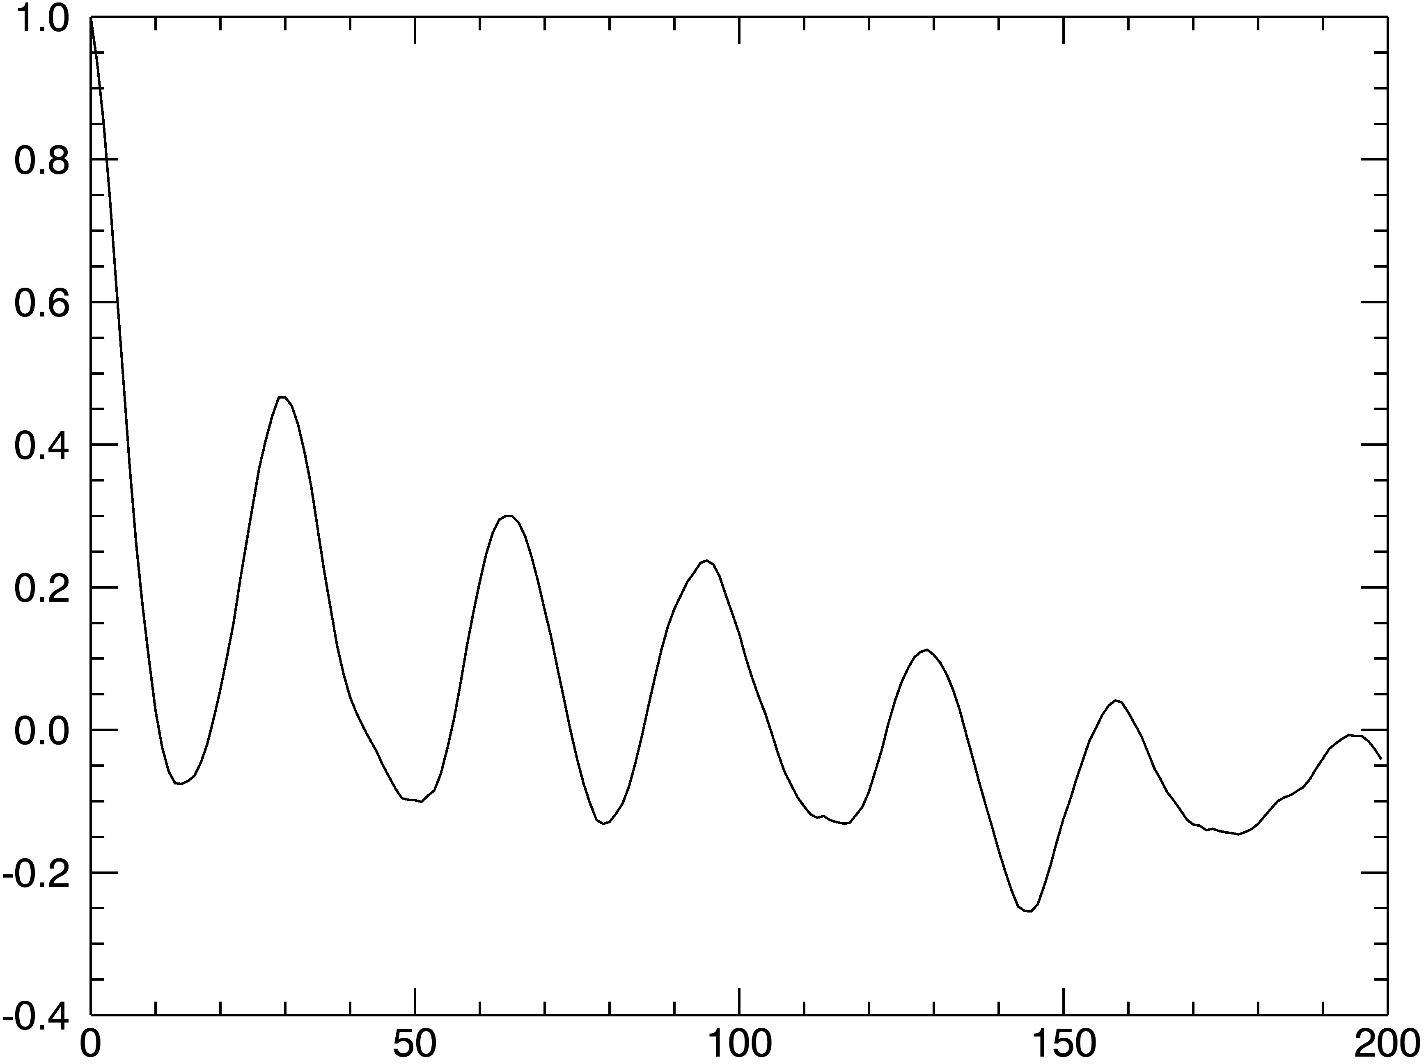
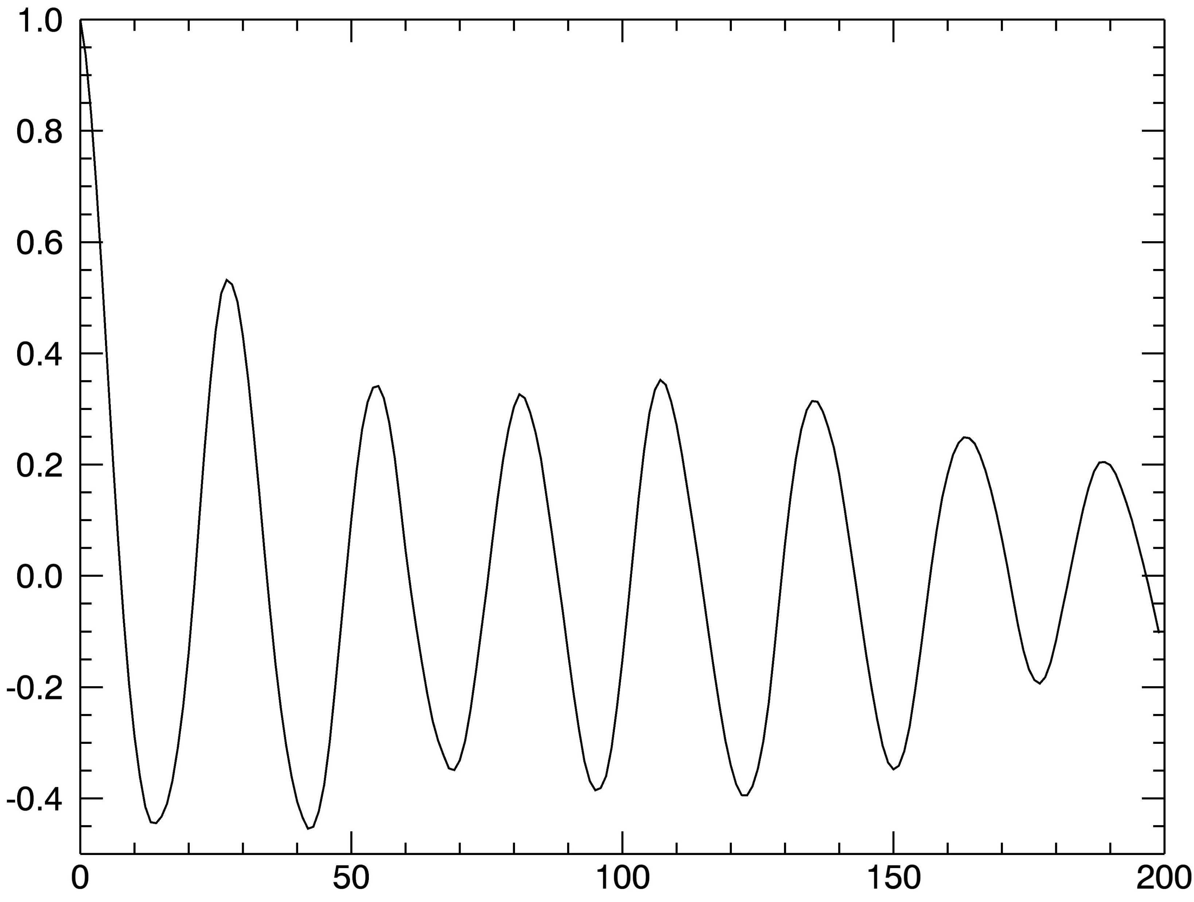
Autocorrelation
plots
2001
2002
10ºN
10ºS
Autocorrelation Coefficient
Autocorrelation Coefficient
Lag (Days)
Lag (Days)
2003
2003
70ºN
70ºS
Autocorrelation Coefficient
Autocorrelation Coefficient
Lag (Days)
Lag (Days)

Slide 16
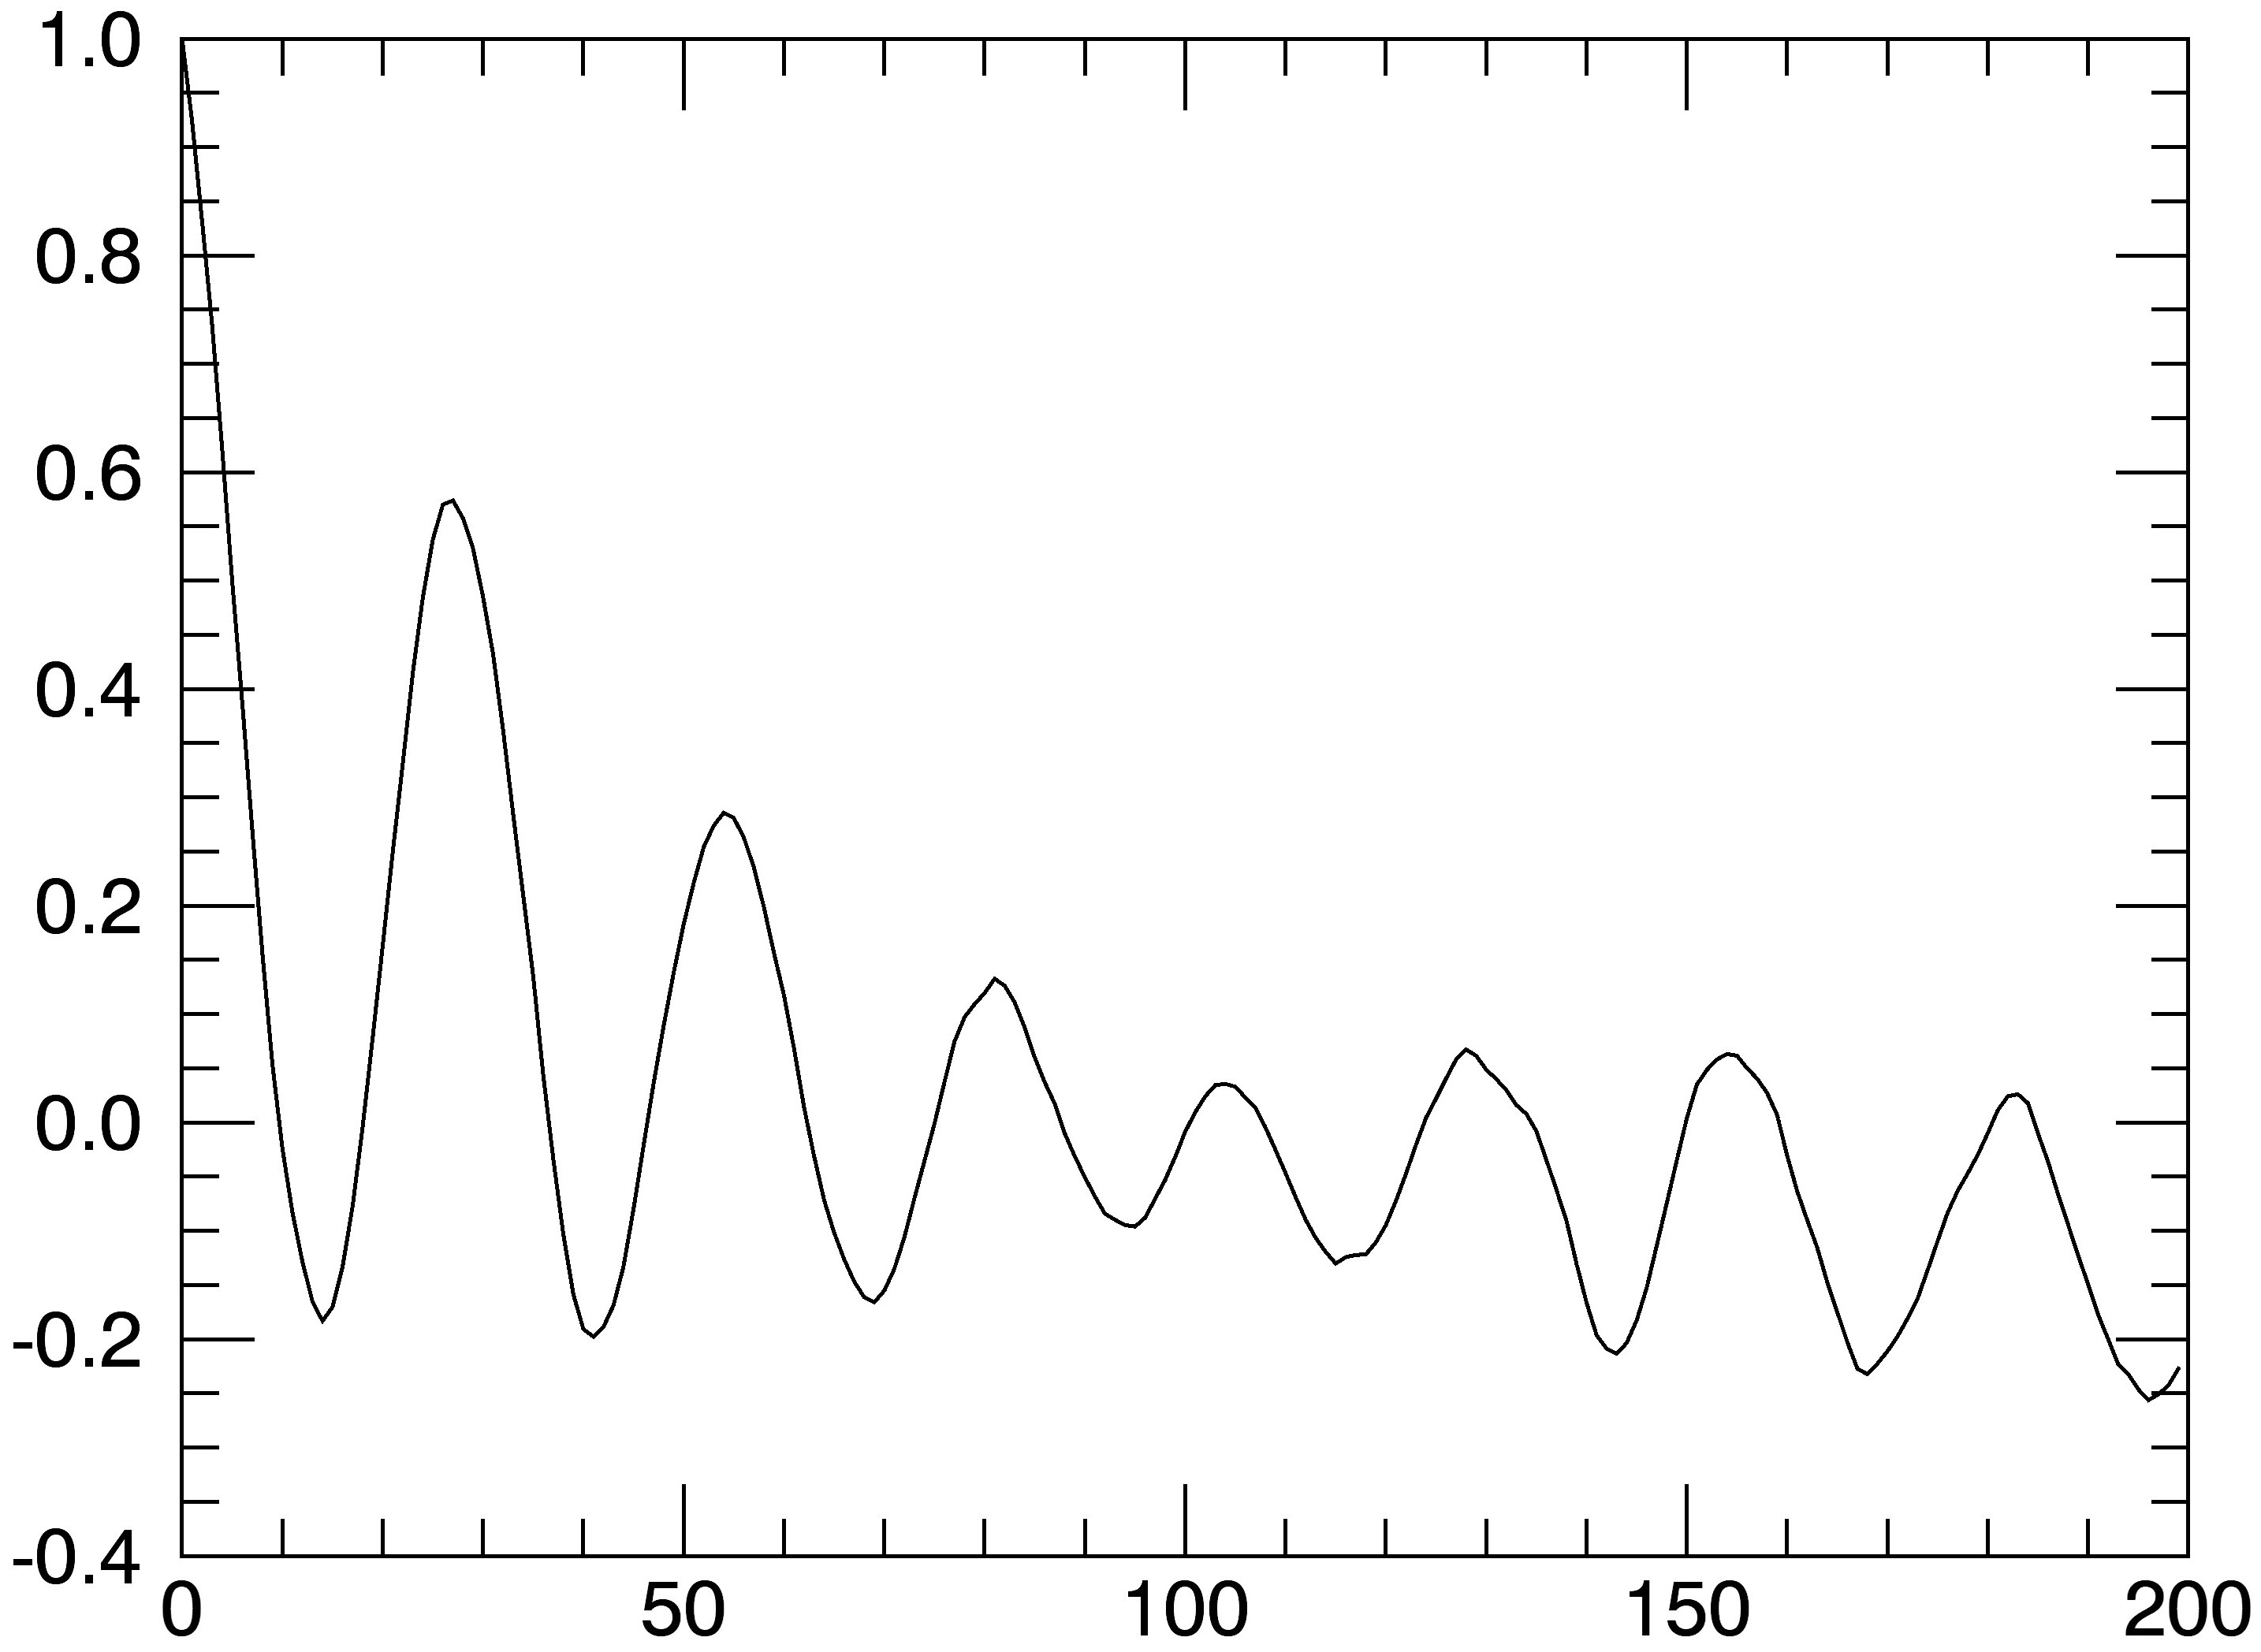
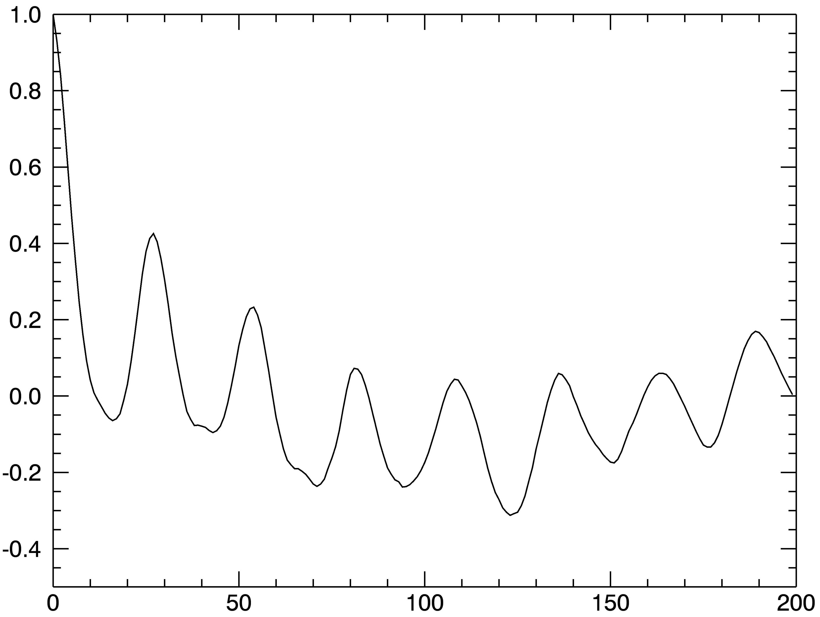
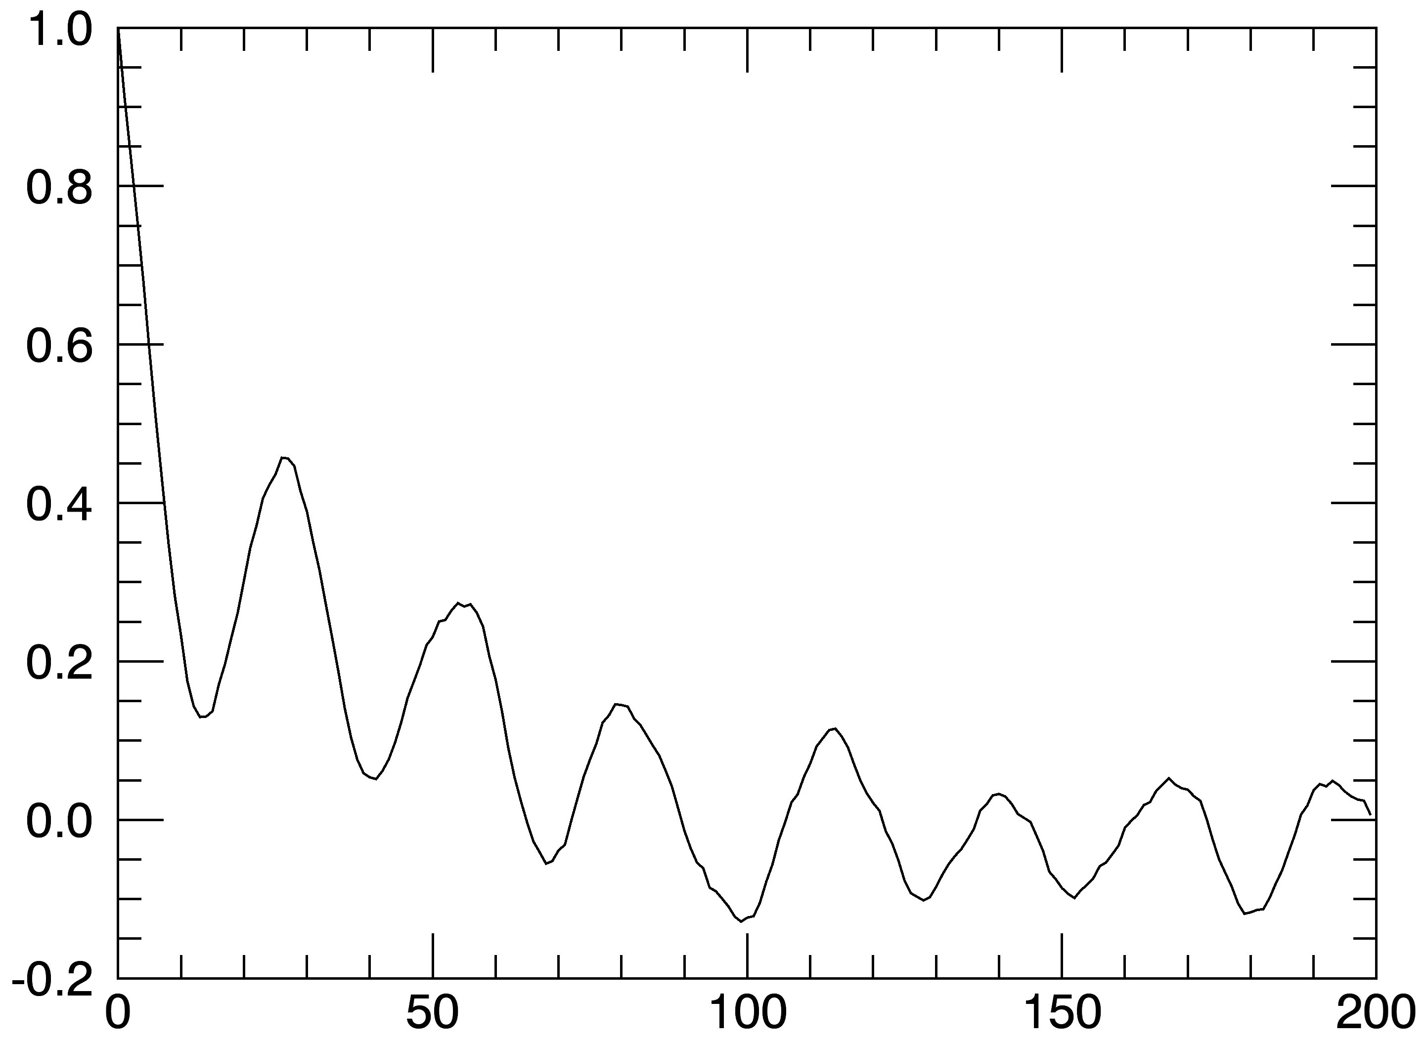
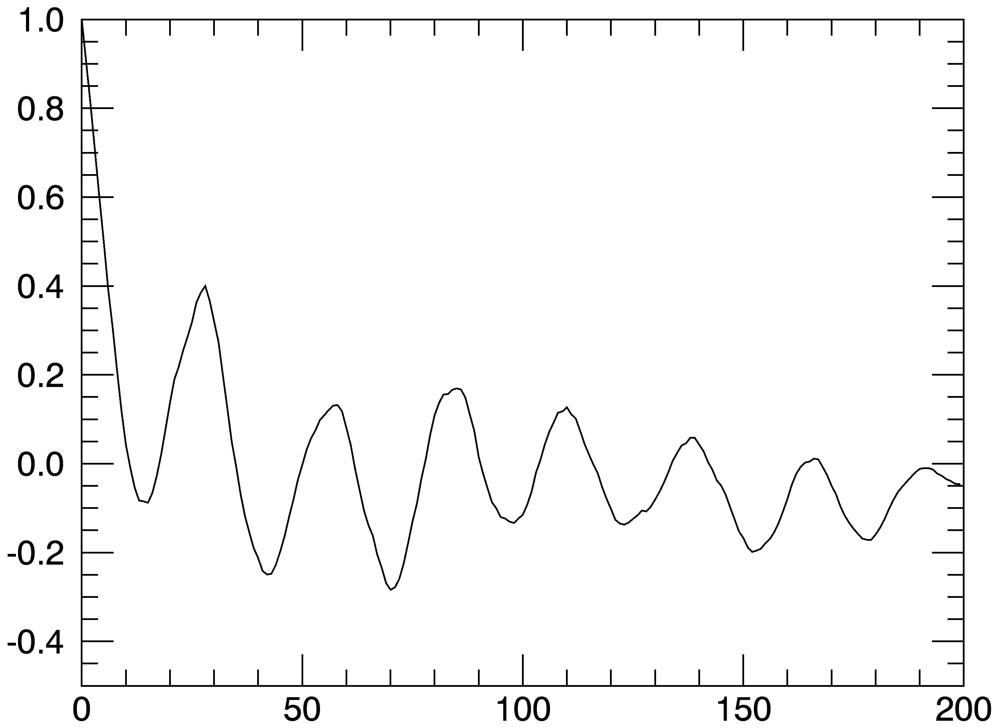
2016
1999
60ºS
20ºN
Autocorrelation Coefficient
Autocorrelation Coefficient
Lag(Days)
Lag(Days)
2015
2016
80ºN
60ºN
Autocorrelation Coefficient
Autocorrelation Coefficient
Autocorrelation Coefficient
Lag(Days)
Lag(Days)

Slide 17
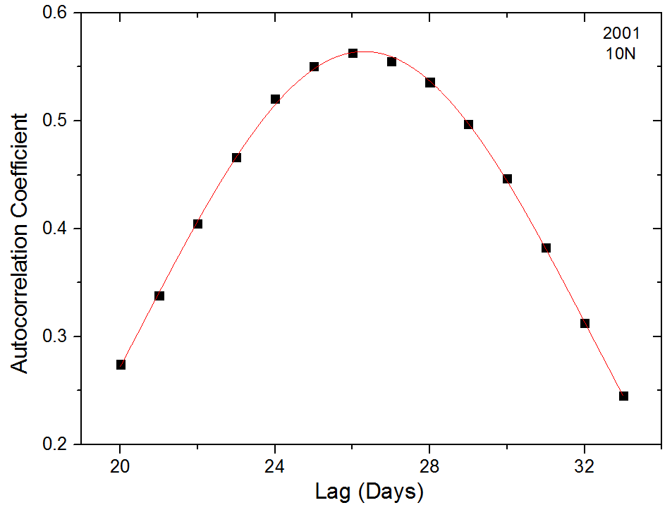
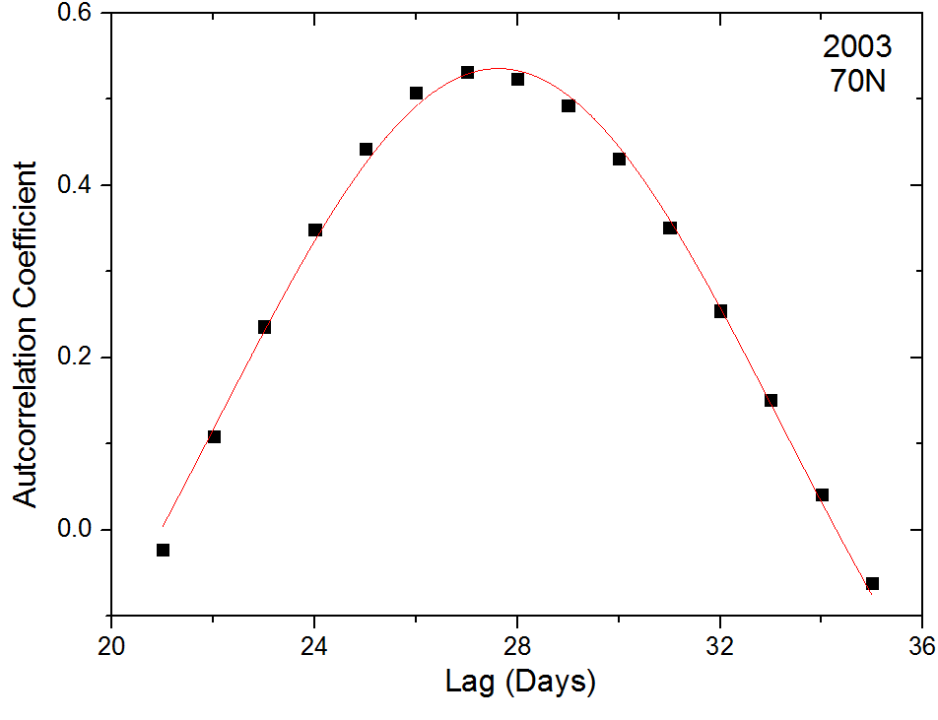
First Peak Analysis
There are 2 possible methods to extract the Rotation period from the Autocorrelation curve.
Count the number and position of the last visible peak and find the rotation period from their ratio (Chandra et. al. 2009, 2010; Chandra & Vats 2011)
We can get a more accrate result if a Gaussian curve is fitted to the first peak and the Rotation Period is obtained from the position of the Gaussian peak.

Slide 18
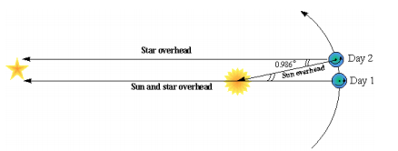
Obtaining the Sidereal Rotation Period
The rotation period obtained is the Synodic Rotation Period, and by taking into account the rotation of earth around the sun, we can obtain the Sidereal Rotation period, which is the real rotation period of the sun

Slide 19
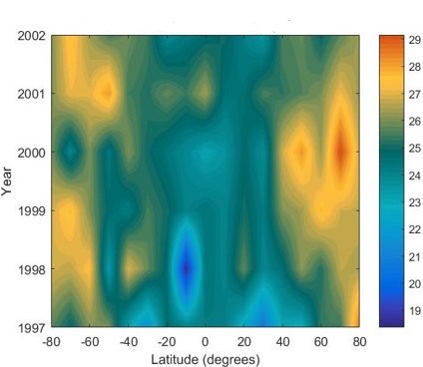
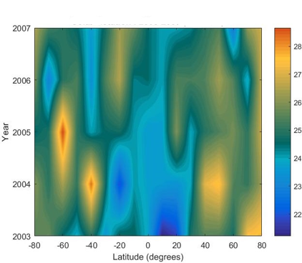
North South Asymmetry in Rotation
Solar Rotation Period: 1997-2002
Solar Rotation Period: 2003-2007

Slide 20
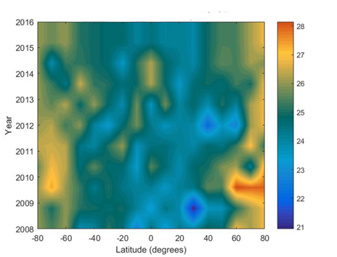
North South Asymmetry in Rotation
Solar Rotation Period: 2008-2016

Slide 21
Conclusions
There is clear indication of Asymmetry in Rotation of the different hemispheres using the Flux Modulation approach.
The asymmetry changes its sign during a solar cycle.
There is a correlation between the prominance of the asymmetry and the 11 year sunspot cycle.

Slide 22
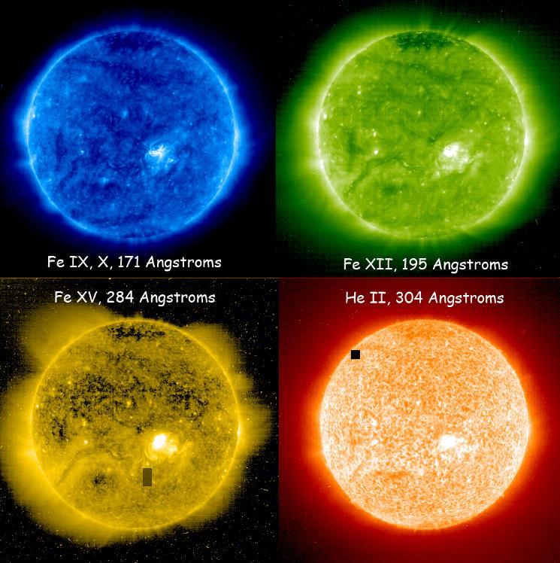
Further Analysis
This can also be observed by studying XUV images for other wavelegths and comparing with the Sunspot number.
XUV images of different wavelengths correspond to the flux obtained from different altitudes in the Corona.
Model the variation of rotation period with the latitude at various height in the coronal atmosphere, down to the transition region.

Slide 23
Thank you!

