Slide 1



FP7 EU – Grant Nr. 31495

Slide 2
#solarnet4m
facebook.com/europeansolartelescope
FP7 EU – Grant Nr. 31495

Slide 3
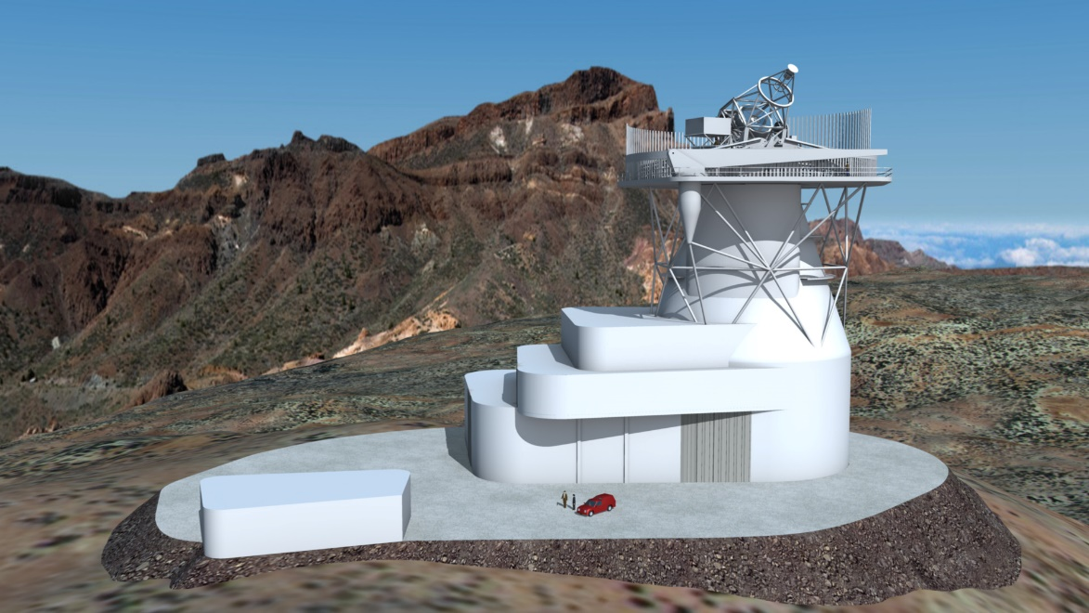

NEW ESFRI
PROJECT
IN 2016
Session 8:
Talk by Sarah Matthews
P

Slide 4
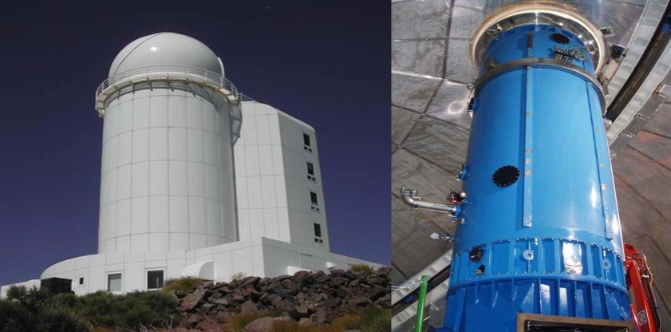
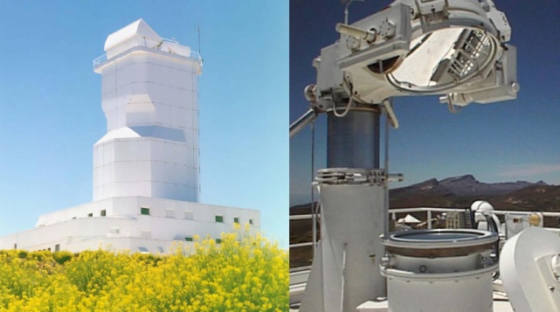
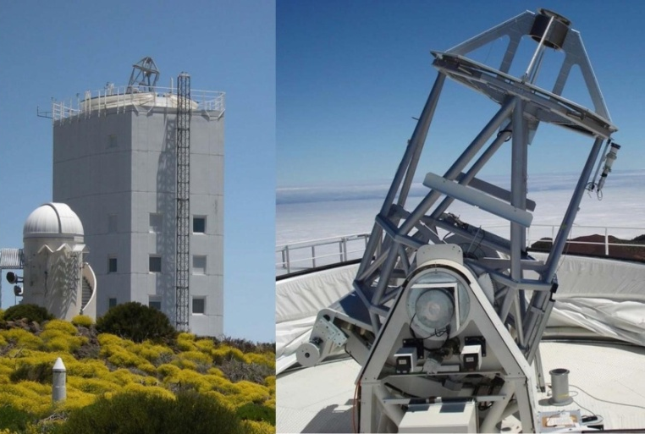
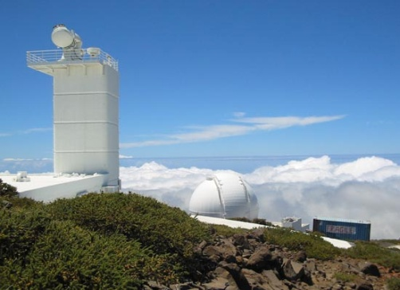
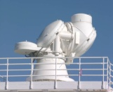
From present European ground-based facilities …
VTT 70 cm (Germany) ─ OT
THEMIS 90 cm (France) ─ OT
SST 100 cm (Sweden) ─ ORM
GREGOR 150 cm (Germany) ─ OT

Slide 5
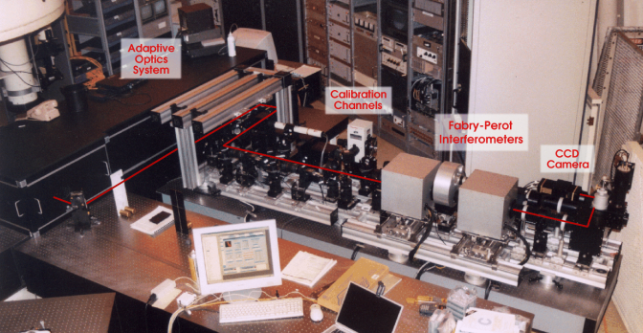
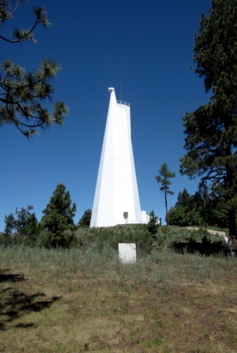
From present European ground-based facilities …
IBIS ─ Italy
@
DST (NM, USA)
ROSA ─ UK

Slide 6
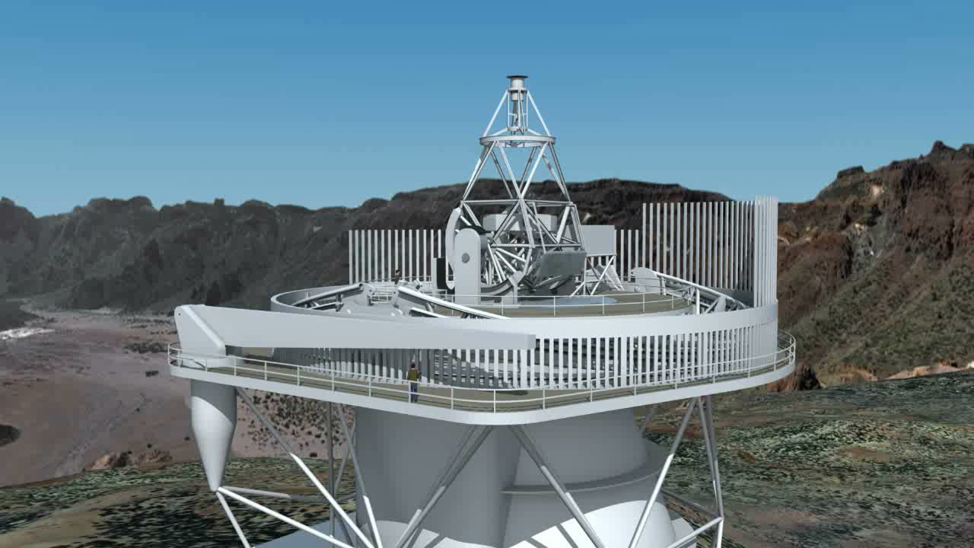
… to the European Solar Telescope, EST.

Slide 7
Meetings
Pipeline development
Schools
Data bases
Student Mobility
Virtual Observatory
Access
Advanced Intrumentation
Coordinated observations
Wavefront control
Relations with industry
Synoptic observations (SPRING)
Outreach
See posters Session 0: WP20, WP30, WP40, WP50, WP60, WP70, WP80, WP90 & WP100
COMMUNITY
TECHNICAL DEVELOPMENTS

Slide 8
Period: 1 April 2013 – 30 March 2017
32 partners:
  24 EU research institutions
  6 EU private companies
  2 USA research institutions
16 countries
Coordinator institution: IAC

Slide 9











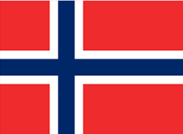




PARTNERS
IAC | ES | UCL-MSSL | UK | UoB | UK
KIS | DE | AISAS | SL | CNR-INO | IT
INAF | IT | AIASCR | CZ | HANKOM | NL
CNRS | FR | HVAR | CR | CIMNE | ES
UToV | IT | ROB | BE | SRS | IT
MPG | DE | IGAM | AU | PNSensor | DE
UiO | NO | UWR | PO | WO | FR
AIP | DE | UCAL | IT | TECNALIA | ES
SU | SE | WU | NL | NSO | USA
UPS | FR | IRSOL | SW | CfA-SAO | USA
QUB | UK | IAA-CSIC | ES

Slide 10
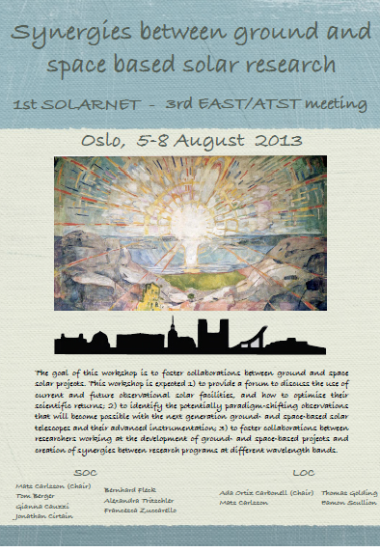
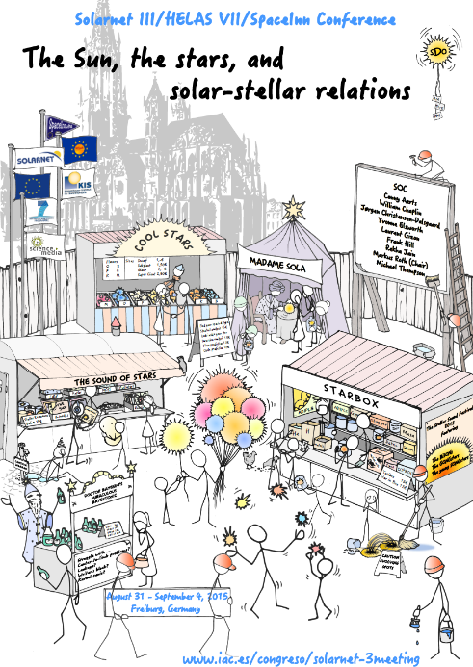
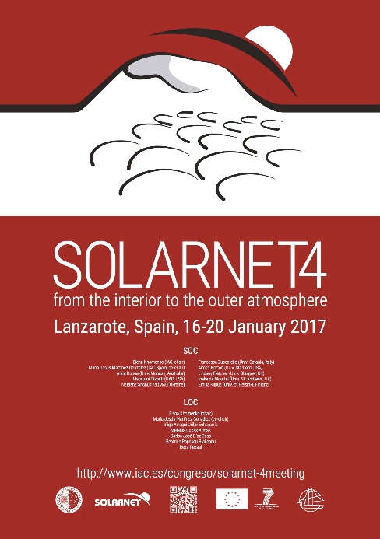
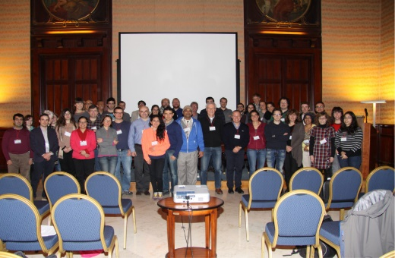
Meetings (WP30 poster)
2013: Synergies between ground- and space-based solar research – Norway
2015: Helio- and astero-seismology – Germany
2014: Solar and stellar magnetic activity – Italy
2017: The physics of the Sun from the interior to the outer atmosphere – Spain

Slide 11
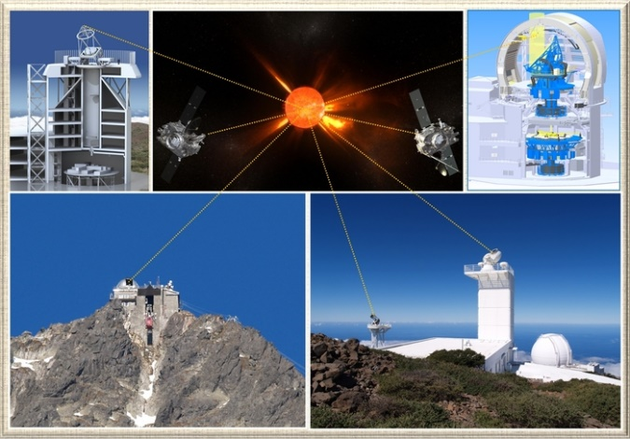
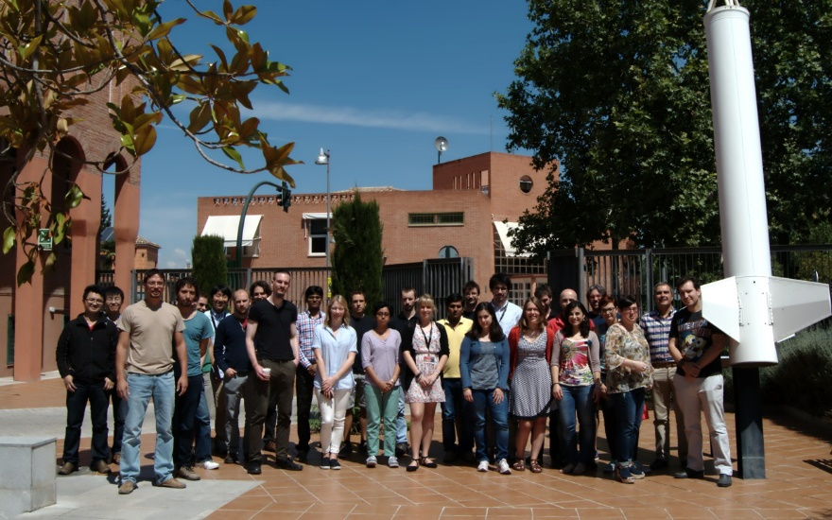
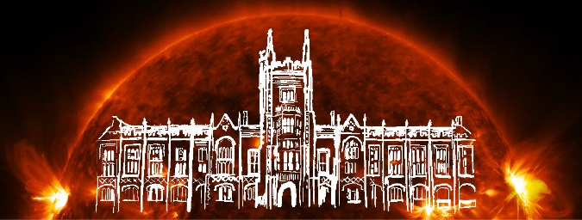
Schools (WP30 poster)
3rd SOLARNET summer school and workshop
5th SOLARNET summer school and workshop

Slide 12
Schools (WP30 poster)
2014: Introduction to solar physics. Radiative processes in the Sun and the stars – Poland
2014: Ground- and space- based instruments. Methods in high resolution and synoptic solar physics – Slovakia
2015: Solar magnetic fields: modeling and measuring techniques. Polarization as a tool to study the Sun, the Solar System, and beyond – Spain
2016: Solar MHD and magnetic reconnection theory. Solar eruptive events: observations and modelling – UK
2016: MHD waves and oscillations in the solar atmosphere, Heating mechanisms in the solar atmosphere – UK
20-25 students/school

Slide 13

Student mobility (WP30 poster)
Funds for short stays (up to 2-3 months) of young
researchers at another institution
Call permanently open
2 evaluations per year
Young researchers: 20 from 9 countries
UK(6), IT(5), PL(2), ES(1), GR(1), RS(1), DE(2), India(1), Iran(1)
Host Institution: 9 countries
ES(5), USA(4), IT(3), UK(2), DE(2), FR(1), SE(1), CZ(1), NO(1)
Average stay: 8.3 months

Slide 14
Telescope operation and Access
(WP20 & WP90 posters)
Observing periods open to external researchers
Service mode: IBIS/ROSA@DST
Proposals evaluated by EAST TAC

Slide 15
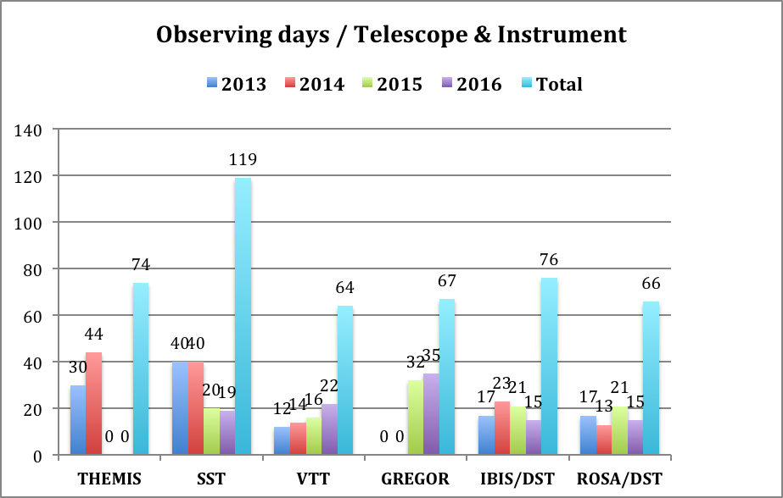
Telescope operation and Access
(WP20 & WP90 posters)
Total: 466 days

Slide 16
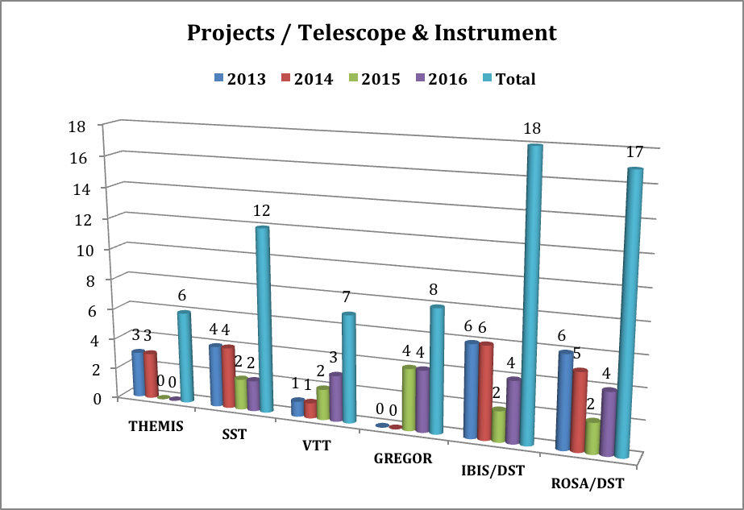
Telescope operation and Access
(WP20 & WP90 posters)
Total: 68 observing proposals / 12 countries

Slide 17
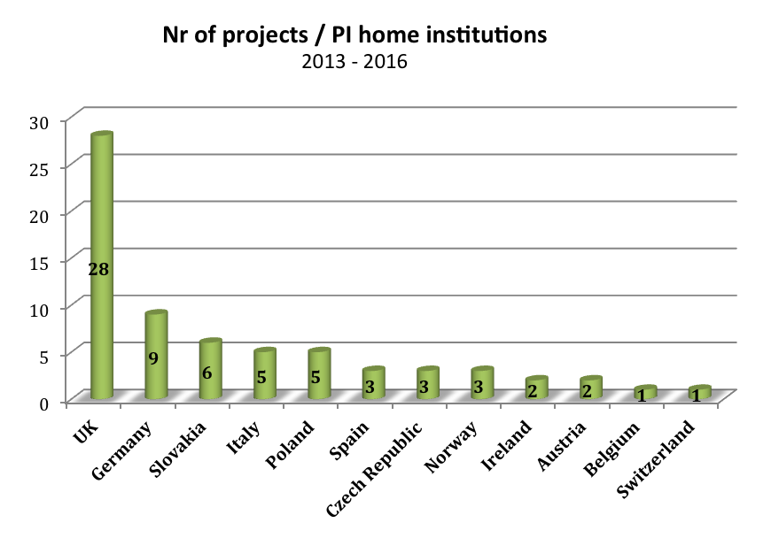
Telescope operation and Access
(WP20 & WP90 posters)

Slide 18
Coordinated observations (WP20 poster)
Green: GRIS@GREGOR
Red: GFPI@GREGOR
Blue: CRISP@SST
Background: HMI
González Manrique et al. (2016)

Slide 19
Pipeline development (WP50 poster)
CRISPRED flowchart (de la Cruz Rodríguez 2015, A&A 573, A40)

Slide 20
Pipeline development (WP50 poster)
CASSDA GUI (Löhner-Böttcher 2016, PhD thesis)

Slide 21
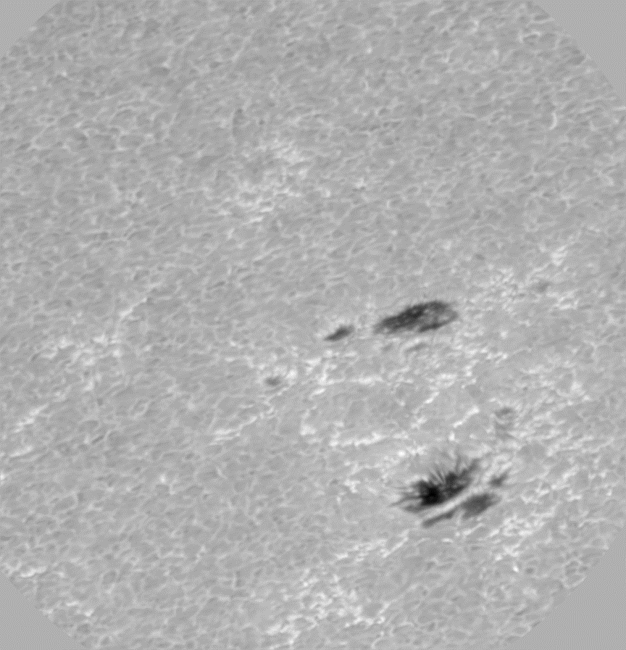
Data storage and retrieval
(WP20 + WP50 + WP100 Posters + Vansintjan’s talk)
Data storage in accordance
to virtual observatory rules
Generation of a prototype
archive using ground-based
data, accessible and
manageable through
Virtual Observatory tools
Courtesy of de la Cruz Rodríguez

Slide 22
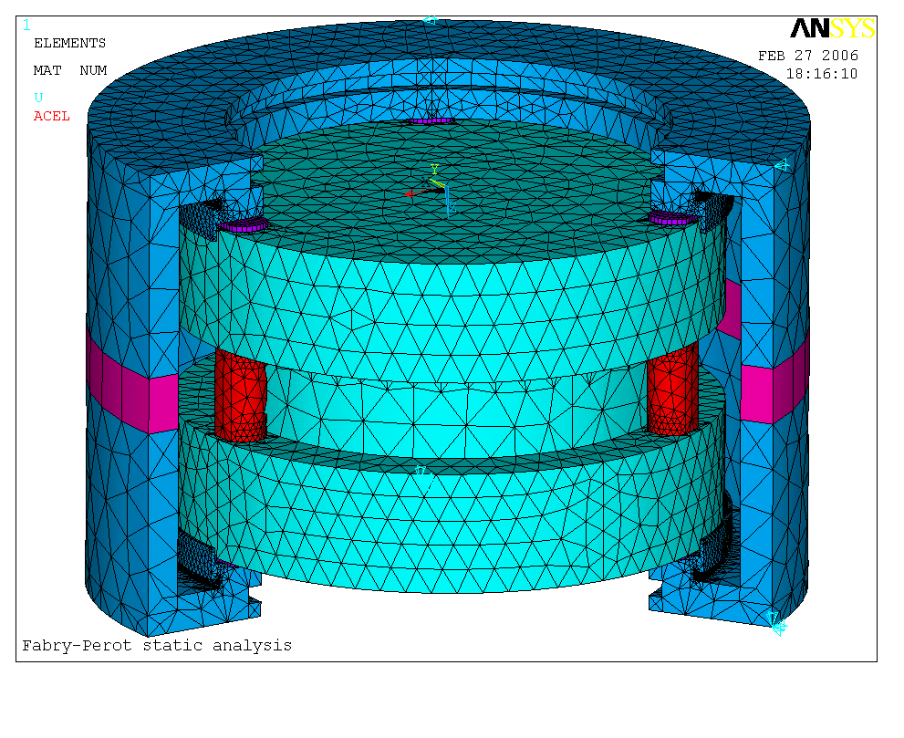
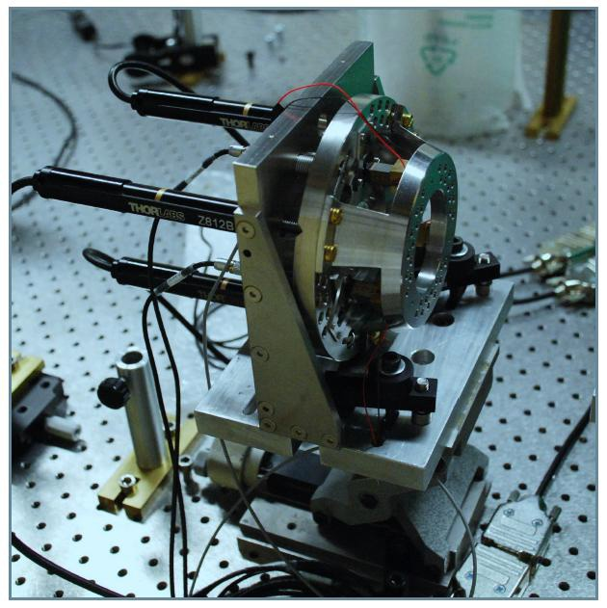
Advanced instrumentation
(WP60 poster + del Moro’s talk + Berrilli et al. poster)
Large etalon development

Slide 23
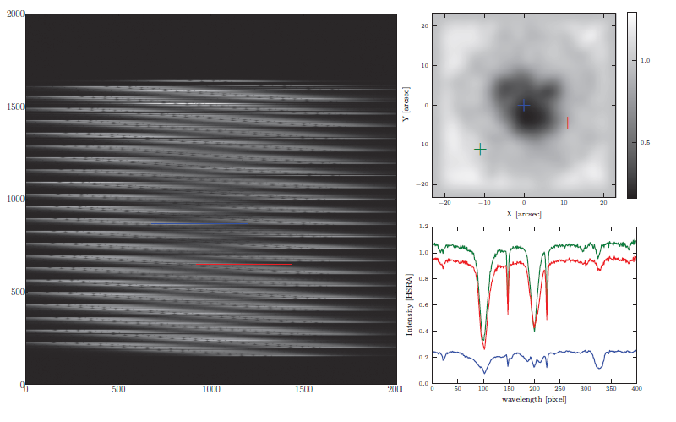
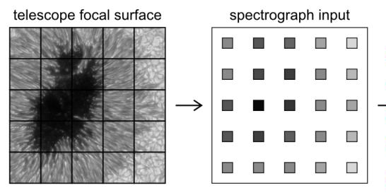
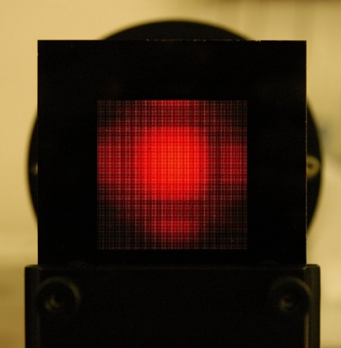
Advanced instrumentation
(WP60 poster + van Noort’s talk)
Microlens-fed 2D spectrograph

Slide 24
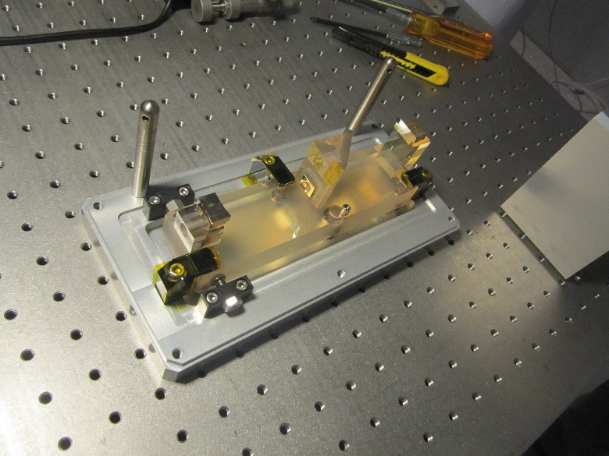
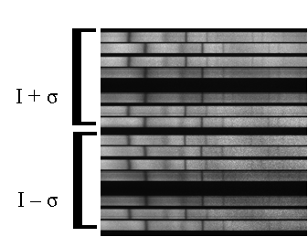
Advanced instrumentation
(WP60 poster + Asensio’s talk)
Image slicer

Slide 25
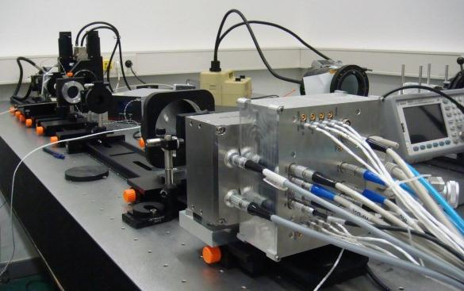
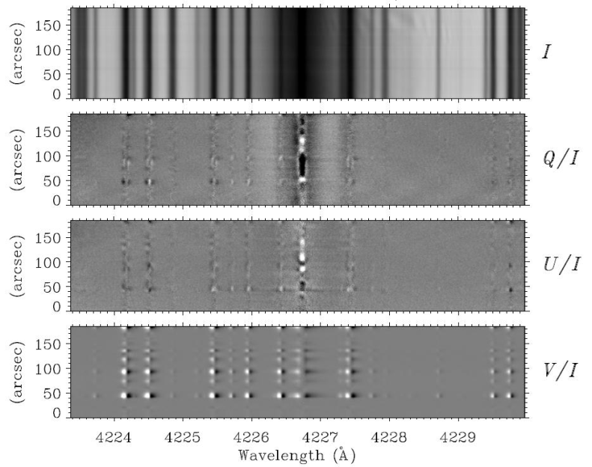
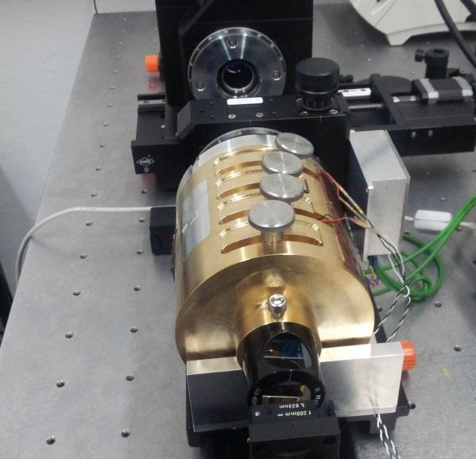
Advanced instrumentation
(WP60 poster + Iglesias’ talk)
Fast Polarimeter

Slide 26
Atmospheric turbulence
(WP70 poster + Hammerschlag et al. + Hartogensis et al. posters)
Implementation of AO optics at THEMIS
EST-like Heat Rejecter prototype for GREGOR (Berrilli’s talk)
AO/MCAO numerical simulations
CFD analyses
Local/non local seeing mesurements

Slide 27
Synoptic telescopes network
SPRING - Roth’s talk + WP80 poster + Gosain et al. poster
Full-disk Doppler velocity images
Full-disk vector magnetic field images
Full-disk intensity images
Cadence not longer than 60 seconds
Spatial resolution of 1 arcsec
Operational at least 90% of the time

Slide 28
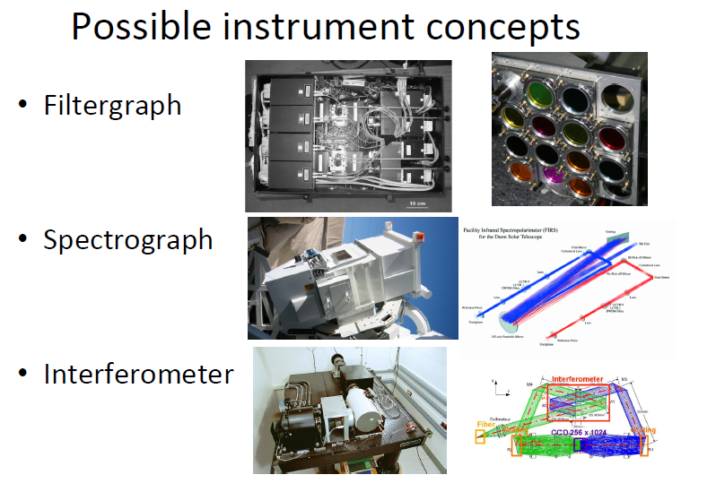
Synoptic telescopes network
SPRING - Roth’s talk + WP80 poster + Gosain et al. poster

Slide 29
SOLARNET-II …

