Slide 1

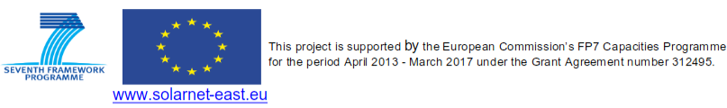
The SOLARNET Solar Virtual Observatory
Presenter: R. Vansintjan
Authors: B. Mampaey, V. Delouille
From the Royal observatory of Belgium
Notes:
My talk will be about the SOLARNET Solar Virtual Observatory prototype developed in the SOLARNET project at ROB

Slide 2
Introduction
The work presented here was done under WP 50.2 of SOLARNET
Under WP 50.1 instrument pipelines were developed and a document on standards for meta-data was written.
One of the aims of the SOLARNET project was to make the date from the different European Solar telescopes ( e.g. GREGOR, SST, THEMIS, etc ) easily available to the community
We think there is a use for a VO that increases the awareness of the different datasets that are available. More so with the campaign like nature of ground based telescopes.
In this presentation I’ll give a description of the SVO and show some of its features.
URL: solarnet.oma.be
Notes:
By searching with the SOLARNET we also want to make researchers of other datasets that they may not have heard of or only take data at certain times

Slide 3
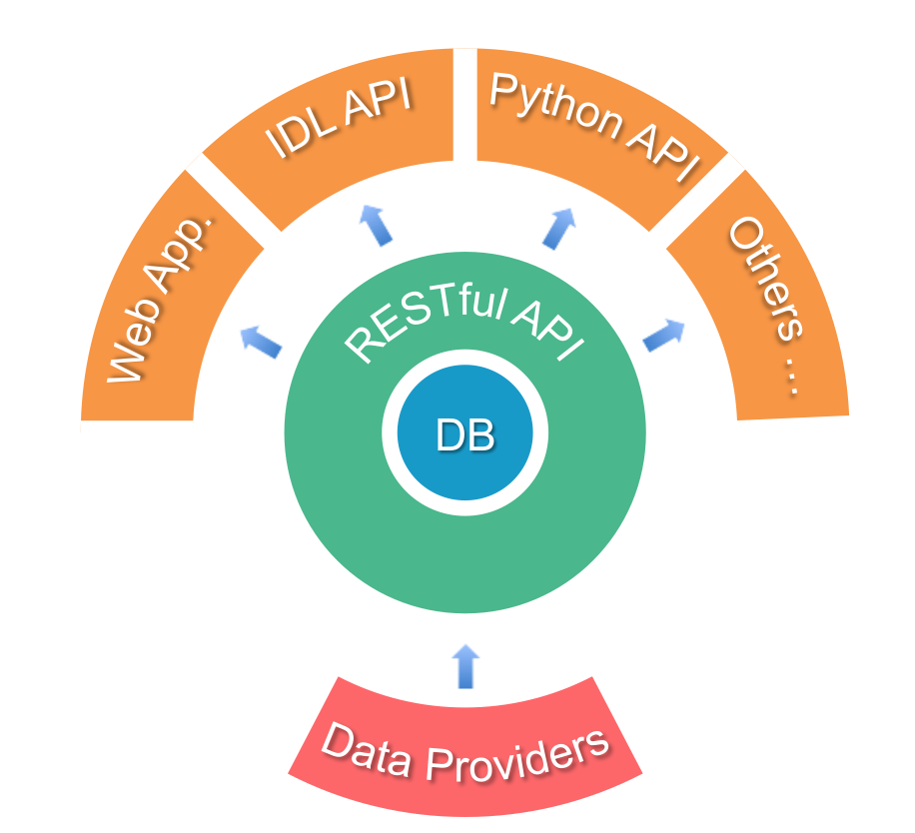
Architecture of the SVO
Notes:
This is the design of the SVO.
The data will be hosted on the servers of the data providers. We collect the metadata into a central searchable database.
To interface with the database we use the widely used RESTful API so that it’s easy to develop new tools that interface with the API
The SVO is made up out of a web App aimed at user friendliness and an IDL and Python API to make more complex searches and to be used in programs and scripts.

Slide 4
SVO features overview
Searches across different data sets (date, wavelength, tags)
Tags for the provider to mark special data
Dataset specific search interface
Quick-look (thumbnail and meta-data)
Search by solar events (event date and type)
Co-observation searches (date of observation overlap)
Data selection download by FTP and ZIP
US VSO as a data provider (ChroTel, XRT)
Notes:
By search across data sets the user will become more aware of what is out there.
Tags give the possibility to mark data in a way that is difficult with meta data and by cross referencing event catalogues.
Quick-look is included if the providers provides something
I’ll show the functionality of the SVO with examples from the web app

Slide 5
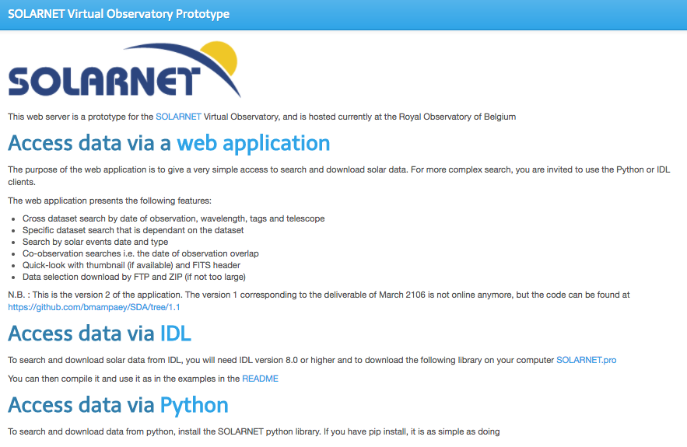
The website: solarnet.oma.be

Slide 6
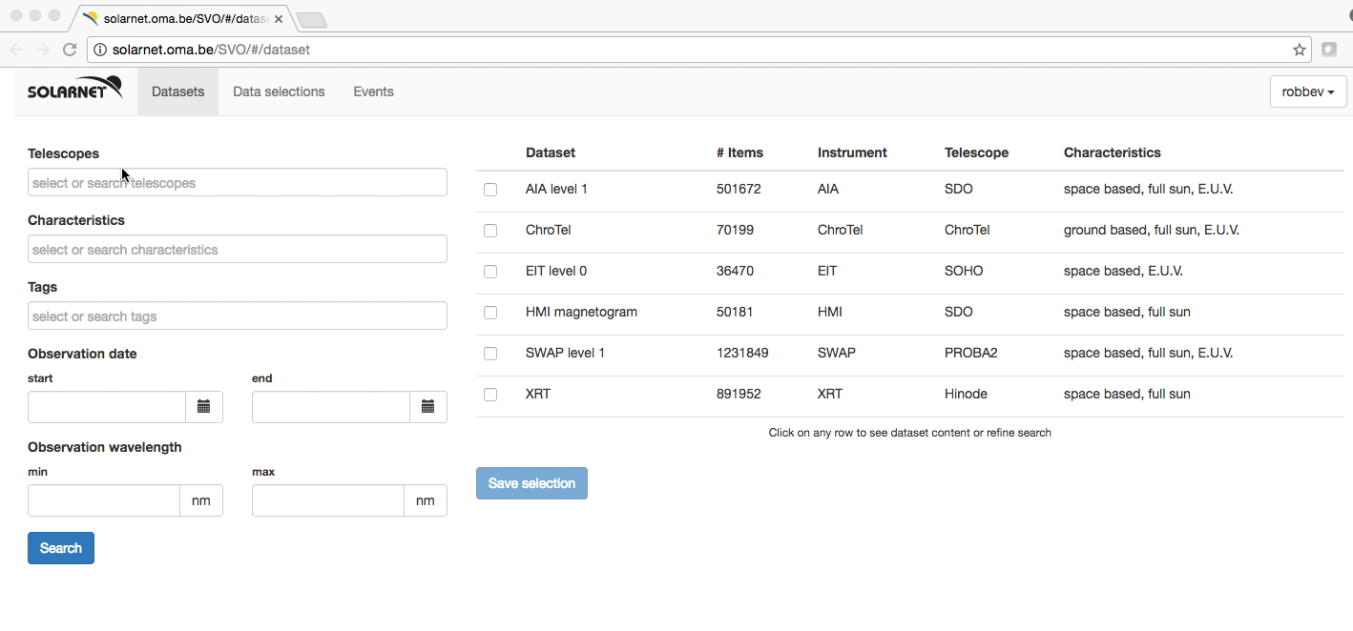
Searching across datasets
Notes:
Here we show the possibilities of searching across datasets.
Selection is possible by telescope (ground based or satellite ) certain characteristics of the data
Tags like a Venus transit or the Halloween event
And date and wavelength

Slide 7
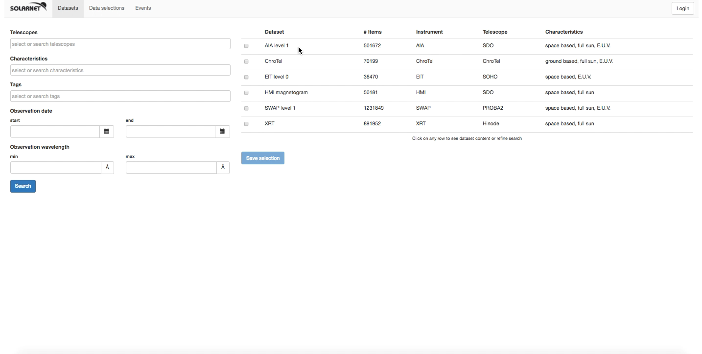
Dataset specific searches and quick-look

Slide 8
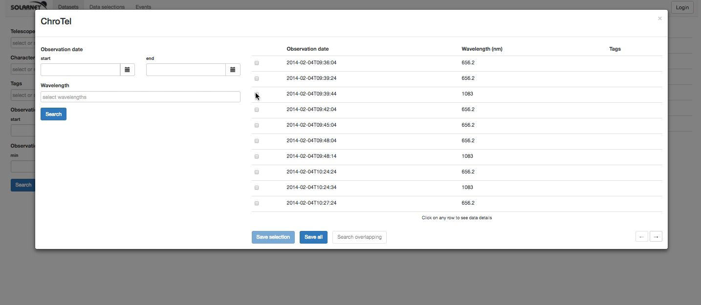
Co-observation searches

Slide 9
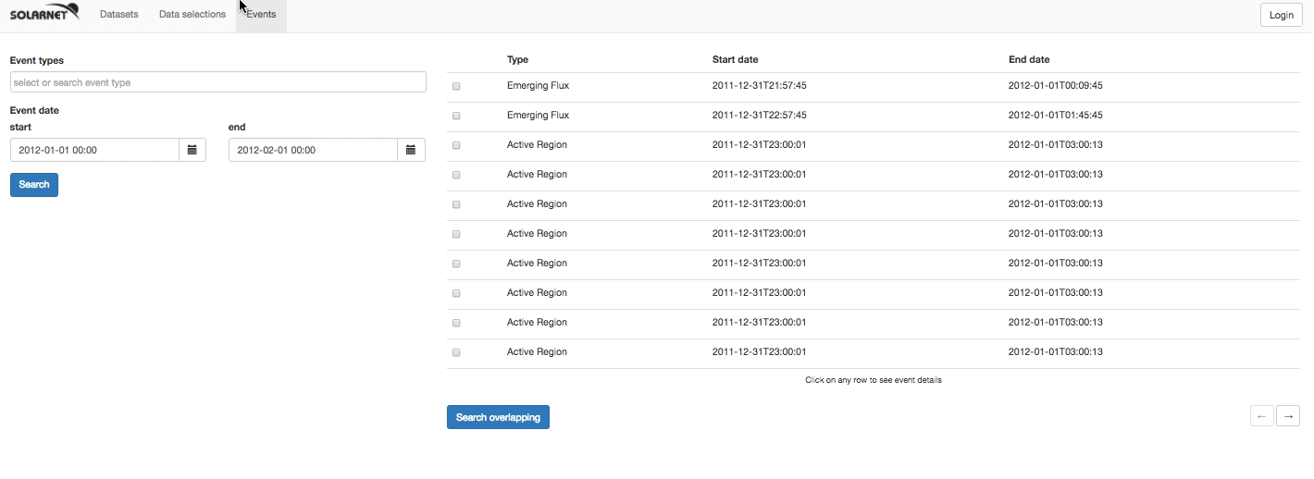
Search by solar events

Slide 10
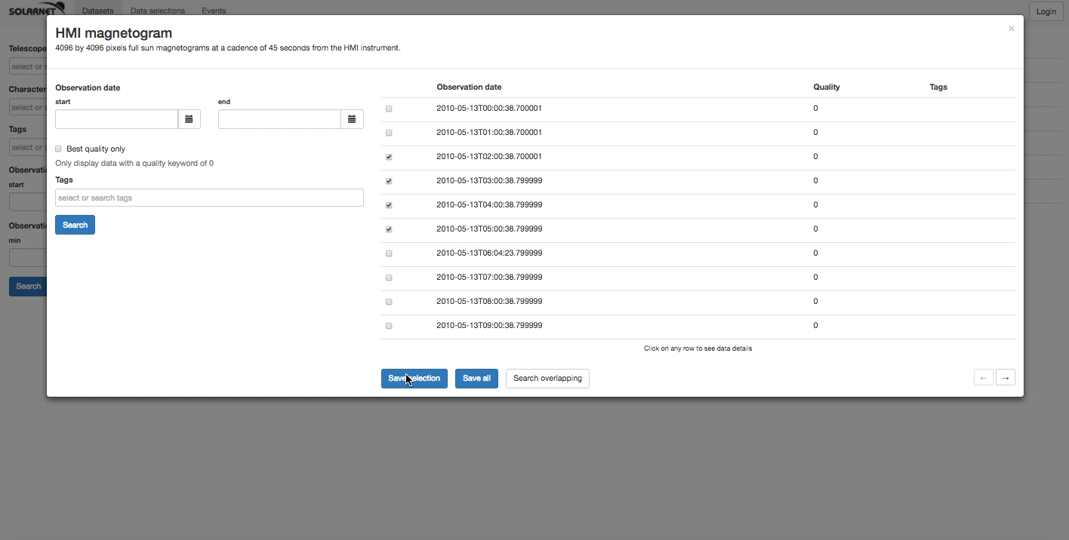
Data selection download

Slide 11
Going forward
Currently we are moving the software from our development sever to an operational server.
As the data from different SOLARNET telescopes is put in a final state, is released, etc… we want to ingest this data into the SOLARNET SVO
We are talking but have no concrete plans to interface the VO with HELIO Heliophysics Event Catalogue
We will develop a manual for the users
At the end of March the SOARNET SVO will have more datasets and we will maintain it on a best effort basis
Notes:
The data from the telescopes in SOLARNET is becoming more available and will follow a metadata stadard.

Slide 12
Thank you!
Feedback is very welcome

