Slide 1
Nanoflare Properties in the Solar Corona
Nicholeen Viall, (NASA/GSFC)
With thanks to Stephen Bradshaw (Rice University), James Klimchuk (NASA/GSFC), ISSI Coronal Heating Team, Coronal Loops Workshops
We thank the SDO/AIA team for the use of these data. This research was supported by a NASA Heliophysics GI.
Notes:
Jim and I did a series of papers on time lag method and its applications; bradshaw and I then took hjis AR model, my timelag method analysis to it

Slide 2
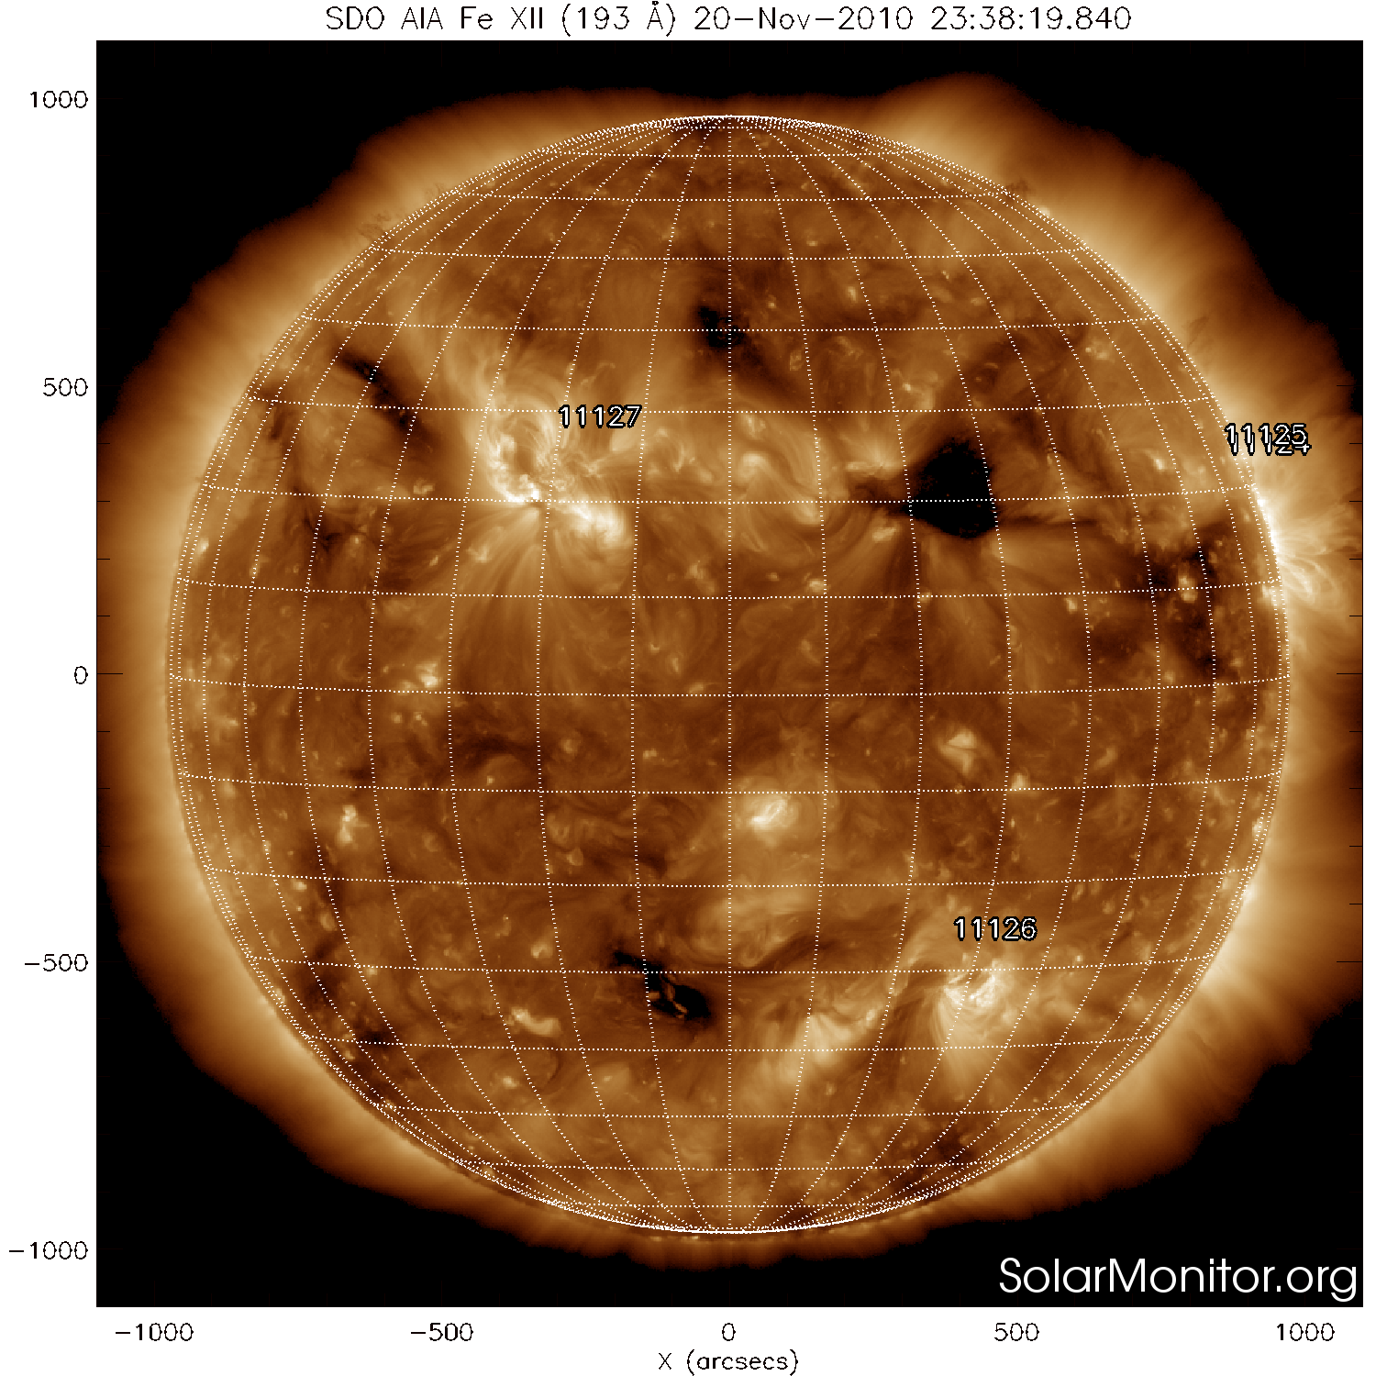
What are the Properties of Coronal Heating on the Sun?
Nanoflare – Impulsive burst of energy (Klimchuk 2006)
Notes:
All we can say so far is impulsive bursts, don’t know mechanism yet (so lets figure out what paremeter space is)

Slide 3
We can get information on the recurrence time of energy release from the thermal evolution in SDO/AIA emission
We find that the observations are best reproduced with heating that recurs every ~ 2000s per flux tube, where there is a distribution of energies and recurrence times
We address question with SDO/AIA – timelag technique can be applied to any multi-wavelength data
Notes:
All we can say so far is impulsive bursts, don’t know mechanism yet (so lets figure out what paremeter space is)

Slide 4
The details of the timing of energy release on a given flux tube have observable thermal consequences
SDO/AIA Light Curves
Coronal Plasma Evolution
335 Å, ~ 3 MK
Temperature
211 Å, ~ 2 MK
335
211
193
94
131 Å, ~0.5 MK
171
131
Density
Viall & Klimchuk 2011
Impulsive heating: only see cooling phase
Notes:
Modeled here; ugarte urra Amy etc countless observations

Slide 5
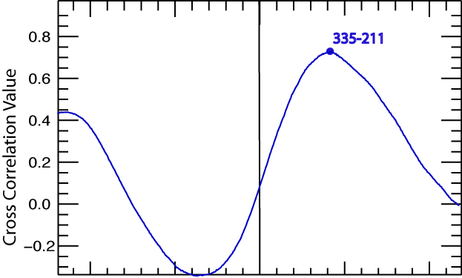
Cross Correlation = Cooling Time
Δt, Time Lag between 335 Å and 211 Å
Cooling time from
335 Å (~3 MK) to 211 Å (~2 MK)
-1000 -500 0 500 1000
Viall & Klimchuk 2011
Time Offset (s)
SDO/AIA light curves predicted with nanoflare model (EBTEL)
Automatically detect post-nanoflare cooling (and other heating forms)
Cross correlate two wavelengths (temperatures) at different temporal offsets: peak cross correlation = time lag between light curves
Notes:
If cooling, then timelag is cooling time. Out of phase is easily distinguishable from noise (which is uncorrelated),

Slide 6
Time Lag Map Shows Post-nanoflare Cooling
(~3 MK-~2 MK)
SDO/AIA 171
0.8 MK
Apply test on pixel-by-pixel basis to 12-hr timeseries
AR core is almost exclusively positive time lags
AR outside core has zero time lag in moss/transition region (Viall & Klimchuk 2014) and in fan loop due to flows (Viall & Klimchuk 2016)
Not just at a few discrete loops ; rather, entire AR core nanoflares, including the ‘diffuse’ emission between loops
Self consistent picture in other 14 pairs of channels (6 channels – 15 pairs)
Negative time lags: slow heating
Positive time lags: post-nanoflare cooling
zero time delay: transition region/moss
Partial cooling
Viall & Klimchuk 2012
Notes:
Perform time lag test at every pixel and tag that pixel with the time lag; create time lag maps; here is one pair of channels

Slide 7
1) >10,000 s recurrence time for energy release on a given flux tube (aka ‘low frequency’ heating) 2) ~2000 s recurrence time for energy release on a single flux tube; power law distribution (Hudson 1991), recurrence time ∝ energy (Cargill 2014) 3) ~500 s recurrence time for energy release on a single flux tube; power law distribution (Hudson 1991), recurrence time ∝ energy (Cargill 2014) 4) <500 s regular and continuous (aka ‘steady heating’)
We Test Four Simple Models for Nanoflare Recurrence Time on a Given Flux Tube:
Reep et al. 2013

Slide 8
Cooling times longer than 500 seconds are typically observed
(~3 MK-~2 MK)
Viall & Klimchuk 2012
Notes:
Perform time lag test at every pixel and tag that pixel with the time lag; create time lag maps; here is one pair of channels

Slide 9
1) >10,000 s recurrence time for energy release on a single flux tube 2) ~2000 s recurrence time for energy release on a single flux tube; power law distribution (Hudson 1991), recurrence time ∝ energy (Cargill 2014) 3) ~500 s recurrence time for energy release on a single flux tube; power law distribution (Hudson 1991), recurrence time ∝ energy (Cargill 2014) 4) <500 s regular and continuous (aka ‘steady heating’)
Cooling times of greater than 500s are observed, precluding such rapid energy bursts.
Reep et al. 2013

Slide 10
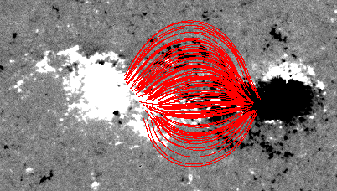
Hydrad Model of an Active Region
Bradshaw & Viall 2016
PFSS to get distribution of flux tube lengths
Build model of AR populating each of 400 field lines with a unique Hydrad flux tube result
Hydrad is a 1-D hydrodynamic model of plasma evolution
Built 3 different ARs to test nanoflare recurrence times

Slide 11
335
AR model; distribution of nanoflares ~2000s avg
211
171
131

Slide 12
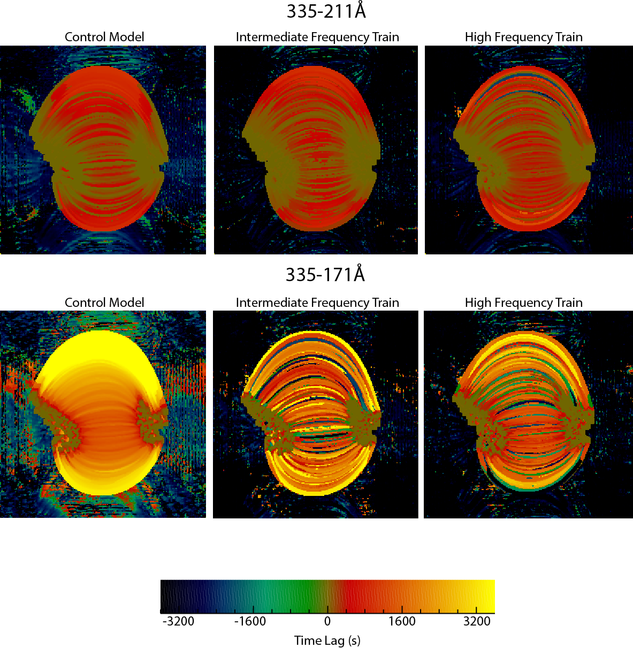
Time lag maps of all three experiments show post-nanoflare cooling
10000 s
2000 s
500 s
2-hr
12-hr
Bradshaw & Viall 2016

Slide 13
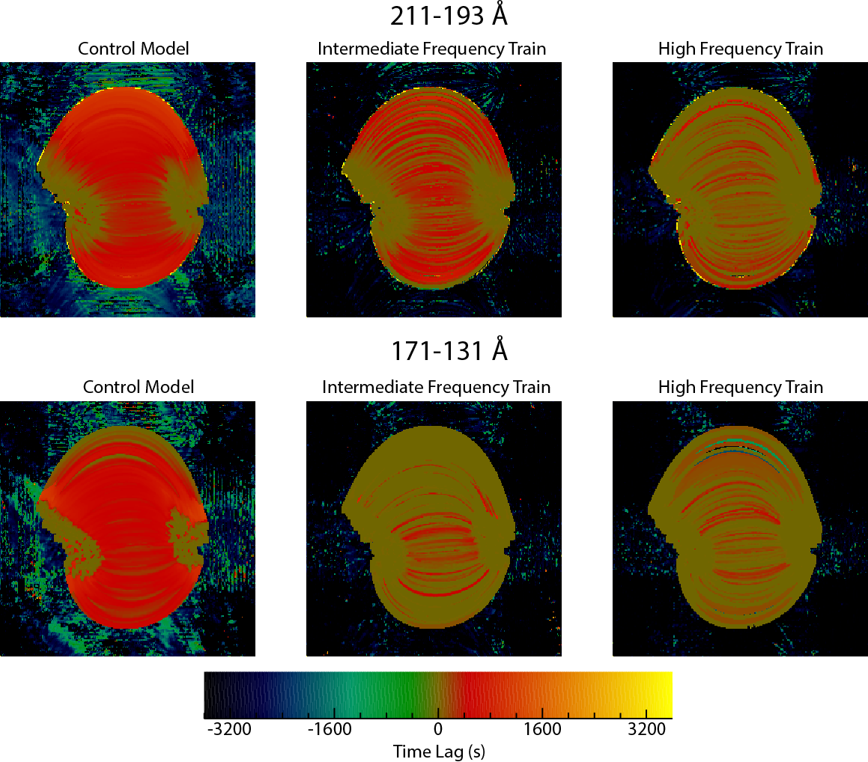
Observed timelag maps show only full cooling in some flux tubes, unlike the 10,000s model
10000 s
2000 s
500 s
2-hr
12-hr
Bradshaw & Viall 2016

Slide 14
1) >10,000 s recurrence time for energy release on a single flux tube 2) ~2000 s recurrence time for energy release on a single flux tube; power law distribution (Hudson 1991), recurrence time ∝ energy (Cargill 2014) 3) ~500 s recurrence time for energy release on a single flux tube; power law distribution (Hudson 1991), recurrence time ∝ energy (Cargill 2014) 4) <500 s regular and continuous (aka ‘steady heating’)
Full cooling observed only occasionally
(DEM analyses also provide evidence against #1)
Reep et al. 2013

Slide 15
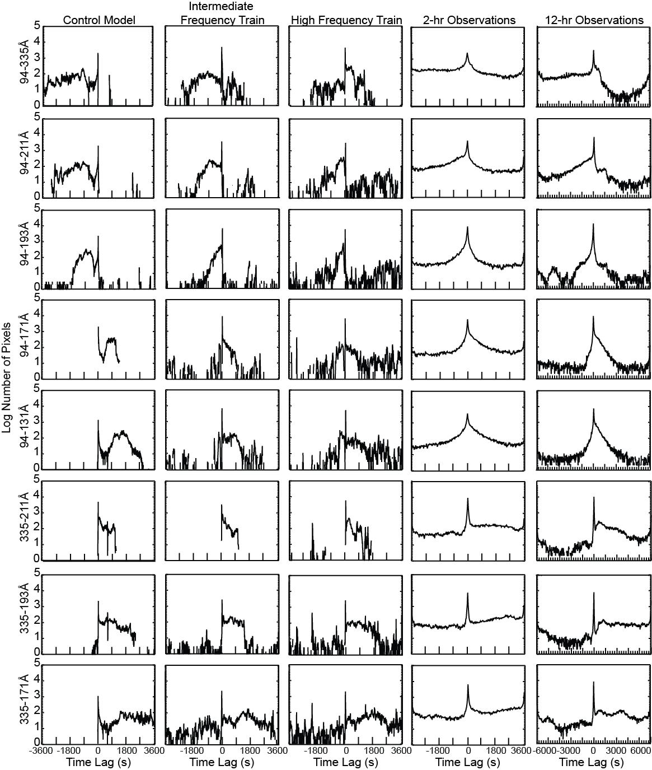
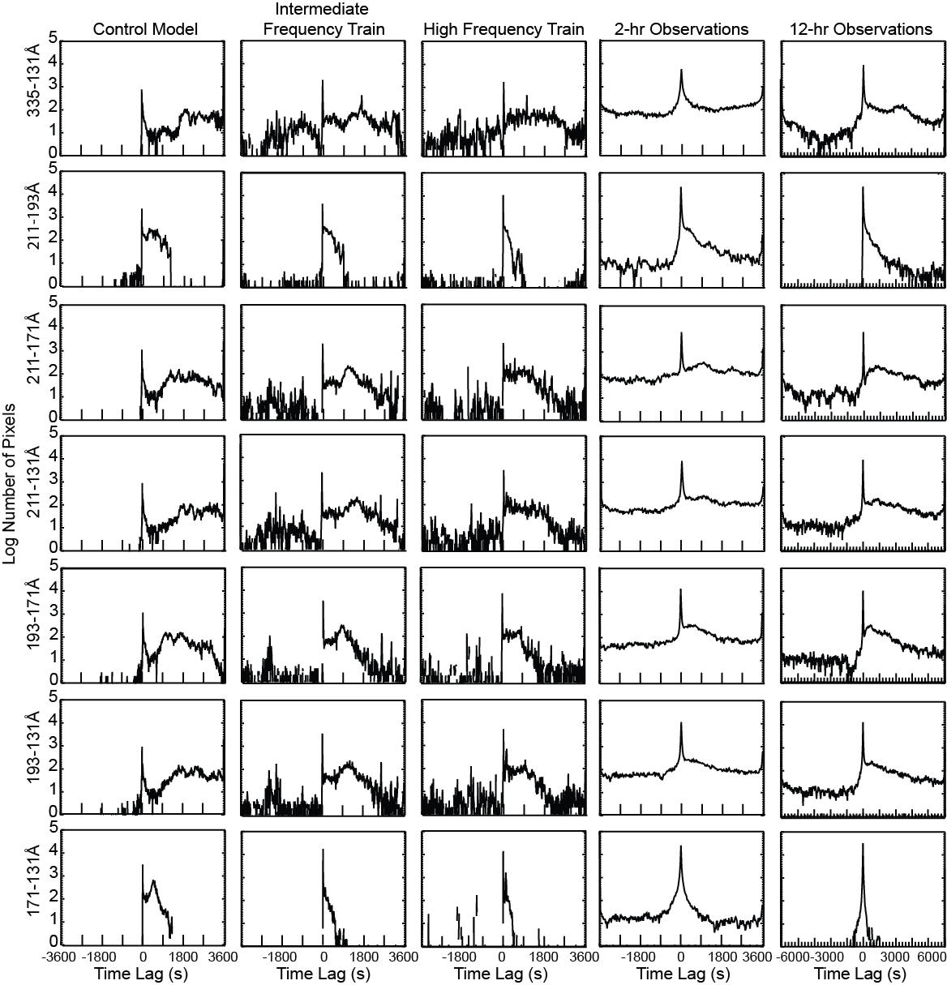
Time lag maps allow statistical comparison; 2000 s distribution matches closest
Bradshaw & Viall 2016
Notes:
This is a statistical argument. Other things could also be going on, but the dominant component of the observed distribution is well described by this distribution of nanoflare trains

Slide 16
1) >10,000 s recurrence time for energy release on a single flux tube 2) ~2000 s recurrence time for energy release on a single flux tube; power law distribution (Hudson 1991), recurrence time ∝ energy (Cargill 2014) 3) ~500 s recurrence time for energy release on a single flux tube; power law distribution (Hudson 1991), recurrence time ∝ energy (Cargill 2014) 4) <500 s regular and continuous (aka ‘steady heating’)
Reep et al. 2013

Slide 17
Bursts of Energy Recur Every ~2000s in AR; Distribution is Required
Burst of energy
We can rule out regular/continuous ‘steady’ heating, i.e. recurrence times of <500s.
We can rule out ‘low frequency’ heating, i.e. recurrence times >10,000s.
Power law distribution of recurrence times, and recurrence times dependent on energy deposition (consistent with DEM observations, Cargill 2014) with an average recurrence time of ~2000s on a flux tube best reproduces time lag AR maps
Distribution is key to simultaneously explaining presence of both partial and full cooling that is observed: sometimes full cooling between energy bursts followed by short intervals of ‘steady’

Slide 18
Remaining Questions
Distribution with ~2000 s is typical for this AR; we need to compare the model with our measurements of other ARs; we need to model QS and compare to our QS measurements
We have narrowed parameter space substantially, but still haven’t determined precise physics of coronal heating

