Slide 1




Kinematics and Magnetic Properties of a Light Bridge in a Decaying Sunspot
M. Falco^{1,2}, J. M. Borrero³, S. L. Guglielmino¹, P. Romano⁴, F. Zuccarello¹, S. Criscuoli⁵, A. Cristaldi², I. Ermolli², S. Jafarzadeh⁶, L. Rouppe van der Voort⁶
¹Università degli Studi di Catania – Dipartimento di Fisica e Astronomia, Sez. Astrofisica – Via S. Sofia 78, Catania, I-95123, Italy
²INAF OAR – Osservatorio Astronomico di Roma – Via Frascati 33, Monte Porzio Catone (RM), I-00040, Italy
³Kiepenheuer-Institut fuer Sonnenphysik, Schoneckstr (KIS). 6, 79110 Freiburg , Germany
⁴INAF OACt – Osservatorio Astrofisico di Catania – Via S. Sofia 78, Catania, I-95123, Italy
⁵National Solar Observatory (NSO), Sacramento Peak Box 62, Sunspot, NM 88349, USA
⁶Institute of Theoretical Astrophysics, University of Oslo, P.O. Box 1029, Blindern, 0315 Oslo, Norway
Falco et al., Solar Phys (2016) 291:1939
SOLARNET IV Meeting – Lanzarote (Spain), 17 January 2017

Slide 2
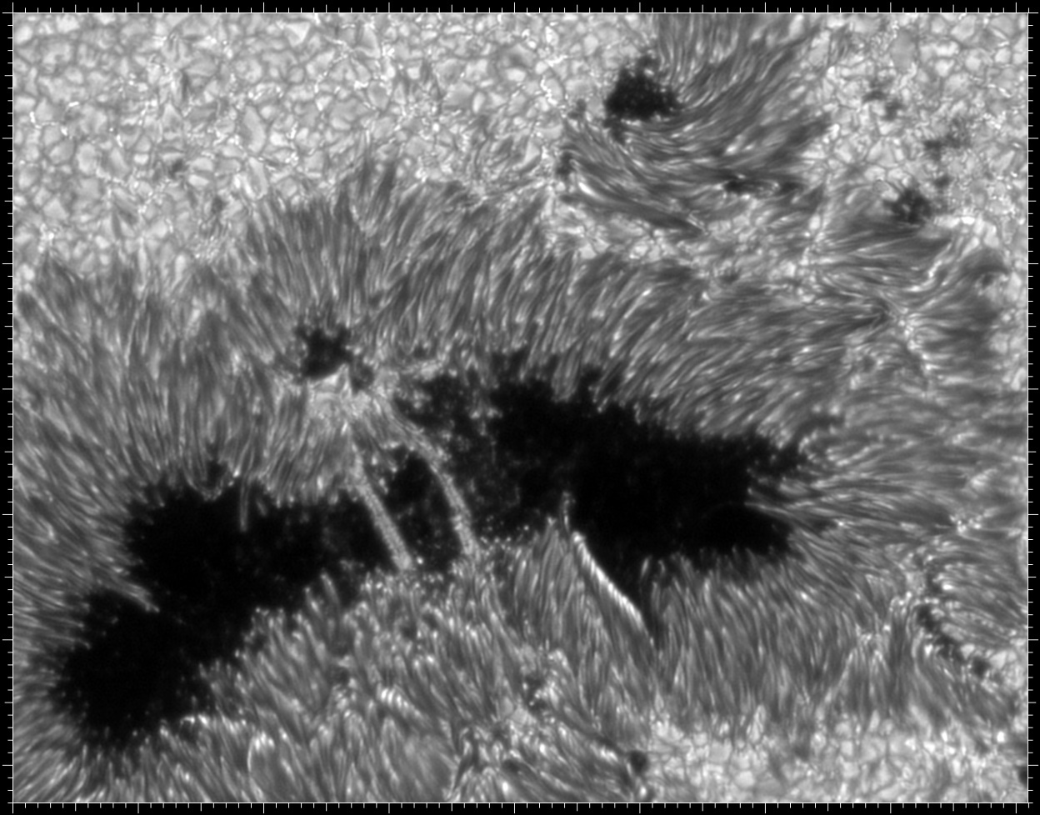
Light Bridges
Light Bridges (LBs): bright and elongated structure delineating borders between dark umbral fragments.
Observed during:
the complex assembly process of a sunspot
the decay phase of a sunspot
field-free intrusions of plasma in the umbral magnetic field
Origin:
signatures of magneto-convection
Photometric: umbral, penumbral, photospheric Intensity
Morphological: Faint and Strong light bridge
Internal structure: Filamentary and Granular light bridge
Magnetic polarity: umbra with same/opposite polarity
Classification:
SOLARNET IV Meeting – Lanzarote (Spain), 17 January 2017

Slide 3
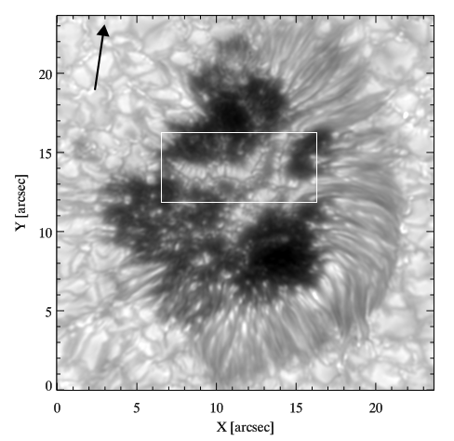
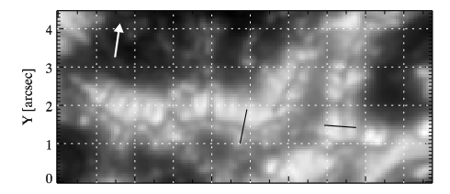
Dark lanes
Central dark lane running parallel to the main axis with a typical width between 0.2’’ and 0.5’’
Dark lanes are the result of a hot upflowing plume braked by surrounding magnetic field, which forces the plume into a cusp-like shape (so called ‘canopy structure’ above the LB according to Jurcak et al., 2006)
(Rouppe van der Voort et al., 2010)
Plasma motions:
The central dark lanes would be due to increased density above the upﬂow as a result of piled-up matter (Schüssler & Vögler 2006);
Lateral bright and dark lanes could correspond to hot upﬂow and cold downﬂow areas, respectively (Schlichenmaier et al., 2016).
SOLARNET IV Meeting – Lanzarote (Spain), 17 January 2017

Slide 4
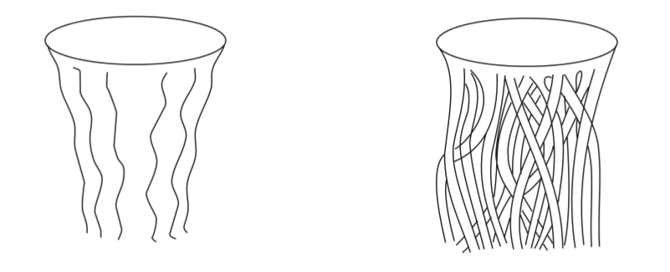
Why LBs are studied?
Understand the interactions of plasma with strong magnetic field
Study of the physical processes responsible for the fine structure of sunspots to understand their subphotospheric structure
Monolithic model
(Cowling, 1957)
Cluster model (Spaghetti-like)
(Parker, 1979)
SOLARNET IV Meeting – Lanzarote (Spain), 17 January 2017
Notes:
The spaghetti-like model explains naturally the existence of umbral dots and bright penumbral filaments (see the following sections), but there are two points that must still be clarified: the first one is what forces keep the magnetic field lines together in the photosphere to create long-lived sunspots, the second one is how the magnetic field strength decreases systematically from spot center. On the other hand, Meyer et al. (1974) studied the possible modes of magneto-convection and predicted the existence of overturning magnetoconvective processes for depths larger than 2000 km, in which magnetized and non-magnetized plasma get mixed and the monolithic model is the favourite (Rempel & Schlichenmaier, 2011). Moreover, during recent years different types of theoretical models have been proposed. For a deeper analysis of these models see the review of Solanki (2003).

Slide 5
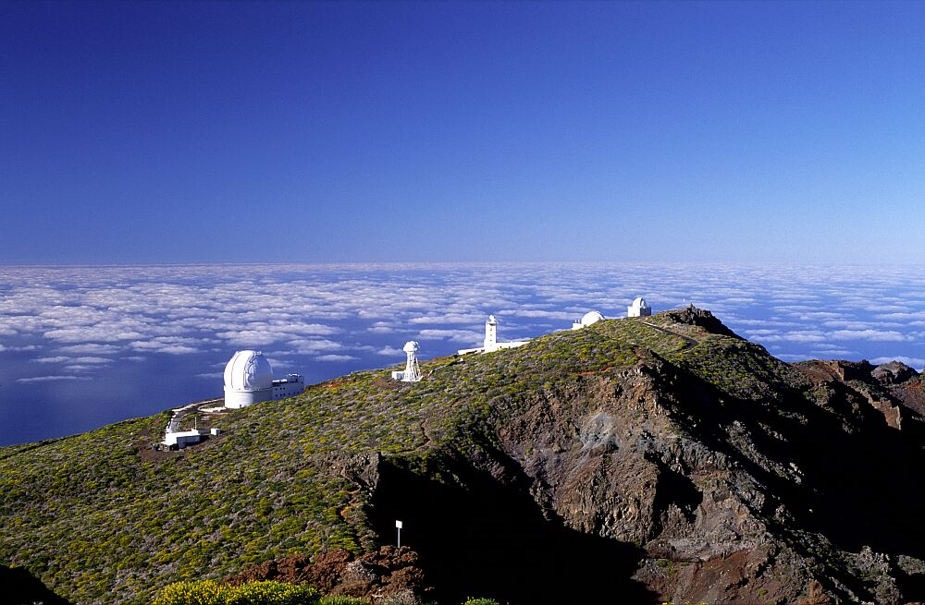
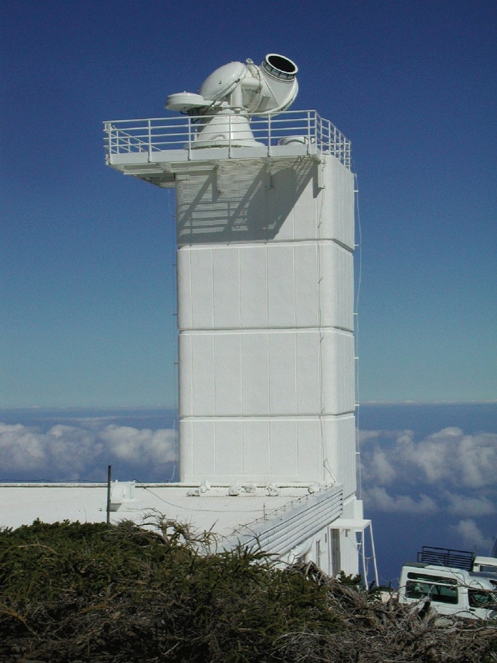
Observational Campaign at the
Swedish Solar Telescope (SST)
6th - 19th August 2011, La Palma (Canary Islands)
S. Criscuoli (PI), I. Ermolli, S. L. Guglielmino, A. Cristaldi, M. Falco, F. Zuccarello
SOLARNET IV Meeting – Lanzarote (Spain), 17 January 2017

Slide 6
Observational Campaign data-set
Instrument | Wavelength | Spectral points | Pixel size (arcsec) | Time Resolution (sec) | Observation days
SST | Fe I 5576 Å | 20 | 0.0592 | 28 | 6 - 19 Aug 2011
 | Fe I pair 6302 Å | 15 | 0.0589 | 28 | 6 - 19 Aug 2011
 | Ca II H core | 1 | 0.0338 | 9 | 6 - 19 Aug 2011
DOT | G band | - | 0.071 | 30 | 7 - 19 Aug 2011
 | Hα | 7 | 0.109 | 30
Hinode | G band | 1 | 0.108 |  | 6 Aug 2011
 | Ca II H | 1 | 0.108
 | Fe I pair 6302 Å (SP) | 140 | 0.32 | 5 maps in 3 h
SDO | HMI continuum | - | 0.5 | 720 | 2 - 7 Aug 2011
SOLARNET IV Meeting – Lanzarote (Spain), 17 January 2017

Slide 7
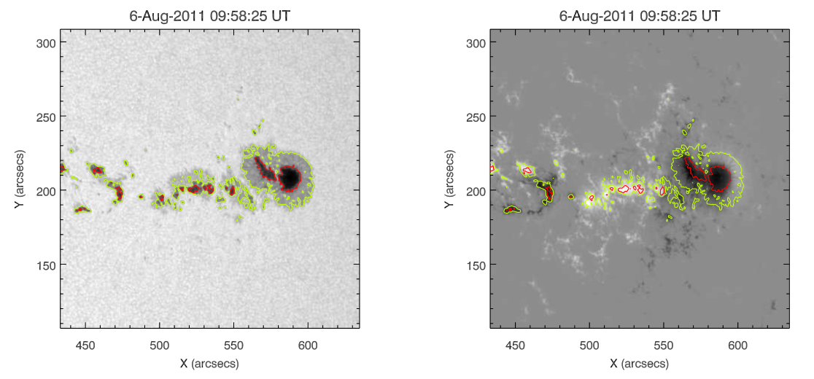
HMI/SDO on August 6, 2011
NOAA 11263 (Coord: N16 W43)
HMI/SDO: Continuum intensity map and LOS magnetogram
obtained in the Fe I 617.3 nm line
SOLARNET IV Meeting – Lanzarote (Spain), 17 January 2017

Slide 8
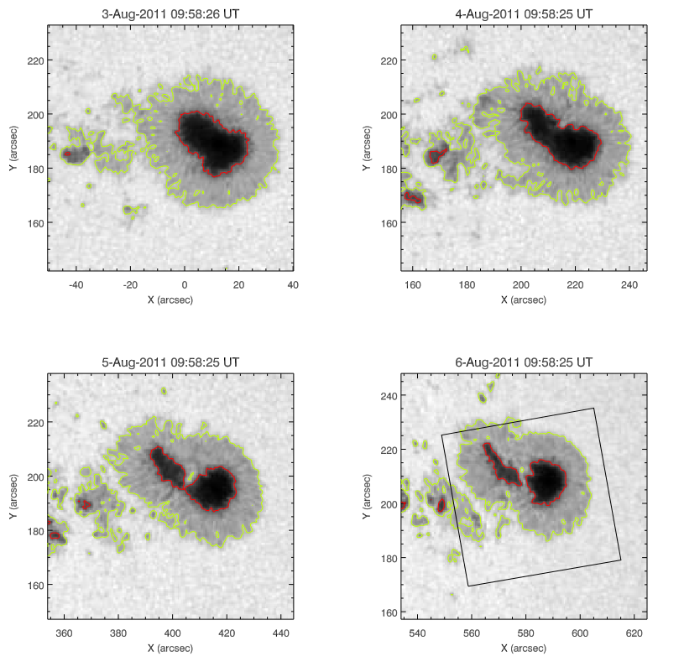
NOAA 11263 evolution: HMI continuum
SOLARNET IV Meeting – Lanzarote (Spain), 17 January 2017

Slide 9
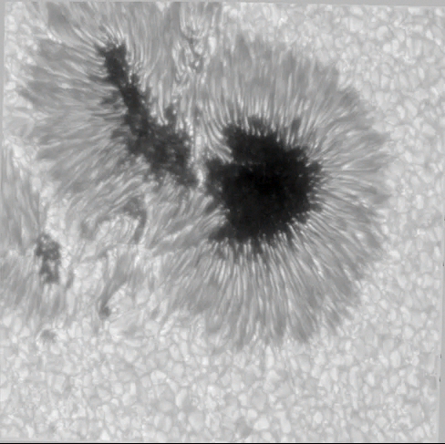
CRISP Continuum - Fe I 5576 Line
SOLARNET IV Meeting – Lanzarote (Spain), 17 January 2017

Slide 10
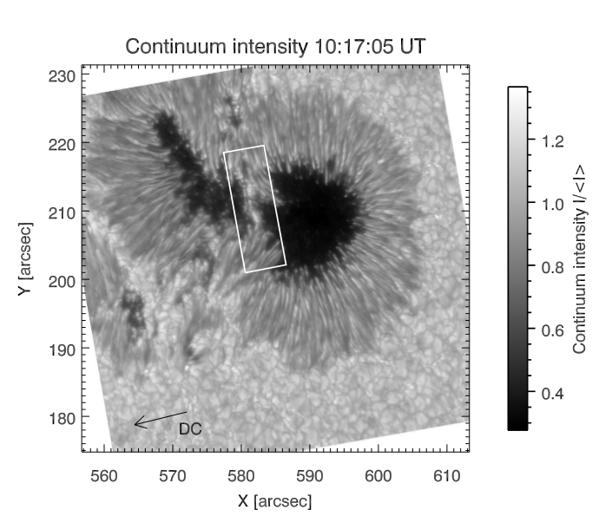
NOAA 11263: SST data
Continuum intensity map obtained by CRISP at the Fe I 630.15 nm line
FOV 57.5 x 57.8 arcseconds (41700 x 41900 Km)
SOLARNET IV Meeting – Lanzarote (Spain), 17 January 2017

Slide 11
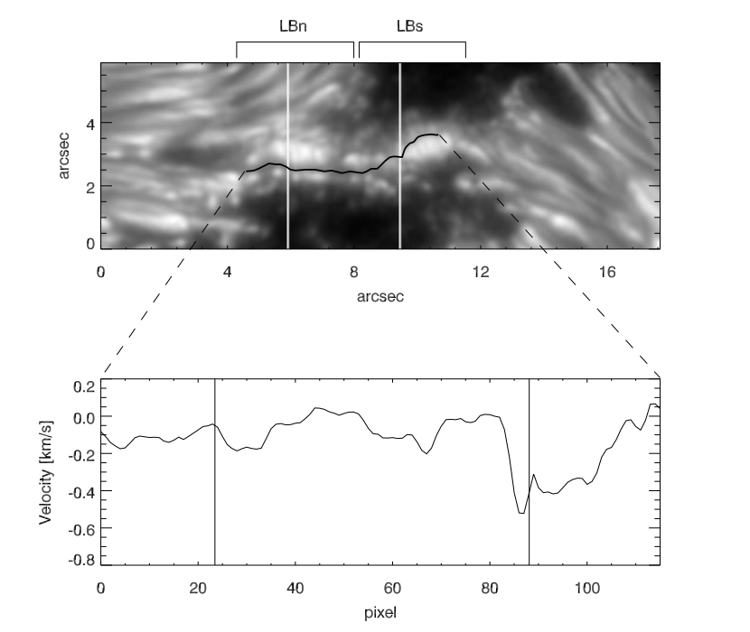
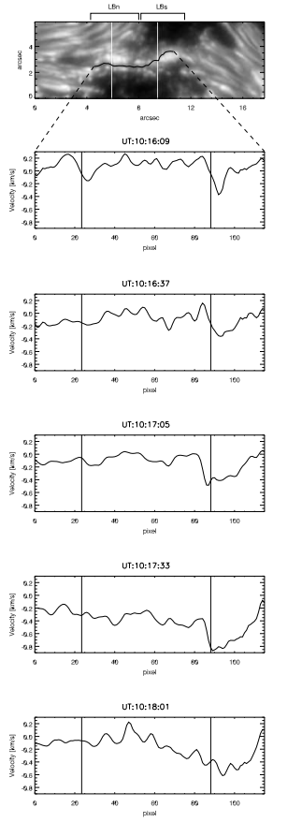
Dark Lane Analysis
In the LB_{n} the LOS velocity values are between 0 and - 0.2 km/s
In the LB_{s} the LOS velocity values are larger, up to - 0.8 km/s
SOLARNET IV Meeting – Lanzarote (Spain), 17 January 2017

Slide 12
SIR Inversion Code
We used SIR inversion code (Stokes Inversion based on Response functions) to obtain:
map of the temperature;
map of the total magnetic field
We inverted the Fe I line at 6301.5 Å and Fe I line at 6302.5 Å at the same time using:
Two initialization models: penumbral model (0.4 < I/I _{c}< 0.8)
umbral model (I/I_{c} < 0.4);
weight (=1) for Stokes I and more weight (=4) for Stokes Q, U, V;
2 nodes for temperature;
1 node (constant with height) for all the other physical parameter (velocity, magnetic field, azimuth, inclination);
fixed microturbulence (=0.0);
fixed macroturbulence (=2.95).
SOLARNET IV Meeting – Lanzarote (Spain), 17 January 2017

Slide 13
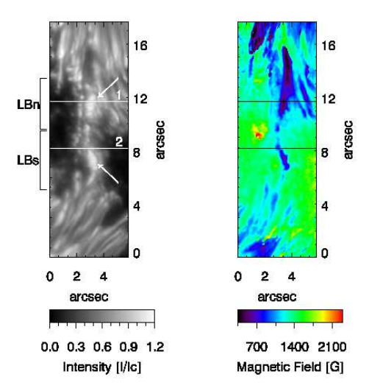
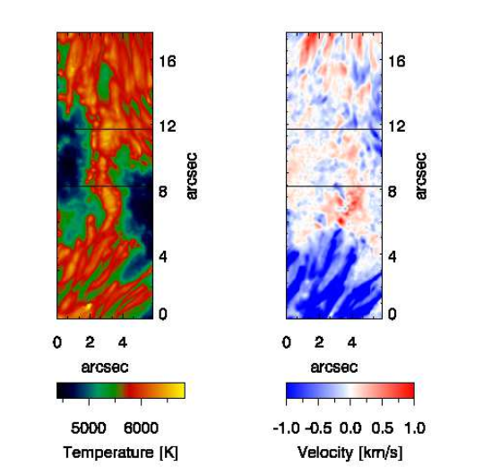
SIR Inversion Results
SOLARNET IV Meeting – Lanzarote (Spain), 17 January 2017

Slide 14
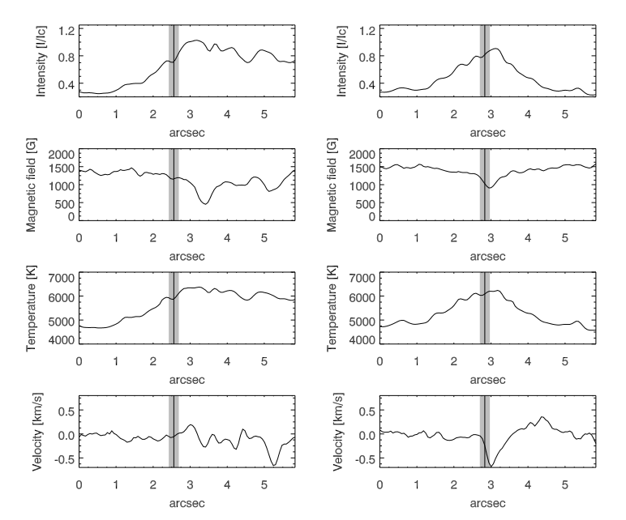
Light Bridge Analysis
LB_{n} LB_{s}
SOLARNET IV Meeting – Lanzarote (Spain), 17 January 2017

Slide 15
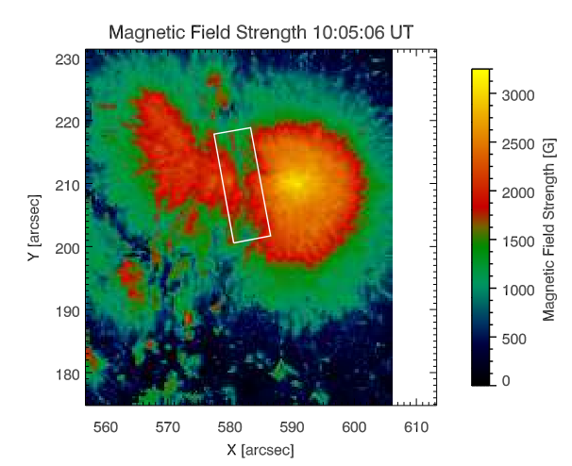
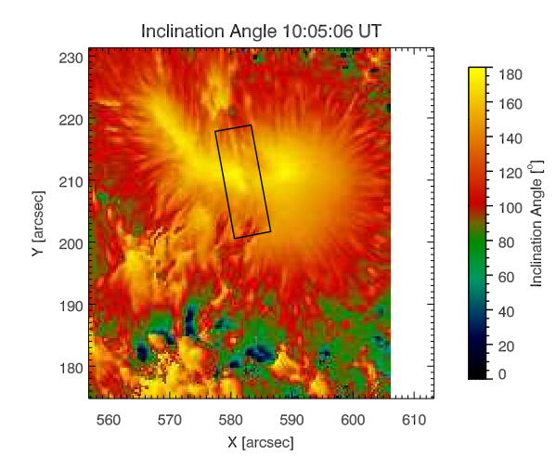
Hinode data inversions
Magnetic field strength and inclination angle maps obtained by the MERLIN Inversion code.
We applied the NPFC code to perform azimuth disambiguation.
SOLARNET IV Meeting – Lanzarote (Spain), 17 January 2017

Slide 16
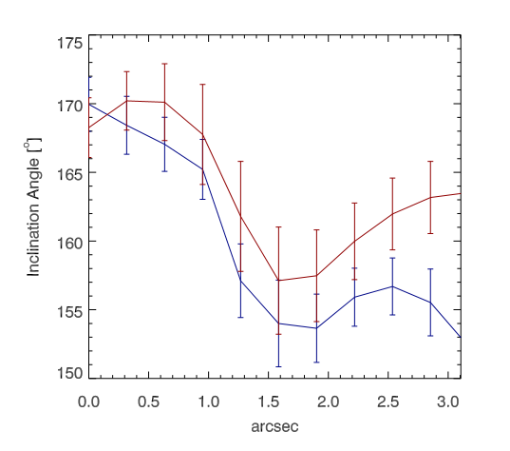
LB Inclination
LBn (blue line): umbral region has values of 170° and lower than 155° in the LB.
LBs (red line): LB region has values of 155° and in the umbral regions the inclination is > 165°
SOLARNET IV Meeting – Lanzarote (Spain), 17 January 2017

Slide 17
Conclusions
The results of the SIR inversion confirm that where the magnetic field is low, convection is more effective and the intensity of the grains of the LB is higher
The DL of the LBn shows both downflows and upflows
The DL of the LBs is characterized by upflows
The strong surrounding magnetic field plays a fundamental role not only in the formation of a cusp-like region with enhanced density and corresponding to the dark lane, but also in the dark lane velocity field.
Convection penetrating from the sub-photospheric layers into a quite field-free gap
monolithic model
vs
spaghetti-like model
SOLARNET IV Meeting – Lanzarote (Spain), 17 January 2017

Slide 18
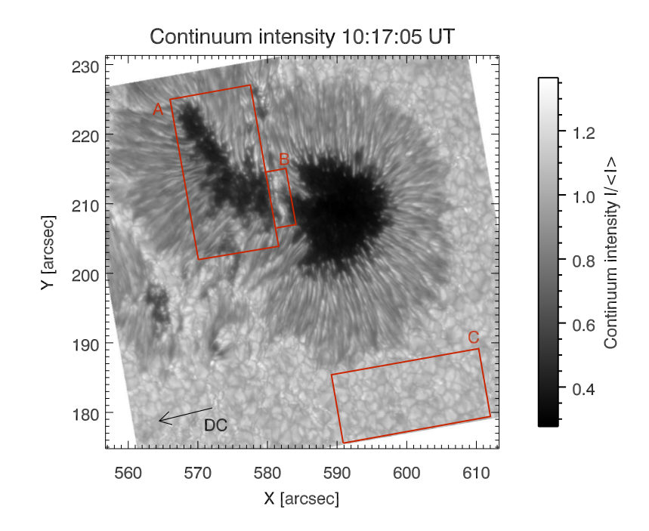
NOAA 11263: SST data
SOLARNET IV Meeting – Lanzarote (Spain), 17 January 2017

Slide 19
Results
Falco et al., A&A 2017 (submitted)
Faint Light Bridge similar properties between LBGs and UDs
Granular Light Bridge granulation features more similar with quiet-Sun granulation (Lagg et al., 2014)
From literature:
Lagg et al., (2014):
  common origin of GLBs and the QSGs that are anchored in deep layers;
  common origin between UDs and FLBs
  starting from a totally diﬀerent study, we obtained a result which supports the one carried out by Lagg et al. (2014)
SOLARNET IV Meeting – Lanzarote (Spain), 17 January 2017
Notes:
Rimmele (1997) and Spruit & Scharmer (2006):
UDs and LBs are produced by feld-free convection in mostly vertical magnetic ﬁeld structures;
the mechanism suggested for the appearing of these structures is overturning convection in ﬁeld-free gaps.
The similarity between LBGs and “normal” granules suggests that granular light bridges are anchored in deep layers. This distinguishes granular light bridges from other convective processes in sunspot umbrae, like umbral dots or faint light bridges, which are, according to MHD simulations, the product of surface magneto-convection within the 1–2 Mm just below the local solar surface.

Slide 20
Thanks!
SOLARNET IV Meeting – Lanzarote (Spain), 17 January 2017

