Slide 1

Physical properties of a group of pores as derived from Ca II 8542 Å observations and inversions at GREGOR
Christoph Kuckein
A. Diercke, S.J. González Manrique, M. Verma, M. Sobotka, J. Löhner-Böttcher, H. Balthasar, and C. Denker
@ch1is #solarnet4m

Slide 2
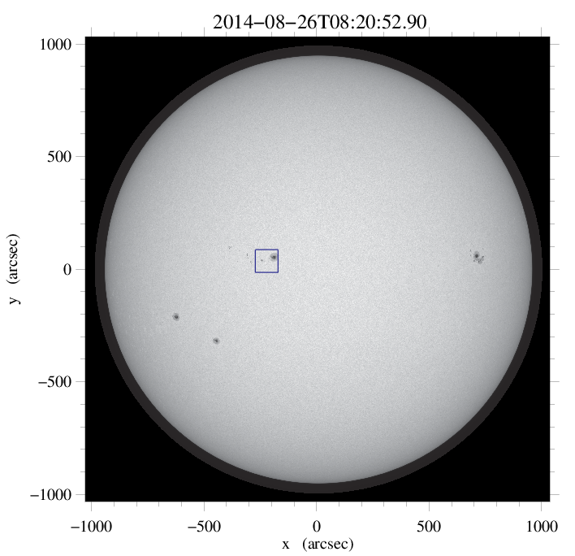
Observations with GREGOR
Group of pores (AR 12149):
2014 August 26
8:23 – 8:39 UT
Coordinates:
9ºN, 15ºE
(x=−245”, y=40”)
μ = 0.97
HMI

Slide 3
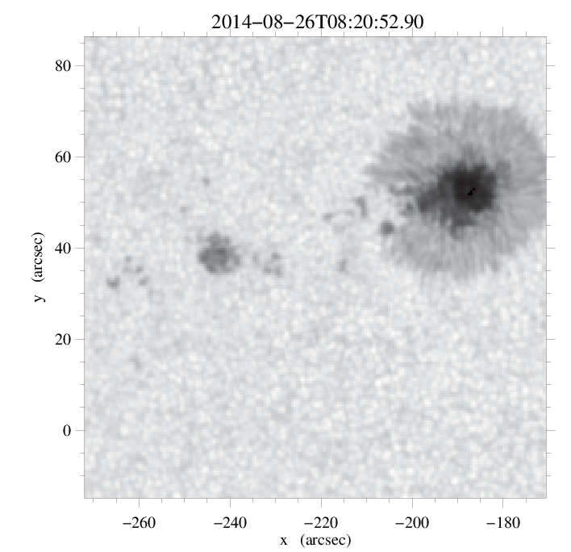
Observations
Group of pores (AR 12149)
HMI

Slide 4
Observations
Group of pores (AR 12149)
GFPI
HMI

Slide 5
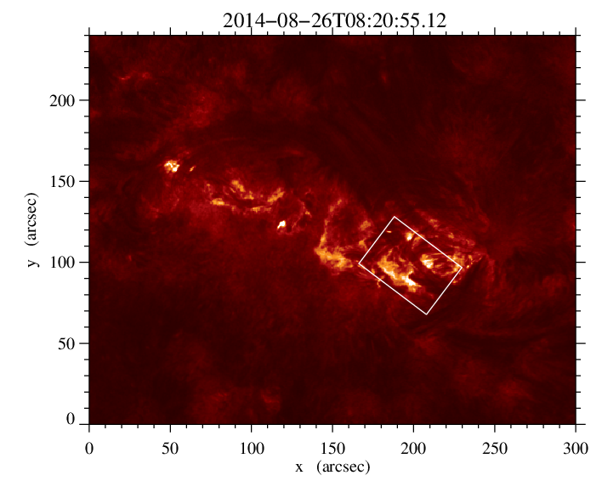
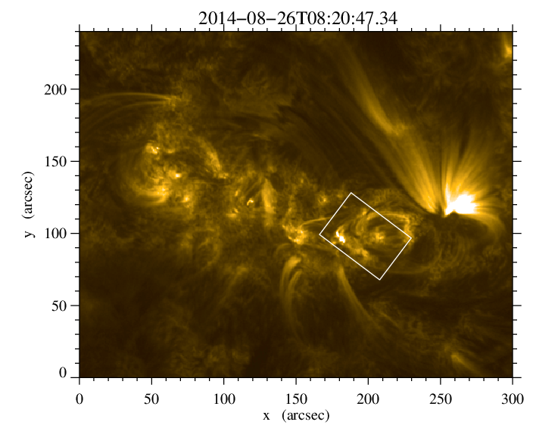
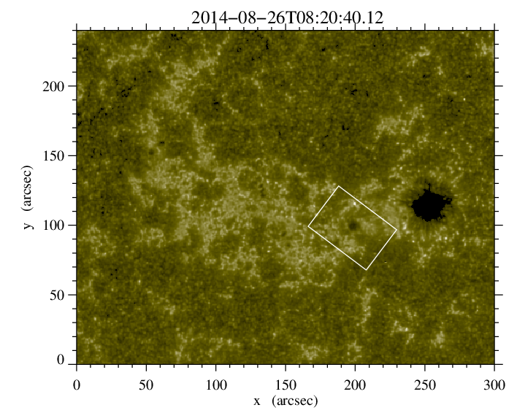
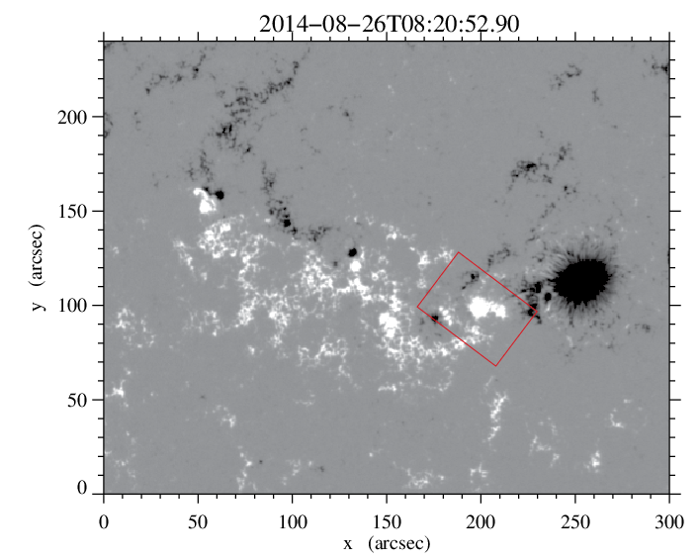
Observations
SDO
304 Å
SDO overview
171 Å
8:20 UT
1600 Å
HMI magnetogram

Slide 6
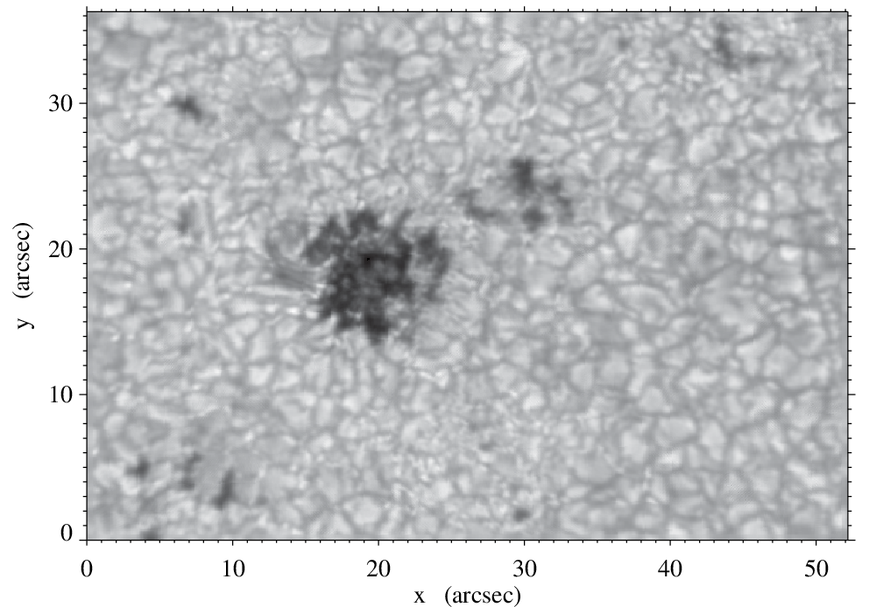
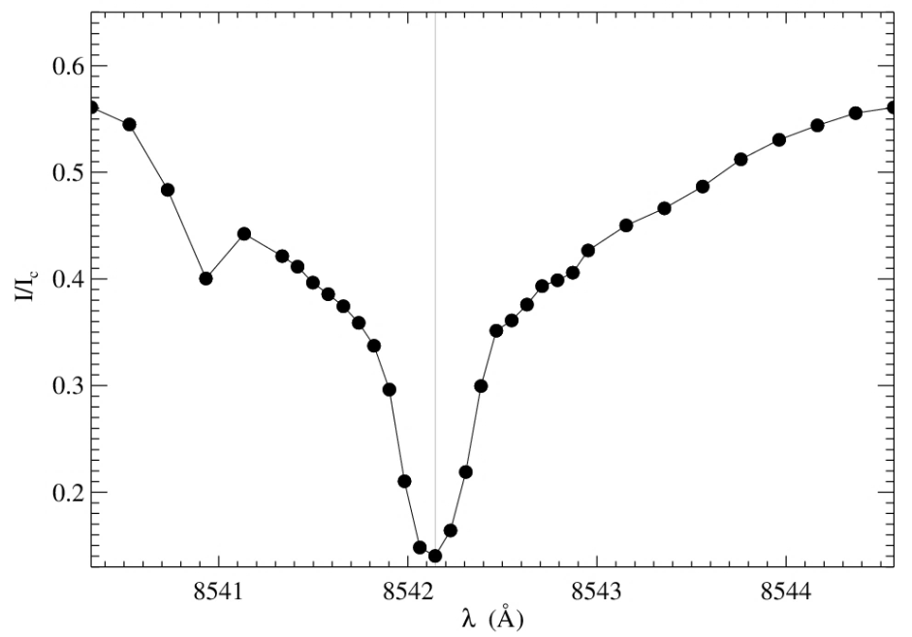
Observations
  GREGOR Fabry-Pérot Interferometer (GFPI)
  20 maps taken between 8:23 – 8:39 UT
  Cadence ~ 47 seconds
  Pixel size: 0.081”/px (2X2 binned mode)
  Exposure time: 80 ms
  Accumulations per step: 4
  36 steps along the Ca II 8542 Å
  Non-equidistant grid:
    Wings: broader steps (∆λ = 0.20 Å)
    Core: narrower steps (∆λ = 0.08 Å)
GFPI quiet Sun profile

Slide 7
Data reduction and reconstruction of GFPI
IDL-based data reduction pipeline with widget support (optional): sTools
Automated data reduction and MOMFBD restoration
sTools pipeline → see also poster (Kuckein et al.) and Kuckein et al. 2017 (arXiv)

Slide 8
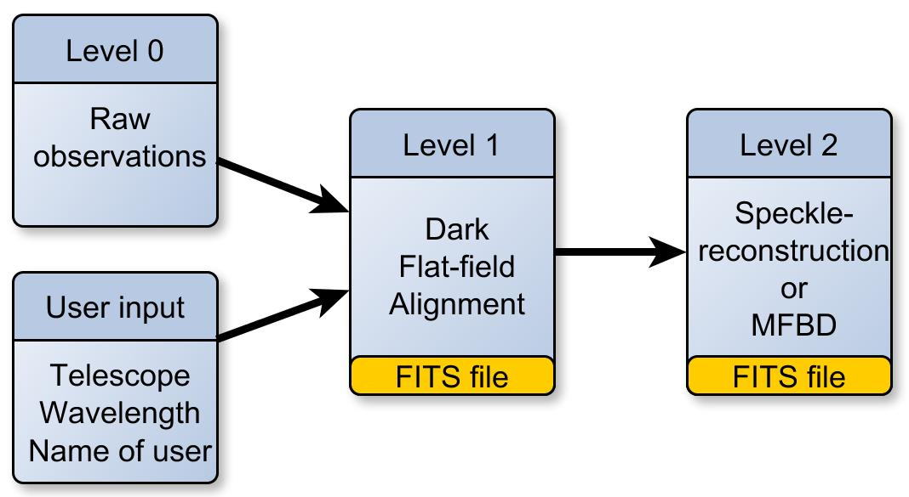
Observations
Ground-based instruments
Blue Imaging Channel (blue channel of the GFPI)
  2 cameras: 4505 Å (blue cont.) and 4307 Å (G-band)
  Frames per burst: 80, Cadence: ~ 30 s
  Exposure time: 4 ms (blue cont.) and 5 ms (G-band)
  Data reduction →
  (sTools)

Slide 9
Observations
Ground-based instruments
Blue Imaging Channel (blue channel of the GFPI)
  2 cameras: 4505 Å (blue cont.) and 4307 Å (G-band)
  Frames per burst: 80, Cadence: ~ 30 s
  Exposure time: 4 ms (blue cont.) and 5 ms (G-band)
  Data reduction →
  (sTools)
Reduced / restored data will be archived at http://gregor.aip.de. If you are interested in data from GFPI or BIC from 2014 and 2015 contact us.

Slide 10
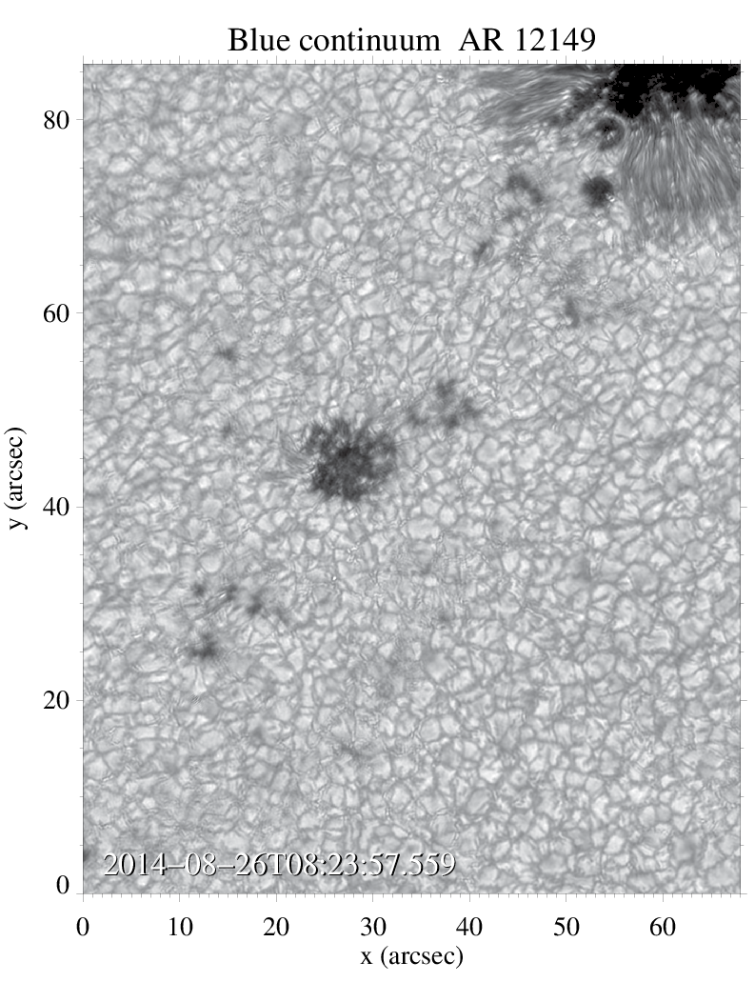
Observations
Blue Imaging Channel (BIC)
  2 cameras: 4505 Å (blue cont.) + 4307 Å (G-band)
  Frames per burst: 80
  Cadence: ~ 30 s
  Data reduction → sTools
GFPI

Slide 11
Observations
Blue Imaging Channel (BIC)
  2 cameras: 4505 Å (blue cont.) + 4307 Å (G-band)
  Frames per burst: 80
  Cadence: ~ 30 s
  Data reduction → sTools
GFPI
Reduced / restored data will be archived at http://gregor.aip.de. If you are interested in data from GFPI or BIC from 2014 and 2015 contact us.

Slide 12
What is happening around the pores between 8:23 and 8:39 UT…?

Slide 13
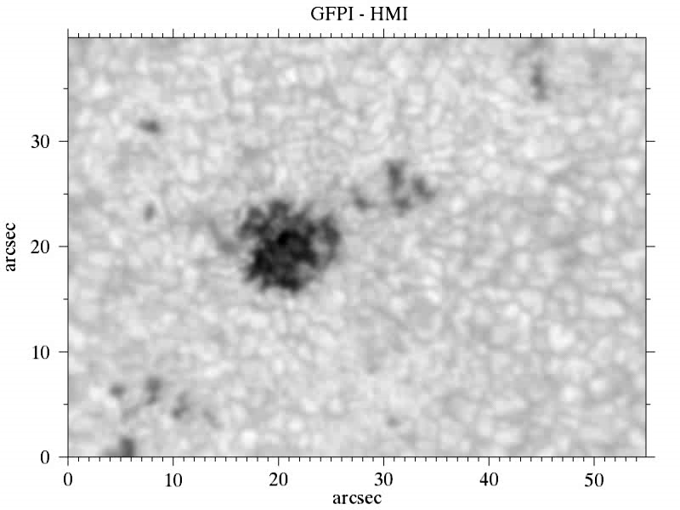
SDO + GFPI overlap
Notes:
Power of combining different telescopes and instruments…

Slide 14
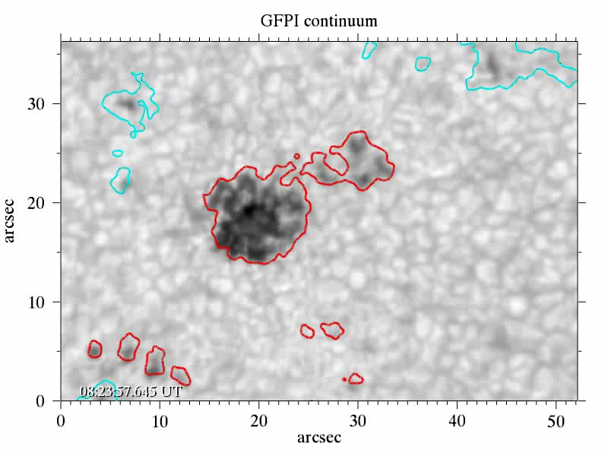
GFPI Ca II 8542 Å maps
GFPI MOMFBD
restored time-series
8:23 – 8:39 UT
HMI magnetogram
contours (8:30 UT):
negative (blue)
and positive (red)
polarities

Slide 15
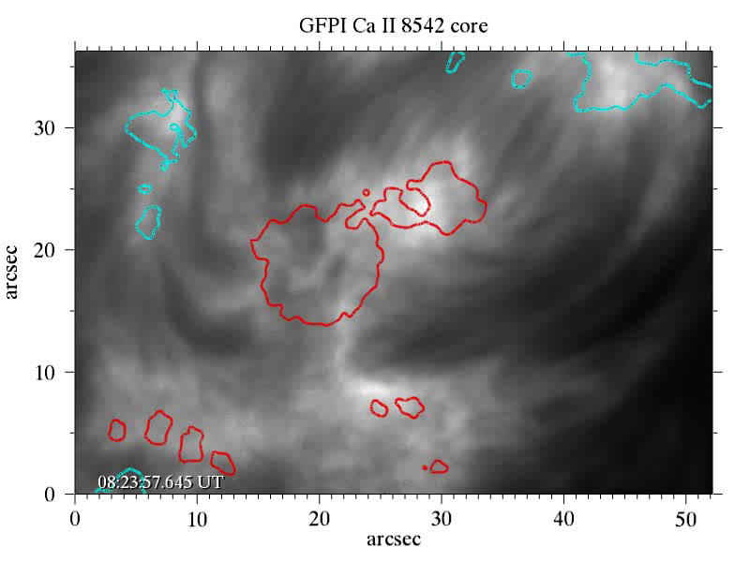
GFPI Ca II 8542 Å maps
GFPI time-series
8:23 – 8:39 UT
HMI magnetogram
contours (8:30 UT):
negative (blue)
and positive (red)
polarities
Arch Filament System (AFS)

Slide 16
GFPI Ca II 8542 Å maps
Arch
Filament
System (AFS)

Slide 17
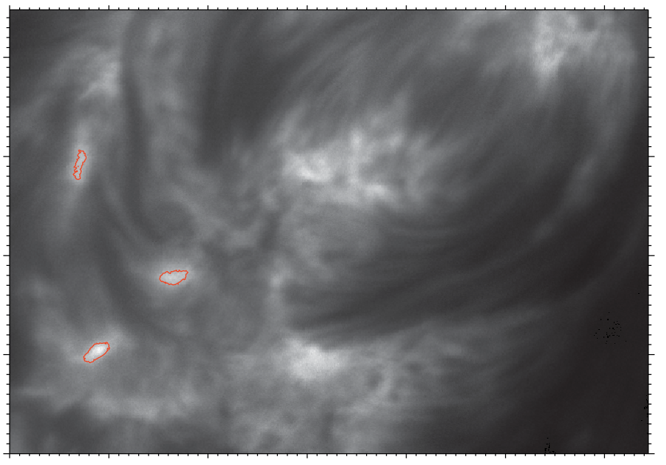
GFPI Ca II 8542 Å maps
Brightening event:
occurs at 8:37 UT
Simultaneously at
3 different areas
Red contours:
Ca II 8542
line-core brightening
(8:37 UT)
GFPI line core image

Slide 18
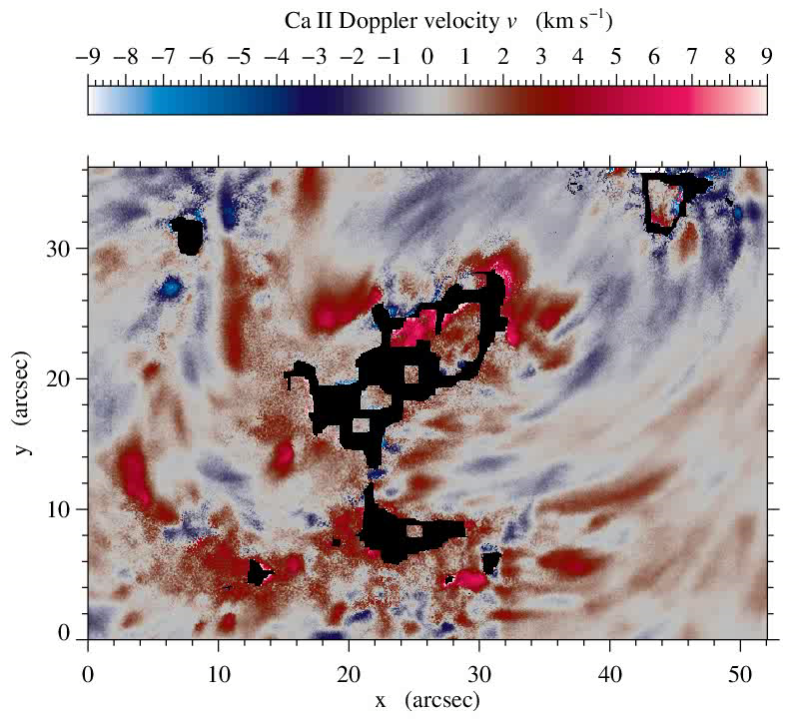
Ca II 8542 Å velocities
First approximation to infer
Doppler velocities
Lorentzian fit using MPFIT
with 4 coefficients
Black areas: bad fit
Time-series 8:23 – 8:39 UT

Slide 19
Ca II 8542 Å velocities
Arch filament
system

Slide 20
GFPI Ca II 8542 Å maps
Upflow region
Red contours:
Ca II 8542
line-core brightening
(8:37 UT)
GFPI line core image

Slide 21
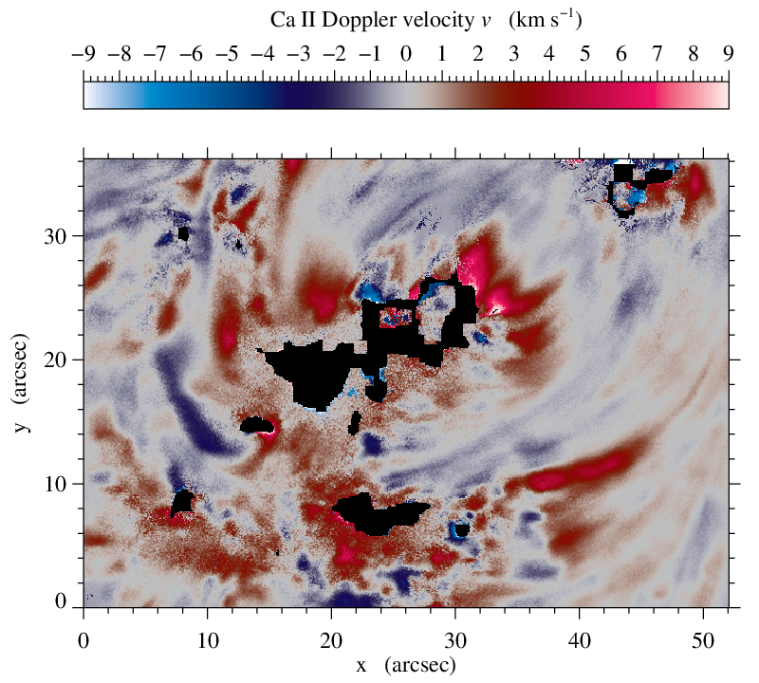
Ca II 8542 Å velocities
Extended “upflow channel”
seen at 8:37
Upflow channel located
between the three
brightening areas
How do the Ca II profiles
look like?

Slide 22
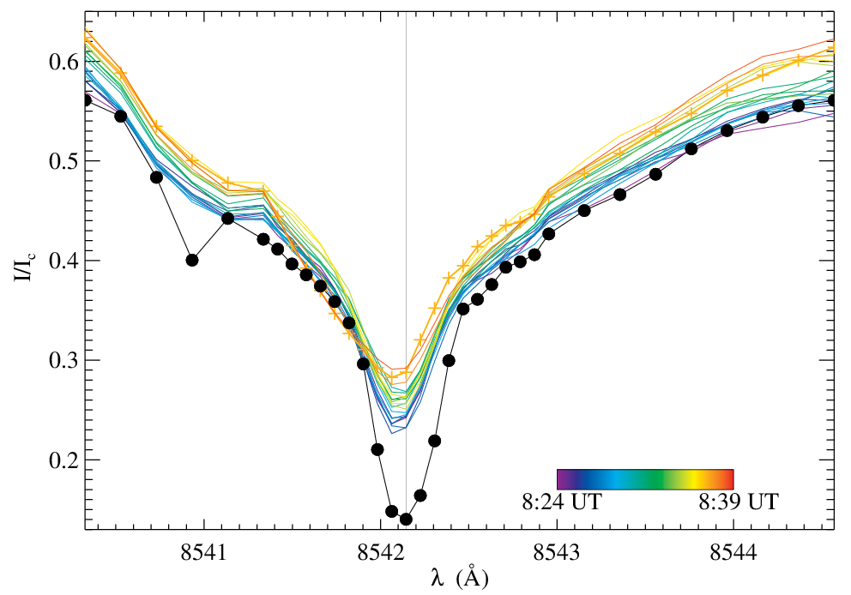
Ca II 8542 Å velocities: blueshift
Time evolution of Ca II profiles (color scaled) of one selected pixel inside the “upflow channel”
Black bullets show the quiet-Sun (QS) profile
Crosses (+) mark the time (8:37) of the brightening event
QS

Slide 23
Spectral line inversions
NICOLE code (Socas-Navarro et al. 2015)
NLTE inversion of spectral lines and Zeeman-induced Stokes profiles
  Only intensity profiles of Ca II 8542 Å line
  Initial model atmosphere: HSRA model (Gingerich et al. 1971) −8.0 ≤ log τ ≤ 1.4
  Test w/ and w/o isotopic splitting (Leenaarts et al. 2014)
  1 cycle parallel inversions
  Nodes: Temperature ≤ 12, Velocity ≤ 8,
  microturbulence ≤ 2, macroturbulence = 1
  Tested 2-component inversions: failed
  Helpful tips from Héctor and Jaime are acknowledged
Notes:
Harvard Smithsonian reference atmosphere model

Slide 24
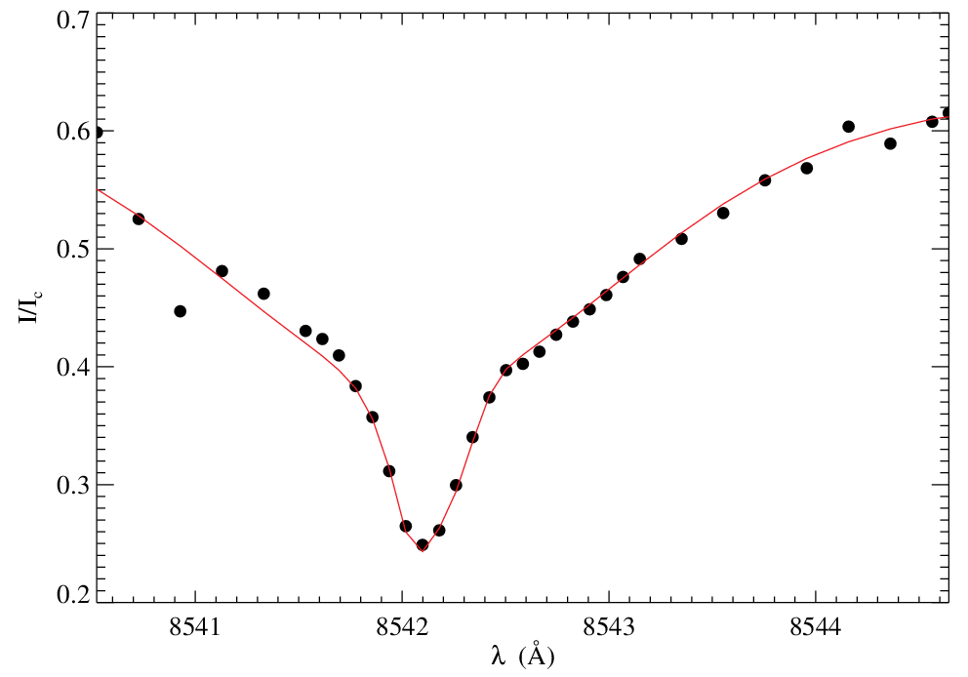
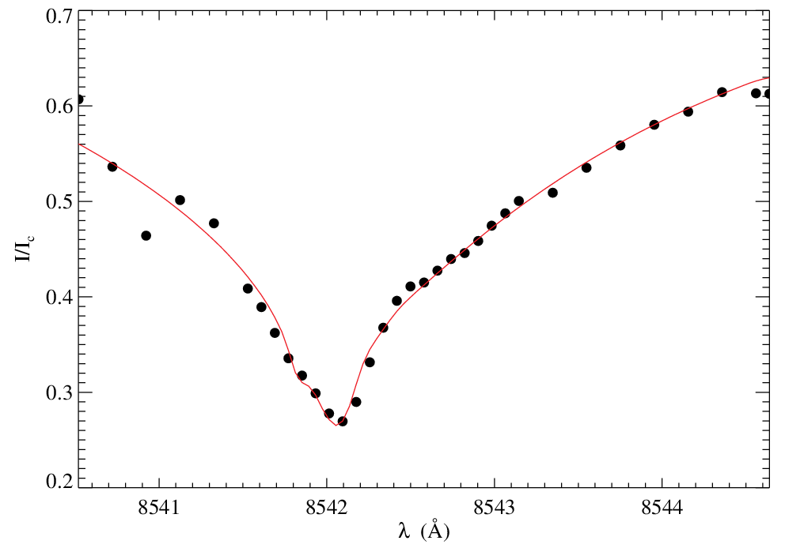
Ca II 8542 Å velocities: blueshift
Inversions example
Before strong upflow
During strong upflow
●●● Observations
NICOLE fit

Slide 25
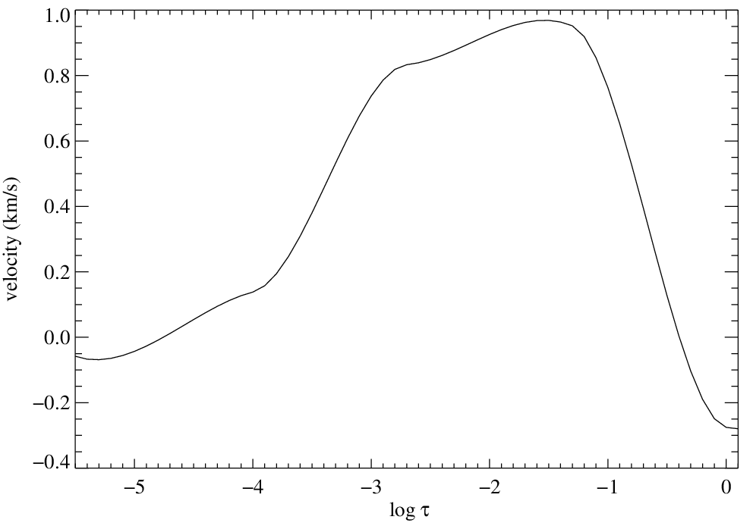
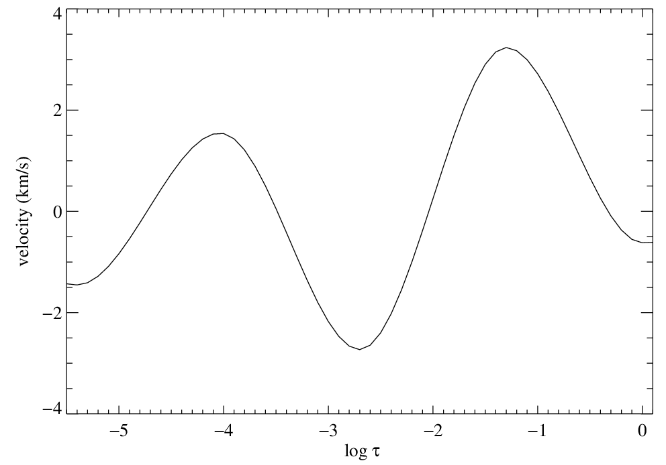
Ca II 8542 Å velocities: blueshift
Velocity vs Height (log τ)
Before strong upflow
During strong upflow
Height

Slide 26
Ca II 8542 Å velocities: blueshift
Velocity vs Height (log τ)
Before strong upflow
During strong upflow
  Velocity high sensitivity −6 ≤ log τ < −4 with a gap aroung log τ ~ −4
Quintero Noda et al. (MNRAS 459, 2016)

Slide 27
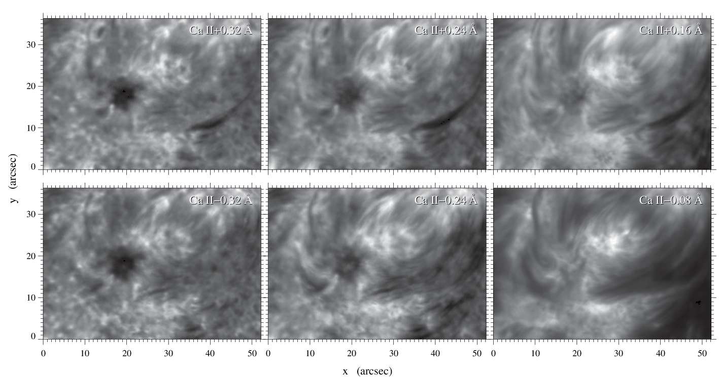
GFPI Ca II 8542 Å scan of the brightening
08:35:31 UT

Slide 28
GFPI Ca II 8542 Å scan of the brightening
08:35:31 UT

Slide 29
GFPI Ca II 8542 Å scan of the brightening
08:35:31 UT

Slide 30
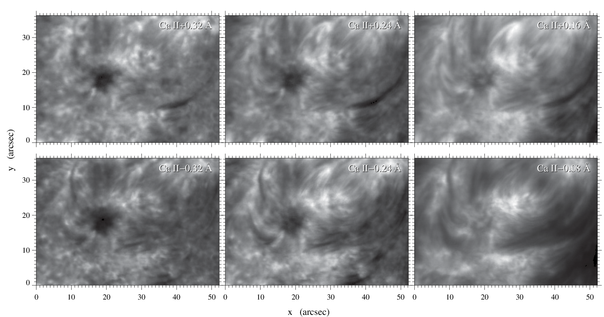
GFPI Ca II 8542 Å scan of the brightening
08:36:16 UT

Slide 31
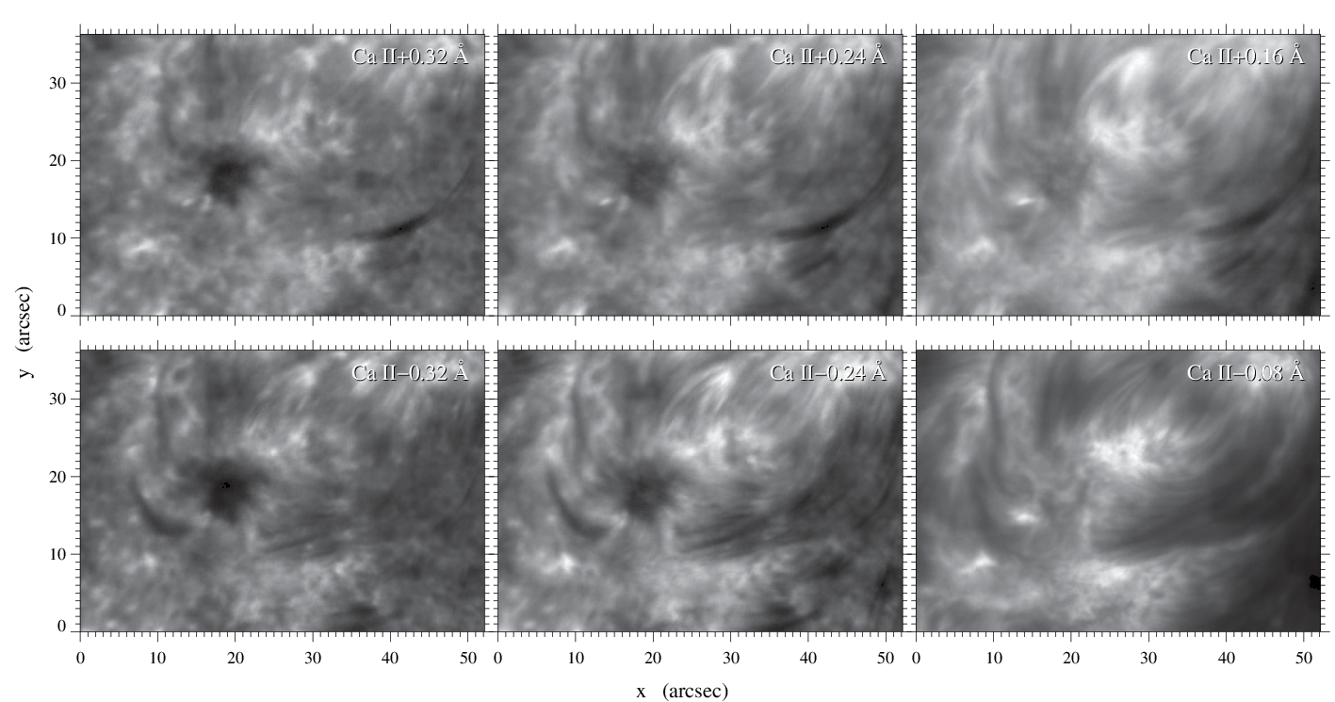
GFPI Ca II 8542 Å scan of the brightening
08:37:03 UT

Slide 32
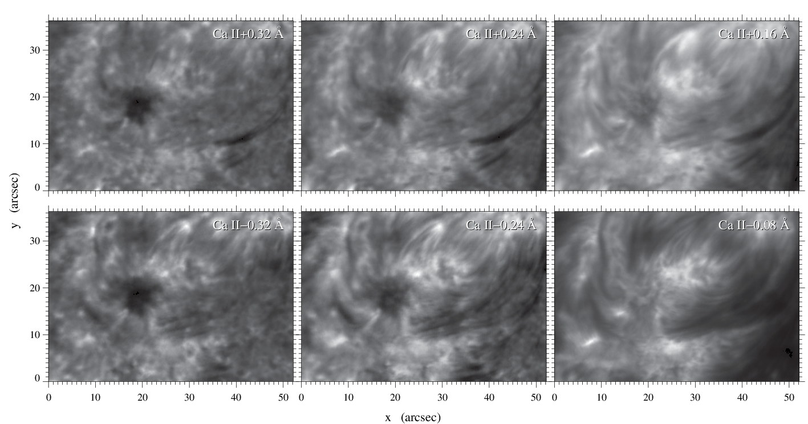
GFPI Ca II 8542 Å scan of the brightening
08:37:50 UT

Slide 33
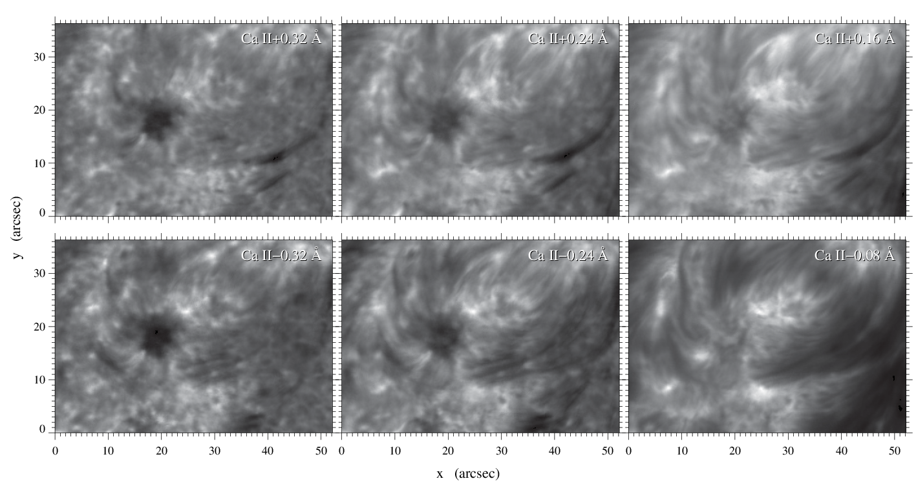
GFPI Ca II 8542 Å scan of the brightening
08:38:38 UT

Slide 34
GFPI Ca II 8542 Å scan of the brightening
Three brightening areas: A1, A2, and A3
A1 and A2 show enhanced Ca II line cores before A3
How do the profiles look like?
3
2
1

Slide 35
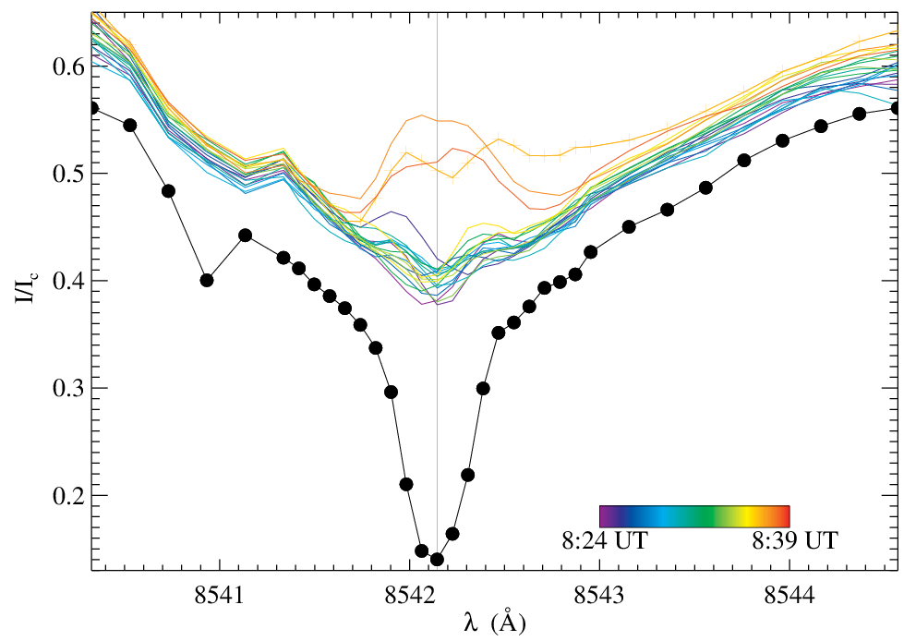
Time evolution of the Ca II profiles
Area 1

Slide 36
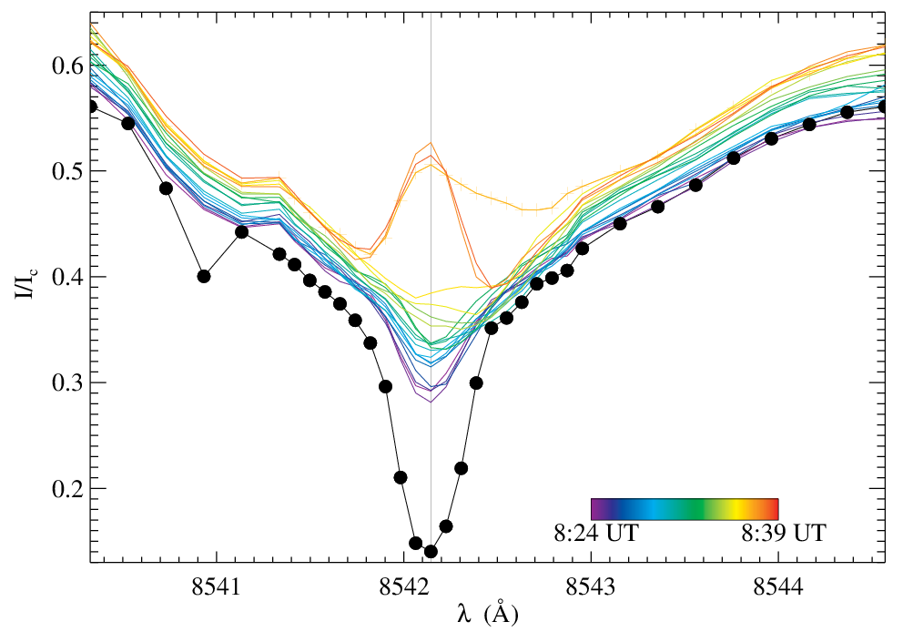
Time evolution of the Ca II profiles
Area 2

Slide 37
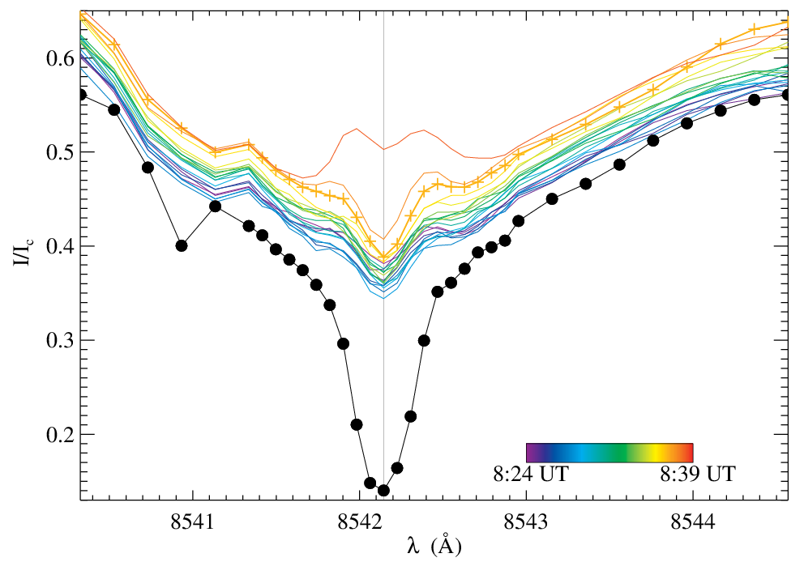
Time evolution of the Ca II profiles
Area 3

Slide 38
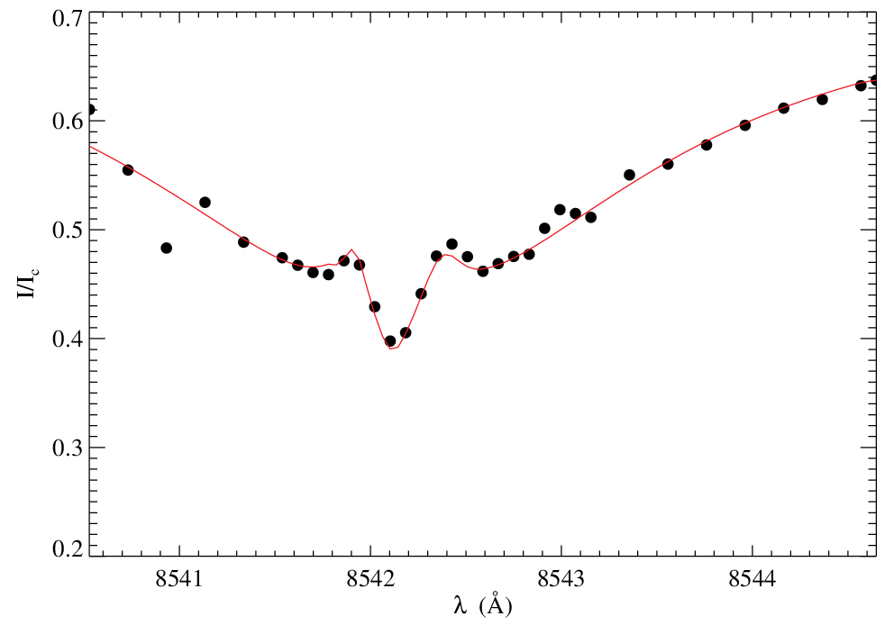
Ca II 8542 Å inversions
One example of area 3
●●● Observations
NICOLE fit

Slide 39
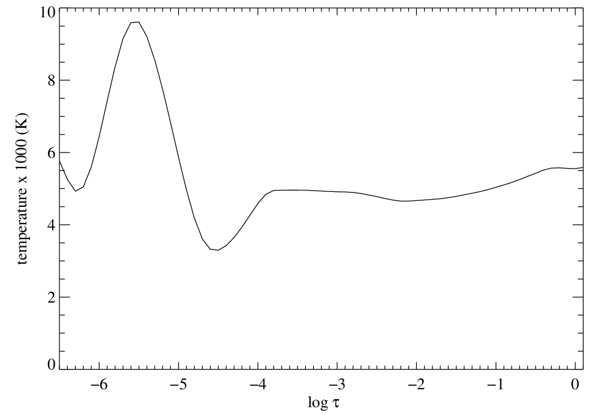
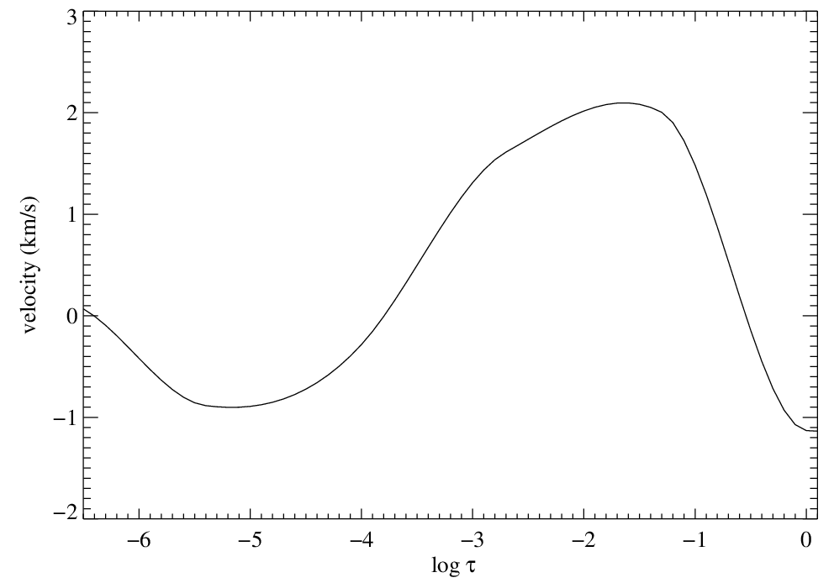
Ca II 8542 Å inversions
One example of area 3
Temperature
Velocity
Height

Slide 40
SDO movies of the brightening
AIA 171 Å, 304 Å, 1600 Å movie sequences (8:30 – 8:42 UT)
  Brightening starts at 8:37 UT
HMI magnetogram sequence (8:30 – 8:42 UT)
Maps have same FOV as GFPI
GFPI brightening contours (left image)
HMI magnetogram contours (right image)

Slide 41
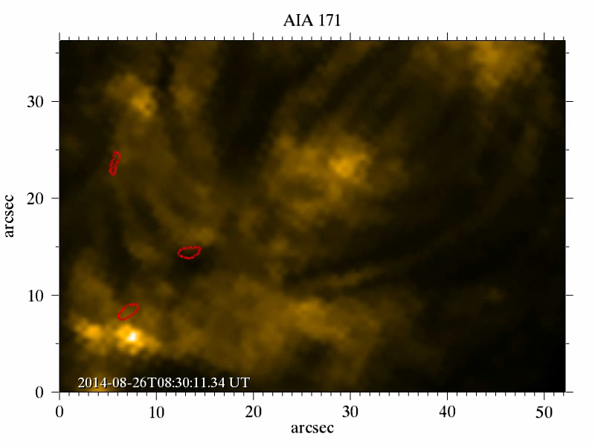
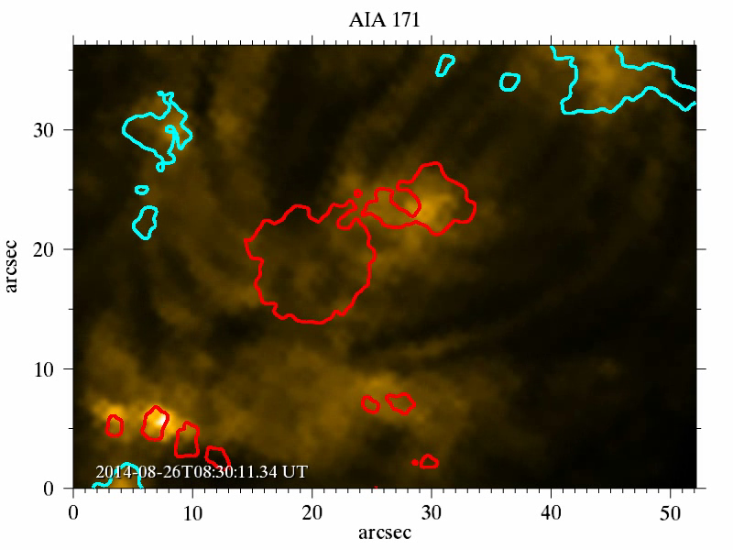
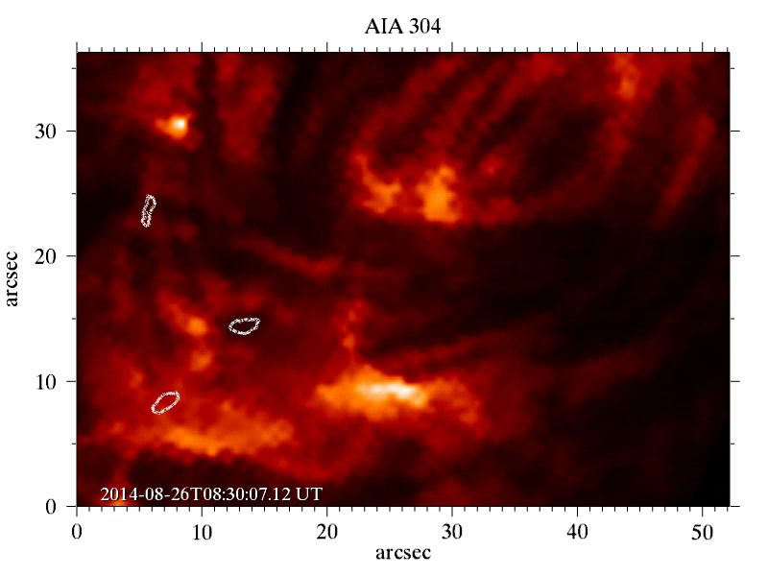
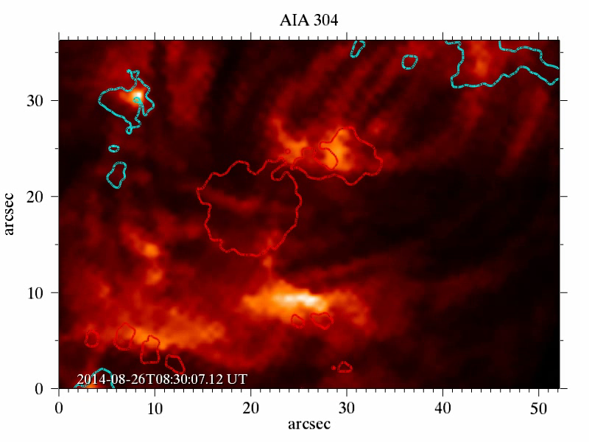

Slide 42
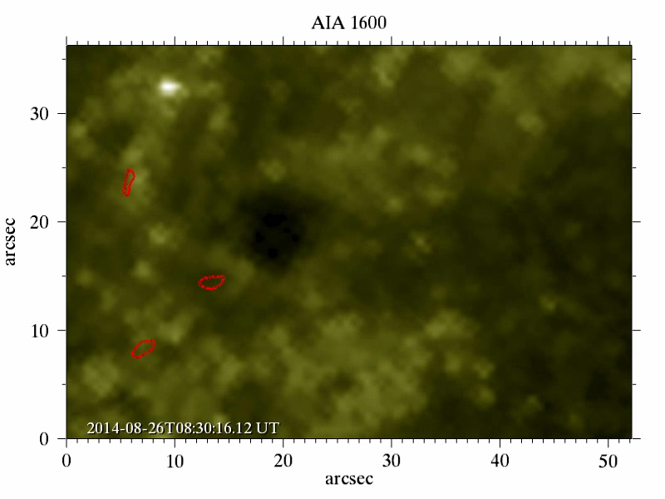
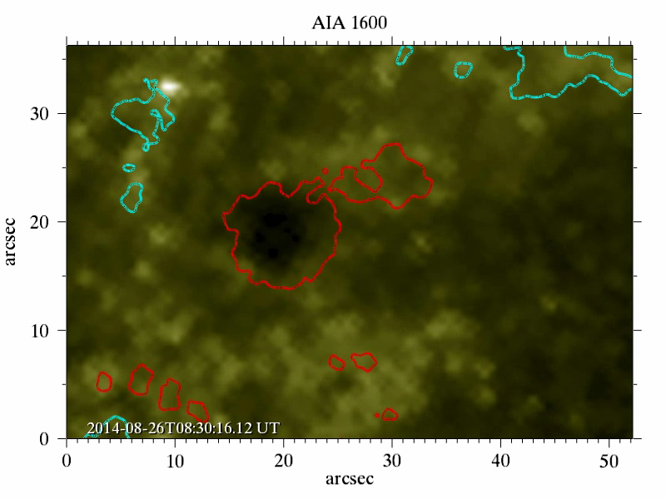
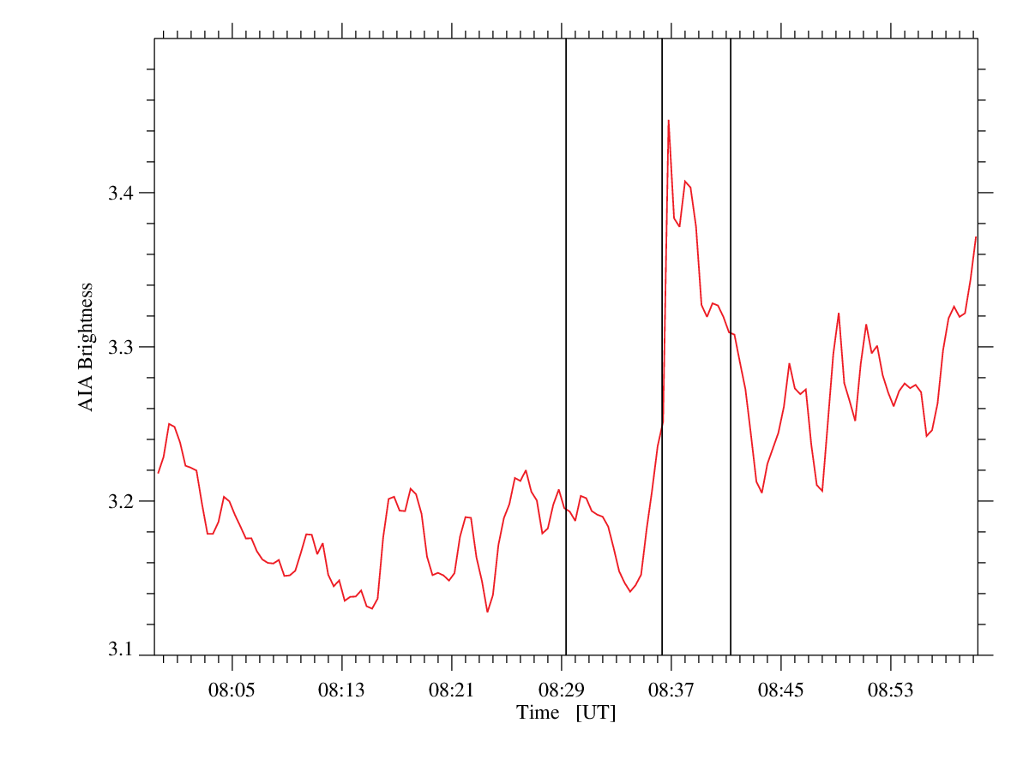
AIA 1600 Å (8:30 – 8:42 UT)
Simultaneous brightening in 3 areas at around 8:37 UT

Slide 43
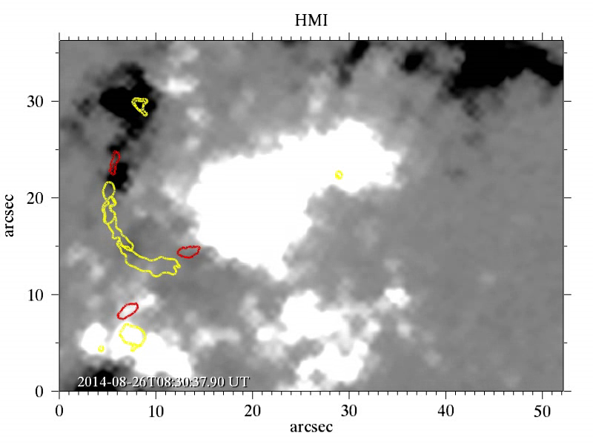
HMI magnetograms
Time-series 8:30-8:42 UT
Contours: Ca II (red) + AIA 171Å (yellow) brightenings
Magnetograms do not show significant changes during brightening

Slide 44
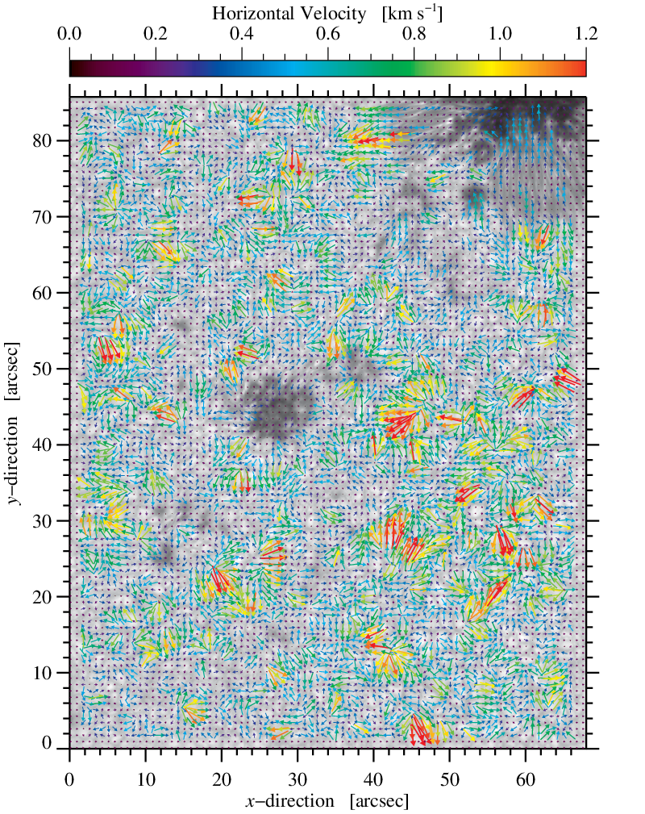
Local Correlation Tracking (LCT)
LCT maps computed for the BIC restored 4505 Å images
LCT shows the horizontal velocities
Time cadence approx 30 seconds, average map approx 15 minutes
• FWHM = 1200 km, background 15 minute averaged image
LCT velocities as rainbow colored arrows : Blue to red - low to high
No significant changes in the photosphere below brightening event (yellow box)
GFPI

Slide 45
Conclusions
GFPI Ca II 8542 Å line-core images show a brightening event at three different areas (A1,A2 and A3) close in space at ~ 8:37 UT
A1 and A2 show a brightening ~ 1 min earlier than A3
In between there is a sudden upflow also at ~ 8:37 UT
Some selected pixels were inverted (A3) with NICOLE
  The brightening is related to an increase of temperature
  Upflows (blueshifts) are inferred also inside the brightening
3
AIA 304 Å and 171 Å also show brightening in A1, A2 and A3 and a “brightening channel” which coincides with the blueshifted channel seen in the Ca II velocities
2
1

Slide 46
Conclusions
AIA 1600 Å sees simultaneous brightening in A1, A2 and A3
HMI magnetogram and LCT photospheric horizontal motions changes are negligible below the brightening event
Ca II brightening are usually related to flaring activity
  Aug 26 (this data): no flares in AR
  Aug 25 (day before): three C1.1 flares at 04:12 and 05:41 UT
  Aug 27 (day after): one C4.4 flare at 02:44 and C4.3 at 03:37 UT
It seems that the brightening areas A1-A3 are independent of the registered flares, but the chromosphere is excited
The sudden increase of temperature in the mid-chromosphere (Ca II 8542 Å), together with brightenings in the corona (AIA 171 Å) and upper photosphere (AIA 1600 Å) might indicate magnetic reconnection

