Slide 1
GBT Mapping Observations of AME near the S140 Region
Max Abitbol
University of Oxford
CMB Foregrounds for B-mode Studies
October 17th, 2018
Tenerife, Spain

Slide 2
Constraining the anomalous microwave emission mechanism in the S140 star forming region with spectroscopic observations between 4 and 8 GHz at the Green Bank Telescope
Max Abitbol, Brad Johnson, Glenn Jones, Clive Dickinson, and Stuart Harper
ApJ 864:97 (2018).

Slide 3
Overview
AME
Excess emission at 10 – 60 GHz.
Not synchrotron, (optically thin) free-free, or thermal dust.
AME could be polarized and obscure B-mode observations.
AME is an important foreground for temperature anisotropy and spectral distortion measurements.
Observations
Planck detects AME from around S140, a star forming region.
We observed the region with the GBT at 4 – 8 GHz.
Possible Source
Spinning dust: electric dipole emission from rapidly rotating dust grains.
Compact HII regions: (optically thick) free-free with high emission measure.
Goal
Determine AME mechanism in this region.
Notes:
How many UCHII regions in galaxy?

Slide 4
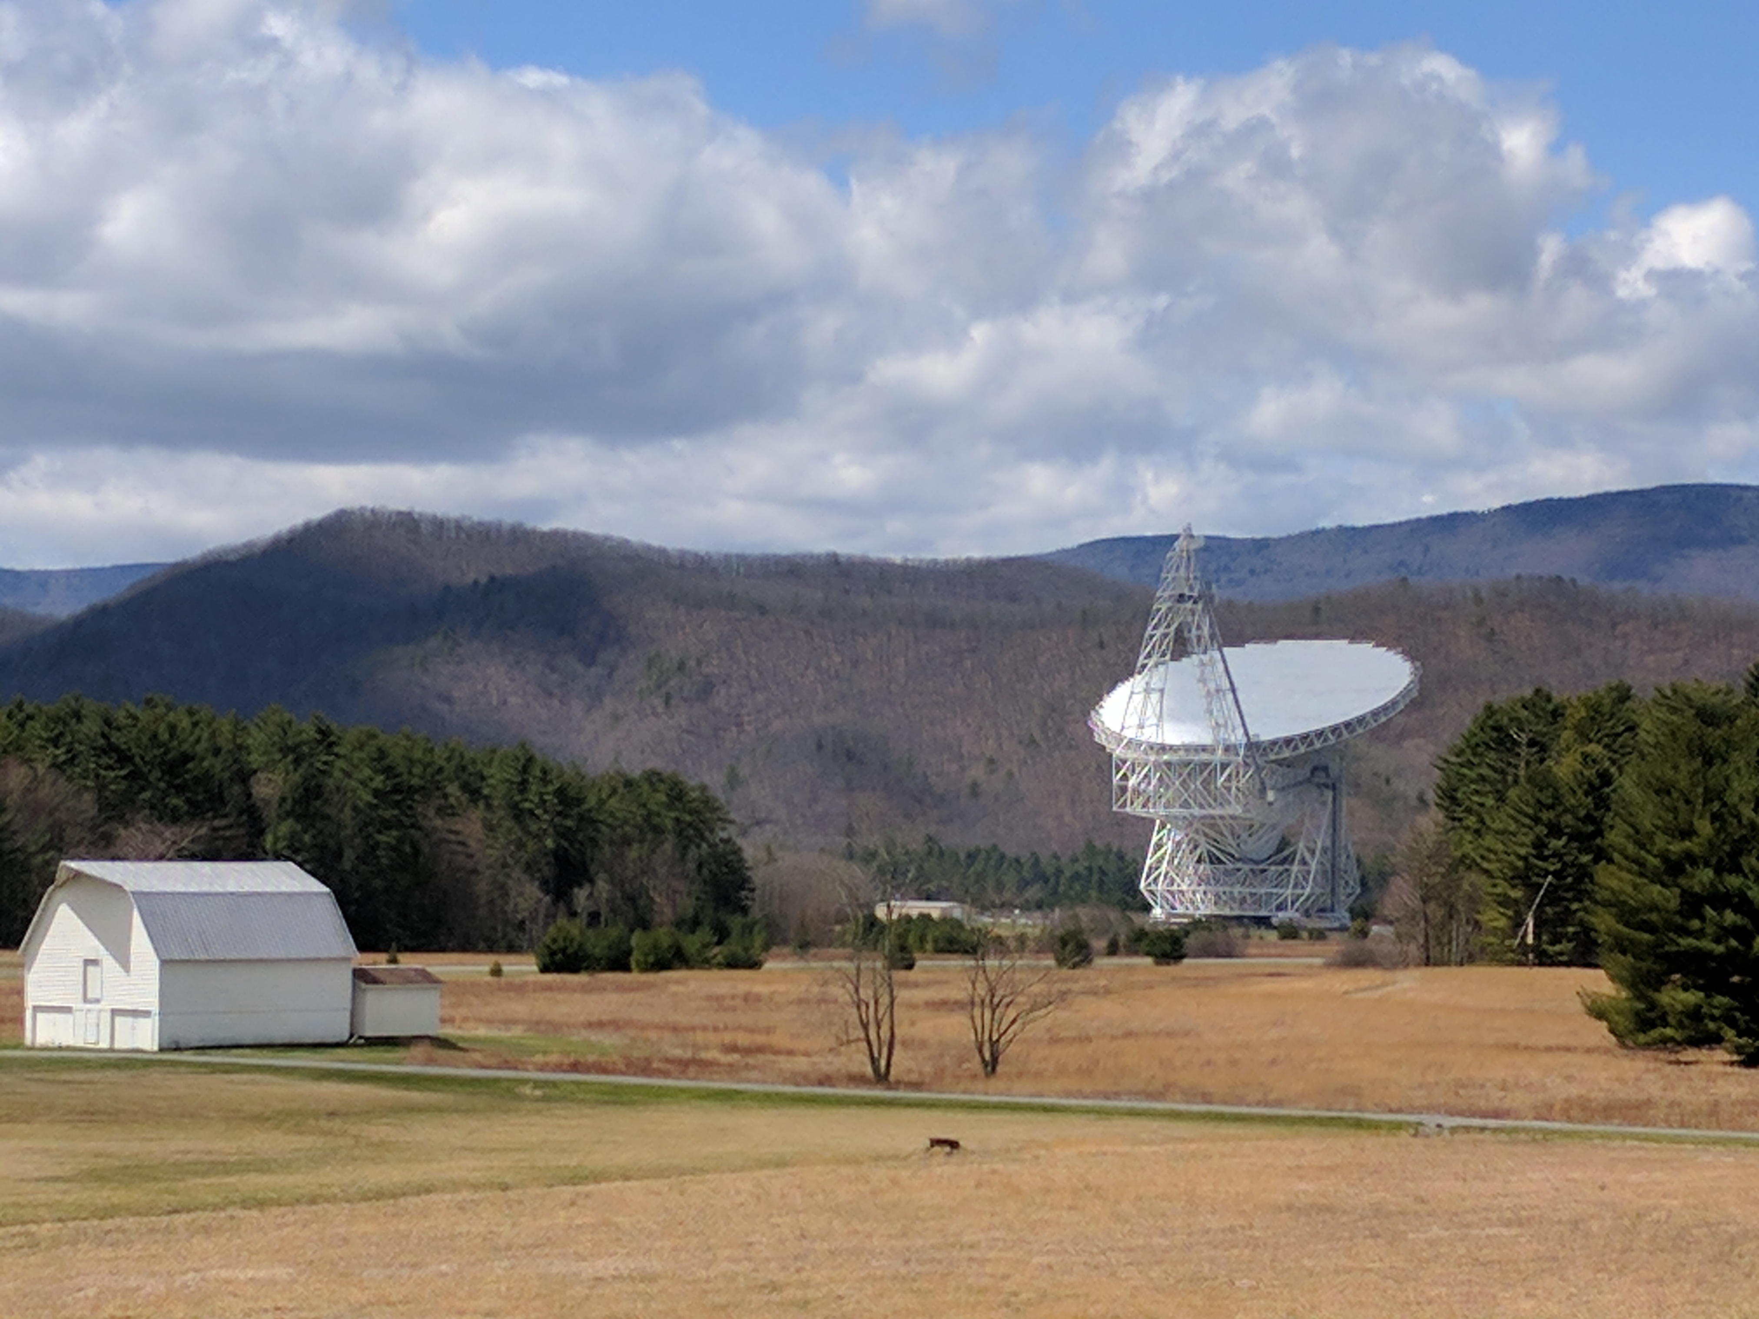
Green Bank Telescope
100 meter Gregorian reflecting telescope.
Observations at C-band using the digital spectrometer backend.
4 – 8 GHz split into 65,536 frequency bins.
Each bin is approximately 100 kHz wide (with overlap at the edges).
Scanned the region as fast as possible given mechanical constraints.
Flashed a noise diode calibration source every other sample.
Data calibrated by using known astrophysical sources.

Slide 5
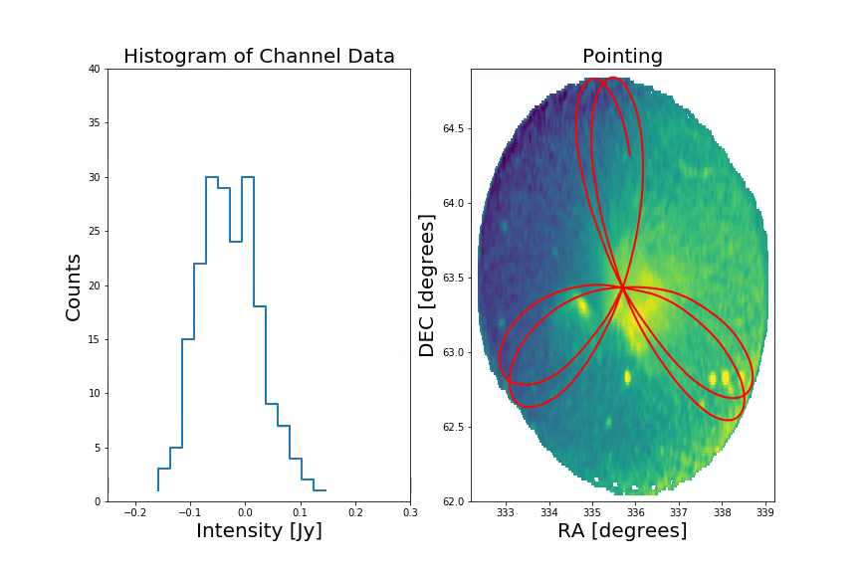
GBT observations

Slide 6
GBT map of G107.2+5.2
Notes:
Look up cepheus cloud

Slide 7
Intensity spectrum of G107.2+5.2
Notes:
Clive ratio?

Slide 8
AME models: UCHII

Slide 9
AME models: spinning dust

Slide 10
Spatial morphology of G107.2+5.2
GBT 4 GHz map with contours
GBT 4 GHz map smoothed for photometry

Slide 11
Spatial morphology of G107.2+5.2
CGPS map at 408 MHz with GBT contours
Planck 28 GHz map with GBT contours
4 GHz map spatially correlated with 408 MHZ map.
28 GHz map doesn’t have spatial resolution to resolve S140.

Slide 12
Spatial morphology of G107.2+5.2
Planck 143 GHz map with GBT contours
Planck 353 GHz map with GBT contours
‘Cloud’ mostly disappears above
100 GHz. Emission dominated by S140.
Spinning dust should correlate spatially with thermal dust.

Slide 13
Conclusion
Spectrum:
  Consistent with both spinning dust and UCHII AME models.
  Spinning dust statistically the better fitting model.
Morphology:
  Diffuse ‘cloud’ optically thin free-free.
  S140 could harbor UCHII region.
  Thermal dust emission throughout aperture but brightest near S140.
External info:
  AMI data of S140 detects rising spectrum of AME.
  AMI model consistent with UCHII.
  AMI model consistent with spinning dust if emission is diffuse and on scales > 10’.
Notes:
Density of gas?

Slide 14
Future work
High spatial resolution 20 – 40 GHz data required.
H-alpha observations could help measure expected free-free emission.
Polarization data.
Radio recombination lines.
Ku-band or higher frequency observations.
GBT on other regions.

