Slide 1

Polar-Areas Stellar Imaging in Polarization High Accuracy Experiment:
Clearing the path to experimental tests of inflation
Konstantinos Tassis
Foundation for Research and Technology – Hellas
University of Crete
Notes:
PASIPHAE is an experiment that aims to revolutionize the way the foreground due to Galactic interstellar dust is removed by experiments seeking an inflationary signature in the polarization of the CMB
PASIPHAE is an acronym but it is also a name (that of the Minoan queen)

Slide 2








The PASIPHAE Collaboration
Our Sponsors
Notes:
PASIPHAE is an international collaboration spanning 4 continents. between …

Slide 3
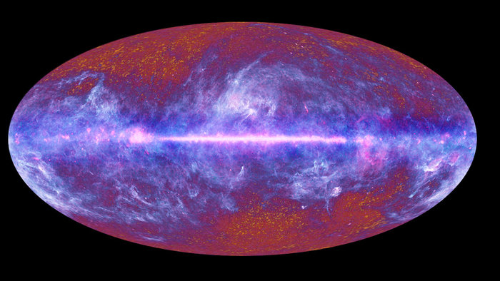
The Problem
Magnetized Galactic dust also emits polarized microwaves
ESA/ LFI & HFI Consortia
Notes:
PASIPHAE aims to address the thermal dust foreground. The early universe is not the only source of polarized microwave emission. Cold, elongated, Galactic dust grains align by the Galactic magnetic field and so also emit polarized microwaves. Their polarization direction depends on the direction of the magnetic field.

Slide 4
The Problem
Magnetized Galactic dust also emits polarized microwaves
ESA/ LFI & HFI Consortia
CMB dust emission removal:
Notes:
The way the dust foreground is subtracted from microwave maps so far is the following:
Here I am showing various contributions to the microwave sky. It is a busy plot, so let’s focus on the two ingredients relevant to the problem: the CMB, and dust.

Slide 5
The Problem
Magnetized Galactic dust also emits polarized microwaves
ESA/ LFI & HFI Consortia
CMB dust emission removal:
dust
CMB
Notes:
Galactic dust, although very cold, ~19K, is still warmer than the CMB, at 3K and so dominates the emission at higher frequencies.

Slide 6
The Problem
Magnetized Galactic dust also emits polarized microwaves
ESA/ LFI & HFI Consortia
CMB dust emission removal:
Map at high frequencies
(dust dominates)
dust
CMB
Notes:
So you map the dust at ~ 353 GHz, where it dominates,

Slide 7
The Problem
Magnetized Galactic dust also emits polarized microwaves
ESA/ LFI & HFI Consortia
CMB dust emission removal:
Map at high frequencies
(dust dominates)
Subtract from lower frequencies
(CMB dominates)
dust
CMB
Notes:
and you scale and subtract this signal from what you see at ~100 GHz, where the cosmic signal contributes significantly.
This technique works well for a scalar quantity such as intensity, and so CMB science so far has been extremely successful despite the presence of Galactic dust.

Slide 8
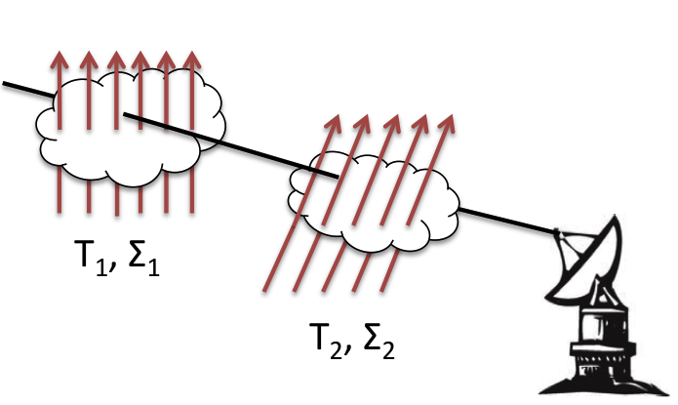
“Map & Subtract” cannot work with polarization
Polarization ROTATES between frequencies
because of multiple clouds and misaligned B-fields
Tassis & Pavlidou 2015
Notes:
Not so for polarization!
There is a problem more severe than originally thought. The 3-dimensional structure of the ISM.
As our group first pointed out in 2015, you can get situations like the following: two clouds lie along the line of sight one dominates the emission at high frequencies and the other at low frequencies. The polarization pattern ROTATES between these frequencies trying to trace the magnetic field of the dominant cloud in each case.

Slide 9
“Map & Subtract” cannot work with polarization
Polarization ROTATES between frequencies
because of multiple clouds and misaligned B-fields
Tassis & Pavlidou 2015
Consensus: frequency decorrelation most unconstrained effect
for current & upcoming B-mode experiment foreground subtraction
Planck Collaboration L 2017, Poh & Dodelson 2017, Hensley & Bull 2017, Puglisi et al 2017, Martizez-Solaeche et al. 2017, Planck Collaboration XXX 2016, Planck 2018 results. XI.
Notes:
This frequency decorrelation of the polarization pattern has been studied by several groups since, and the consensus among these studies is that it is the most unconstrained effect for foreground subtraction for current and upcoming B-mode experiments. And PASIPHAE seeks to remedy that.

Slide 10
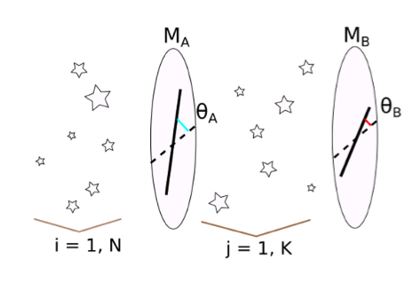
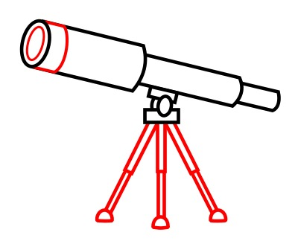
The Solution: 3D Magnetic Tomography
Use stars of known distances as lamp posts
Measure stellar polarization
  get B direction in different clouds
  measure and model out 3D effects
Notes:
The same dust grains that emit polarized microwaves also absorb starlight and impart polarization on the emerging light. So we can use stars of known distances as lamp posts. If we measure the polarization of many stars of different but known distances along a line of sight, then we can infer the direction of the magnetic field between them, and use this information to subtract the dust foreground from CMB polarization, including 3-dimensional effects.

Slide 11


The Solution: 3D Magnetic Tomography
Use stars of known distances as lamp posts
Measure stellar polarization
  get B direction in different clouds
  measure and model out 3D effects
Possible for the first time
Notes:
Only now is this approach possible, because of GAIA and PASIPHAE.
ESA’s Gaia mission has delivered reliable parallaxes for a billion stars.
PASIPHAE will deliver the necessary polarization measurements.
And for the first time, we will be able to construct a tomographic map of the Galactic magnetic field direction

Slide 12
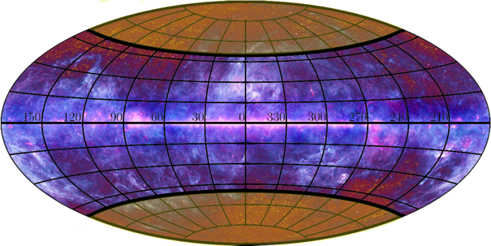
PASIPHAE optopolarimetric survey
PASIPHAE survey area
Skinakas Observatory, Crete, Greece
PASIPHAE survey sites
SAAO, Sutherland, South Africa
Notes:
The PASIPHAE survey will cover the high Galactic latitudes that CMB polarization experiments target. PASIPHAE will run concurrently from two sites: in the Norther hemisphere, at the Skinakas Observatory in Crete. In the Southern hemisphere, at the South African Astronomical Observatory in Sutherland.

Slide 13
The PASIPHAE survey:
Will observe all stars with Rmag ≤ 16.5
Will deliver mean polarization down to 0.1% at 3σ for 0.25 deg² pixels
Survey rate: 8 deg²/night (Skinakas 1.3m ) -- 7 deg² /night (SAAO1.0 m) assuming 70% efficiency
1,500 deg² / yr

Slide 14
PASIPHAE optopolarimetric survey
Measure polarization of several million stars
Notes:
PASIPAHE will measure the polarization of several million stars, in a part of the sky that is essentially unexplored in optical polarization. I am showing here the number of stars per square degree with currently measured polarization properties as a function of Galactic latitude. The high Galactic latitudes of interest have been neglected and the current state of the art is disheartening, at one star per three square degrees. The reason is because it is driven by the star formation community that cares about the galactic plane where stars are forming inside molecular clouds

Slide 15
PASIPHAE optopolarimetric survey
Major Leap:
x1000 improvement
in # of stars with measured
polarimetric properties
Measure polarization of several million stars
Notes:
PASIPAHE will take us at least to 360 stars per square degree, a thousand-fold improvement over the current state of the art.
To achieve this both systematic and statistical uncertainties will be below 0.1%. We need this kind of unprecedented accuracy because at these high latitudes there is little dust, so the polarization is low.

Slide 16
WALOP: the PASIPHAE polarimeter
Wide Area Linear Optical Polarimeter (WALOP)
Innovative and well-tested technology of RoboPol
Implements low-systematics design in a wide field
Commissioning in 2019
Notes:
This is achieved by WALOP: an innovative, wide-area, linear optopolarimeter, designed specifically for this project.
WALOP builds on the well-tested, no-moving-parts, low-systematics technology of RoboPol that has been running on Skinakas with tremendous success since 2013, and it implements the RoboPol design in a wide-field instrument.
Its development is currently underway, with commissioning planned in 2019.

Slide 17
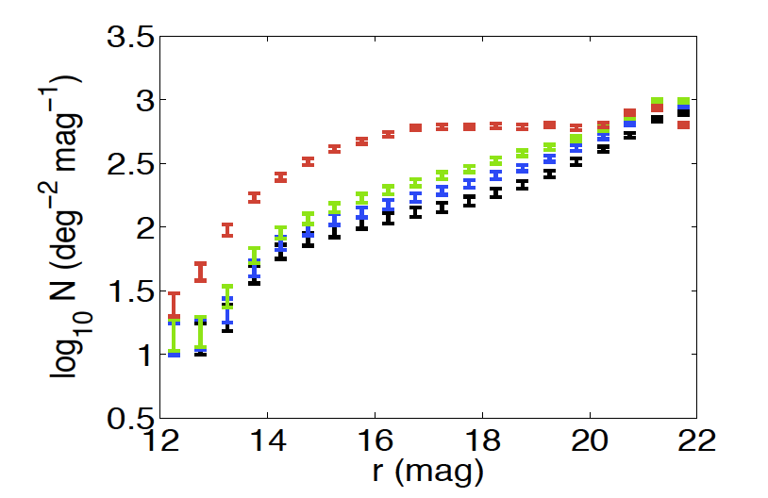
Feasibility: Stellar Density
At least 360 stars of R_{mag} < 16.5 at the Galactic pole
Black b = 90⁰
Blue b = 75⁰
Green b = 65⁰
Red 20⁰ < b < 30⁰
Gao 2011 from SDSS DR7
Notes:
We have performed extensive feasibility studies for all aspects of this project.
We have confirmed that stellar density is high enough even at high Galactic latitudes to do tomography

Slide 18
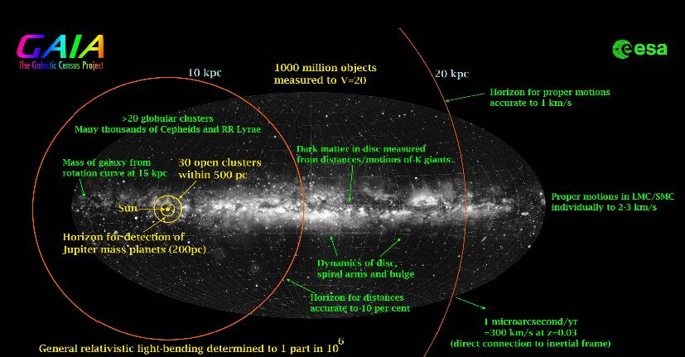
Feasibility: Distances
Notes:
We have confirmed that Gaia has delivered distances of sufficient accuracy for enough far-away stars.
For instance, the red clump giants
that dominate in the magnitude interval 8 ≤ R ≤ 10
will allow us to measure polarization with the required
accuracy up to several kpc.

Slide 19
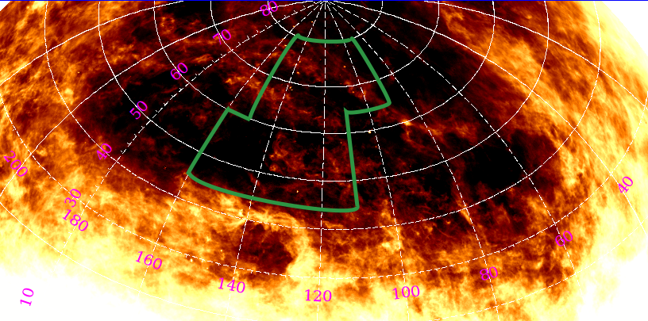
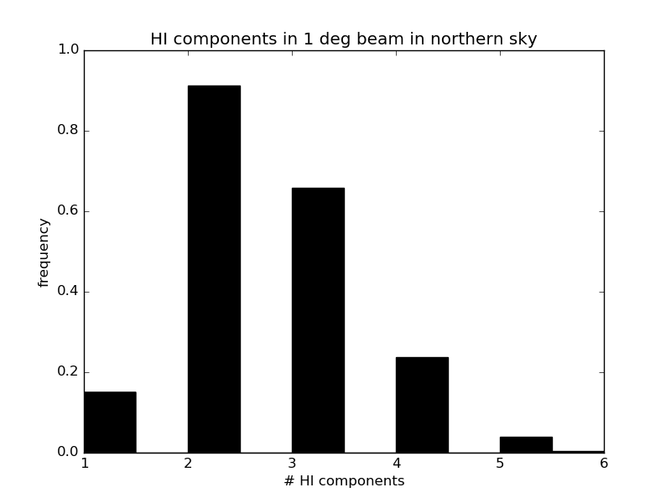
Feasibility: # of clouds along the los
HI data from the Effelsberg-Bonn HI survey
Notes:
We have confirmed from HI data that the number of dust clouds along the line of sight is knowable and manageable.

Slide 20
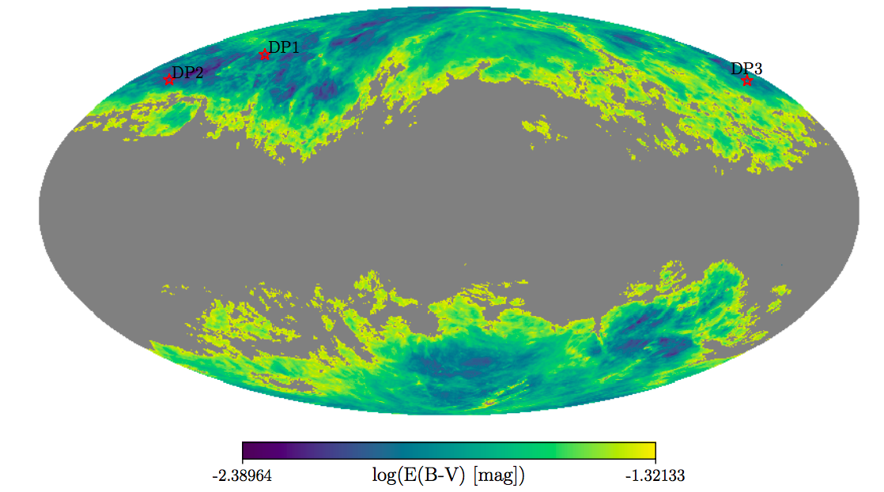
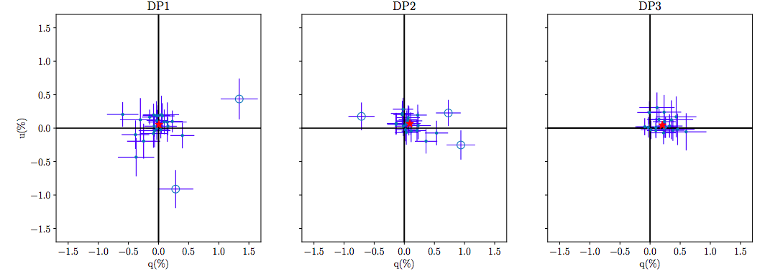
Feasibility: Degree of Polarization
Skalidis et al. 2018 A&A, 616,52
p_{mean} = (0.054±0.038)%
p_{mean} = (0.208 ± 0.044)%
p_{mean} = (0.113 ± 0.036)%
Notes:
We have confirmed that stellar polarization level is recoverable at high Galactic latitudes by performing a mini survey of 3 areas of the northern sky with the least amount of dust

Slide 21
Feasibility: Polarization Systematics
RoboPol standards program
Notes:
Since we are pushing the envelope of polarimetry with this program. Systematic uncertainties is the major obstacle of reaching such low optical polarization levels.
We have underway a large program for establishing stable polarimetric standards all over the targeted area of the sky.

Slide 22
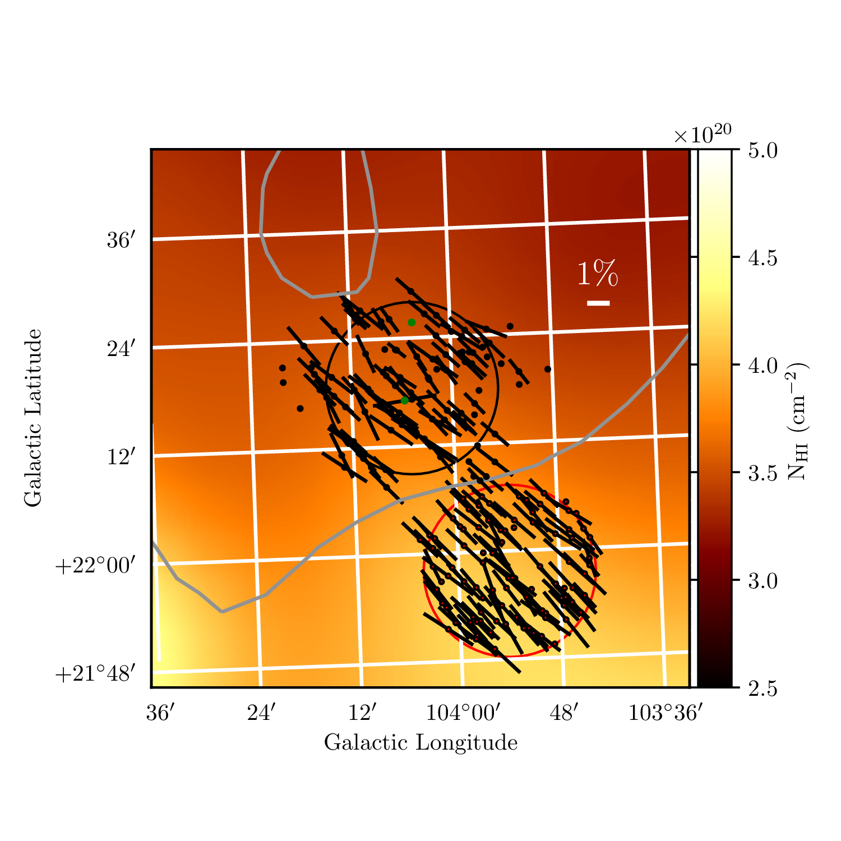
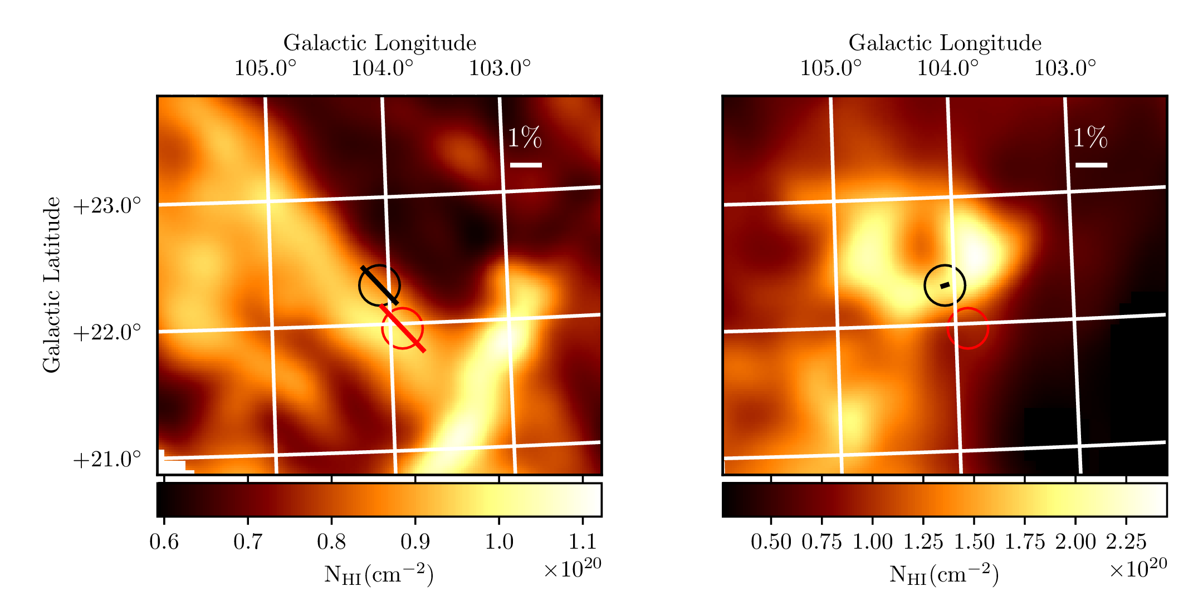
Feasibility: Tomography
Panopoulou et al. 2018
arXiv:1809.09804
Notes:
And while WALOPs are being developed we have used the RoboPol for a pathfinding first demonstration of the magnetic tomography technique
We picked a region of the sky, where we have two clouds, overlapping, but only partially. We used HI PPV data to do this.
So we have one region where the only cloud along the line of sight is this nice elongated cloud, I will call it the baguette cloud, and a neighboring region where you have an overlap of the baguette cloud and this croissant--shaped cloud. We measured the polarization of many stars in both regions, and combined them with GAIA distances. The result is shown here with these lines. These are magnetic fields with an angle at least 60 deg.

Slide 23
Improving CMB foreground subtraction 1
0th-order approach
  3-D effects important only when B-fields in different clouds along LOS are misaligned (by >60 deg)
  Pixels with such misaligned clouds can be identified and masked out
  (as with point sources)
  PASIPHAE+Gaia data alone
  can produce such a mask.
EVPA difference between 150GHz and 350GHz
Tassis & Pavlidou 2015
Misalignment:
90⁰
85⁰
80⁰
75⁰
60⁰
Notes:
ΟΚ say we got the 3D map of the galactic B-field direction. How can we use this information to aid the CMB foreground subtraction
The obvious question is PASIPHAE maps polarization in absorption but CMB foreground is in emission: how do we connect absorption and emission?
To zeroth order, we don’t even need to do that!
All you need to do is find which pixels have clouds with significantly misaligned magnetic fields.
What we showed in our 2015 paper is that the 3-D effects only cause appreciable decorrelation of the polarization pattern between frequencies if the magnetic fields in different clouds are misaligned by more than 60 degrees. Here in this plot the polarization angle difference in 2 frequencies is in the y axis and the temperature of the second cloud is on the x axis. You can see that no matter what the temperature, the magenta lines which is the smallest misalignment I show here, at 60 degrees, never decorrelate by more than a few degrees
GAIA and PASIPHAE alone, through magnetic field direction tomography, will immediately identify areas of the sky where you have such problematic misalignments, and you can then simply mask these areas out – treat them in exactly the same way you treat, say, point sources.

Slide 24
Improving CMB foreground subtraction 2
1st-order approach
  Now: modified-black-body model is fitted in each pixel (using e.g. Planck data)
  With PASIPHAE: fit one modified-black-body model for each cloud, using:
  B-field direction from PASIPHAE/Gaia + Planck data (T)
  + cloud edges, column density from all-sky HI surveys
  Approach is both more accurate and computationally less expensive
  Is polarization due to absorption predictive of emission polarization?
  YES!
  emission, absorption Q,U are tightly correlated
  3-d effects can account for most of scatter
Planck Intermediate results XXI (2015)
Notes:
But you can be even more sophisticated than that, because in fact absorption Q and U are extremely well correlated and predictive of emission Q and U, as Planck has showed. So here is a first-order approach:
What happens right now in the map-and-subtract scheme, is that a MBB model for dust emission is fitted per pixel based on high-frequency data, and extrapolated to lower-frequency data.
We can instead fit a fancier model, where a MBB model is fitted *per cloud*, using HI maps to find the edges of clouds and scale their emissivities, and the magnetic field direction in each cloud, as measured by PASIPHAE, to set the relative values of Q and U that give you the polarization angle in each cloud. If you have more than one clouds along the line of sight, you naturally add up the Stokes parameters from each.
Then you use this model, which is both more accurate and computationally less expensive than what is currently used to do dust foreground subtraction, *including* three dimensional effects.
The Oslo group is leading this analysis

Slide 25
Wider Impact
Impact on other Astronomy fields
3-D Tomographic Map of Galactic B-field:
  What is the origin of Galactic B-field?
  Is the B-field dynamically important in
  interstellar clouds?
  Where are ultra-high-energy cosmic rays
  coming from?
Credit: Ntormousi & Tassis in prep.
credit: Pavlidou 2015
Notes:
Although PASIPHAE science is driven by the hunt for B-modes, its impact will be very wide.
First, the 3-D tomographic map of the Galactic magnetic field direction, by itself, will revolutionize our ability to approach questions such as:
What is the origin of the Galactic Magnetic field? Is the Magnetic field dynamically important in interstellar clouds? And, even what is the origin of ultra-high-energy cosmic rays?

Slide 26
Wider Impact
Impact on other Astronomy fields
3-D Tomographic Map of Galactic B-field:
  What is the origin of Galactic B-field?
  Is the B-field dynamically important in
  interstellar clouds?
  Where are ultra-high-energy cosmic rays
  coming from?
Polarimetric Database PUBLICLY AVAILABLE
  Stellar Astrophysics
  High-energy astrophysics
Credit: Ntormousi & Tassis in prep.
credit: McSwain 2014
credit: Pavlidou 2015
credit: Pavlidou 2015
Notes:
Second, all polarization measurements from our survey, will be publicly available, and will reveal in stellar astrophysics, intrinsically polarized stars
and in high-energy astrophysics, synchrotron emitters.
And of course there is great potential for serendipitous discoveries with these novel science products.

Slide 27
Thank you
PASIPHAE WP today on arXiv: 1810.05652 http://pasiphae.science
Notes:
Please check out the PASIPHAE WP out today!

Slide 28
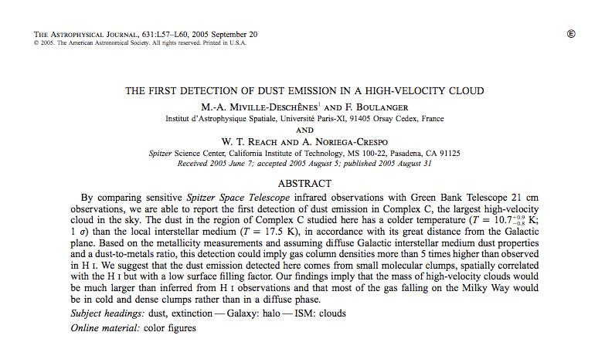
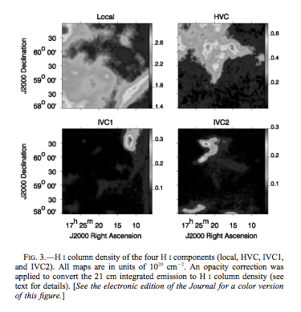
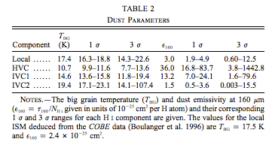
Cloud Temperature Gradient

