Slide 1
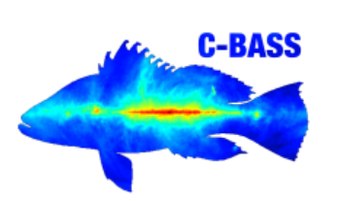
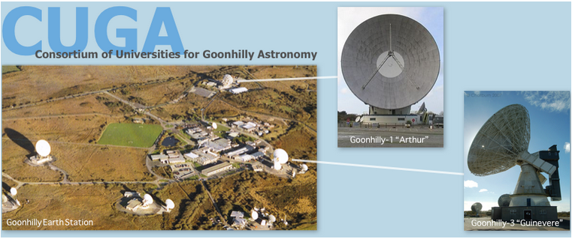
NextBASS
Jaz hill-valler
UNIVERSITY OF OXFORD: Mike Jones, Angela Taylor (C-BASS), Luke Jew (C-BASS), Richard Grumitt (C-BASS), Alexander Pollak (GHY-3), Jamie Leech (C-BASS SKA), Daliso Banda (AVN)
Hochschule Munich: Christian Holler

Slide 2
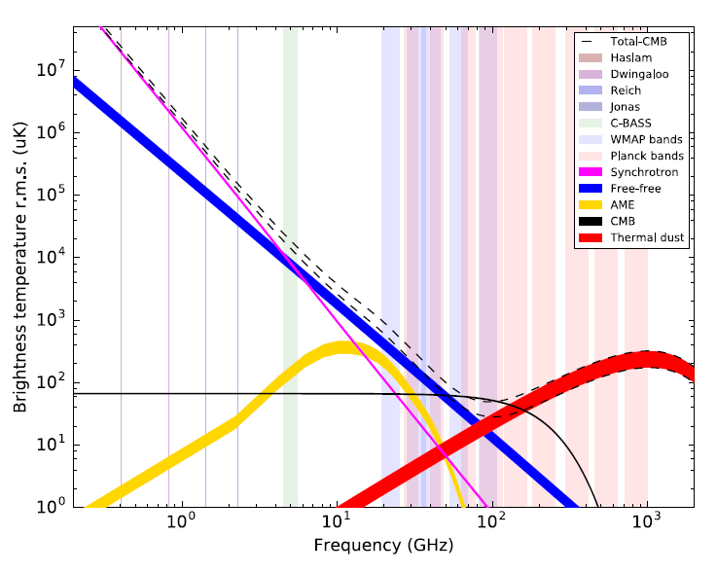
Concept
Cover frequency ‘gap’ between 7-30 GHz
2 bands each covering total bw = 2:1
20% bw for each channel
Achieve an equivalent sensitivity that matches future CMB missions
1 feed for 7-15 GHz
30+ feeds for 7-15 GHz
6m telescope to match resolution of C-BASS
THREE STAGES:
X-BASS … NEXTBASS … ELFS
$$1μKarcmin=A_{s}{\left(\frac{v}{v_{0}}\right)}^{β}$$

Slide 3
Three stages

Slide 4
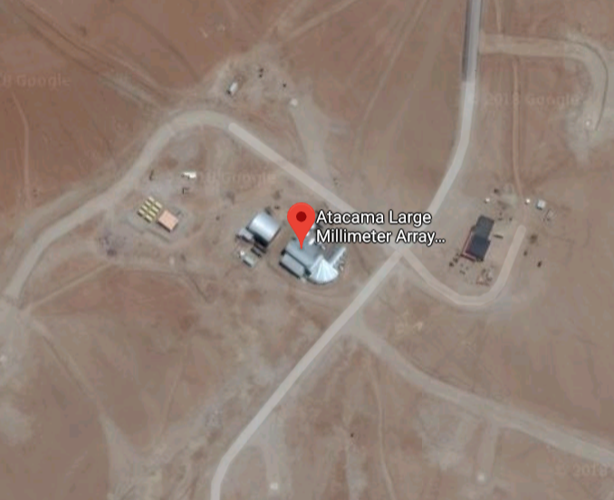
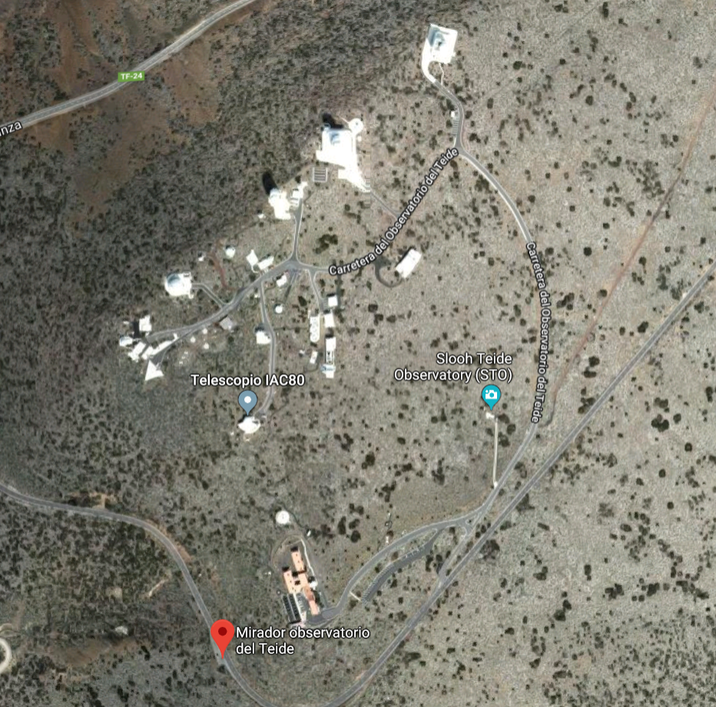
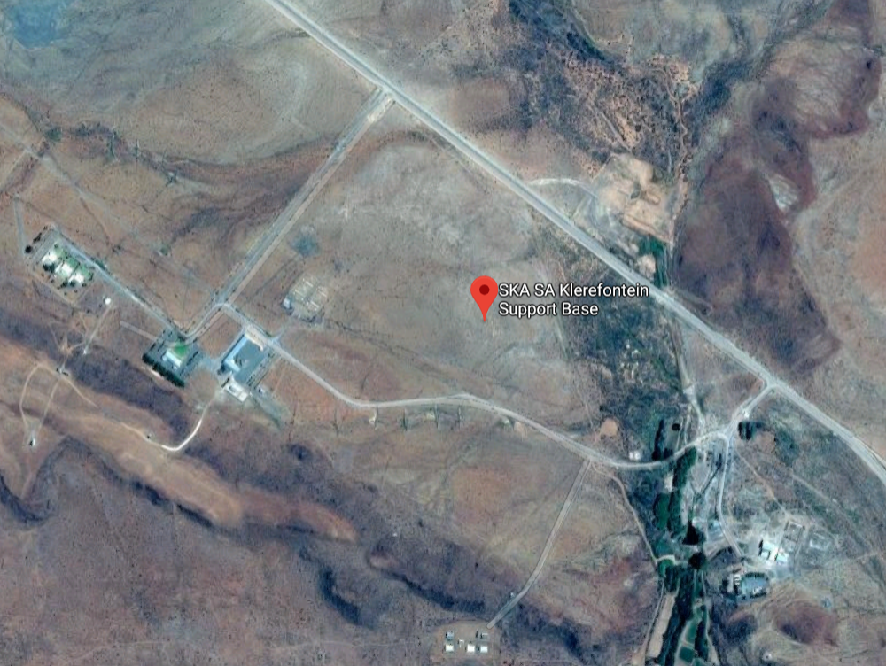
Atacama
Tenerife
7 – 30 GHz
7 – 30 GHz
Klerefontein
7 – 15 GHz

Slide 5
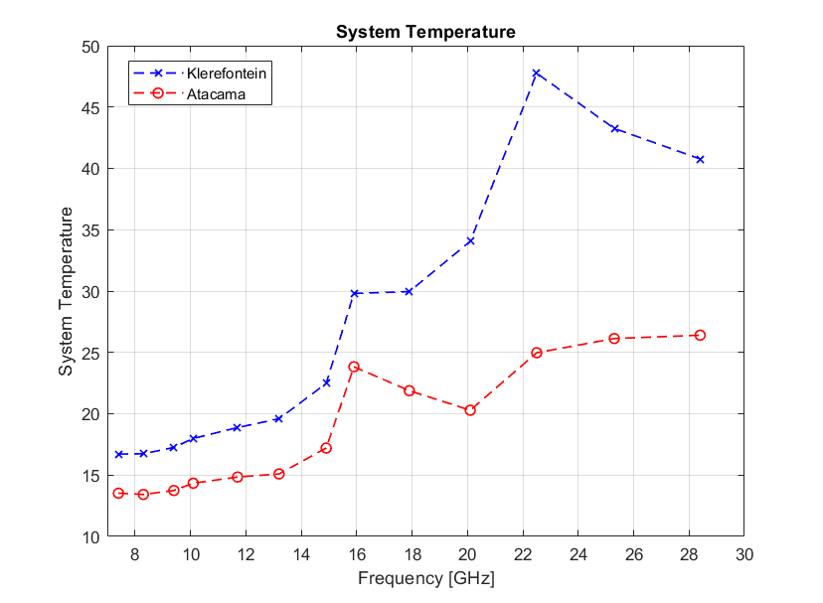
Sites and total survey time
Total survey time = n_{years}*0.5 (night obs) *0.8 (usable data)

Slide 6
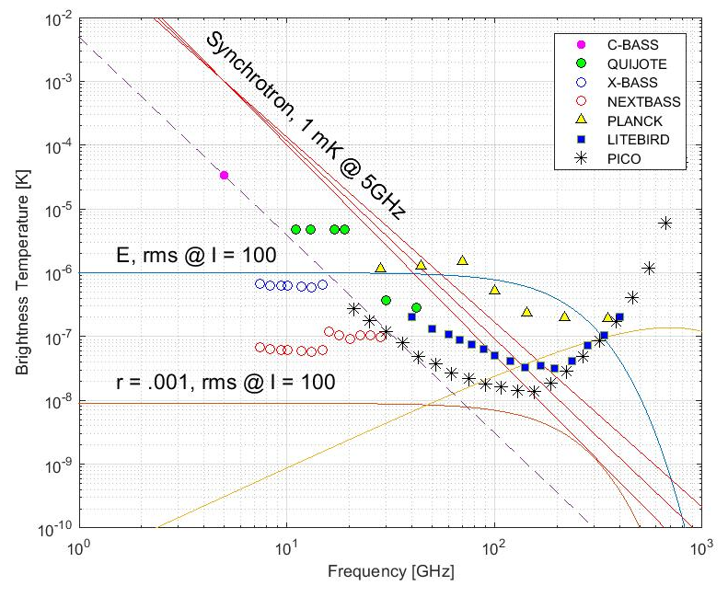
Sensitivities
NextBASS, 5 years, 1 feed 7-15GHz, 30 feeds 15-30 GHz
F [GHZ] | I [uKdeg] | P [uKdeg]
7.4 | 1.64 | 0.55
8.3 | 1.54 | 0.51
9.4 | 1.48 | 0.49
10.1 | 1.49 | 0.50
11.7 | 1.43 | 0.48
13.2 | 1.37 | 0.46
14.9 | 1.47 | 0.49
15.9 | 0.36 | 0.12
17.9 | 0.21 | 0.10
20.1 | 0.27 | 0.09
22.5 | 0.32 | 0.11
25.3 | 0.31 | 0.10
28.4 | 0.30 | 0.10

Slide 7
Single Pixel Simulations
Estimate experiment sensitivity -> 1 deg pixels (I) and 3 deg pixels (P)
Different combinations of experiments (add more freq. channels)
Range of pixel regions with different foreground levels
Generate Jeffreys Prior for each free parameter
Three levels of complexity: BASIC, CURVED SYNCHROTRON, COMPLEX
Intensity:
Straight synch… + curvature term… + free to move free-free Electron temperature
Polarisation:
Straight synch… + curvature term… + 1% (of I) AME component
Bayesian statistical methods + MCMC sampling algorithm
Plot probability density function for each parameter
Fit spectrum to each run & plot error bars
… NEXT STEP: ERROR MODELLING … e.g. fitting a basic sky model to a complex sky

Slide 8
Basic Polarisation Model
Planck + LiteBIRD
Planck + LiteBIRD + C-BASS
Planck + LiteBIRD + C-BASS +
X-BASS
Planck + LiteBIRD + C-BASS + NextBASS

Slide 9
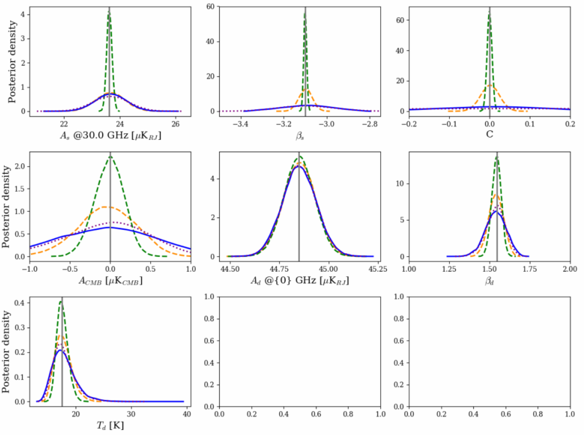
… add synchrotron curvature…
Planck + LiteBIRD
Planck + LiteBIRD + C-BASS
Planck + LiteBIRD + C-BASS +
X-BASS
Planck + LiteBIRD + C-BASS + NextBASS

Slide 10
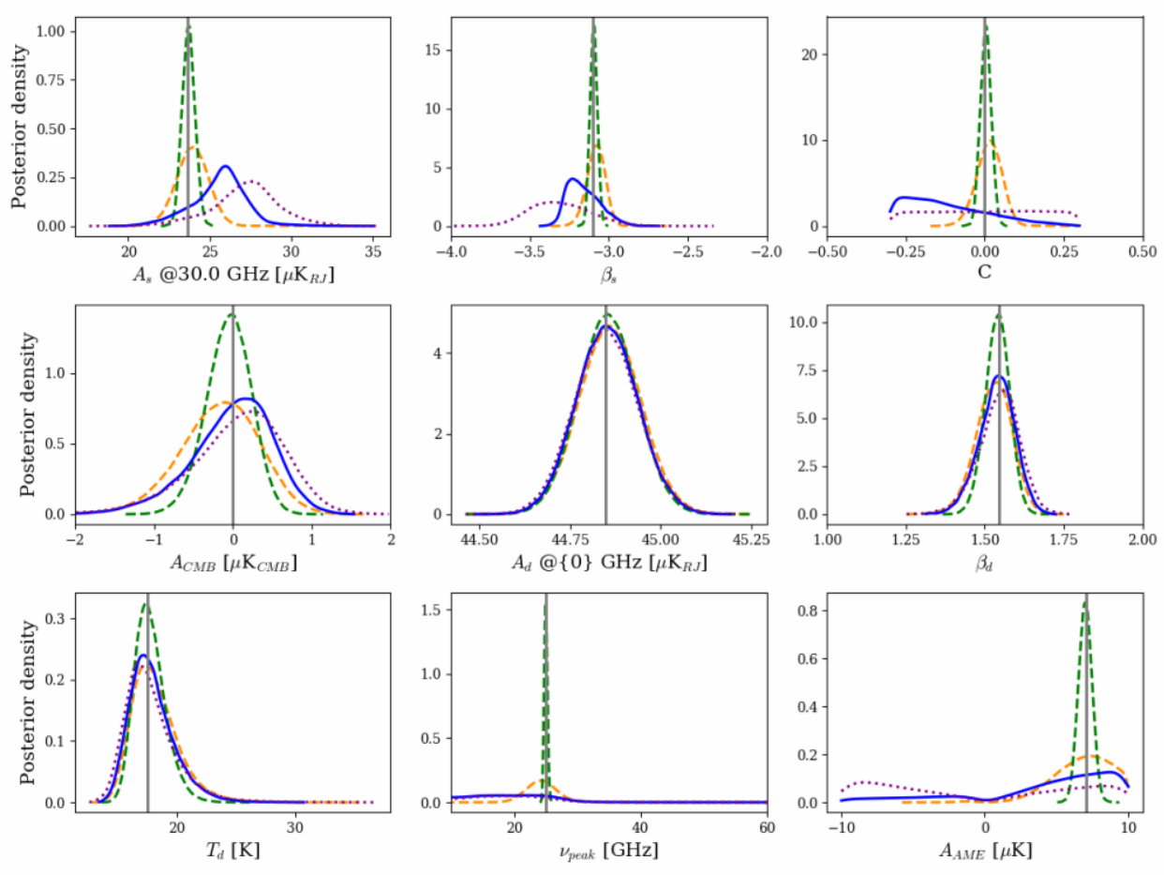
… add 1% polarised AME
Planck + LiteBIRD
Planck + LiteBIRD + C-BASS
Planck + LiteBIRD + C-BASS +
X-BASS
Planck + LiteBIRD + C-BASS + NextBASS
A^{B}_{AME} = 1% (A^{I}_{AME})

Slide 11
Planck + LiteBIRD + C-BASS
B POL – CMB AMP = 0, BRIGHT GALACTIC PLANE

Slide 12
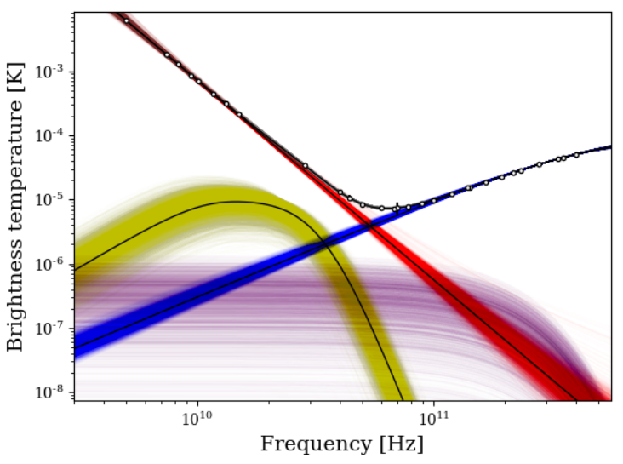
… + X-BASS
B POL – CMB AMP = 0, BRIGHT GALACTIC PLANE

Slide 13
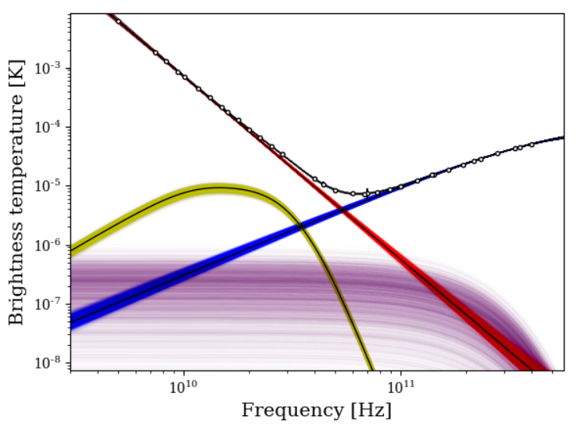
… + NextBASS
B POL – CMB AMP = 0, BRIGHT GALACTIC PLANE

Slide 14
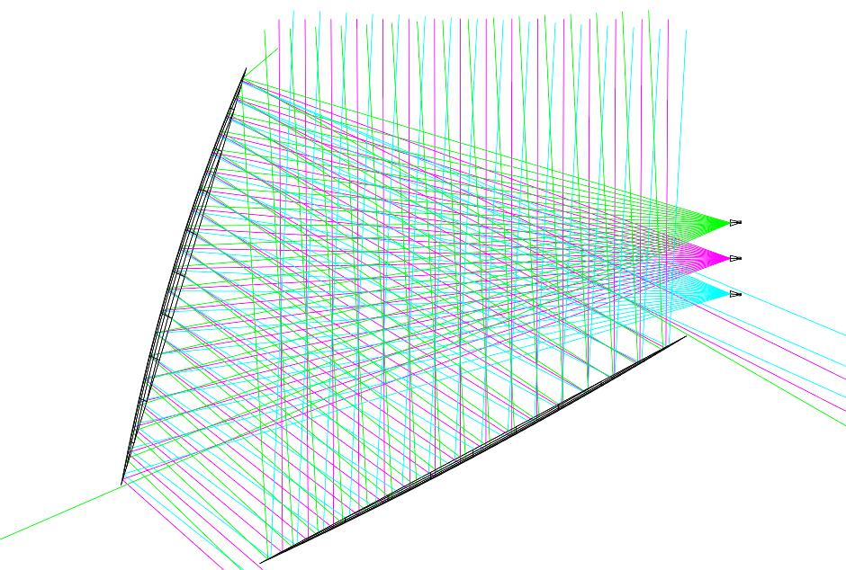
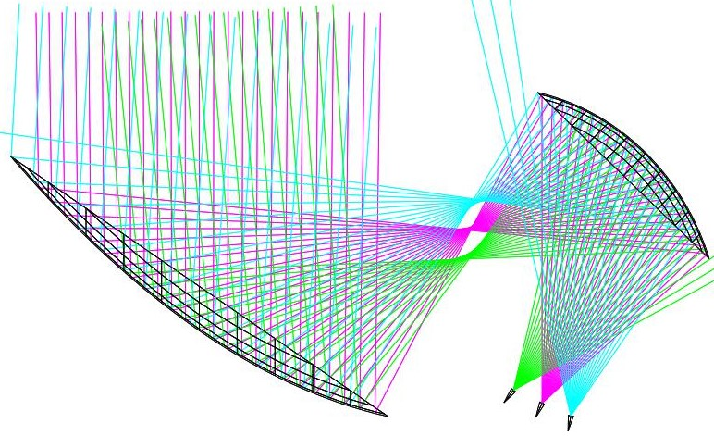
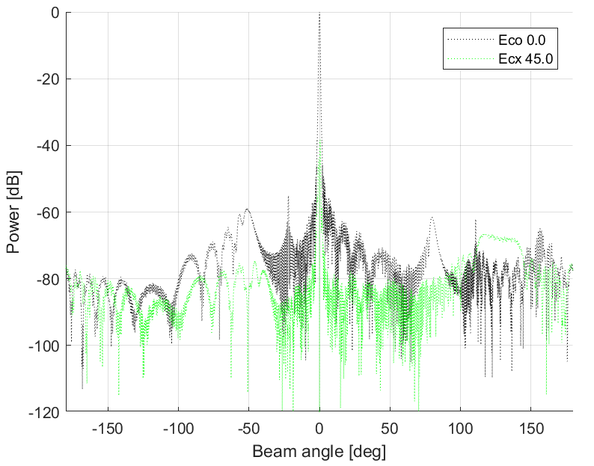
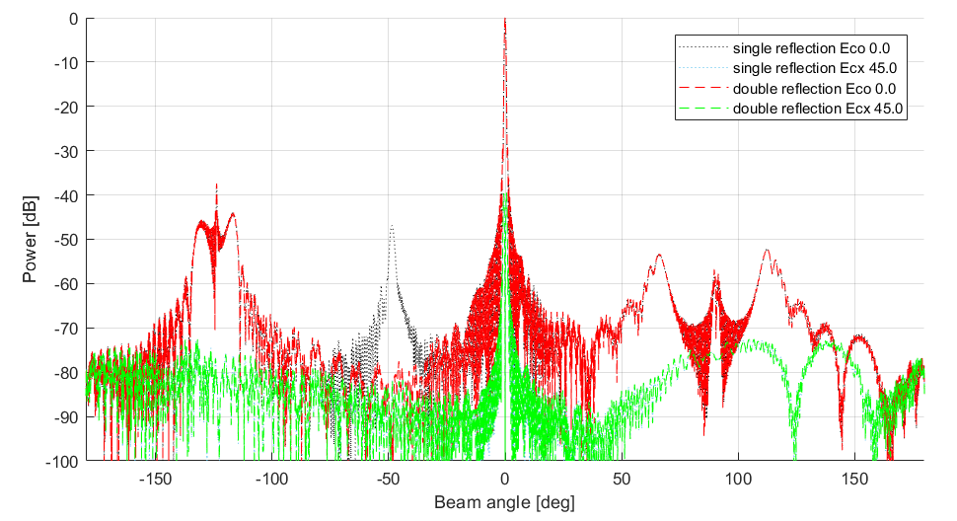
NextBASS Optical Design
6m Cross-Dragone
Off-axis Gregorian also possibility (FP smaller/not uniform)

Slide 15
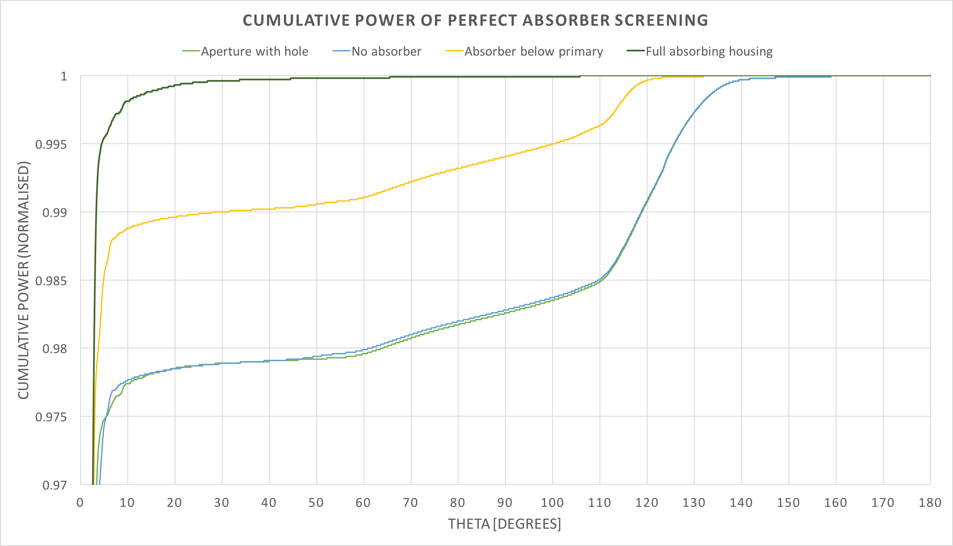
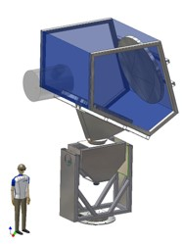
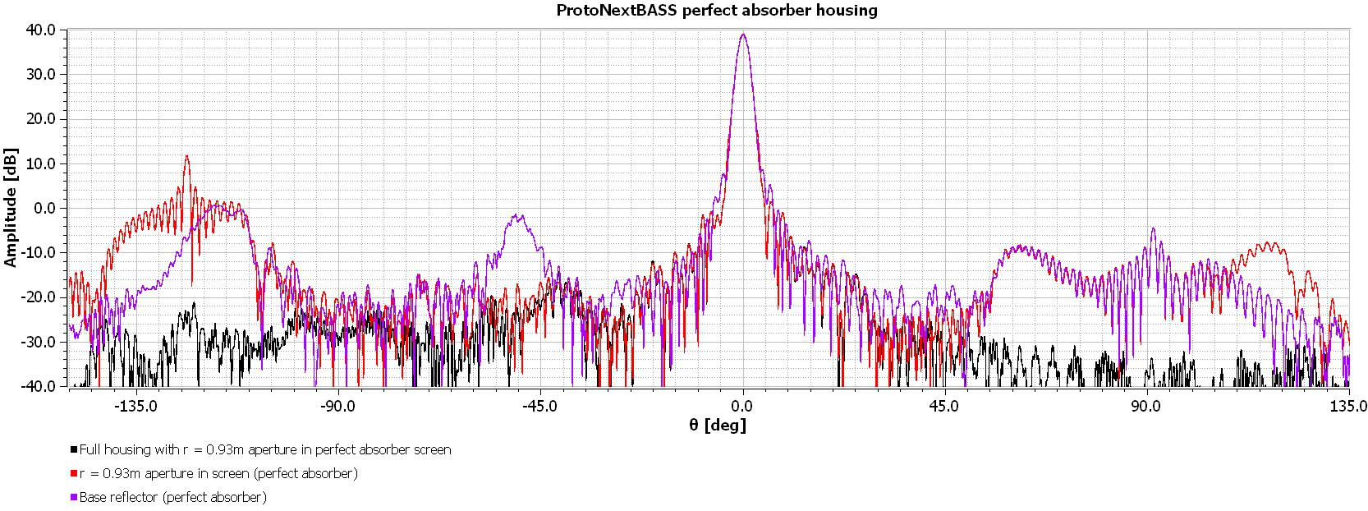
Ground Shield
Based on QUIET optical baffling & ClOVER shield
Modelled as perfect absorber
Housing reduces far sidelobes
Baffle gets rid of secondary spillover
Improves cumulative power –
Meaning higher beam efficiency
l
α
$$\tan\left(α\right)=l/d$$

Slide 16
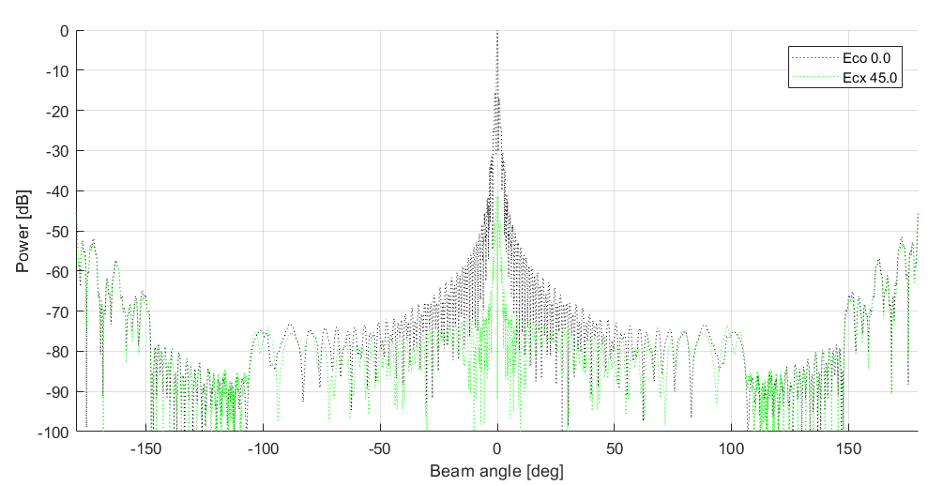
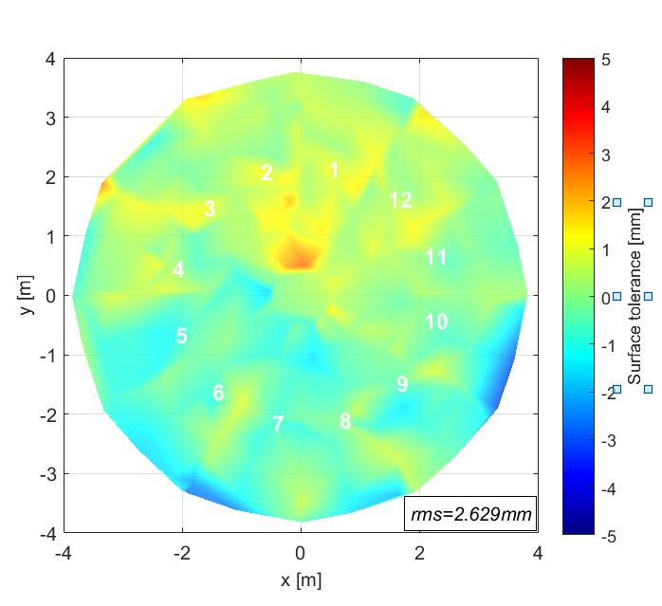
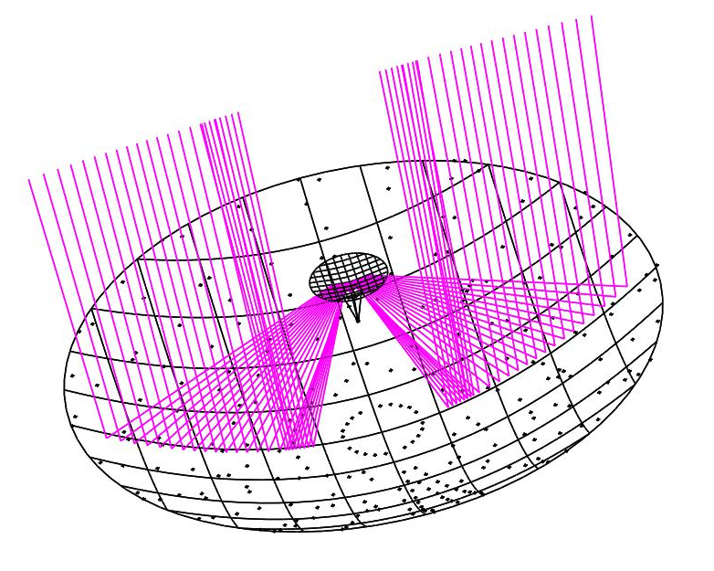
X-BASS Optical Design
1 feed, 7-15 GHz
C-BASS South Dish
2016 Photogrammetry data
RMS surface accuracy ~ 2,63mm
Will work up to 15GHz
Profiled corrugated horn – CHAMP Optimisation

Slide 17
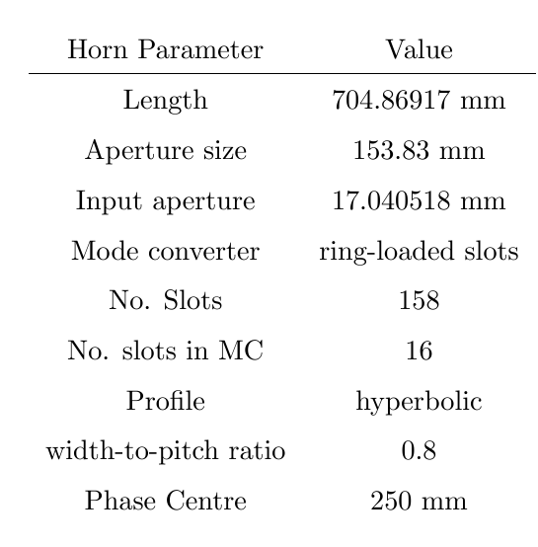
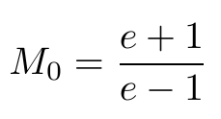
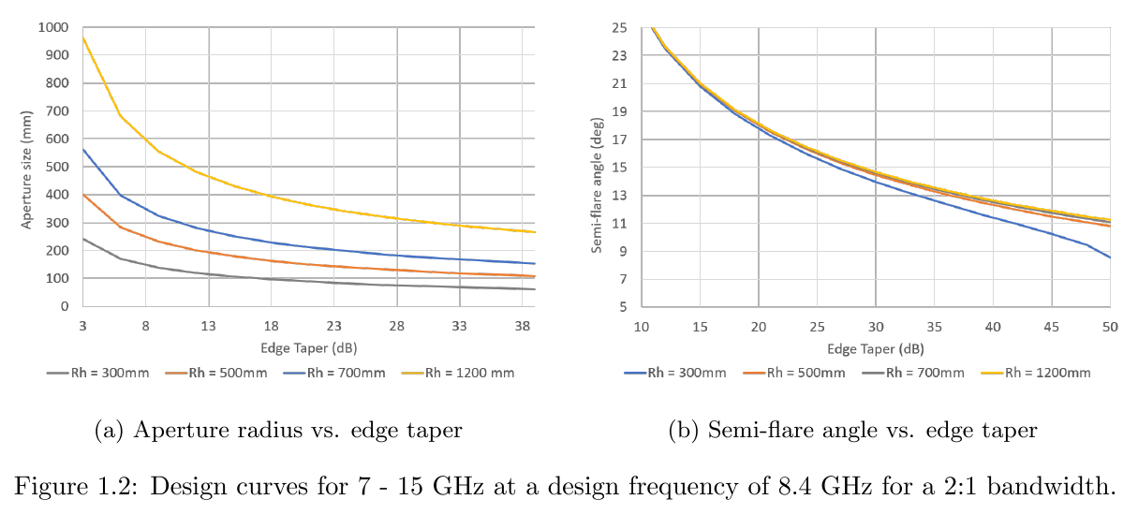
NextBASS Feed Design for CXD
25 dB
ω_{horn} = ω_{optics}

Slide 18
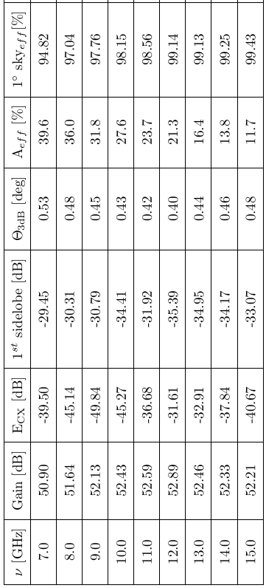
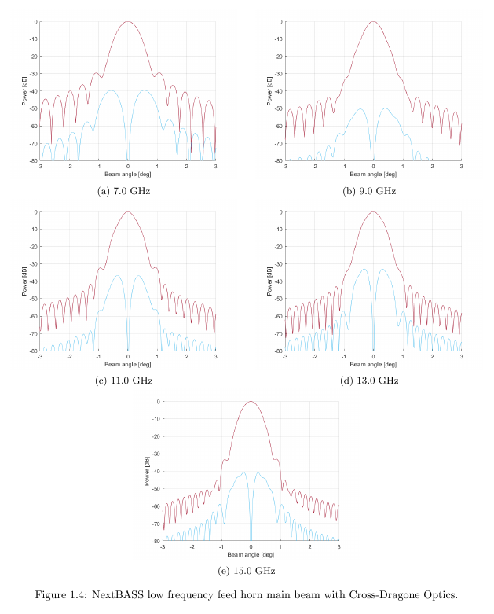
Performance of NextBASS Feed with CXD
99% of total power within 1 degree beam without shielding!

Slide 19
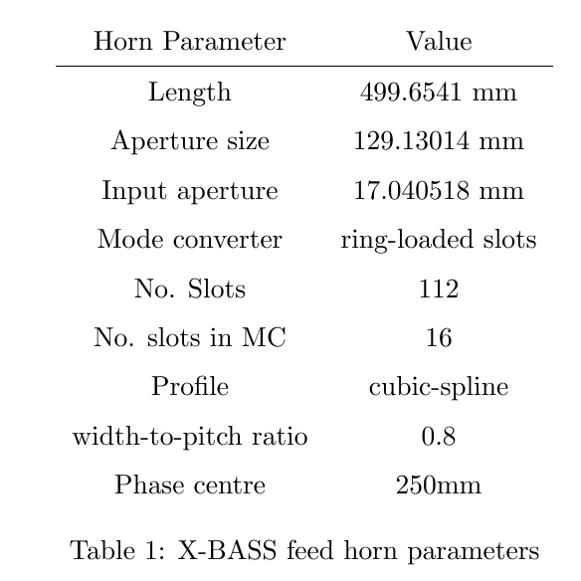
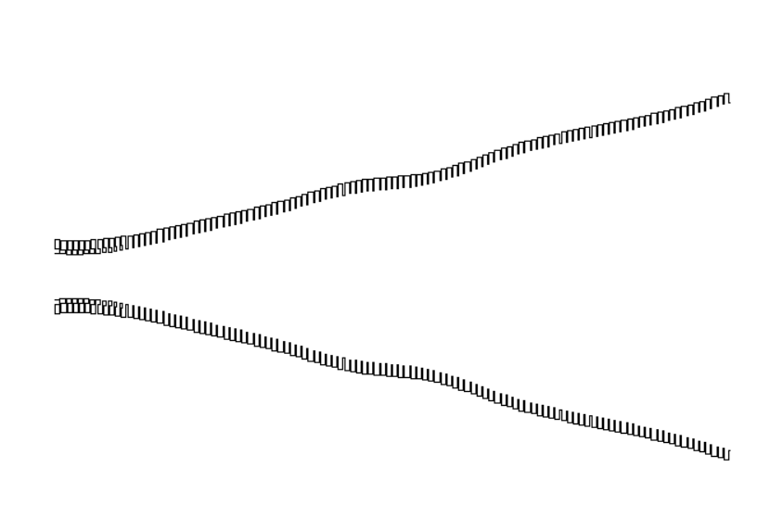
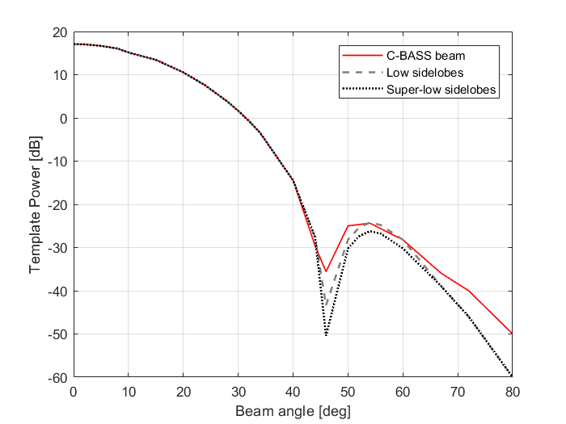
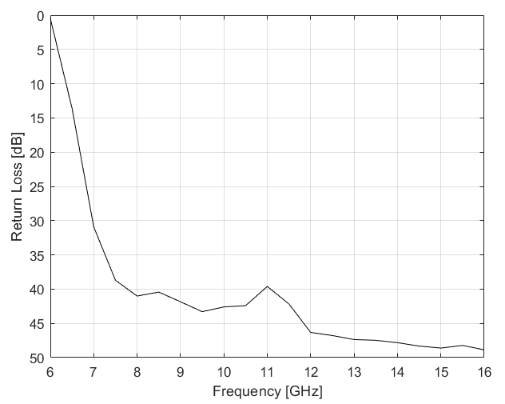
X-BASS Feed Design for on-axis
Cassegrain
CHAMP profile optimised feed
Cubic spline profile of 10 points
Optimised to match the C-BASS South feed horn pattern

Slide 20
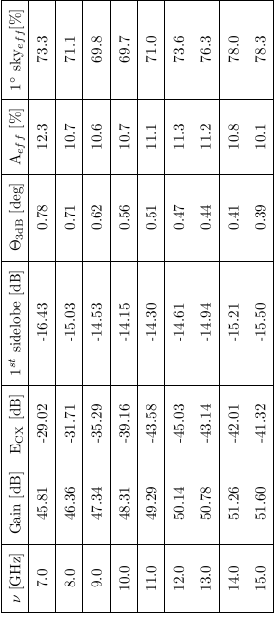
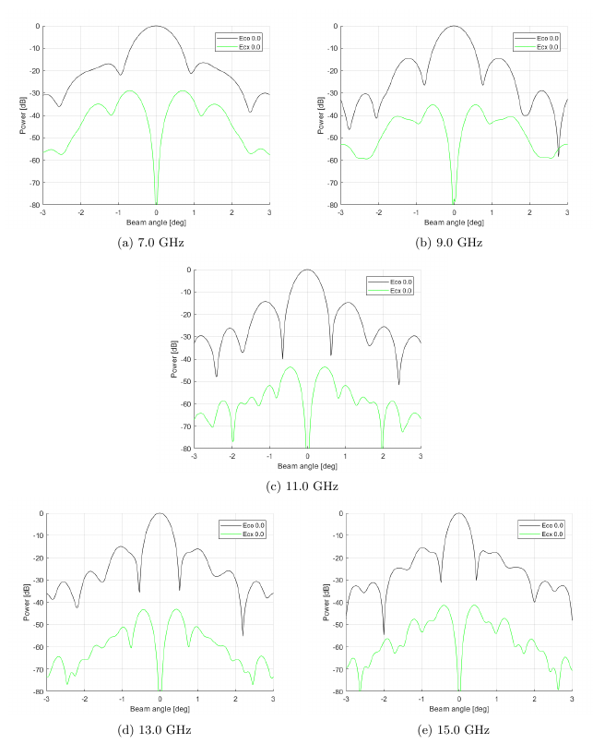
Performance of X-BASS Feed
with C-BASS South Optics
maximum ECX of -30 dB

Slide 21
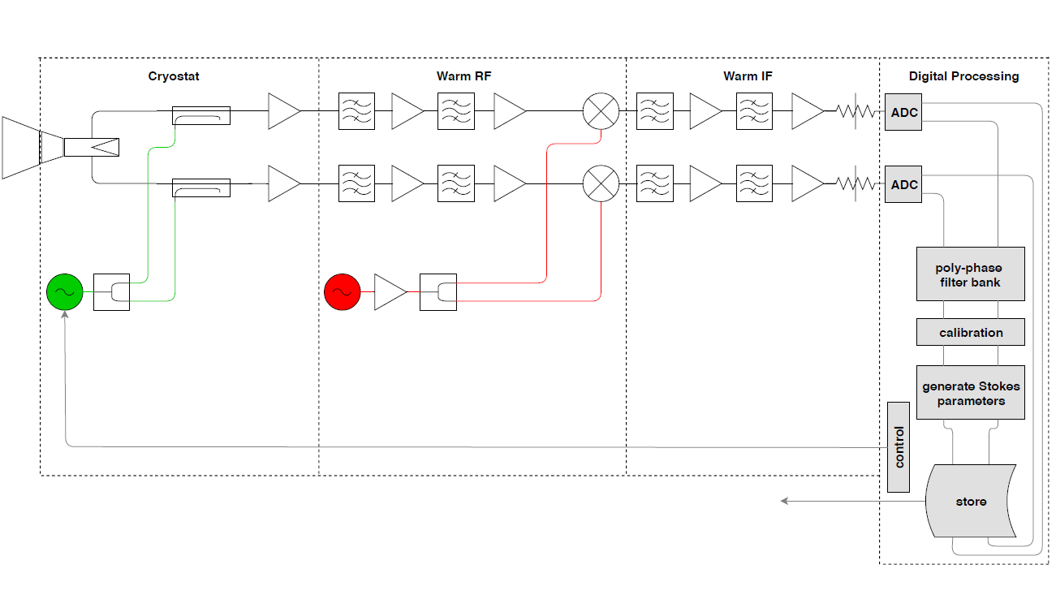
Receiver
Linear polarisation
Convert to LCP & RCP in FPGA
Xilinx RF system on-chip, 14 bit, 4 GSPS (X-BASS)
Intel (Altera) Stratix 10 DRAM SiP, 3.5 bit, 20 GSPS (NextBASS)

Slide 22
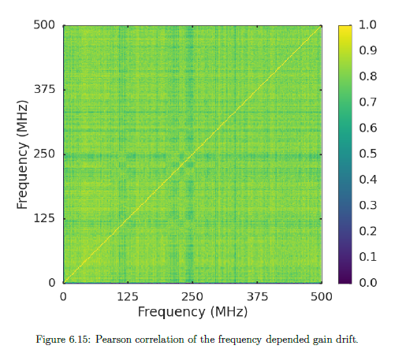
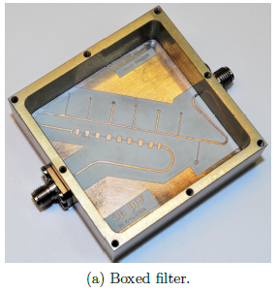
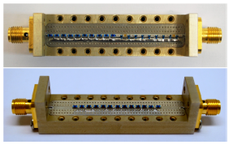
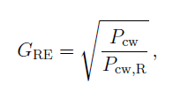
Technology Development
2:1 bandpass filters, anti-aliasing filters using microstrip
2:1 bandwidth quad-ridge ortho-mode transducer (A. Pollak in prep)
Continuous wave stabilisation (GHY-3 - A.Pollak, C.Holler)
Reference signal then calibrates for whole band
Reduces number of RF channels compared to C-BASS from 4 to 2

Slide 23
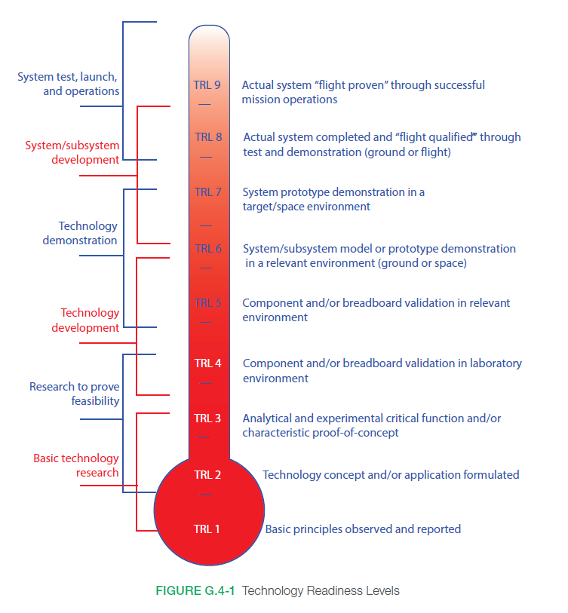
TRL?
TRL9 We have it, we’ve tested it and it works
TRL8 We’ve done the commissioning tests
TRL7 We’ve tested the whole thing in the field
TRL6 We’ve tested the whole thing in the laboratory
TRL5 We’ve modelled it and tested in the field
TRL4 We’ve modelled it robustly and tested it in the lab
TRL3 There has been a proof of concept
TRL2 The design concepts have formulated
TRL1 Its been scribbled on the back of the envelope somewhere

Slide 24
Part | X-BASS | TRL | NextBASS | TRL
Telescope | C-BASS South | 9 | CXD, baffle & ground-shield | 3
Feed Horn | Profiled corrugated feed [DP] + ring-loaded slots, 2:1 bw (7-15 GHz) | 4 | hyperbolic corrugated feed [DP] + ring-loaded slots, 2:1 bw (7-15 GHz & 15-30 GHz) | 4
CW | GH3 (A. Pollak & C. Holler) | 4 | GH3 (A. Pollak & C. Holler) | 4
OMT | 2:1 BW – under development | 4 | 2:1 BW – under development | 4
LNA | LNF-LNC6-20C, 6 to 20 GHZ | 9 | LNF-LNC6-20C, 6 to 20 GH, LNF-LNC15-29B, 15 to 29 GHz LNA | 9
BPF | Micro-strip, tested 7-15 GHZ | 5 | Micro-strip, tested 7-15 GHz Micro-strip, un-tested 15 – 30 GHz | 4
RF Amplifier | A0X20, 2-20 GHz | 9 | HMC994Achip | 9
Mixer/LO | HMC733/HMC1048A | 9 | HMC292ALC3BTR | 9
AAF | Micro-strip, 0 – 2 GHz | 9 | Micro-strip, 0 – 9.5 GHz | 4
IF Amplifier | CBASS IF | 9 | A0X20 | 9
ADC | XILINX UltraScale RF System on-chip | 6 | HDMCAD5831, 3.5 bit, 20 Gbps | 4
FPGA | XILINX UltraScale RF System on-chip | 6 | Intel (Altera) Stratix 10 DRAM SiP | 3

Slide 25
Summary
From forecasting
7-30 GHz needed to constrain realistic foregrounds
Complete coverage over this frequency range is technologically attainable
Large scale low frequency CMB foreground project is essential to complement CMB-S4 and satellites

