Slide 1
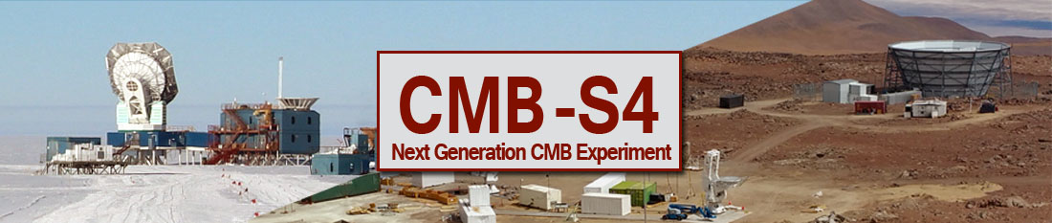
Julian Borrill
CMB-S4 Co-Spokesperson
Computational Cosmology Center, Berkeley Lab
& Space Sciences Laboratory, UC Berkeley

Slide 2
Once In A Lifetime
With apologies to David Byrne

Slide 3
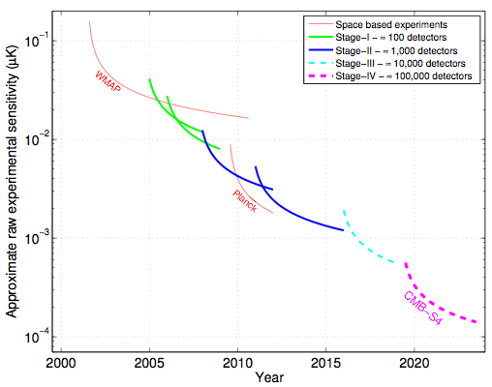
CMB Sensitivity Moore’s Law

Slide 4
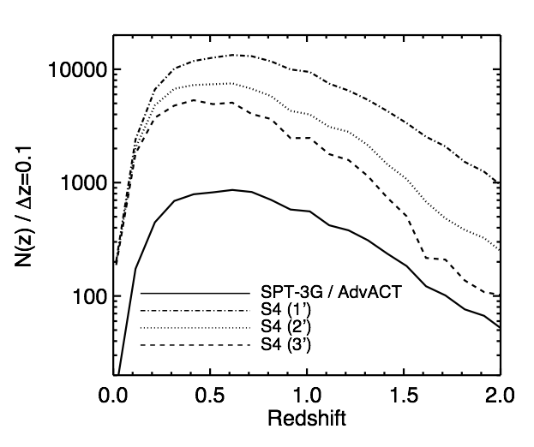
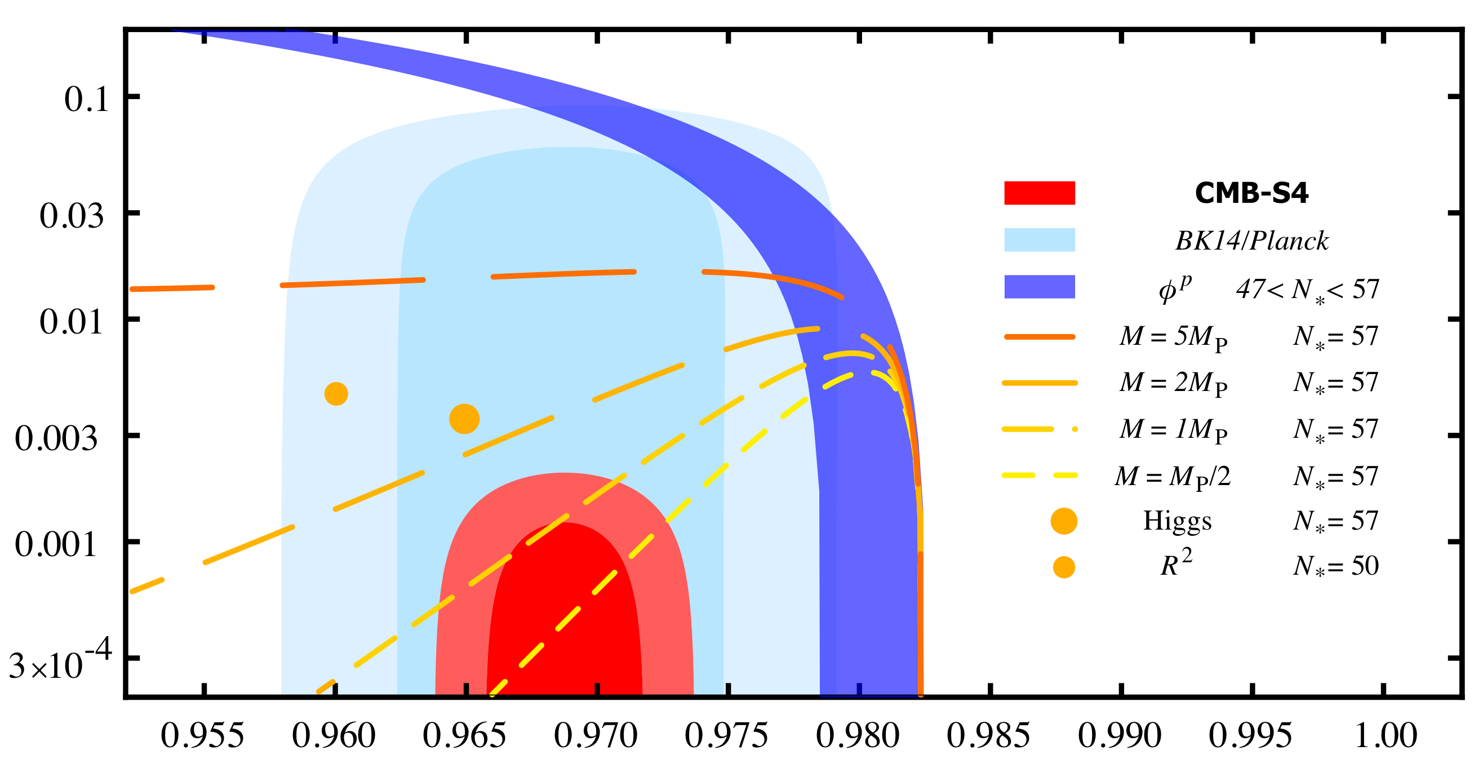
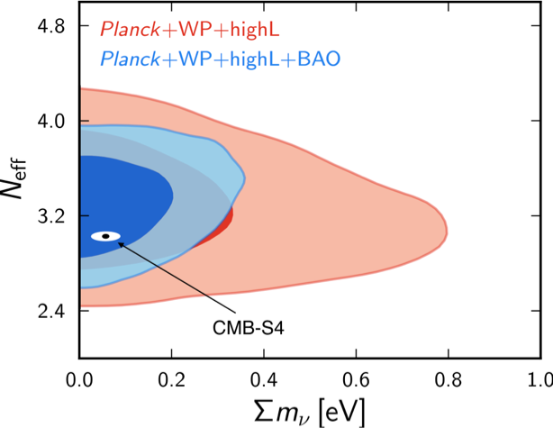
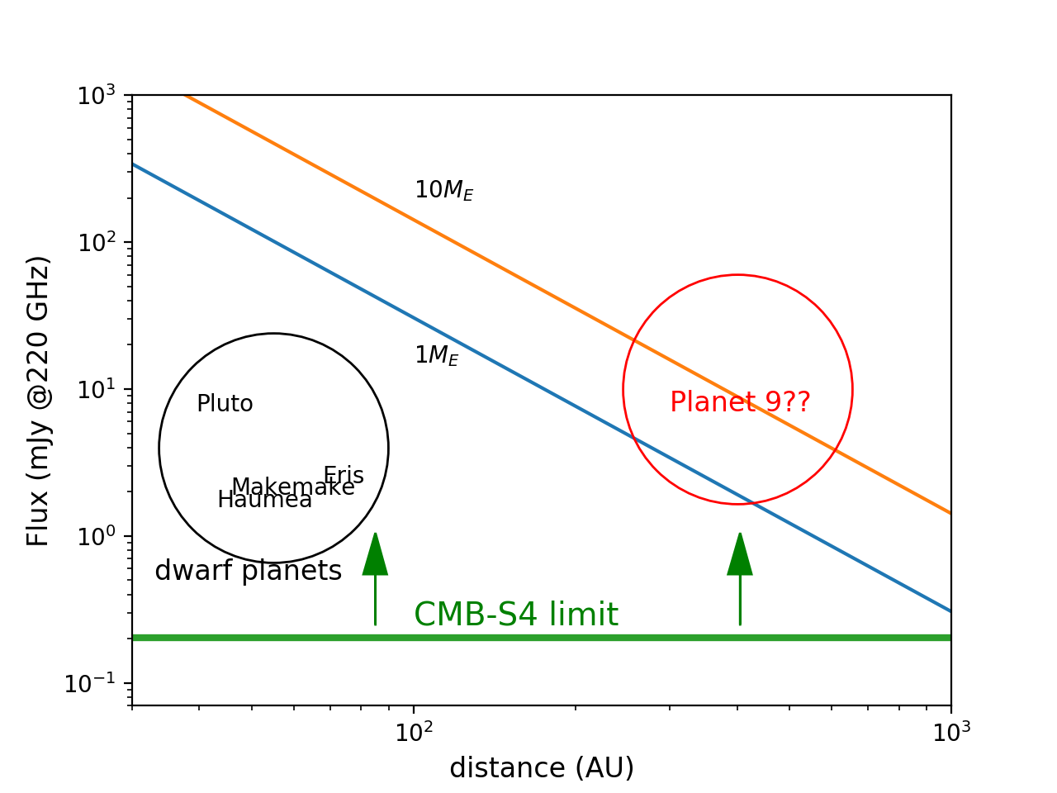
CMB-S4 Science
Inflation
Neutrino mass & light relics
Clusters
Solar System Survey
r
LSST
ns
And much much more!

Slide 5
See Also
- CMB-S4 website: http://cmb-s4.org
- CMB-S4 wiki: https://cmb-s4.org/wiki/index.php/Main_Page
- CMB-S4 science book: http://arxiv.org/abs/1610.02743
- CMB-S4 technology book: http://arxiv.org/abs/1706.02464
- CDT report: www.nsf.gov/mps/ast/aaac/cmb_s4/report/CMBS4_final_report_NL.pdf

Slide 6
You may ask yourself
“Well, how did I get here?”

Slide 7
2013 – Snowmass
US CMB community convergence on the “project-after-next”
Multiple 3rd generation projects in advanced planning:
  AdvACTpol, BICEP-3, SPT-3G, Simons Array
Realization that 4th generation would require a sea-change
Order of magnitude more:
  Detectors (100,000s)
  Data (10s PB)
  Dollars (100s $M)
Only possible as a
  Single community-wide effort
  Supported by NSF & DOE

Slide 8
2015 – Particle Physics Project Prioritization Panel (P5)
“Recommendation 18: Support CMB experiments as part of the core particle physics program. The multidisciplinary nature of the science warrants continued multiagency support.”
“As the scale of CMB experiments grows from Stage 3 … to Stage 4 … increased international collaboration and coordination among major CMB projects will be needed.”
“DESI, LSST, and CMB-S4 provide complementary, breakthrough capabilities”
Recommended to NSF PHY & DOE HEP under all budget scenarios.
$200M project, construction starting in 2016 and operations in 2023.

Slide 9
2016/7 – Astronomy & Astrophysics Advisory Council (AAAC)
Concept Definition Taskforce convened by AAAC at request of DOE & NSF
“The CMB-S4 CDT is asked to develop a concept for implementing a ground-based CMB-S4 experiment. … Specifically, the CDT is asked to deliver:
  Science Requirements and their rationale
  Measurement and Technical Requirements derived from the Science Requirements
  Project Strawman Concept … Cost ”
Core principle: One project, one collaboration, one dataset, two sites.
Report unanimously accepted by AAAC in fall 2017.

Slide 10
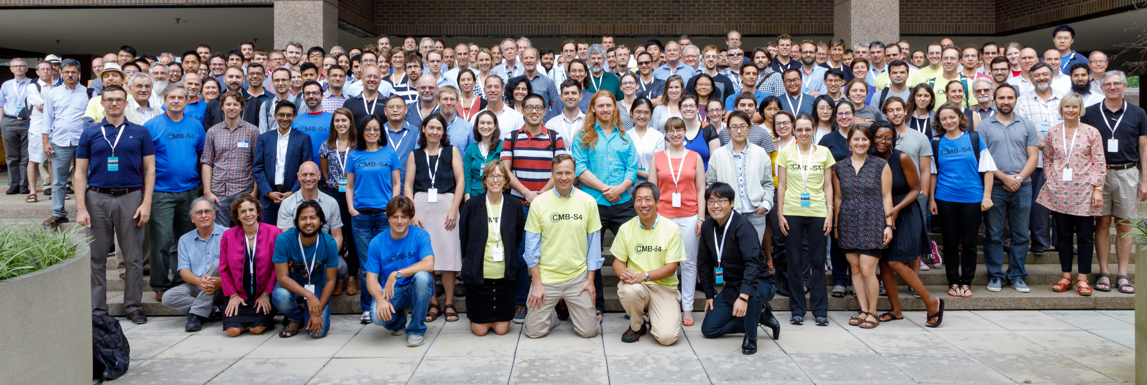
2018 – Collaboration Formation
Biannual open meetings to develop CMB-S4 starting in 2015, alternating between a university and a DOE laboratory.
CDT: “Going forward with the CMB-S4 project with multiagency and other support requires a formal CMB-S4 collaboration.”
  Fall 2017 (Harvard): Interim Collaboration Coordination Committee + 3 Bylaws Working Groups convened.
  Spring 2018 (Argonne): draft bylaws debated & amended.
Final bylaws overwhelmingly approved; collaboration formed & first elections held.
174 members: 136 US + Australia, Canada, France, Germany, Italy, Japan, Sweden, UK
Princeton – Fall 2018

Slide 11
2018 – Project Schedule
Fiscal Year Quarter | Review Milestones
Q4 FY2018 | R&D Proposal to DOE & CDR Proposal to NSF
Q2 FY2019 | DOE CD0 Approved
Q2 FY2019 | Initial Input to the Decadal Survey
Q4 FY2019 | NSF CDR Approved
Q2 FY2021 | Decadal Survey Results
Q2 FY2021 | NSF PDR and DOE CD1 & CD3A (Long Lead Construction) Approved
Q2 FY2022 | NSF FDR and DOE CD2 Approved
Q4 FY2023 | DOE CD3B Approved
Q4 FY2026 | DOE CD4 Approved
Q1 FY2027 | Start of Operations

Slide 12
You may say to yourself,
"My God! What have I done?”

Slide 13
CMB-S4 Project
There is a price to pay for crossing the $100M threshold.
CMB-S4 will be a ground-based experiment run like a satellite mission:
  “Can’t Fail” replaces “Best Effort”
  Science goals set measurement requirements which drive technical requirements.
    Any changes must be tracked through performance matrix
  Multiple gate-keeping reviews
  10% budget for project management
  40% budget for contingency
  Alphabet soup of project management acronyms

Slide 14
Parallel Agency Construction Projects
NSF Major Research Equipment & Facility Construction (MREFC) | DOE Construction Project
Conceptual Design Review (CDR) | CD0: Mission need
Preliminary Design Review (PDR) | CD1: Alternative selection & cost range
Final Design Review (FDR) | CD2: Performance baseline
Start of construction | CD3: Start of construction
 | CD4: Start of operations
Essential to align review schedules to avoid doubling workload.
Operations is yet another dimension.
Multiple reviews are also an opportunity to refine the design.

Slide 15
Technically-Limited Schedule
Eg. operations in 2027 requires being able to fabricate 70K qualified detectors every 6 months by mid-2023!

Slide 16
And you may ask yourself, "How do I work this?"

Slide 17
Goals/Requirements

Slide 18
Experiment Design
Iterative refinement of instrument and observation to meet measurement requirements subject to all constraints.
Epoch | Instrument | Observation | Cost
2015 P5 | 500K detectors | Atacama + South Pole | $200M
2017 CDT | 2 LAT : 136K : 20-270GHz 1 LAT : 68K : 20-270GHz 14 SAT : 168K : 30-270GHz | Atacama : 7 years : 40% sky TBD : 7 years : 3-8% sky TBD : 4-8 years : 3-8% sky | $412M + $32M/year
2019 CD0/CDR | “Decadal Survey Report” (in progress)
2021 CD1/3a+PDR | Selected Alternative/Preliminary Design Long-Lead Time Construction |  | Cost Range
2022 CD2+FDR | Final Design |  | Total Project Cost
2027 Operations | - | Optimized for fixed instrument & cost

Slide 19
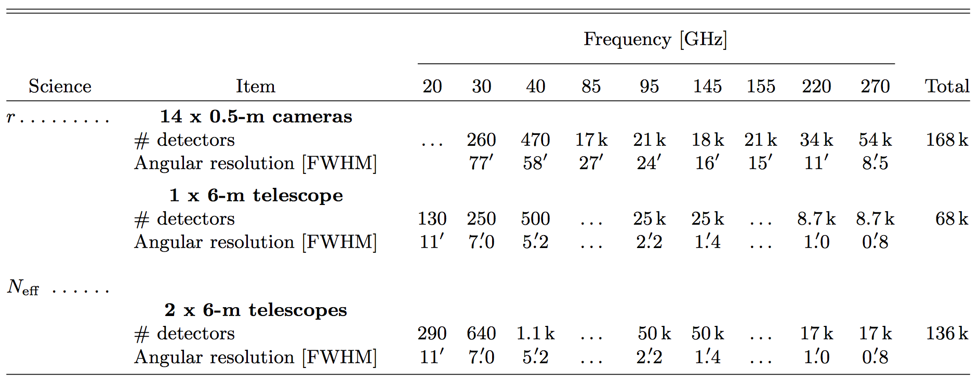
Current Status
CDT “Strawperson” Design:
DSR “Reference” Design:
  Refine for realism & self-consistency
  Develop full project budget & schedule
  Expand science scope for Decadal Survey

Slide 20
You may ask yourself,
"Am I right, am I wrong?"

Slide 21
Optimization Challenge
Design a single experiment that can meet the full suite of science-driven measurement requirements under (uncertain) constraints:
  Cost: DOE+NSF, international & private partners, legacy hardware & data, …
  Site infrastructure: power, bandwidth, construction season, …
  Site observations: atmosphere, available sky, solar/lunar avoidance, …
  Foregrounds: dust, synchrotron, AME, …
  Other datasets: S3, WMAP/Planck, C-BASS, S-PASS, … SO, LiteBIRD, European all-sky synchrotron, …
Two main knobs – bands (till CD2) & observations (till CD4)
Each can be adjusted for both SAT and LAT.

Slide 22
Frequency Bands
What bands do we need on each telescope for our science goals to be robust to foreground contamination:
  How many bands do we need?
  How low do we need to go for synchrotron?
  How high do we need to go for dust, and can we?
  What is the cost/benefit of band-splitting?
    90/150 vs 85/145 + 95/155
  What sensitivity & resolution do we need in each band?

Slide 23
CDT Approach
Focus on r-forecasting.
Map-domain simulations.
6 different dust + synchrotron models, ranging from Gaussian with simple uniform SEDs to MHD-derived.
Started SATs with dichroics at 30/40, 90/150, 220/270 GHz.
Found that a high-resolution (LAT) 20GHz channel was needed to reduce the bias from unmodeled synchrotron residuals to an acceptable level.
“ … all of these models are consistent with current data, and we should be careful not to necessarily associate nominal sophistication with greater probability to more closely reflect reality.”
How do we move from more to better foreground models?

Slide 24
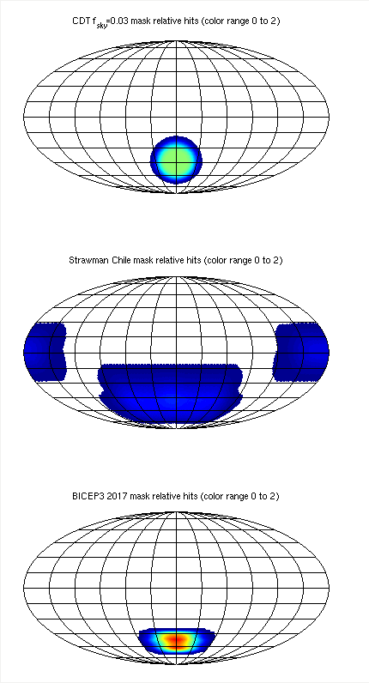
Observation – Small Area
Optimization of SAT + delensing LAT over:
  Sky fraction
  Hit uniformity
  Observing efficiency
  Foreground contamination
  Delensing
First step: CDT circular 3% patch with cosine apodization being replaced by realistic BICEP3 & SO deep scans.
What is the optimal distribution of SATs?
What is the best delensing survey?

Slide 25
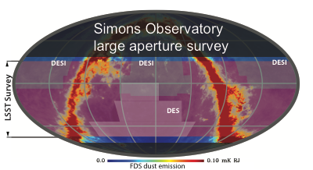
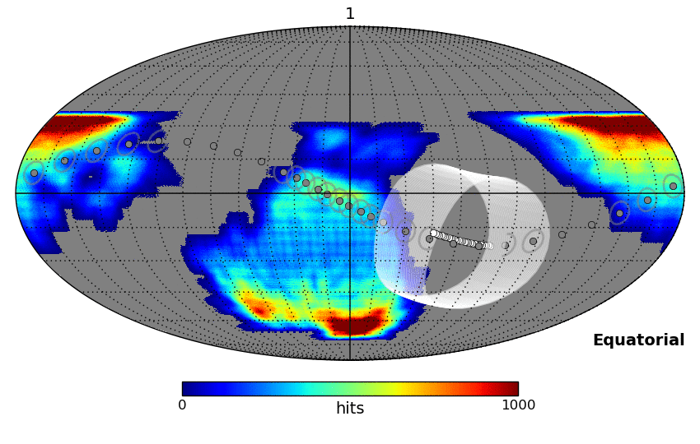
Observation – Wide Area
Optimization wide-area LATs over:
  Sky fraction
  Bimodal hit distribution
  Observing efficiency
  Cadence for transients
  Coverage of LSS surveys
CDT assumed uniform 40% sky coverage, similar to SO wide survey.
What role does the wide-are survey play in delensing?
Can we achieve the cadence for transients?

Slide 26
Summary
CMB-S4 represents a unique opportunity for the global CMB community.
Achieving our science goals requires a complex optimization, over multiple telescopes and sites, with dynamic constraints.
Please work with us to make this the best experiment it can be.
  http://cmb-s4.org

Slide 27
Into the blue again, after the money's gone.
Once in a lifetime,
Stage-4 Microwave Background.

