Slide 1
Galactic Foreground Survey from Summit Camp, Greenland
Summer 2018
Ari Kaplan, Peter Meinhold, Nic Rupert, Philip Lubin
Physics Dept.
Univ of California – Santa Barbara
University of Oslo - Harald Thommesen, H.K. Eriksen,
I. Wehus
Niels Bohr Inst – Pavel Naselsky,
Per Rex Christiansen, Hao Liu,
Sebastian Von Hausseger, J. Creswell
Villum Foundation

Slide 2
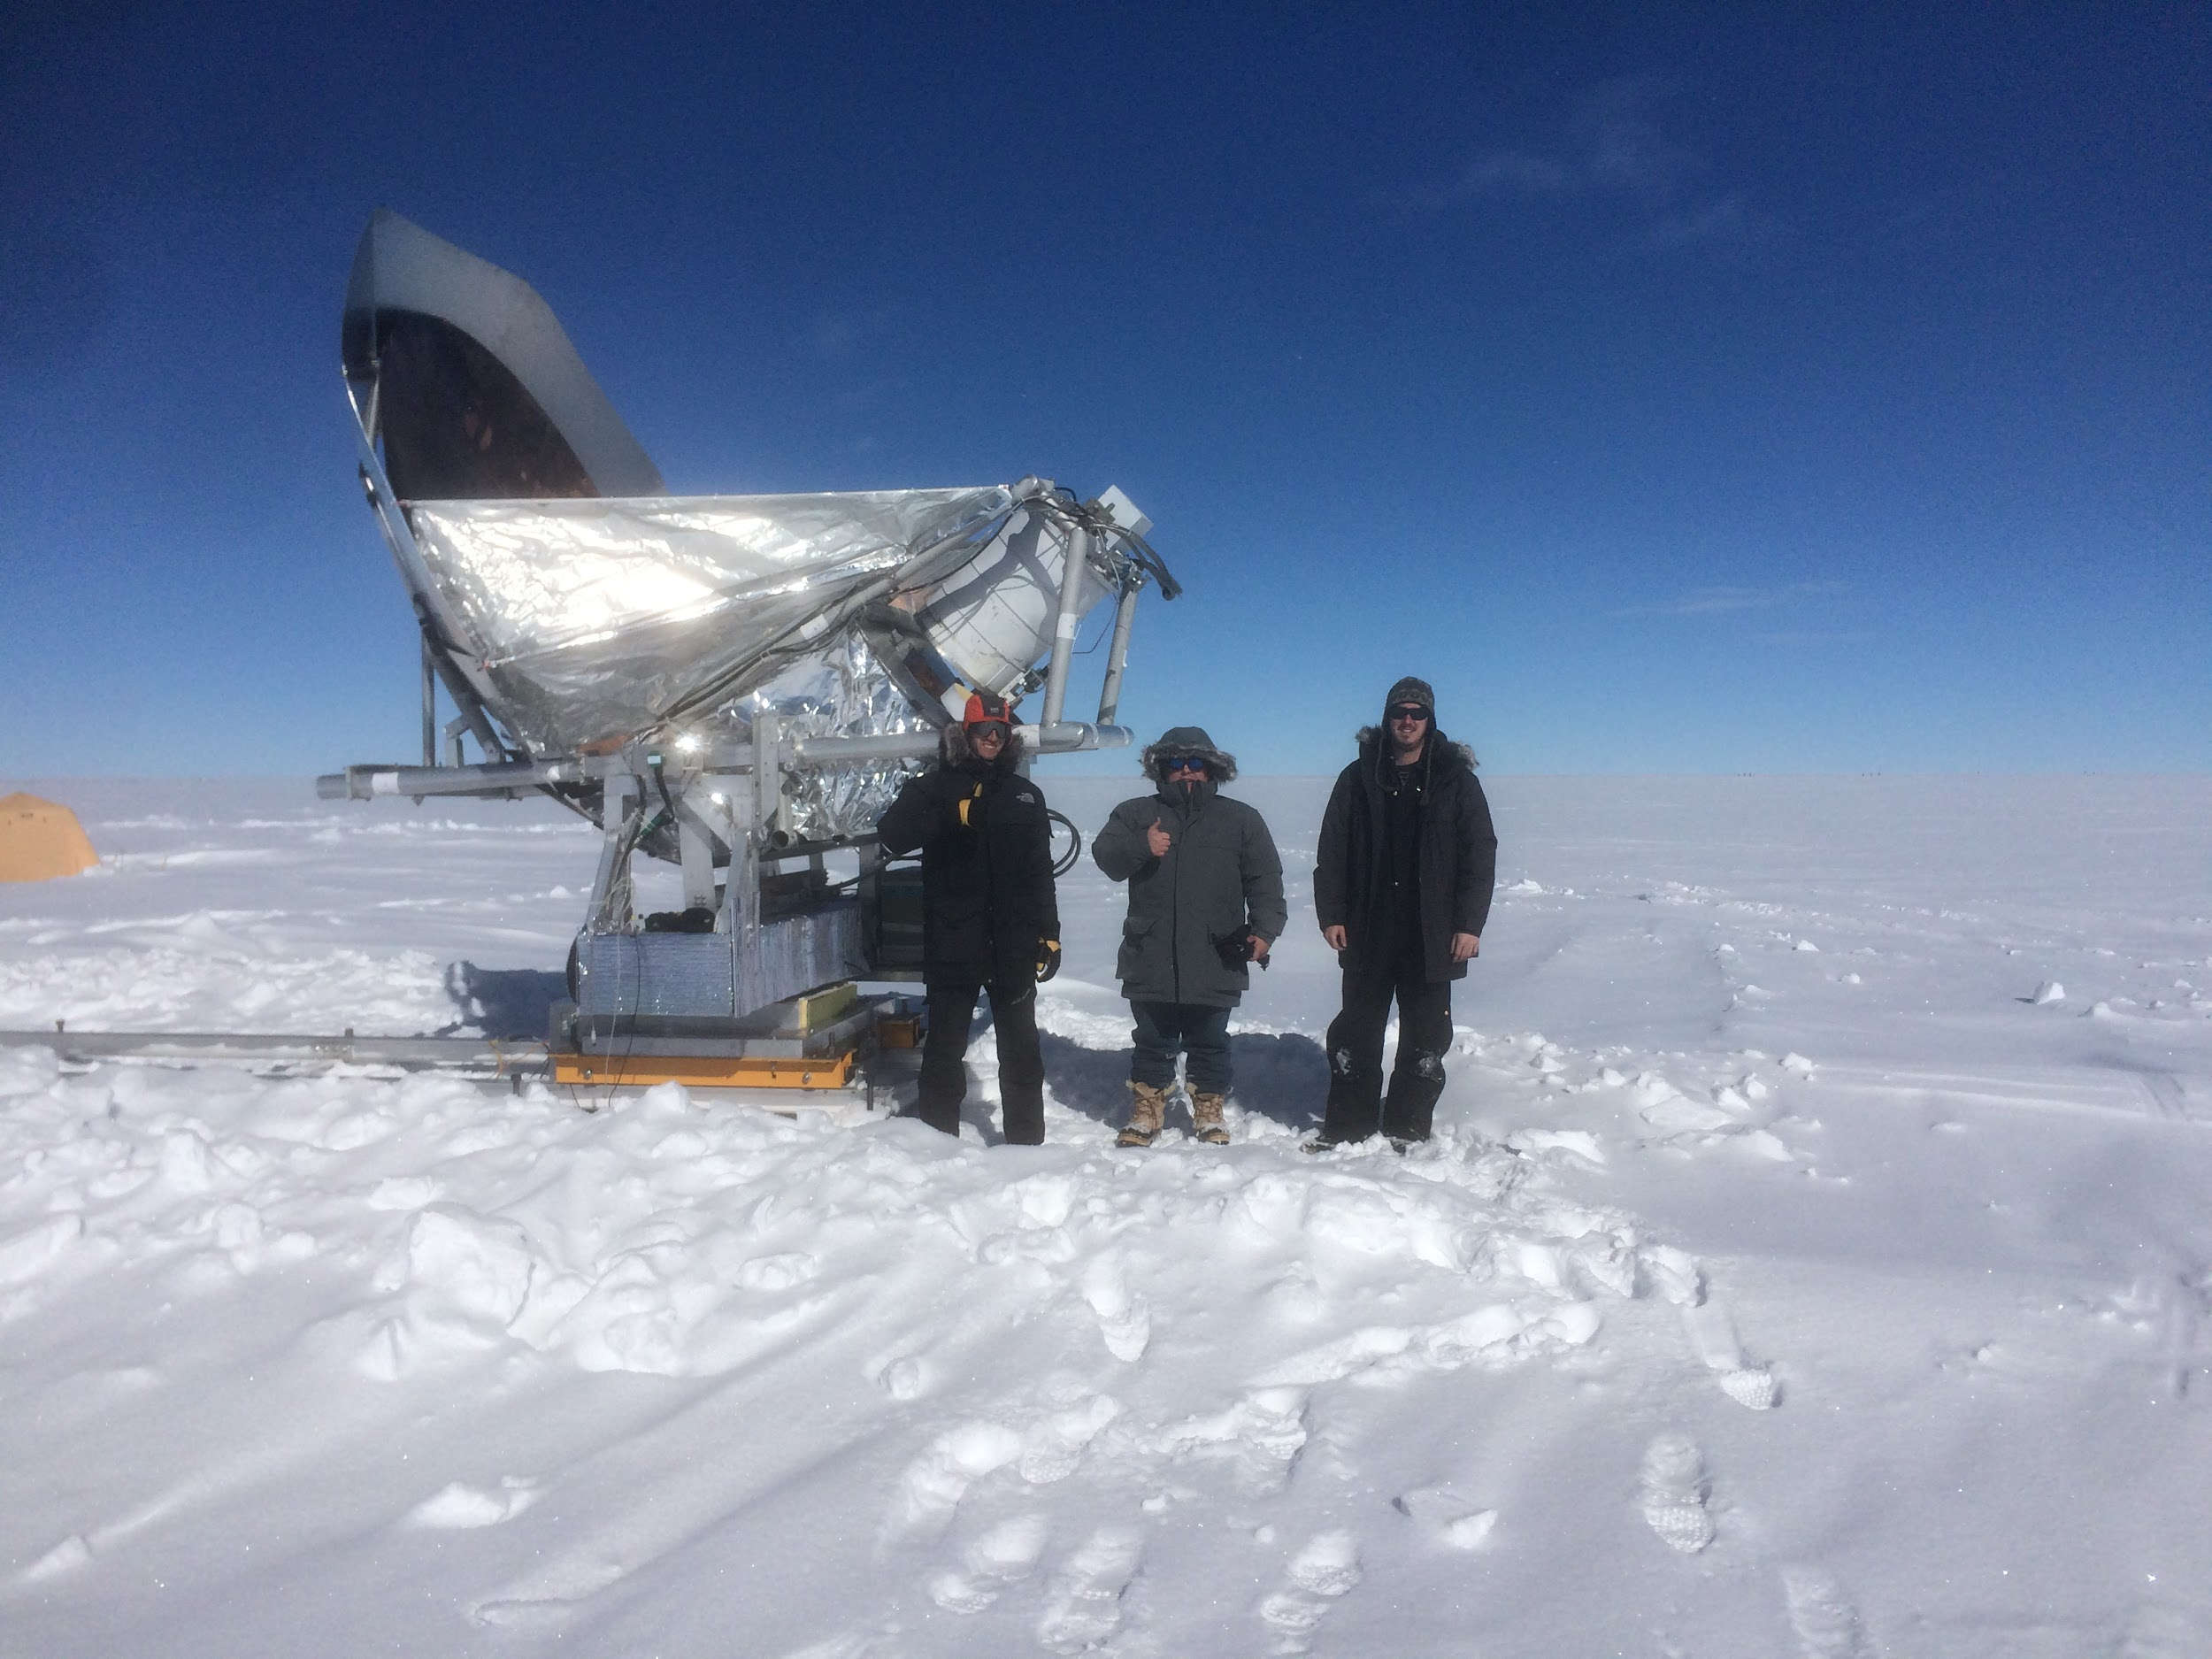
Deployment Team
Peter Meinhold - UCSB
Ari Kaplan - UCSB
Nic Rupert - UCSB
Harald Thommesen - U. Oslo

Slide 3
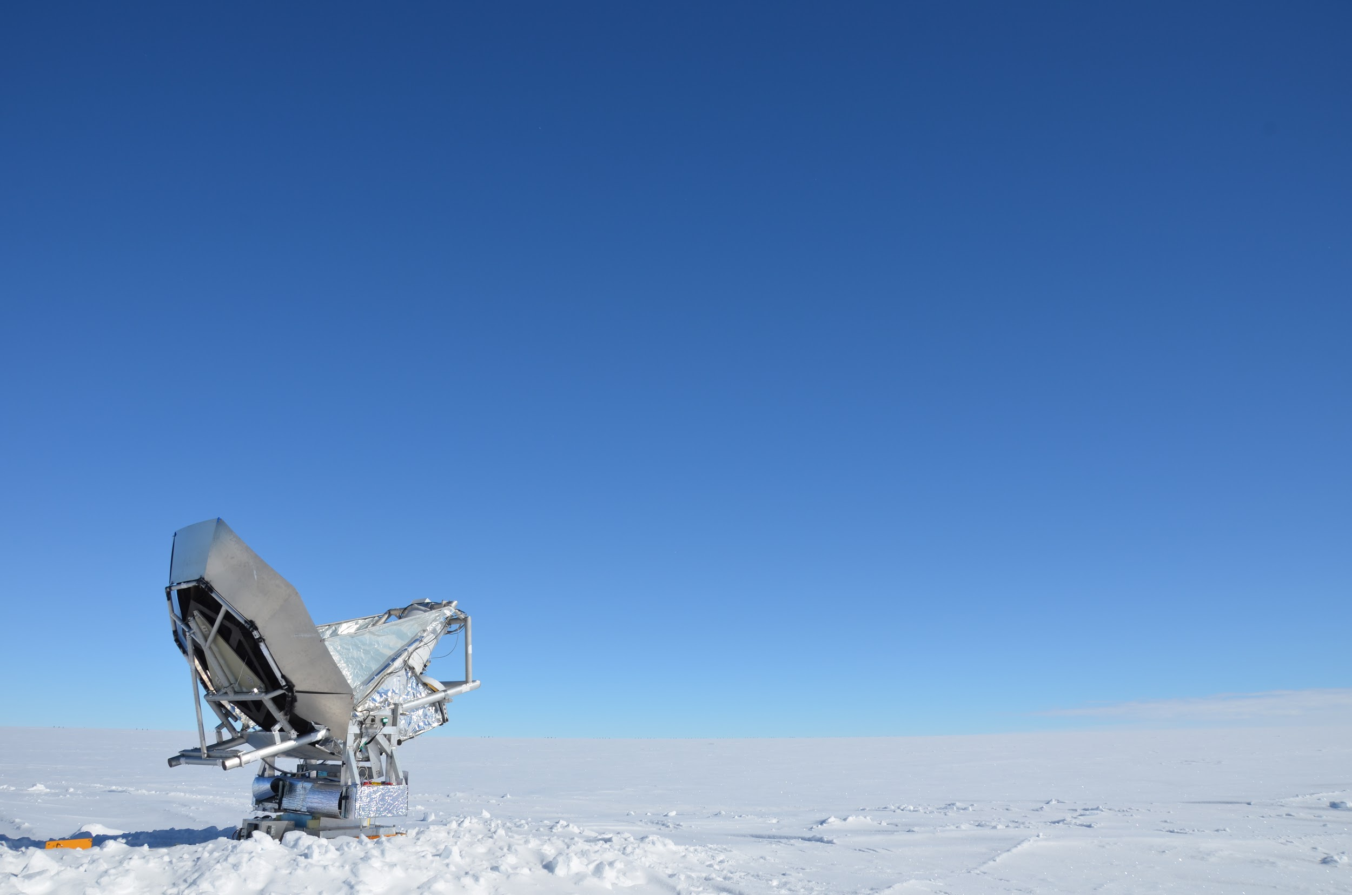
Research Goals
Map Polarized Galactic Foreground emission at 10 GHz to complement higher frequency data in detection of primordial B-modes
Field Test Current Instrument for future observations at additional frequencies
Assess Summit Camp viability as a long-term research site for cosmological observations

Slide 4
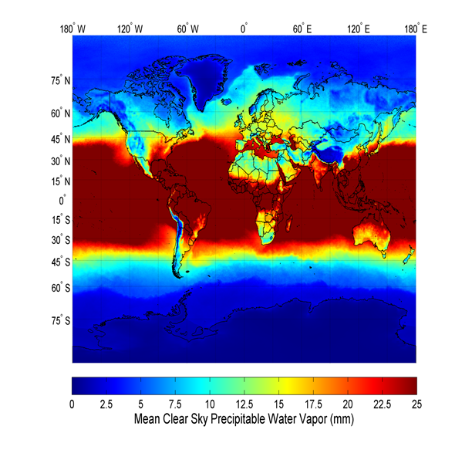
Why Summit/Greenland?
High Altitude Site in Northern Hemisphere
Altitude of 3230 meters
Can Cover ~44% of N Celestial Hemisphere From Greenland
Can Get total N Celestial Hemisphere if combined with California site
Polar desert with good PWV statistics.
PWV ~ 2 mm in Summer
PWV ~ 0.2 mm in Winter
Suen et al. arXiv:1312.5918

Slide 5
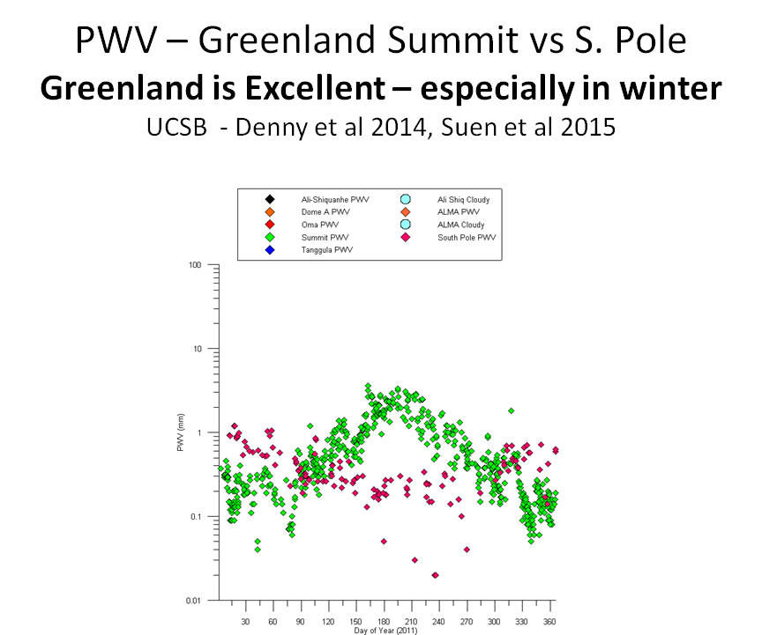

Slide 6
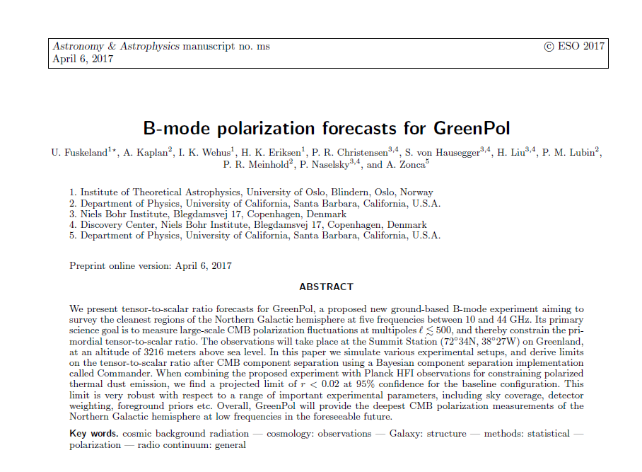
Greenland Forecasts
Paper in progress from U. Oslo Institute of Theoretical Astrophysics in collaboration with UCSB GreenPol project
Tensor-to-scalar ratio forecasts for a ground based B-mode experiment in Greenland given a range of experimental parameters

Slide 7
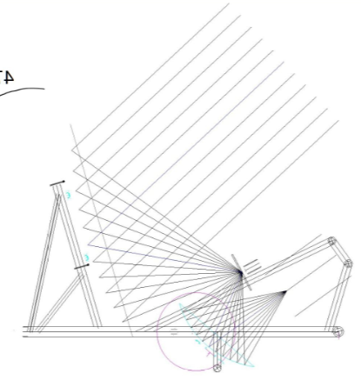
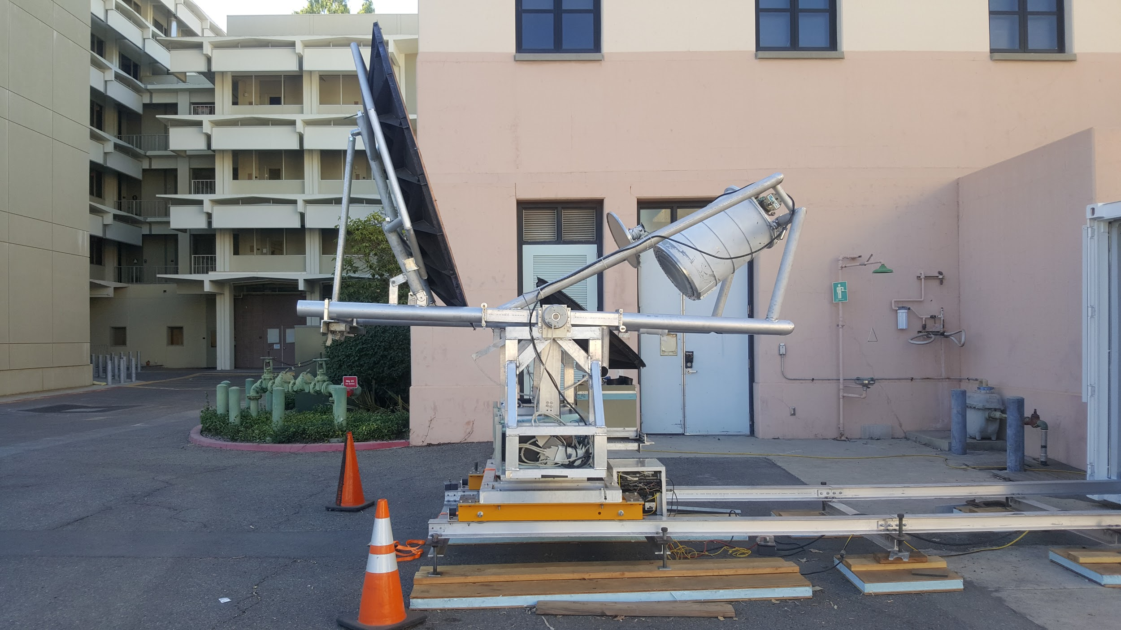
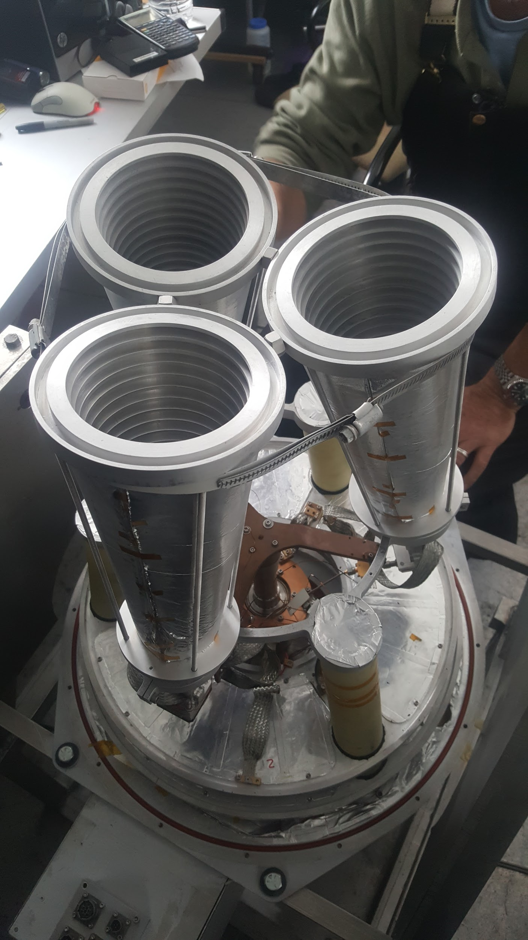
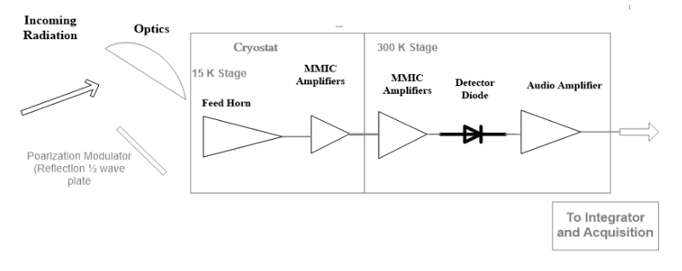
Instrument
Primary Mirror
2.2 Meter off-axis Carbon Fiber Gregorian Telescope
Optics
3 Feed horns at 10 GHz
Reflection ½ wave plate for polarization modulation
Receiver
20 K Cryo cooled HEMT Amplifier
Post-Amp custom RFI filters
Reflection ½ Wave Plate
Detector
Secondary Mirror
Notes:
Emphasize the simplicity of reciever set up, all modulation is done with ½ wave plate

Slide 8
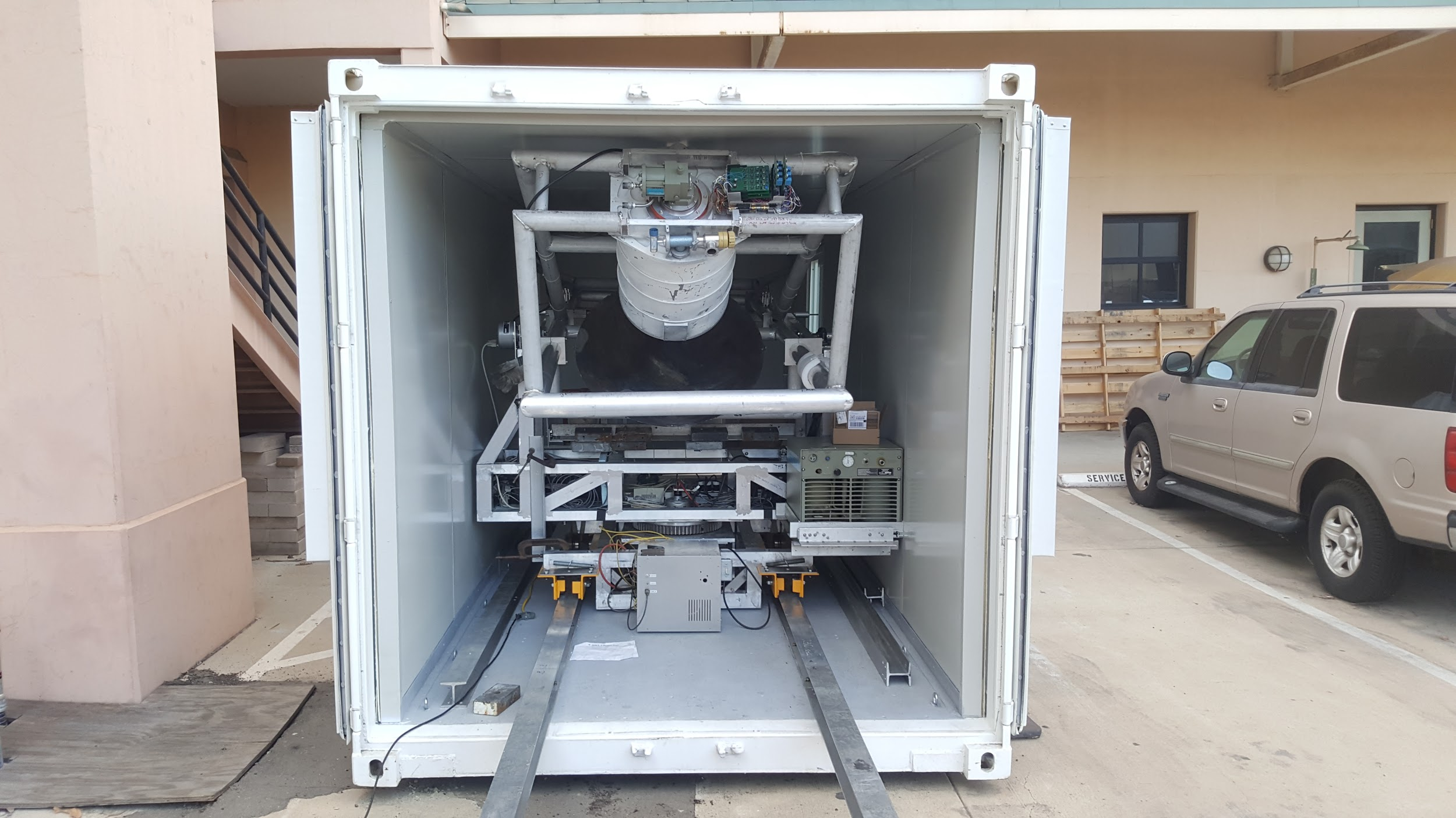
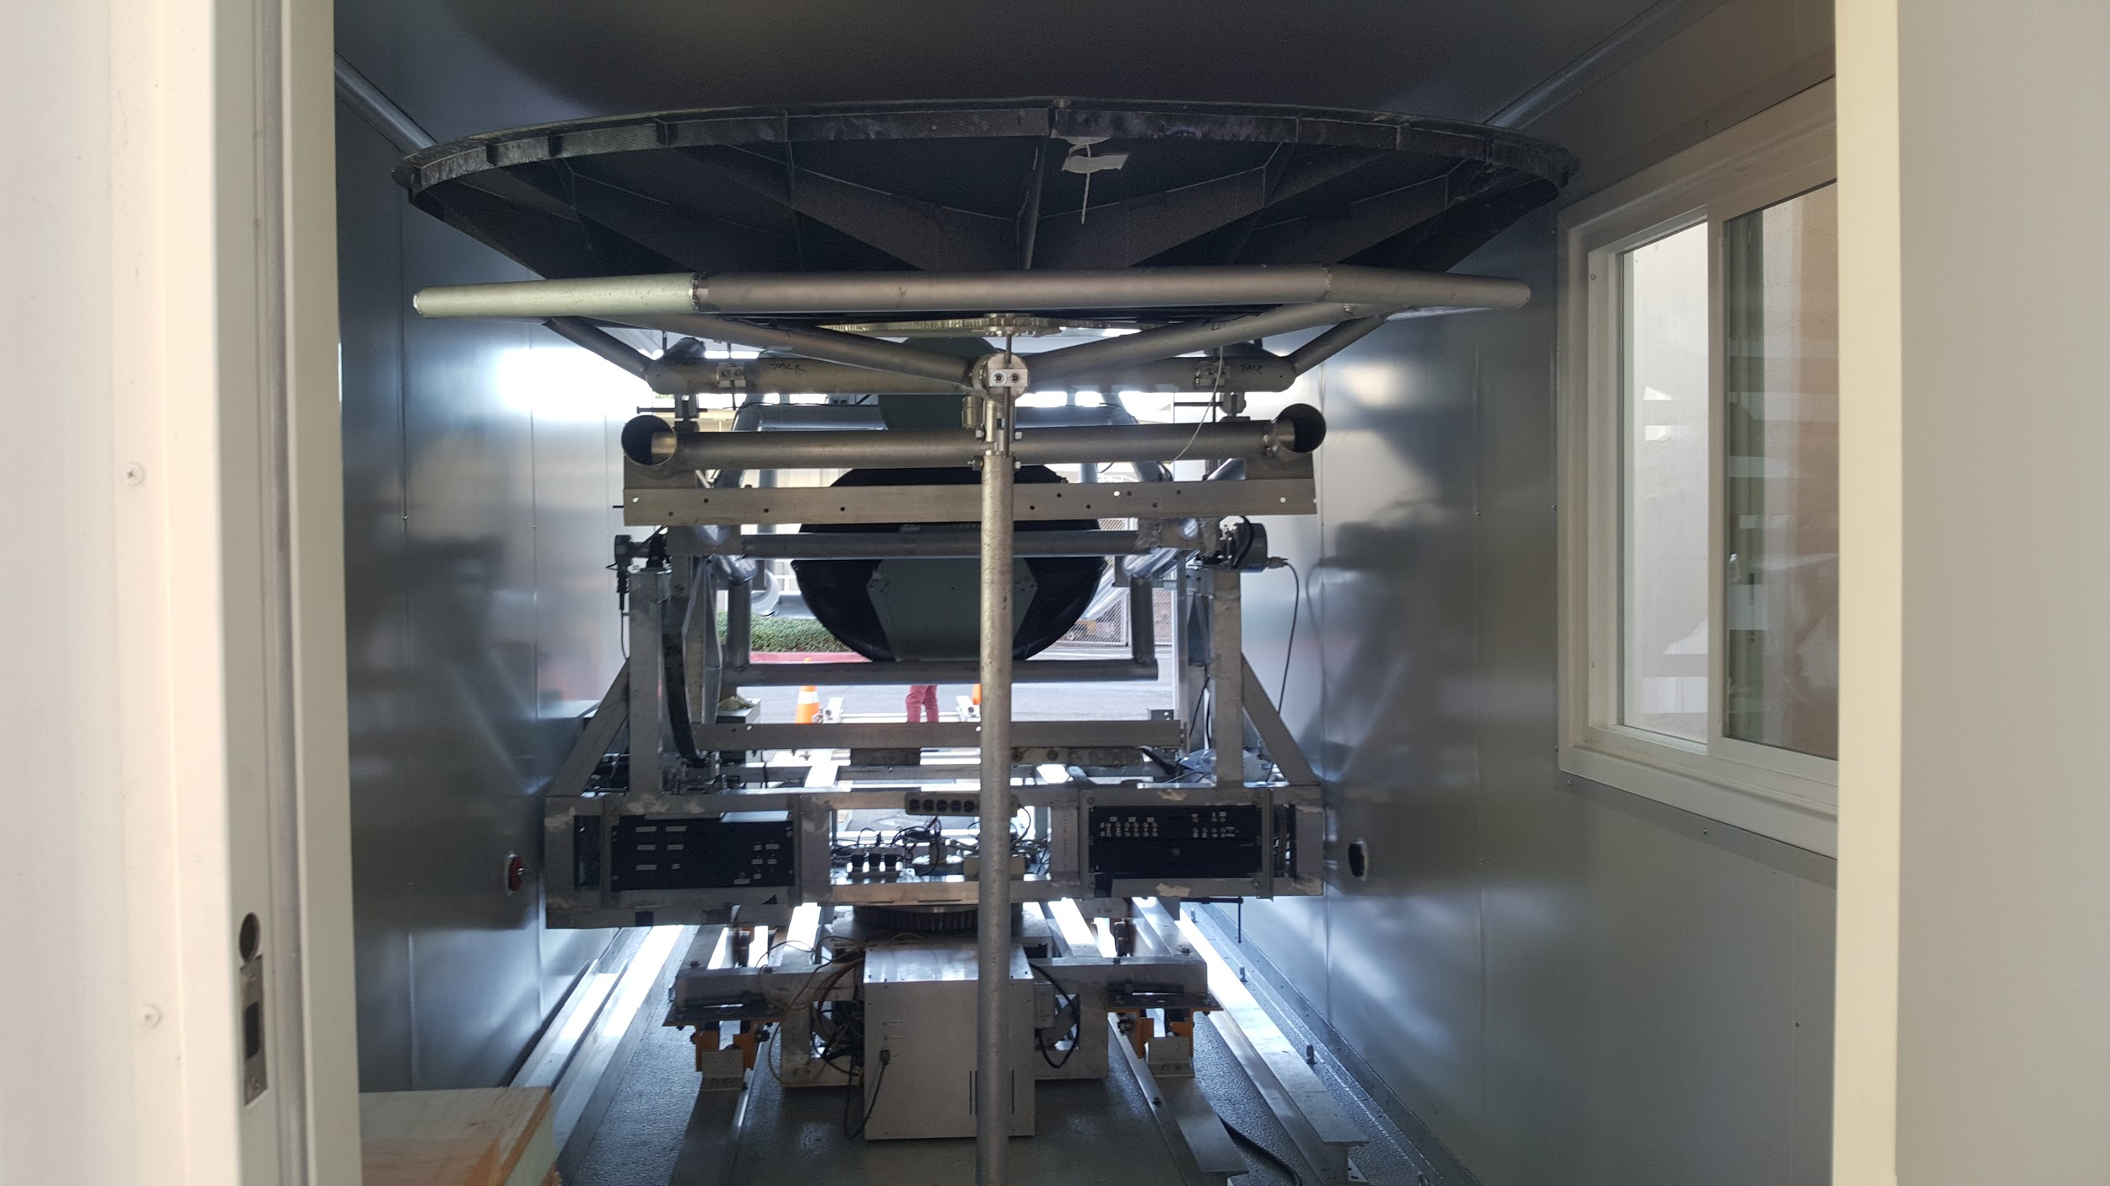
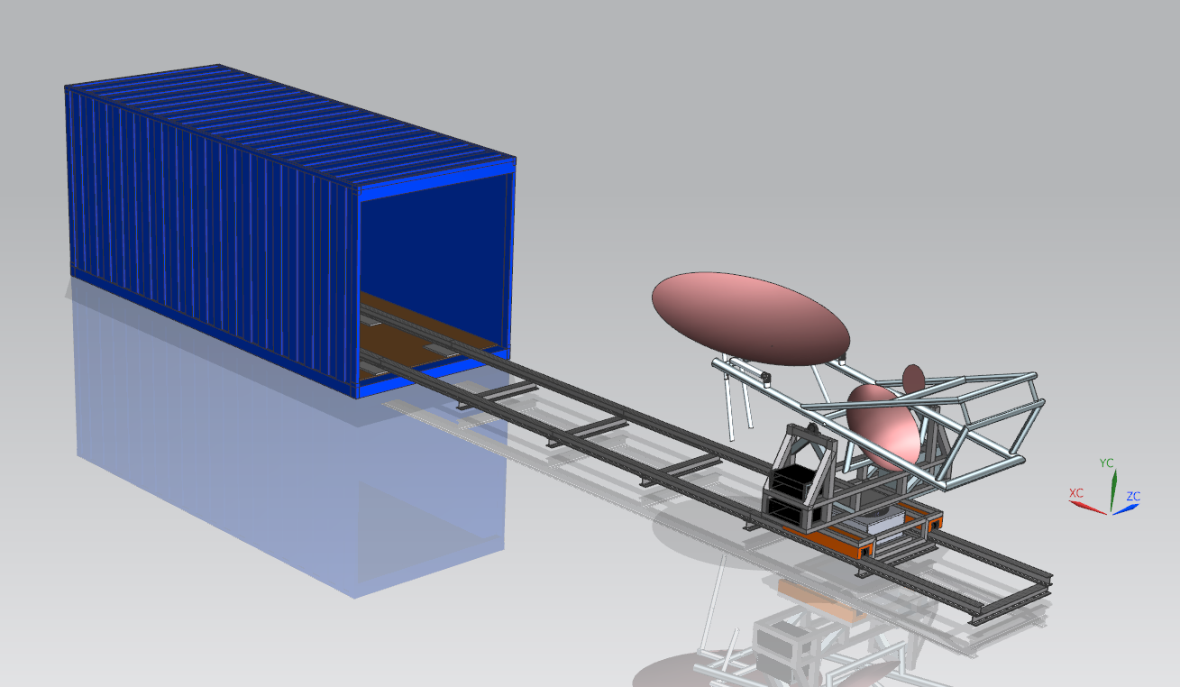
Telescope in a Box
Designed and built in-house
System is designed to be rapidly deployed or put away based on weather conditions
Rail System
Foldable Telescope/Deployable Baffle
Standard ISO container 8X8.5X20 feet (Just barely fits)

Slide 9
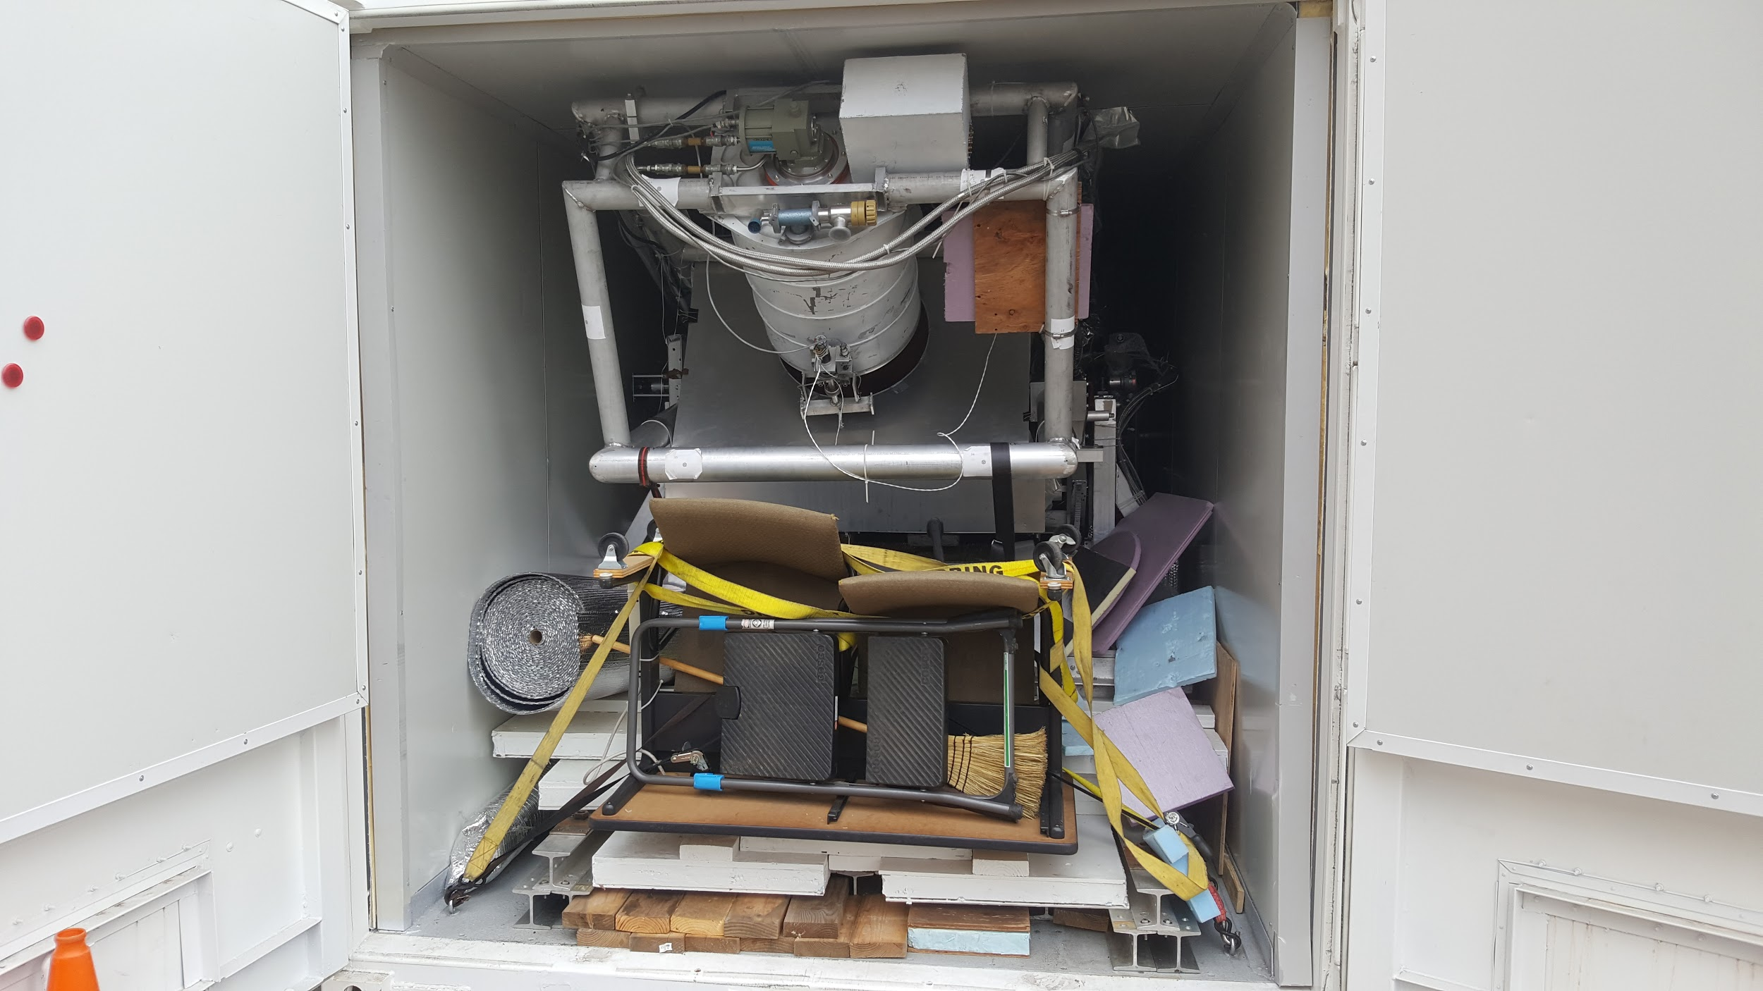
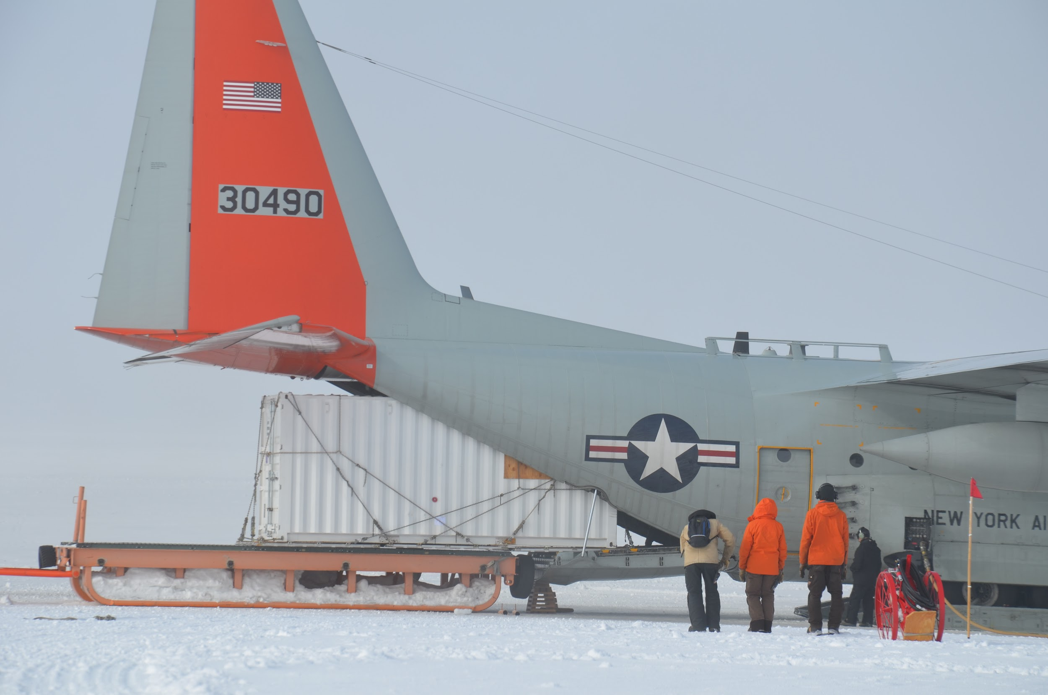
Shipping
Logistics handled by Polar Field Services contractor
Everything goes in ISO container
Telescope
Pads for dealing with snow drift
Tools/Equipment
Office Supplies
Container weight ~ 5,443 Kg
Container shipped cross country by truck, then shipped to Summit Station via C-130
Travel time: ~ 3 weeks
Container takes up a full C-130

Slide 10
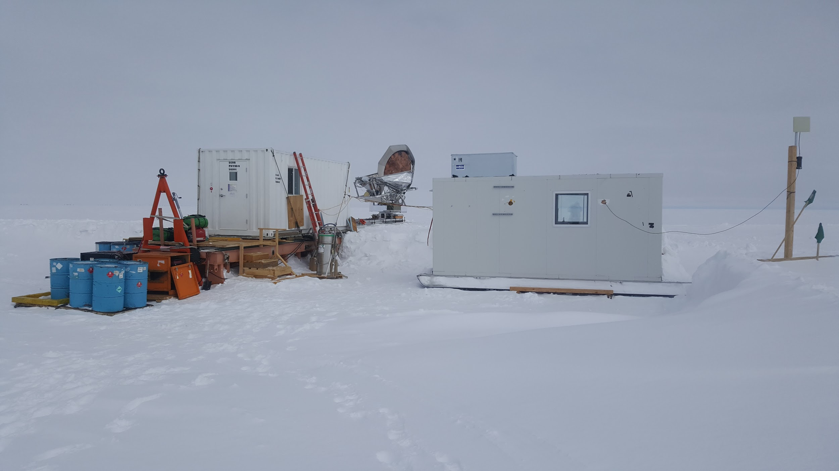
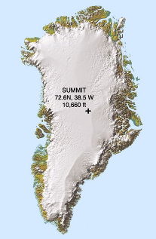
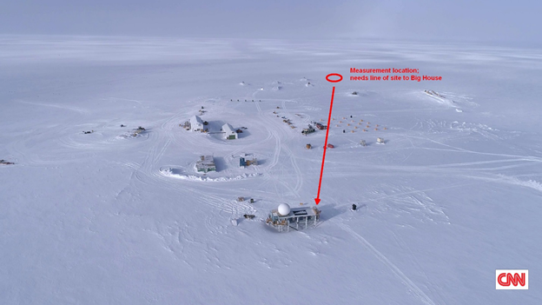
Setting up
ISO Container
Point to point Wifi Receiver
My Apartment
Container+Workstation placed at observing site by support staff prior to team arrival
Setting up work station
ISO Container
Plan Q
Rails
Team arrival to being ready for observing: 4 days (This includes waiting on weather)
Cooling
Closed cycle He Compressor for cryo cooler
~ 2 days to cool and maintain vacuum
Fuel + Generators
That’s a telescope… In case it wasn’t obvious
~ 1 km
Notes:
Add site layout slide (birds eye view), show where it is in greenland, find picture with site layout

Slide 11
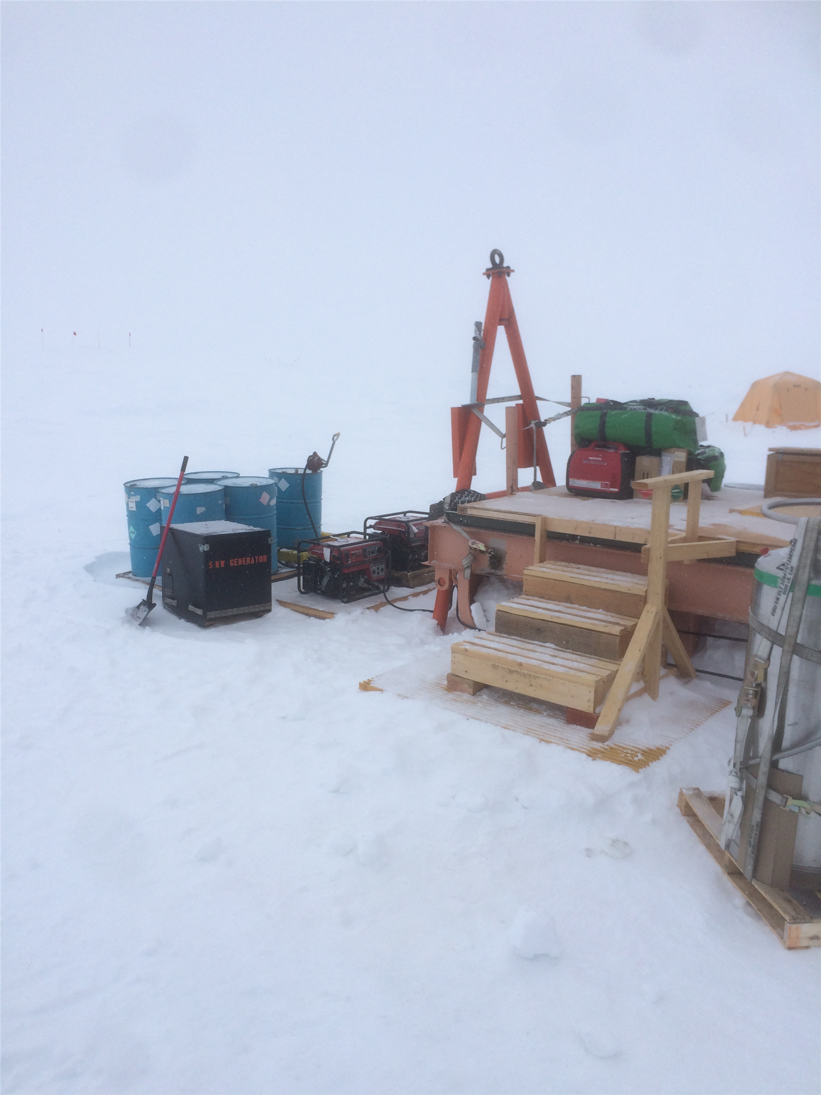
Power Requirements
6.5 KW Generator
Load
Telescope Az drive (low power)
He Compressor (~3 kW)
On board acquisition system
Vacuum Pump (Intermittently)
1-6 Computers (2 Desktops, 4 Laptops)
Space Heater (only when Az drive/pump were off)
Refueling - every 8 hours
Maintenance - provided by support staff every few days
Electrical System
UPS - Full up Dual Conversion
Grounding issue

Slide 12
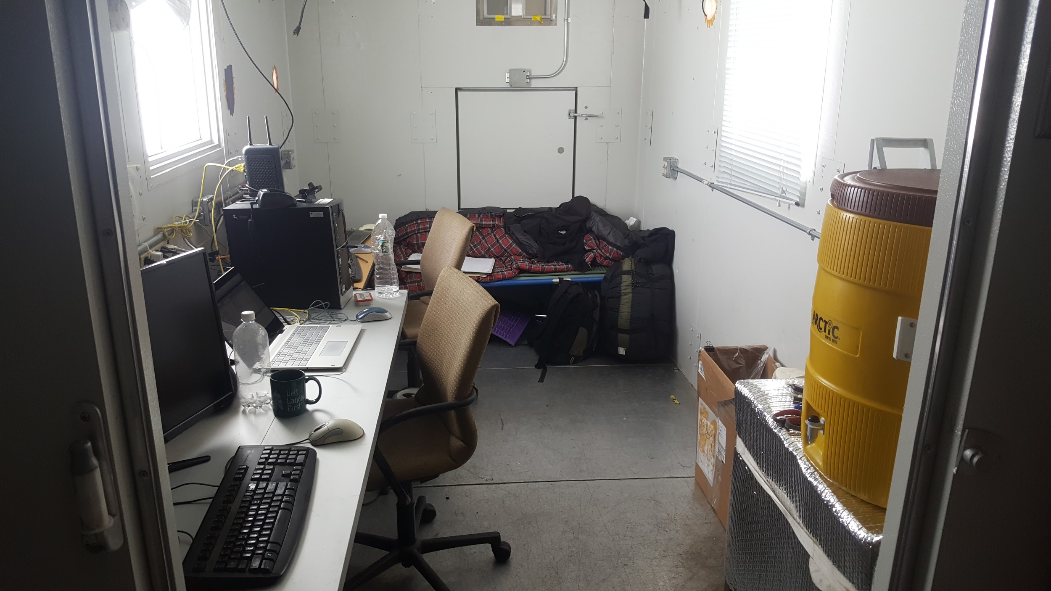
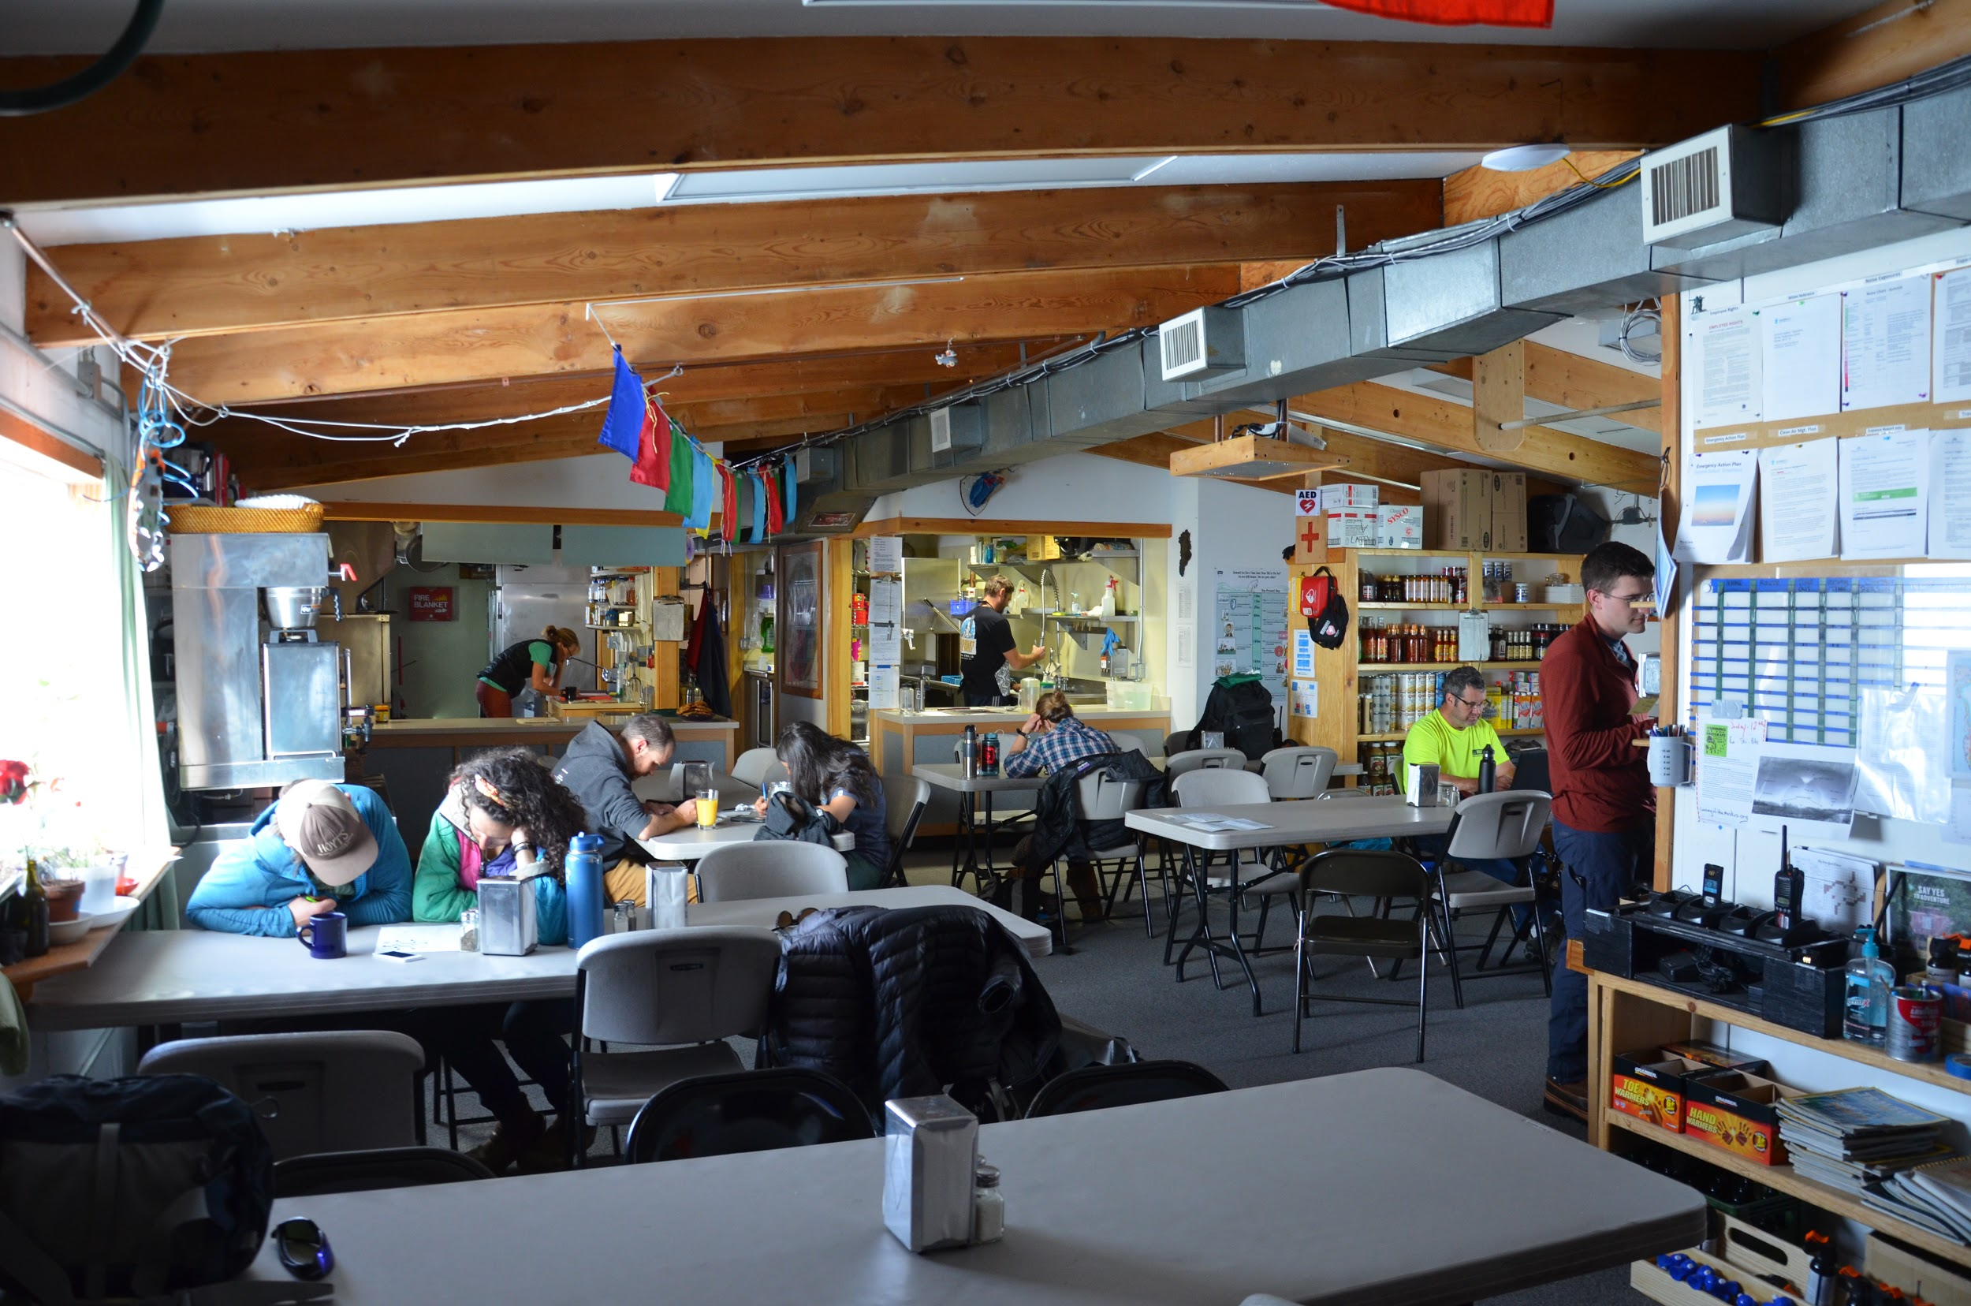
Working at Summit
Weather “Condition 1,2,3”
Snow shoveling (often)
Deploying/Rolling in telescope based on weather
Summit Support
Fuel
“Lodging”
Meals (awesome)
Heavy equipment/technical support
Snow Grooming
Internet/Wi-fi Set-up
Snowmobiles
Radios
Bear Safety
Notes:
Condition 3 - clear, condition 2 - 1km, condition 3 - 50 m

Slide 13
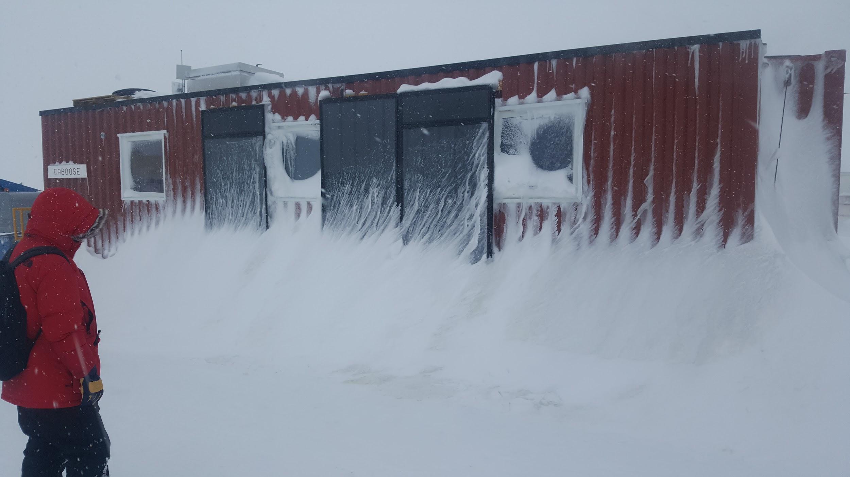
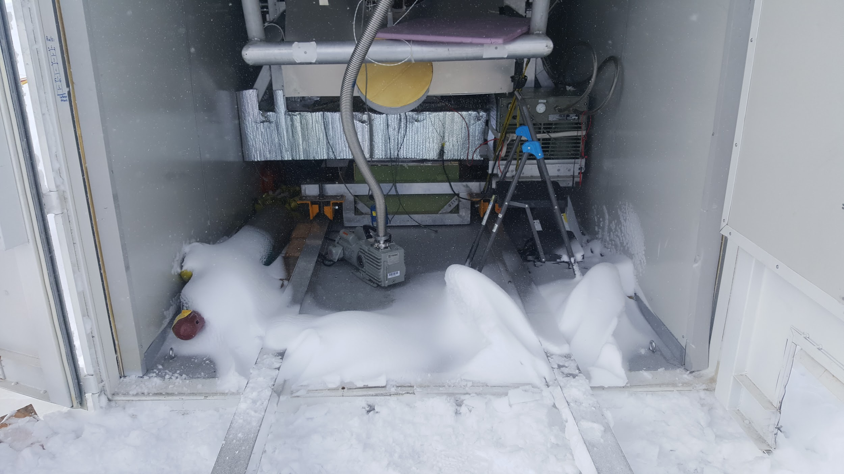
Hurdles to observations
Dealing with Weather
~10% time = good observing conditions (i.e. clear skies)
How weather got in the way
High winds
Blowing snow
Freezing fog
Snow accumulation
Overcast sky
Frozen mechanical components
Equipment Challenges from shipping
Mechanical
Electronics

Slide 14
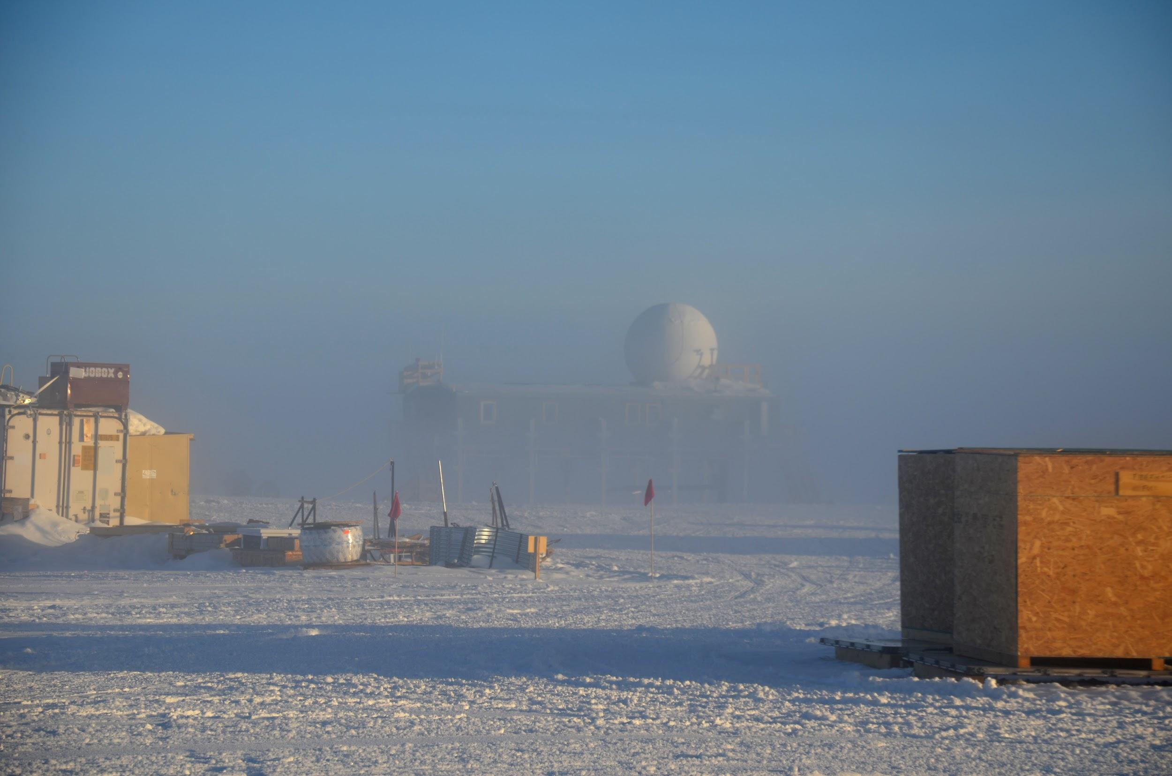
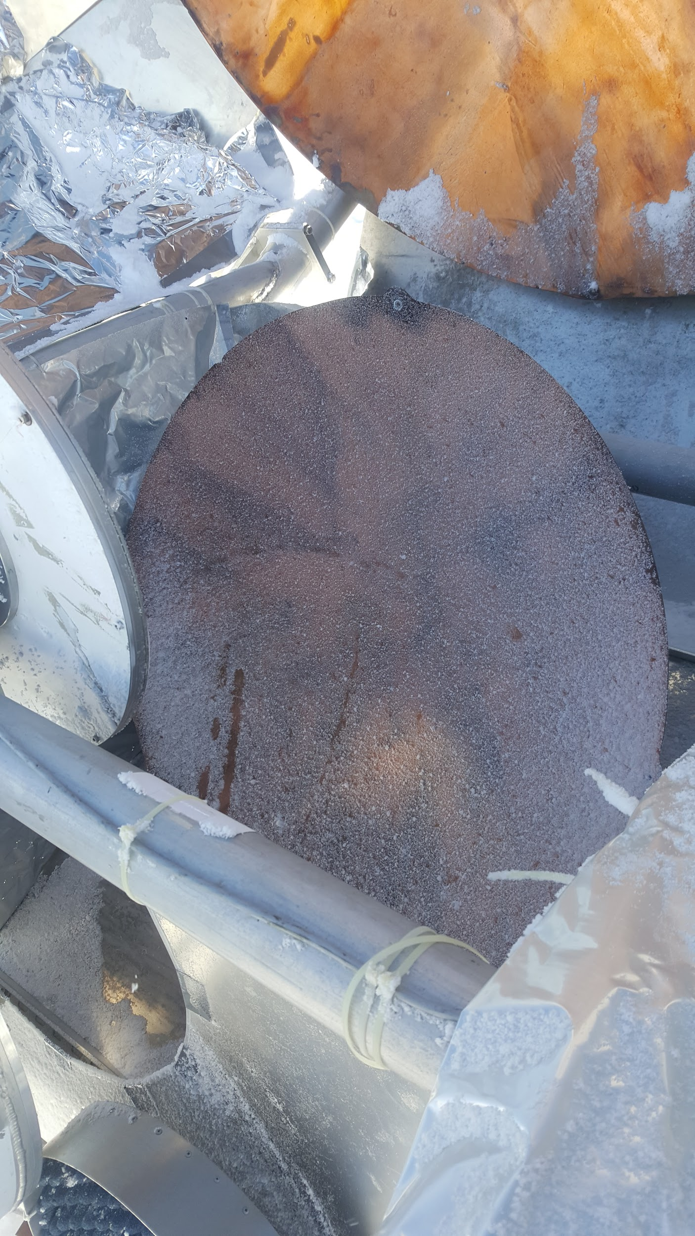
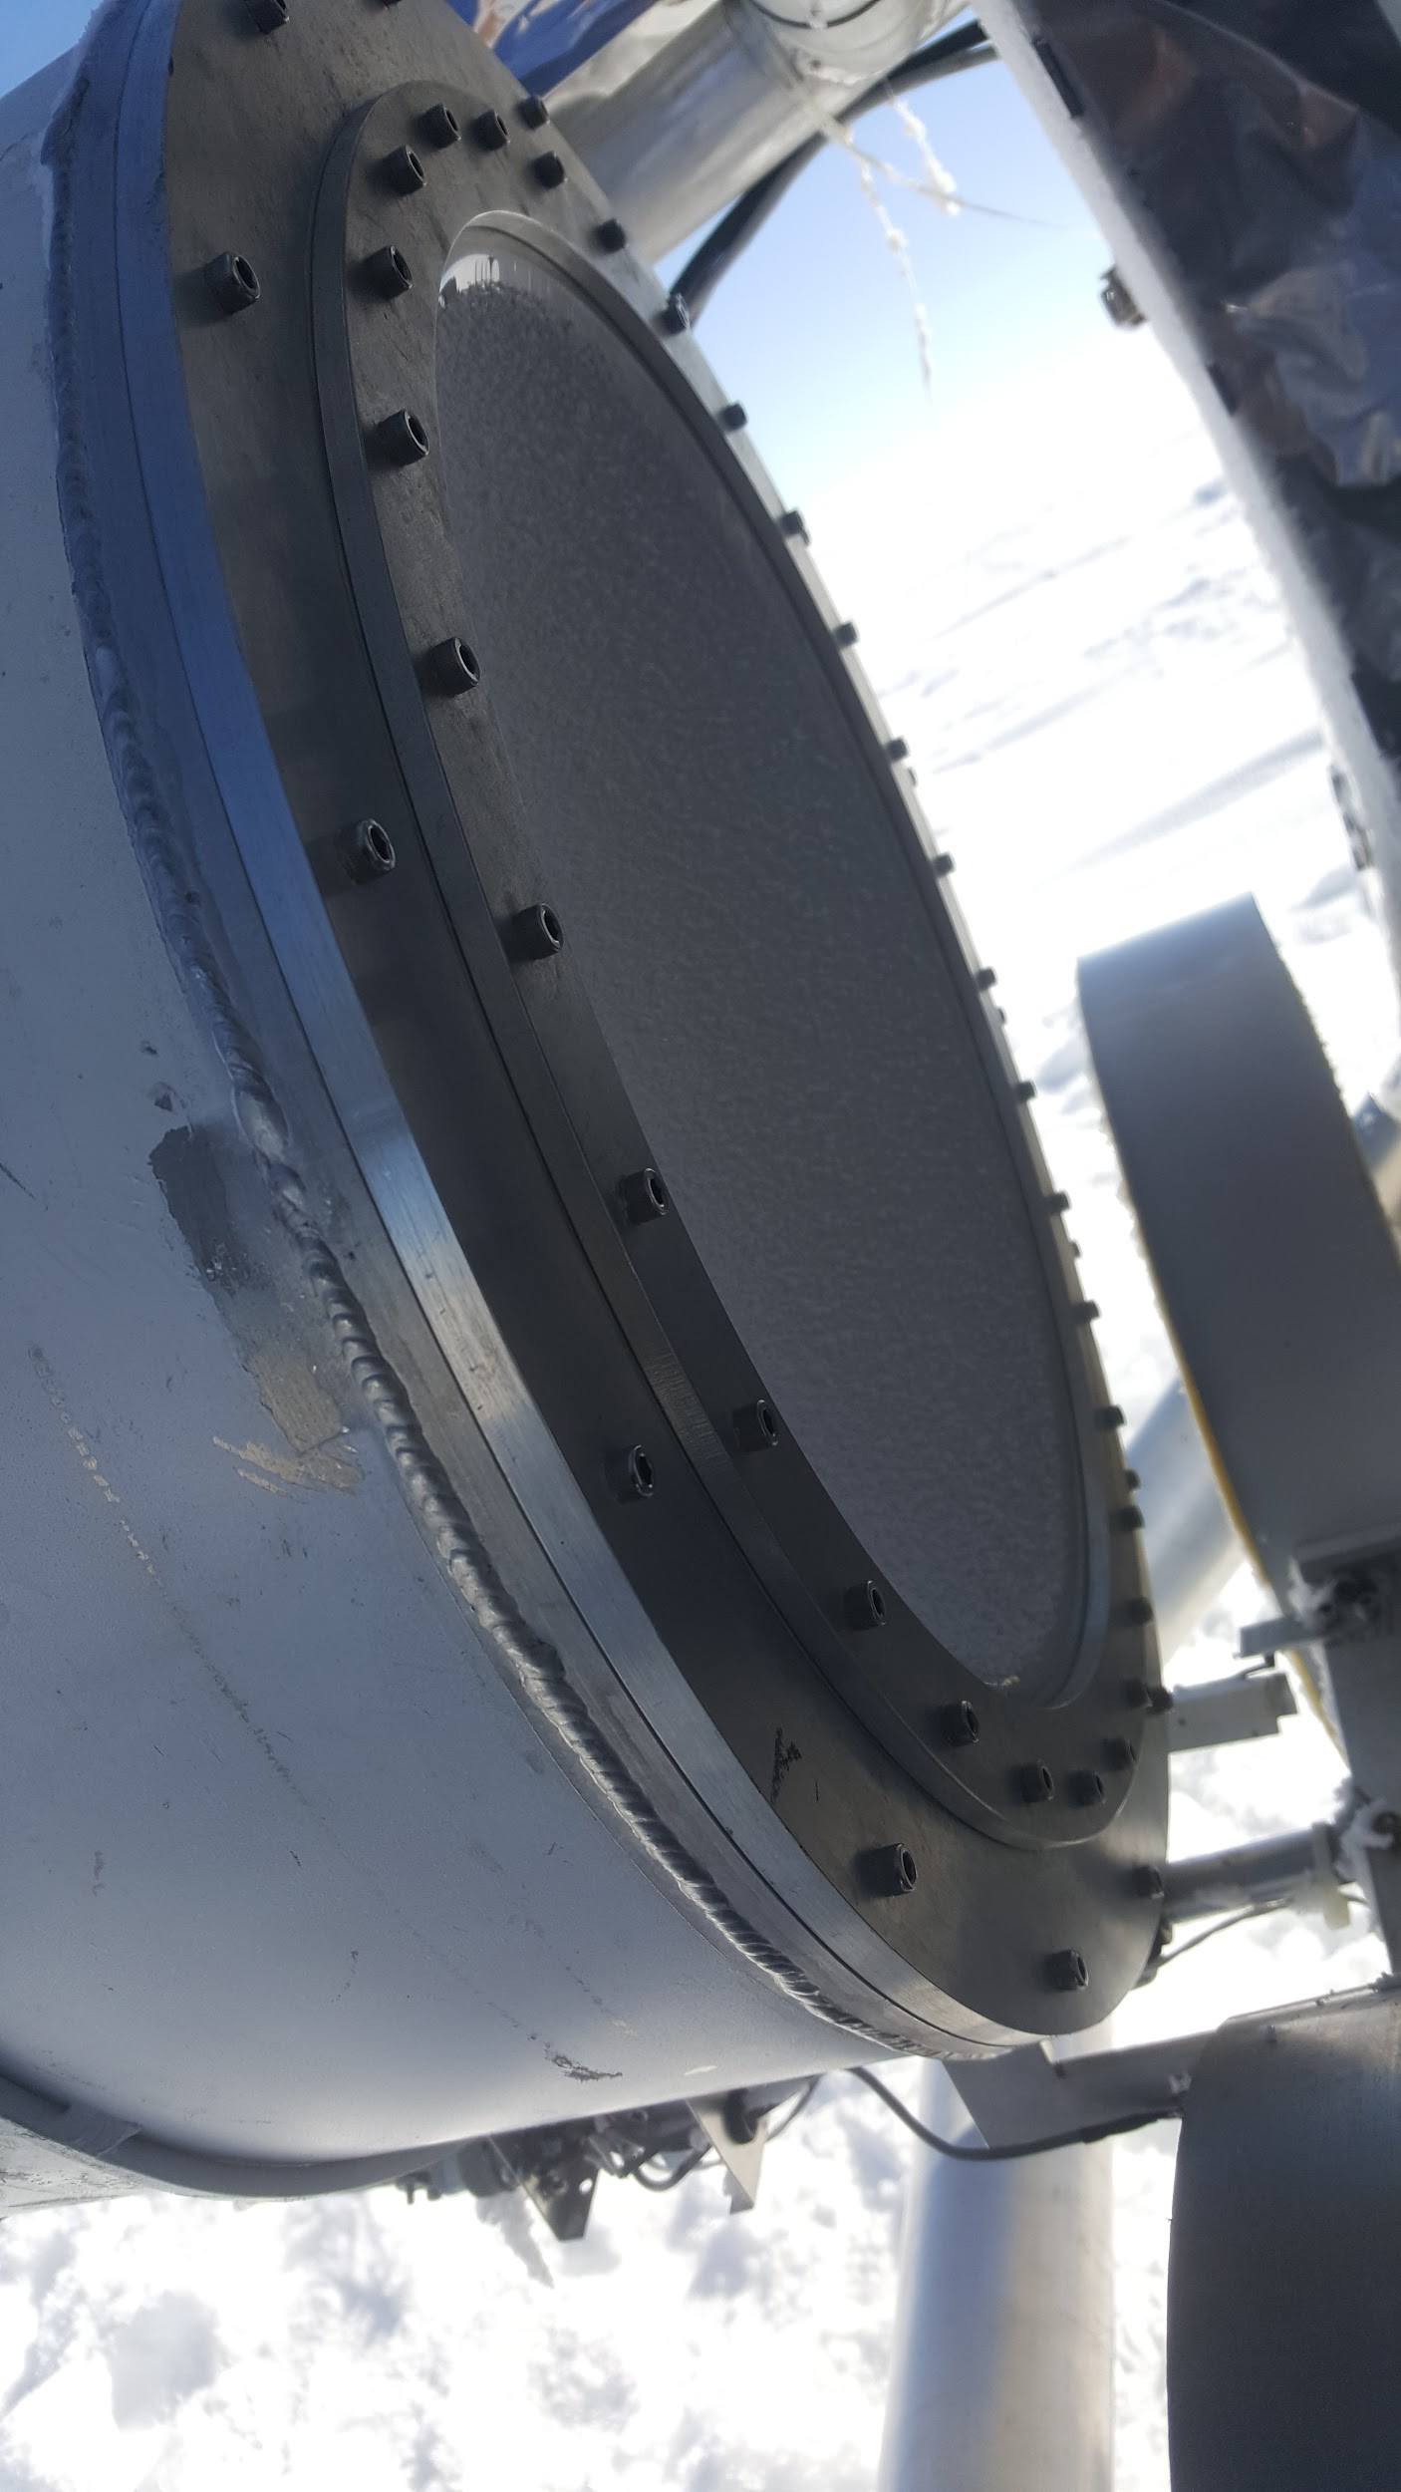
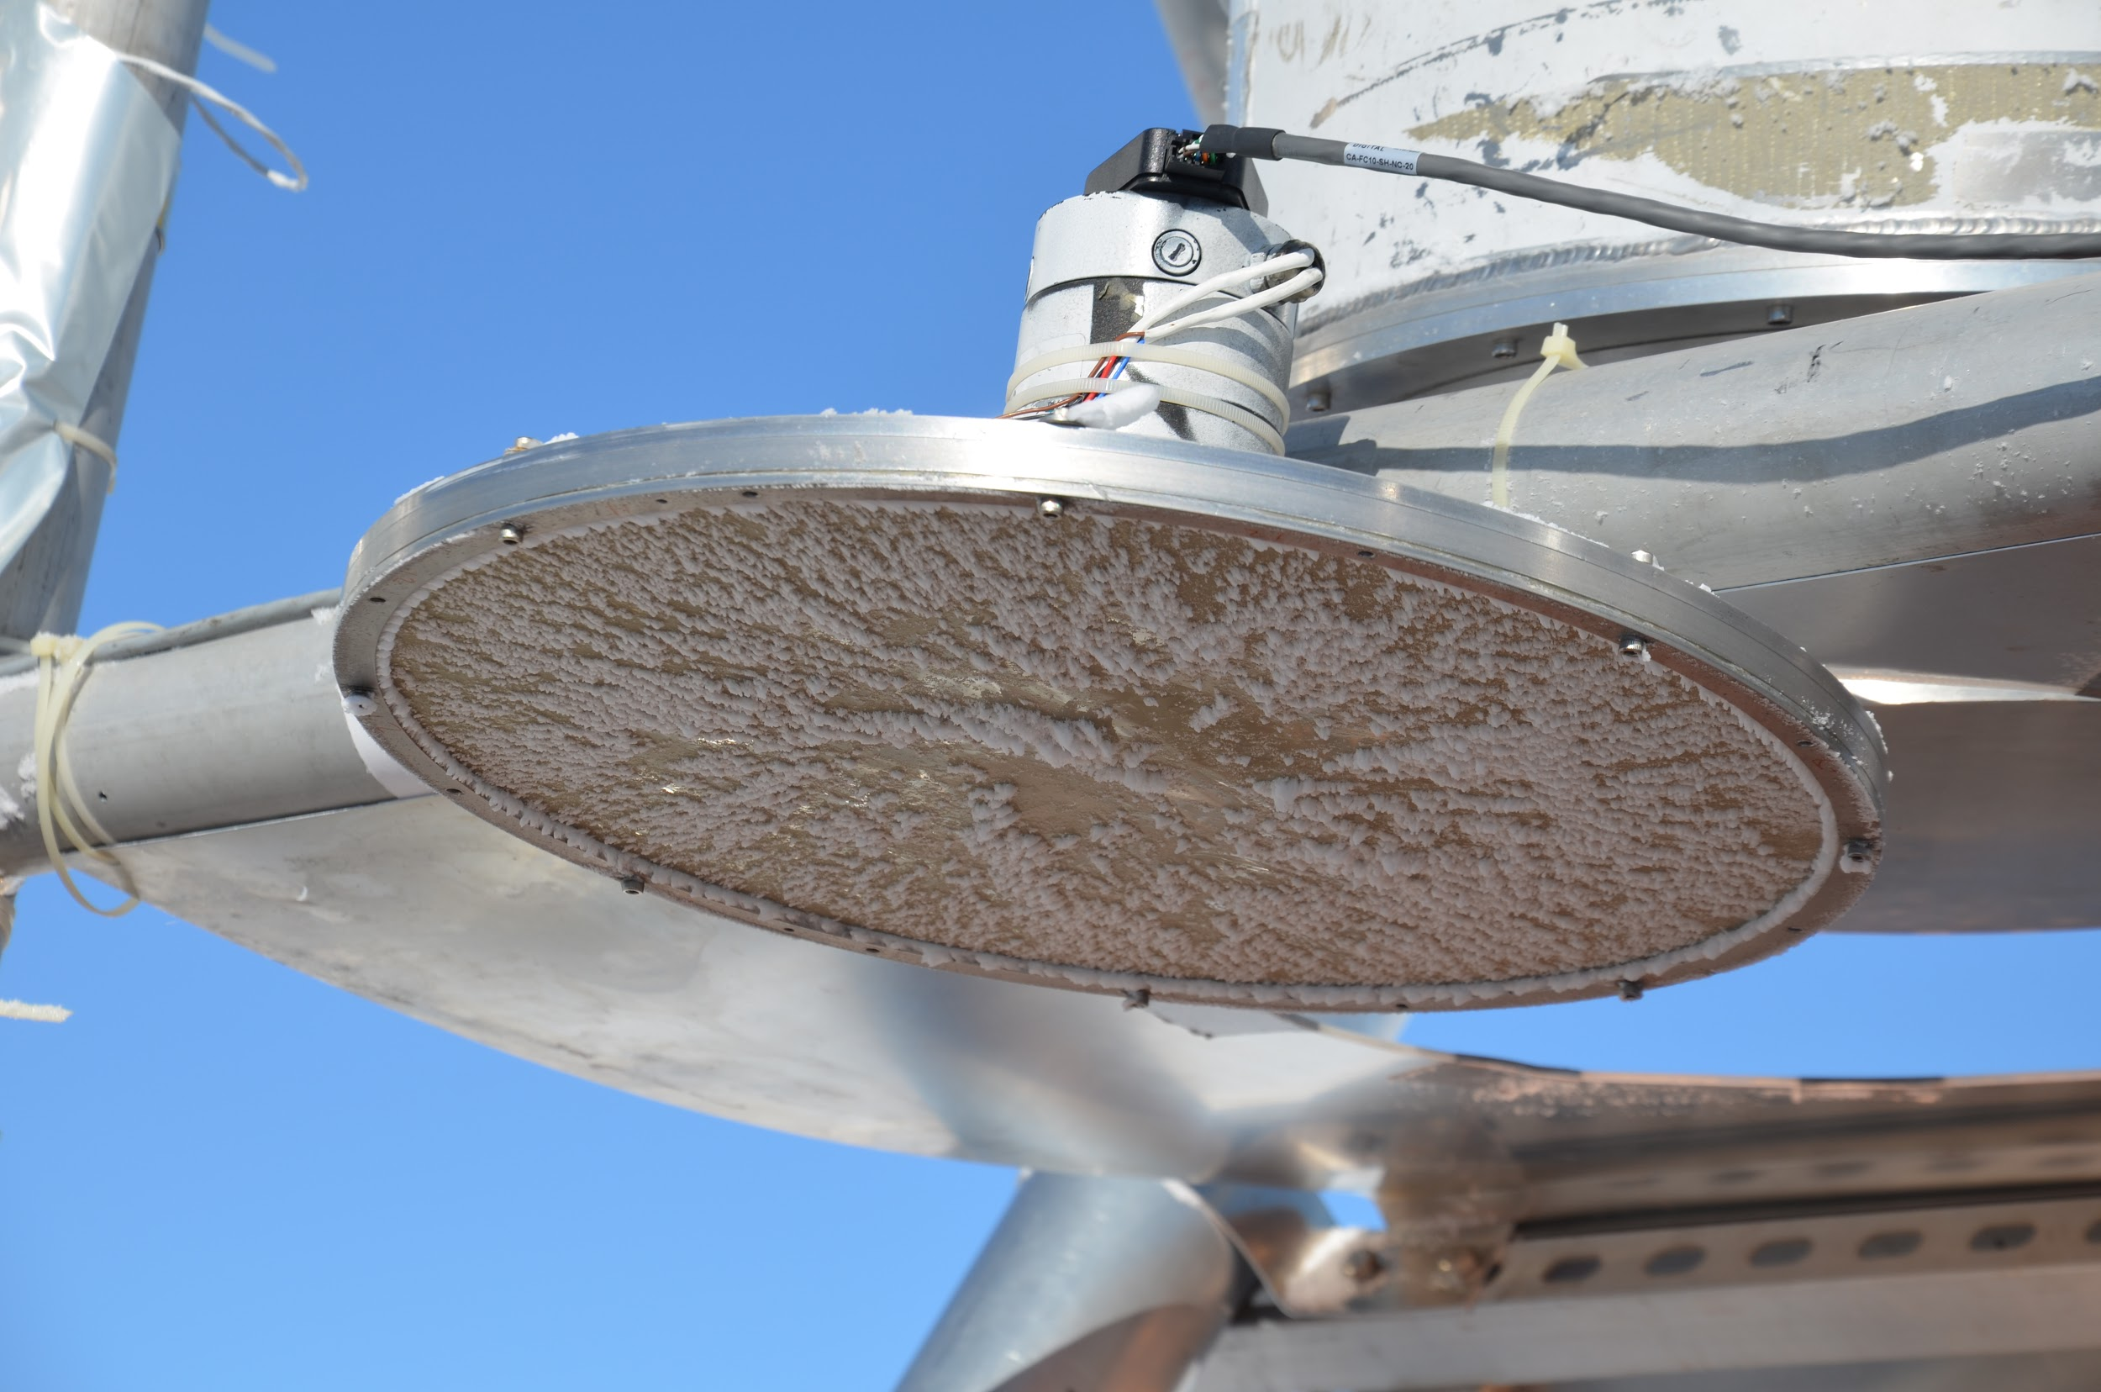
Freezing Fog

Slide 15
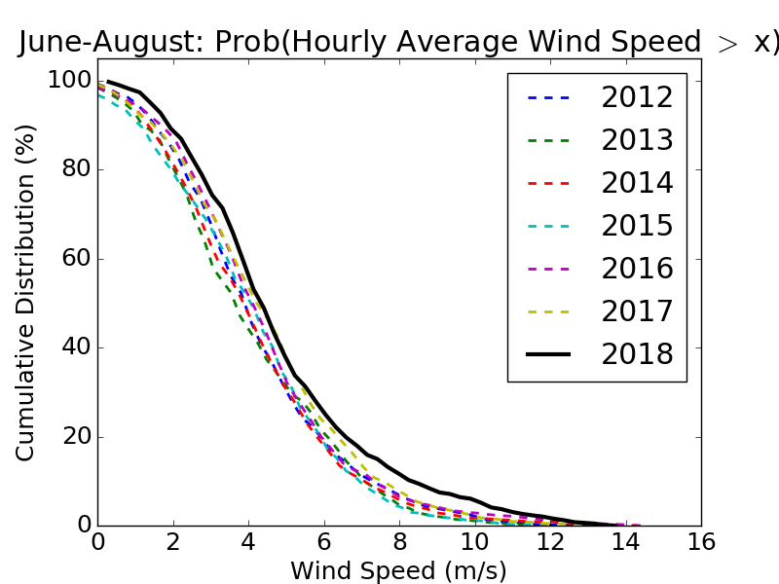
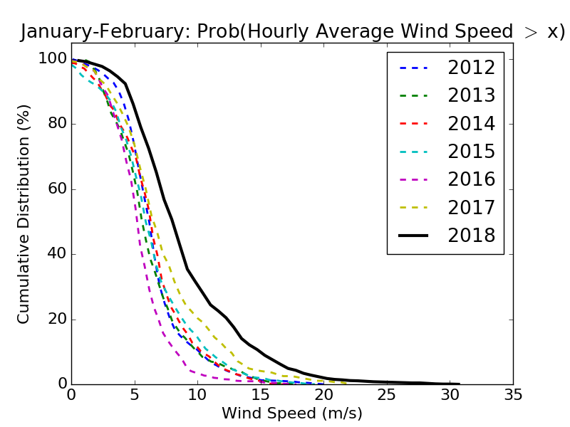
Weather Statistics - Wind
Data obtained from ESRL Global Monitoring Division
Wind Speeds > ~ 5 m/s showed up in data (visibly shook telescope)
Summer 2018 was worse than previous season (but not by much)
Winter is even worse
Blowing Snow
Notes:
Earth system research labratory

Slide 16
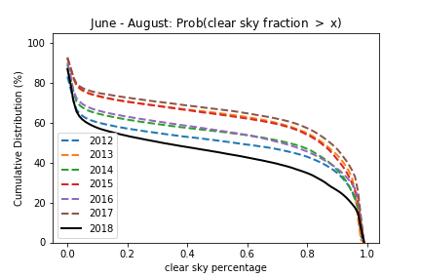
Weather Statistics - Clouds
Data obtained from Summit Camp Total Sky Imager (TSI), processed data sets produced by NOAA
Clear sky fraction > 90% for ~20-50% of season depending on year
Often clear sky periods come in small chunks
Notes:
National oceanic and atmospheric administration

Slide 17
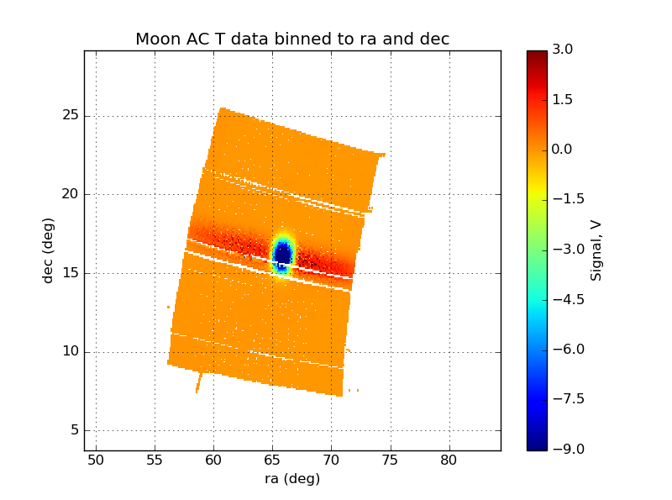
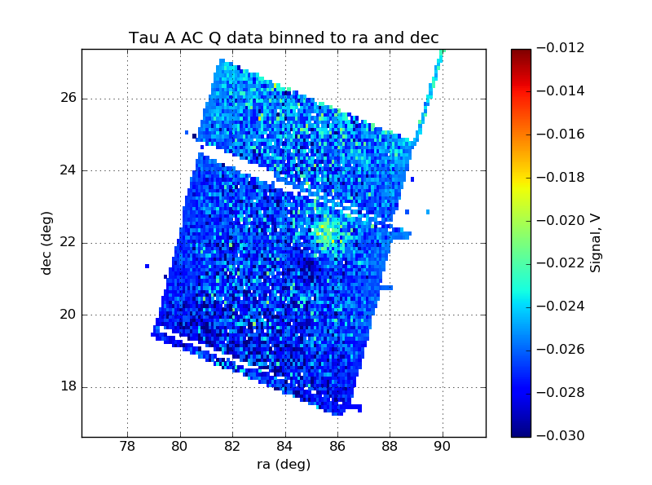
Data
Instrument was working
Moon scan
Tau A scan
Still working on processing the little we have

Slide 18
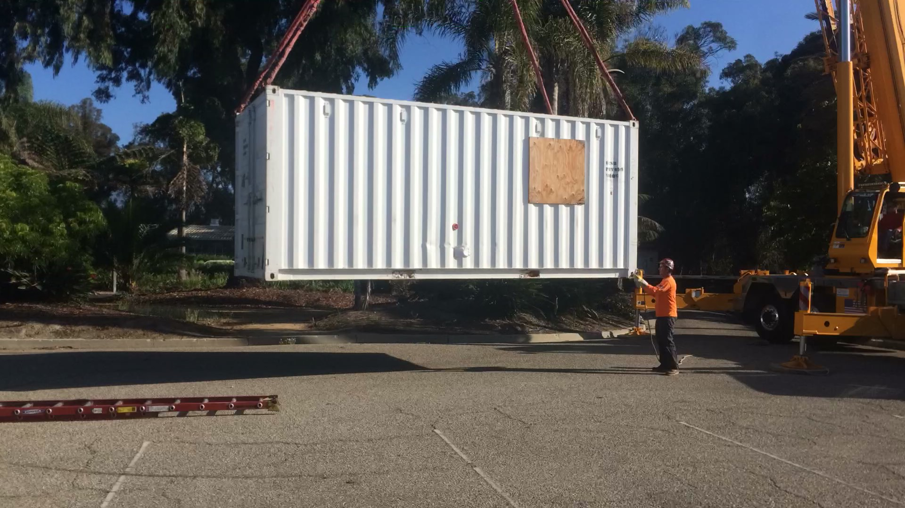
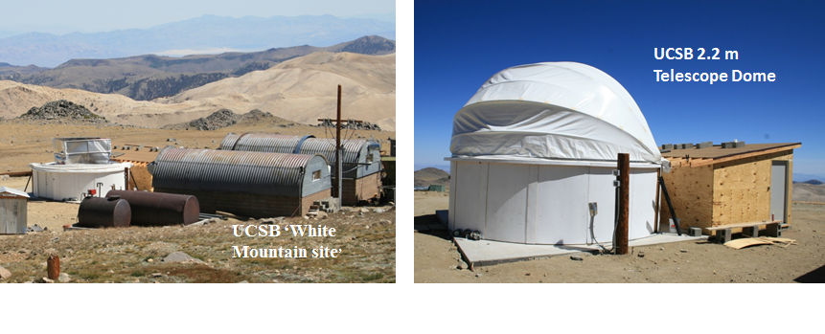
Conclusion and Future Plans
Instrument field test was successful
Challenging site for cosmological studies
Continue observations at UCSB+high dry California site (White Mountain)
Arrival Back in SB
Notes:
White mountain pictures

Slide 19
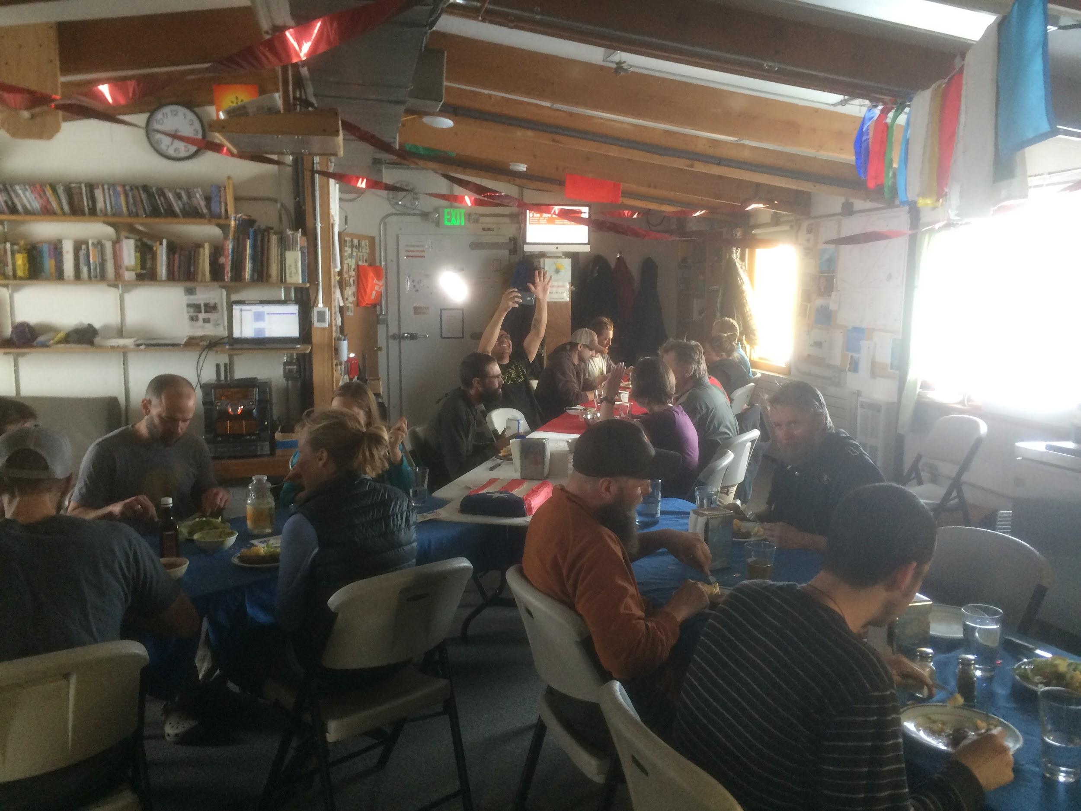
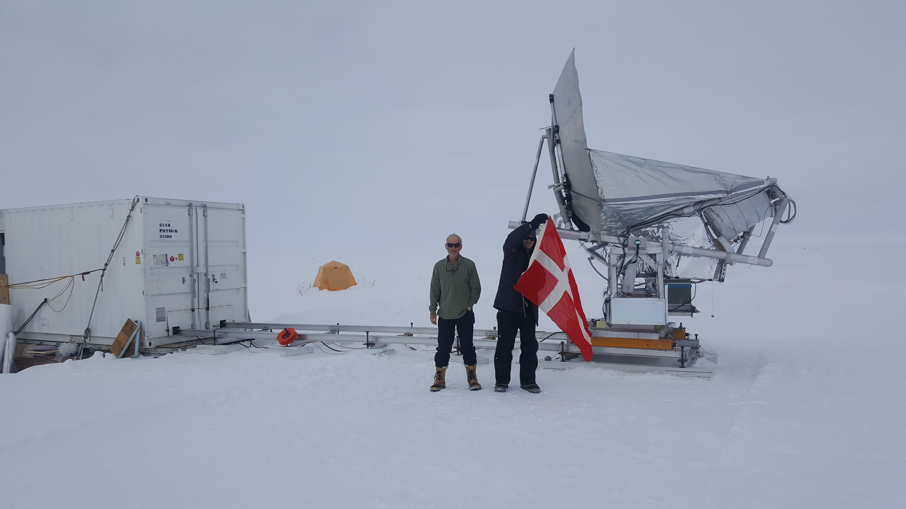
Thanks
Support
Summit station support staff
UCSB lab group and supporting physics department staff
NSF
Funding
Niels Bohr Institute
Villum Foundation

