Slide 1
Science Policies and Timeline
Marco Sirianni - ESA

Slide 2
Science Policies team
JWST (& HST) policies are implemented by the Science Policies Group @ STScI
Personnel:
Neill Reid, Lead for JWST science policies
Claus Leitherer, Lead for HST science policies
Lou Strolger, Calls for Proposals, Grants
Amaya Moro-Martin
Andy Fruchter
Molly Peeples
Brian Williams
Brett Blacker, Technical support
Most of the material presented here is extracted from a presentation
of N. Reid given on Dec 11 2017

Slide 3
JWST Observing Programs
GO Guest Observer (GO programs)
Open access for the community
70%+ of total time in Cycles 1 through 5
GTO Guaranteed Time Observer (GTO) programs
4020 hours allocated over first 30 months (i.e. Cycles 1 through 3)
GTOs have submitted proposals for 3820 hours
Director’s Discretionary Time (DD) programs
Up to 10% (≤877 hours ) /cycle
Rapid response observations & targeted science programs,
such as Early Release Science program

Slide 4
Cycle 1 GO Proposal Categories
Small :<25 hr. 12 month exclusive access period by default – up to ~3500 hours.
Medium: 25-75 hr. 12 month exclusive access period by default – up to ~1500 hours
Large: >75 hr. no exclusive access period by default – up to ~1000 hours
Balanced distribution in program sizes over all JWST cycles but smaller programs will likely dominate in Cycle 1, even though there will be no cap on program size.
• Other GO categories:
Calibration, Long-term, Treasury
Survey programs - analogous to HST SNAPshot programs
Target of Opportunity programs
No joint programs with other observatories in Cycle 1
•Archival proposals
AR – to analyse data from DD ERS programs
Theory, Community Software

Slide 5
Parallel Science
JWST was conceived as a prime-only telescope, but operating instruments in parallel increases the science return
Parallel science observations have been enabled for Cycle 1
Coordinated parallels Single program, complementary observations
Both datasets carry the same exclusive access period
The following combinations will be available for coordinated parallels
NIRCam Imaging + MIRI Imaging
NIRCam Imaging + NIRISS WFSS
MIRI Imaging + NIRISS WFSS
NIRCam Imaging + NIRISS Imaging (NIRCam must be prime)
NIRSPec MOS + NIRCam imaging (NIRSpec must be prime)
Pure parallels Separate proposals, distinct programs
Parallel observations may not drive primary program parameters
Pure parallel observations are non-proprietary
Most (but not all) 2-instrument combinations will be available for pure parallel observations
Parallels will not be allowed for prime programs that require high stability (e.g. exoplanet transits, coronagraphy)

Slide 6
Duplications
To maximize the efficiency of the observatory, scientifically unjustified duplicate observations are forbidden
Duplications are defined by instrument mode: Observations are flagged as duplicate when:
they target the same astronomical source, AND use the same instrument, the same spectral element or central wavelength, AND exposure times within a factor of 4.
IMAGING: observations are flagged as duplications if the instrument Field of View overlaps by more than 50% (TBR).
NIRSpec, potential duplications are flagged based on overlap in the Field of View Flagged observations will be checked for duplication on a slit-by-slit basis
Duplicated Observation Can be allowed when they are:
- scientifically justified in the proposal
- recommended by the TAC
- approved by the STScI Director

Slide 7
Duplications - MOS
NIRSpec MOS observations add an extra dimension of complexity
Duplications are defined on a source-by-source basis, not by field
NIRspec targets cannot be determined until the orientation is set
Most programs will be submitted with minimal orientation constraints
The orientation will be set when the observations are placed on the Long Range Plan
Simulations by the NIRSpec team show that observations of the same target list at different orientations leads to limited overlap in observed sources
Eliminating in-common sources from MOS observations does not increase observing efficiency
Consequences:
Observers can propose for observations of previously-observed source fields There must be an appropriate justification as to why additional observations are justified
If the proposal is accepted, limited (<25%?) overlap in targets with previous programs will be allowed
Adjudicated on a case by case basis

Slide 8
Cycle 1- Time Allocation Committee
JWST is likely to be popular with the community
HST attracted 1200 proposals in Cycle 25; ALMA, 1600 in Cycles 4 & 5
We need to avoid saturating reviewers ➔ limit the load per panel
For planning purposes, assume N=1600 & 21 panels
For JWST Cycle 1 we plan on distributing the TAC process over a 2-week period
Week 1 “Galactic”, Week 2 “Extragalactic”
– two TAC chairs
- 10-11 panels meet Monday-Wednesday noon
Panel chairs meet to consider Large/Treasury proposals Wednesday afternoon – Friday
8 panelists/panel + chair; ~15% ESA, ~5% Canada
JWST Cycle 1 GO TAC is planned for June 17 – 29 2018 @STScI

Slide 9
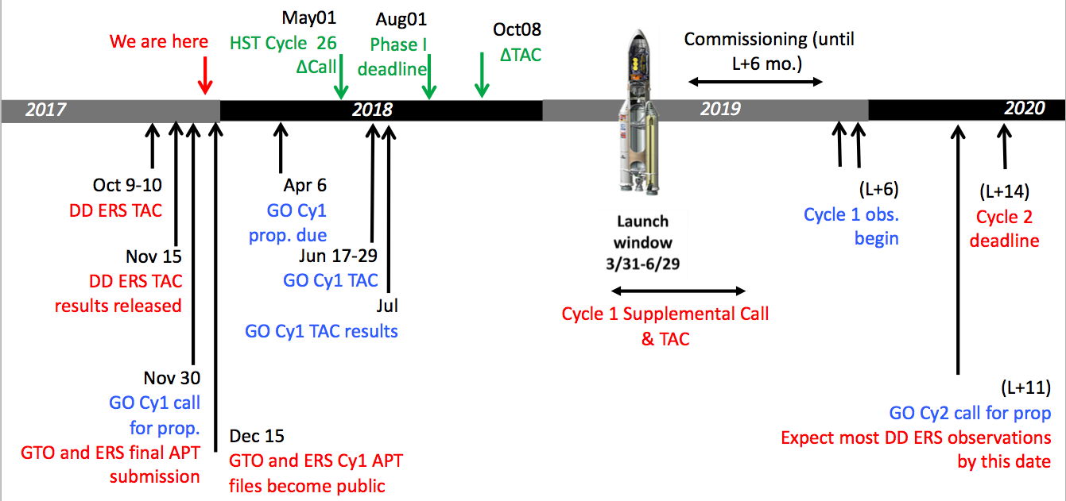
Science Timeline
HST
WE ARE HERE
Supplemental cycle 1 Call for proposal to address ability to follow up new discoveries
STScI is working with JSTUC to define scope, schedule criteria
At the end of commissioning
GO, ERS and GTO programs
will be interleaved.

Slide 10
Less than a month from Cycle 1deadline
JWST will not only offer new instrument and observing modes, but will also
”offer” new tools to prepare the proposals:
ETC, APT, Documentation, Help Desk.
The next two days are just the latest event of a long series of webinars, conference and workshops organized by the JWST team to support the JWST community in the preparation of their proposals.
This workshop is less hands-on than the previous one
in ESAC – as homework you could use some of the
science cases guidelines presented there as well.
They may fit more closely your specific science case:
https://www.cosmos.esa.int/web/jwst-2017-esac/hands-on-material

