Slide 1
Detector Parameters
Marco Sirianni - ESA

Slide 2
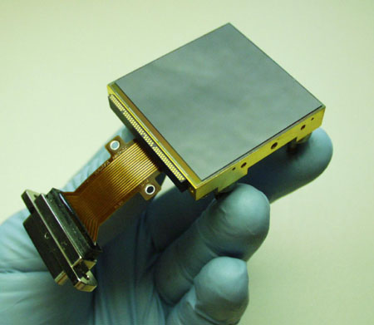
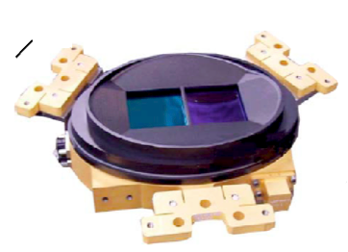
JWST Detector Technologies
Near IR Detectors
MID IR Detectors
Technology: HgCdTe
Manufacturer: Teledyne
Size: 2048x2048 pixels
Operating Temp: ~40 K
Technology: Si:As
Manufacturer: Raytheon
Size: 1024x1024 pixels
Operating Temp: ~7 K
Each detector is called Sensor Chip Assembly (SCA)
The Focal Plane Array (FPA) of a given instrument can have one or
more SCAs
NIRCAM 2 FPAs (1 SCAs) 0.6-2.3 μm
NIRCAM 2 FPAs (4 SCAs) 2.4-5.3 μm
NIRSpec 1 FPA (2 SCAs) 0.6-5.3 μm
NIRISS 1 FPA (1 SCA) 0.6-5.3 μm
MIRI 3 (1 SCA) 5-28 μm

Slide 3
MULTIACCUM - Non Destructive Readout
Hybrid technology allows to monitor
charges as they accumulate in each pixel
without erasing them
Signal
Non destructive
reads during
integration
12
Fit to the slope provide the count rate
reset
Several benefits of MULTIACCUM readout:
Multiple reads average down the read noise
History of the integration is maintained
Increase dynamic range
3
1
2
idle
Time
Signal
Cosmic
ray hit
Signal
Saturation
12
2
3
1
Time
Time

Slide 4
Detector Concepts - Frame
The charge in each pixel is sampled with a regular cadence
All JWST detectors generally use 4 different outputs to simultaneously read four different areas of the detector.
FULL Frame
SUBARRAY
The entire array is
read out pixel by pixel
only a selected portion
of the detector is read out
NOTE: In APT AND ETC Full Frame is selected as SUBARRAY=FULL
The time needed to scan all the pixels in the selected array is the Frame Time
Full Frame Times:
NIRCAM & NIRISS 10.7 sec
NIRSpec 10.7 – 14.4 sec
MIRI 2.7 - 23.9 sec
Subarrays are used to reduce the Frame Time
to observe brighter objects.
Different instruments offer different subarrays (size, positions, use).
APT and ETC show only the subarrays offered in each observing mode (template).

Slide 5
Detector Concepts - 3D CUBE
Each Read (Frame) can be save as a slice of a 3D data Cube
Signal
12
Non destructive
reads during
integration
12
2
1
Time
reset
3
1
2
idle
Time
When all reads are saved the readout pattern is called -RAPID
e.g. NRS-RAPID, NIS-RAPID etc
For MIRI all reads are always saved

Slide 6
Detector Concepts - GROUPS
Getting all the reads in the ramp is the optimal situation, but it is not always feasible due to data volume limitations
Solution #1 - Average reads on board
Signal
12
11
Only the averaged
groups are sent to ground
3
Groups of reads
can be averaged
on board
10
9
3
2
4
2
3
1
Time
reset
2
1
1
idle
Time
N_FRAMES = Number of frames averaged in each group
NIRCam | 1, 2, 4, 8
NIRISS | 1, 4
NIRSpec | 1, 4, 5
MIRI | 1

Slide 7
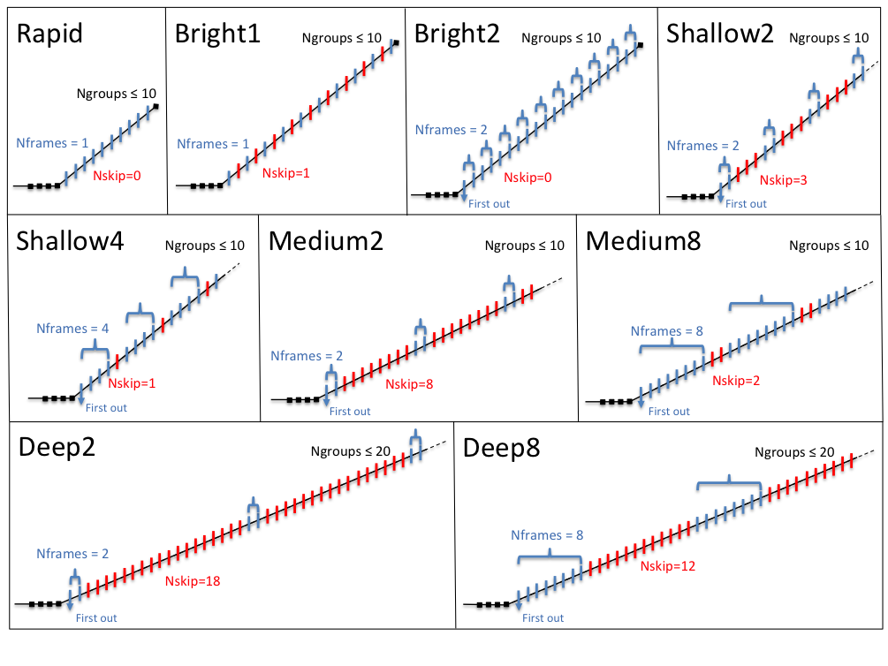
Detector Concepts - NSKIP (NIRCAM ONLY)
Solution #2 - Discarding some reads
12
Signal
12
Signal
12
Non destructive
reads during
integration
12
11
Reads not
saved- “Skipped”
11
11
11
10
10
10
10
Only a reduced number
ff groups are sent to
the ground
3
3
2
2
1
1
Time
reset
Time
reset
3
3
2
1
2
1
idle
idle
Time
Time
Readout Patterns
are a combination
of averaged frames
NFRAMES
and skipped frames
NSKIP

Slide 8
Detector Concept - NSAMPLE - MIRI ONLY
MIRI always uses NFRAME=1 and NSKIP=0
But it offers two readout patterns:
FAST MODE: each pixel is sampled once before moving to the next one
NSAMPLE=1
Frame Time = 2.7 sec
Default mode for Imaging
SLOW MODE: each pixels is sampled multiple times to reduce read noise
NSAMPLE = 9
Frame time = 23.9 sec
Default mode for MRS

Slide 9
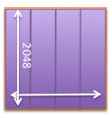
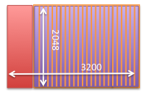
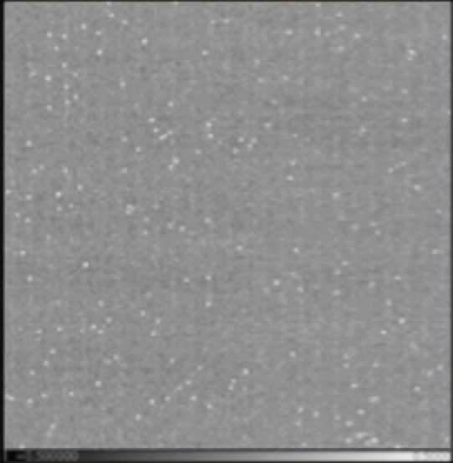
Detector Concept - IRS² - NIRSpec ONLY
Most NIRSpec observations are detector limited -> most stringent noise requirement
NASA/GSFC group analyzed noise properties of NIRSpec detector system and developed a new low noise readout scheme for NIRSpec Full Frame exposures.
“High level” recipe to reduce noise and noise correlation:
Send more reference pixels “to the ground” for post processing
Read reference pixels more frequently
Improved Reference
Sampling and Subtraction
Raw data
format
Traditional
IRS²
Frame Time 10.7s
Frame Time 14.6s
Processed dark
exposure
Traditional
IRS²

Slide 10
READOUT PATTERN
The combination of NSAMPLE, NFRAMES, and NSKIP
defines the READOUT PATTERN used in one INTEGRATION
SI | READOUT PATTERN | NSAMPLE | NFRAMES | NSKIP
NIRISS | NIS-RAPID NIS | 1 1 | 1 4 | 0 0
NIRCam | RAPID | 1 | 1 | 0
 | BRIGHT1 BRIGHT2 | 1 1 | 1 2 | 1 0
 | SHALLOW2 SHALLOW4 | 1 1 | 2 4 | 3 1
 | MEDIUM2 MEDIUM8 | 1 1 | 2 8 | 8 2
 | DEEP2 DEEP8 | 1 1 | 2 8 | 18 12
NIRSpec | NRS-RAPID NRS | 1 1 | 1 4 | 0 0
 | NRSIRS²⁻RAPID NRSIRS² | 1 1 | 1 5 | 0 0
MIRI | SLOW FAST | 9 1 | 0 0 | 0 0

Slide 11
Integrations and Exposure
One exposure can have multiple identical integrations
READOUT PATTERN
-RAPID
Exposure
Integration #1
Integration #2
Integration #3
Signal
reset
idle
reset
reset
idle
Time
Multiple integrations reduce overheads

Slide 12
NESTED Concept
FRAME #1 [ FRAME #2, FRAME #3, FRAME #4 …]
GROUP #1 [GROUP #2, GROUP #3, GROUP #4 …]
INTEGRATION #1 [INTEGRATION#2, INTEGRATION #3 …]
EXPOSURE #1 [EXPOSURE #2, EXPOSURE #3 …]
THE USER CAN SELECT :
FRAME TYPE (FULL OR SUBARRAY) - > SETS THE MINUM INTEGRATION TIME
READOUT TYPE -> SETS THE NUMBER OF FRAMES PER GROUP
NUBMER OF GROUPS - > SETS HOW LONG THE INTEGRATION WILL BE
NUMBER OF INTEGRATIONS
NUMBER OF EXPOSURES (e.g. NUMBER OF DITHERS)

Slide 13
ASTRONOMER PROPOSAL TOOL (APT)
Once the instrument and the observing mode (TEMPLATE) are selected
only he available SUBARRAYS and READOUT PATTERNS can be selected in pull down menus
The user can adjust the NUMBER of GROUPS per integration
And the number of INTEGRATIONS per exposure
The selected combination will be repeated at each dither position
to produce the total number of integrations and total exposure time

Slide 14
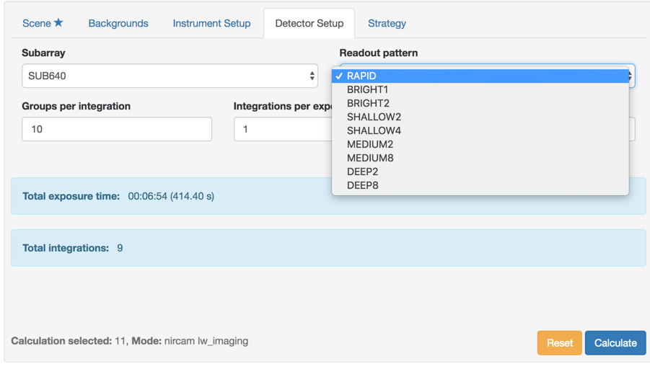
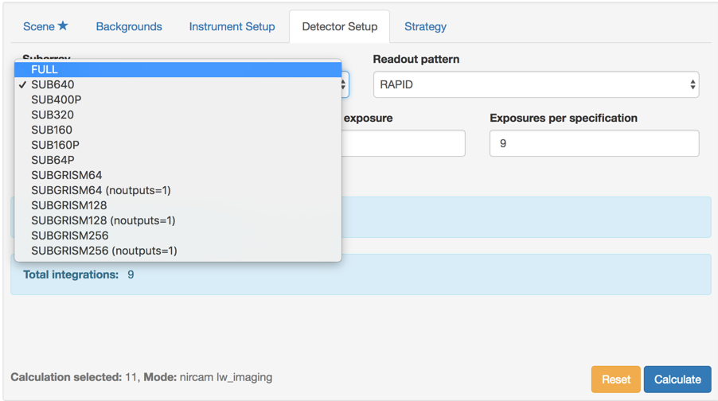
Exposure Time Calculator (ETC)
Once the instrument and the observing mode (TEMPLATE) are selected,
under the DETECTOR SETUP tab, user can select the available
READOUT PATTERN and SUBARRAY
Example : NIRCAM Imaging
The configuration for the ETC calculation is then completed with:
Number of GROUPS PER INTEGRATION
Number of INTEGRATIONS PER EXPOSURE
Number of EXPOSURES

Slide 15
Detector Readout modes and patterns - JDOX Links
NIRCam - https://jwst-docs.stsci.edu/display/JTI/NIRCam+Detector+Readout+Patterns
NIRISS - https://jwst-docs.stsci.edu/display/JTI/NIRISS+Detector+Readout+Patterns
NIRSpec - https://jwst-docs.stsci.edu/display/JTI/NIRSpec+Detector+Readout+Modes+and+Patterns
MIRI - https://jwst-docs.stsci.edu/display/JTI/MIRI+Detector+Readout+Overview
Best practice JDOX pages provide useful hints and tradeoff discussion

